Slide 1
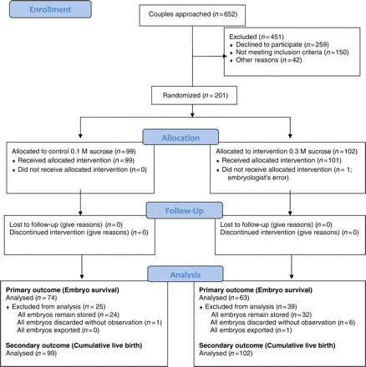
Figure 1 Progress of participants through the RCT of conventional versus increased concentration sucrose in freezing ...
Notes:
Figure 1 Progress of participants through the RCT of conventional versus increased concentration sucrose in freezing and thawing solutions for human embryos.
Unless provided in the caption above, the following copyright applies to the content of this slide: © The Author 2011. Published by Oxford University Press on behalf of the European Society of Human Reproduction and Embryology.This is an Open Access article distributed under the terms of the Creative Commons Attribution Non-Commercial License (http://creativecommons.org/licenses/by-nc/2.5), which permits unrestricted non-commercial use, distribution, and reproduction in any medium, provided the original work is properly cited

Slide 2
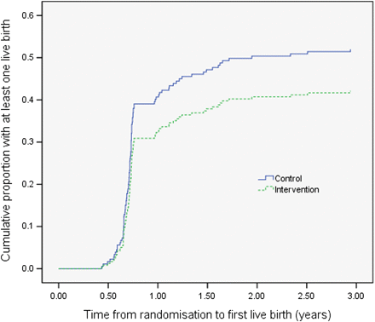
Figure 2 Time to first live birth in groups allocated to control or intervention. For couples with more than one ...
Notes:
Figure 2 Time to first live birth in groups allocated to control or intervention. For couples with more than one pregnancy leading to live birth, the time to event is defined by the number of years between randomization and the date of the first live birth; subsequent live births are not included; couples with no live birth were censored at the date the database was closed or at the date all their embryos were discarded or exported.
Unless provided in the caption above, the following copyright applies to the content of this slide: © The Author 2011. Published by Oxford University Press on behalf of the European Society of Human Reproduction and Embryology.This is an Open Access article distributed under the terms of the Creative Commons Attribution Non-Commercial License (http://creativecommons.org/licenses/by-nc/2.5), which permits unrestricted non-commercial use, distribution, and reproduction in any medium, provided the original work is properly cited

