Slide 1
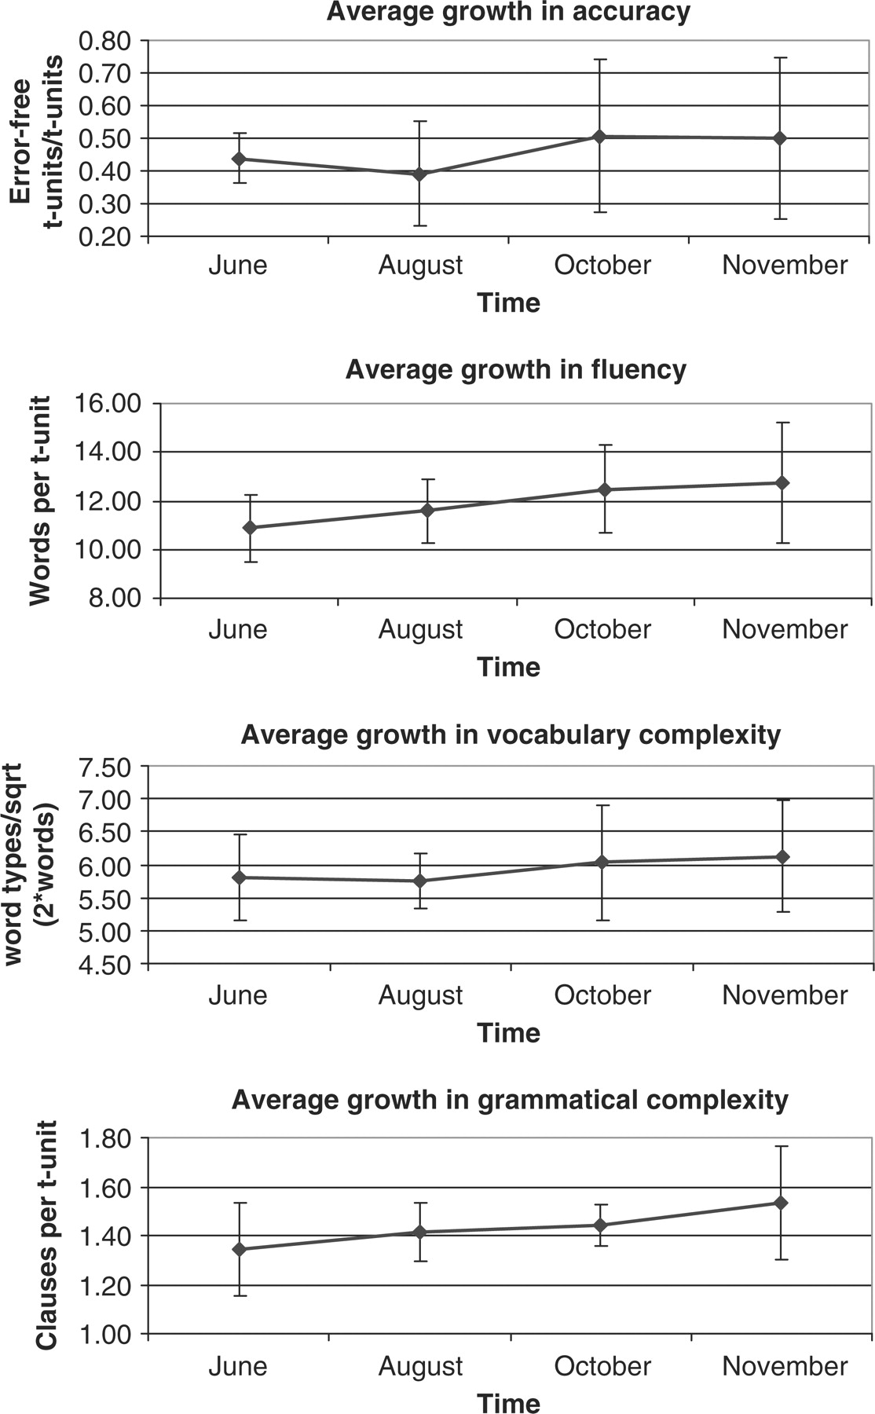
Figure 1: Group averages (±1 SD) over time on four indices using written data
Notes:
Figure 1: Group averages (±1 SD) over time on four indices using written data
Unless provided in the caption above, the following copyright applies to the content of this slide: © Oxford University Press 2006

Slide 2
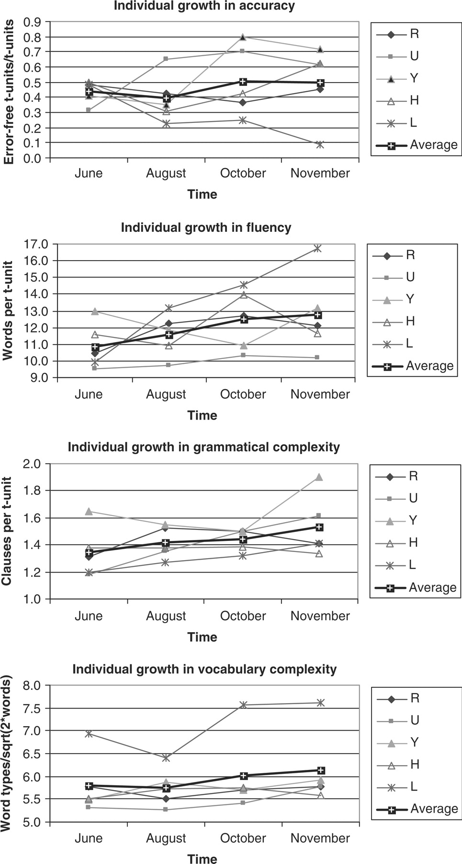
Figure 2: Interindividual variation over time and the average for five participants on four indices using written data
Notes:
Figure 2: Interindividual variation over time and the average for five participants on four indices using written data
Unless provided in the caption above, the following copyright applies to the content of this slide: © Oxford University Press 2006

Slide 3
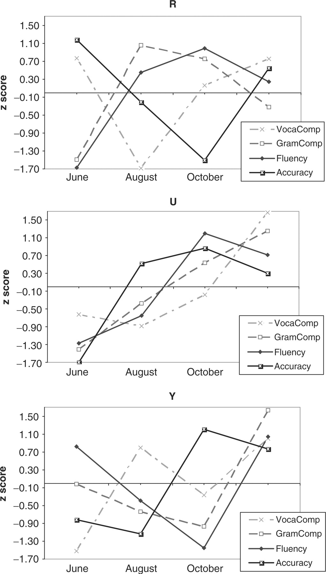
Figure 3: Intraindividual variation over time for five participants on four indices using written data
Notes:
Figure 3: Intraindividual variation over time for five participants on four indices using written data
Unless provided in the caption above, the following copyright applies to the content of this slide: © Oxford University Press 2006

Slide 4
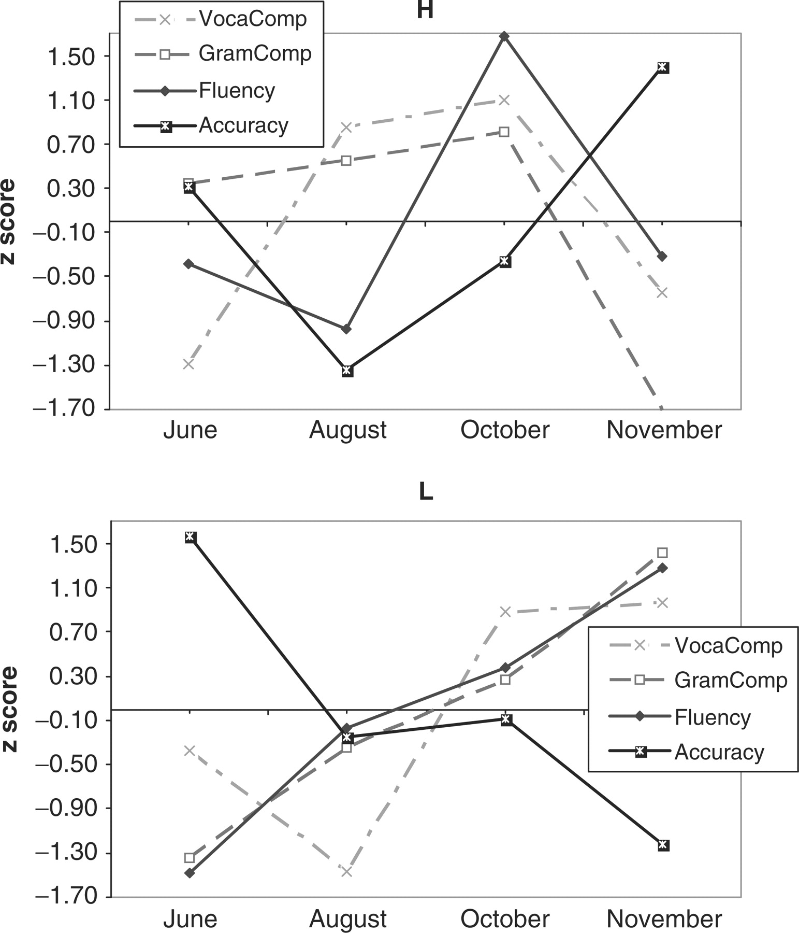
Figure 3: Intraindividual variation over time for five participants on four indices using written data
Notes:
Figure 3: Intraindividual variation over time for five participants on four indices using written data
Unless provided in the caption above, the following copyright applies to the content of this slide: © Oxford University Press 2006

Slide 5
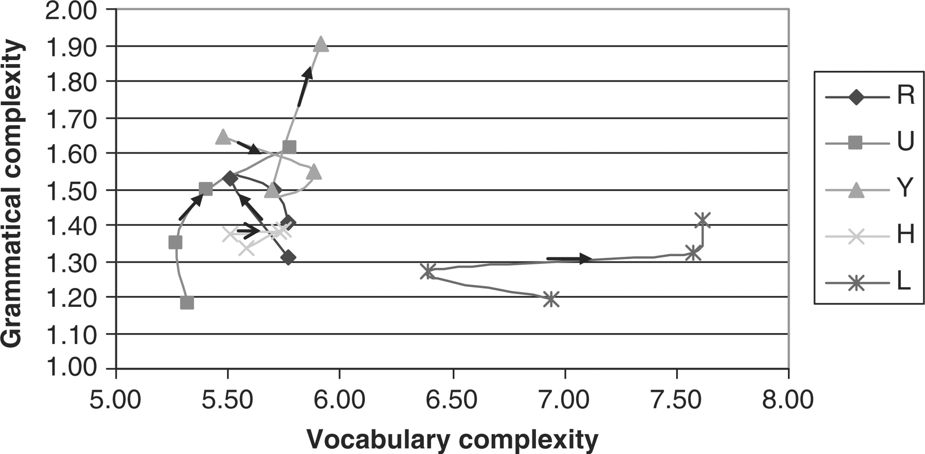
Figure 4: Change of grammatical complexity compared with vocabulary complexity for five participants using written ...
Notes:
Figure 4: Change of grammatical complexity compared with vocabulary complexity for five participants using written data
Unless provided in the caption above, the following copyright applies to the content of this slide: © Oxford University Press 2006

Slide 6
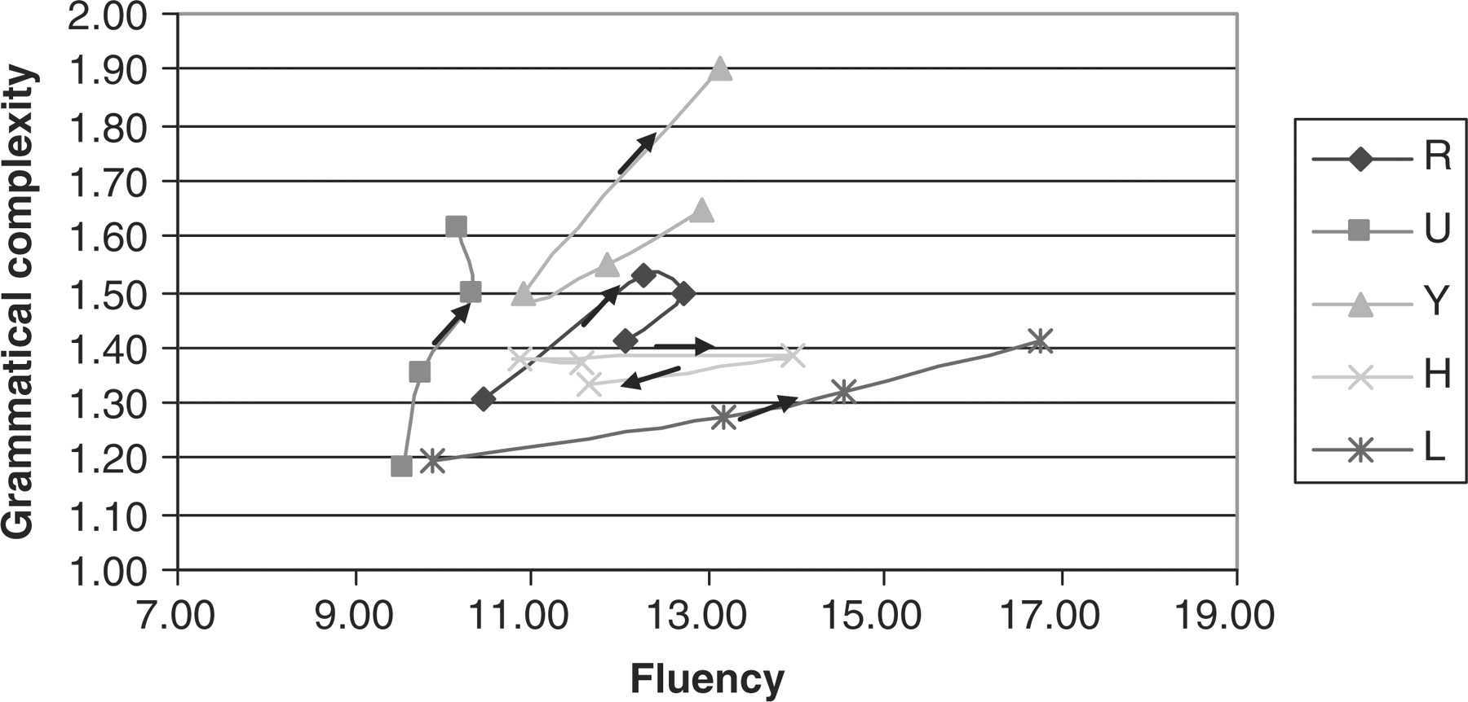
Figure 5: Change of fluency compared with grammatical complexity for five participants using written data
Notes:
Figure 5: Change of fluency compared with grammatical complexity for five participants using written data
Unless provided in the caption above, the following copyright applies to the content of this slide: © Oxford University Press 2006

Slide 7
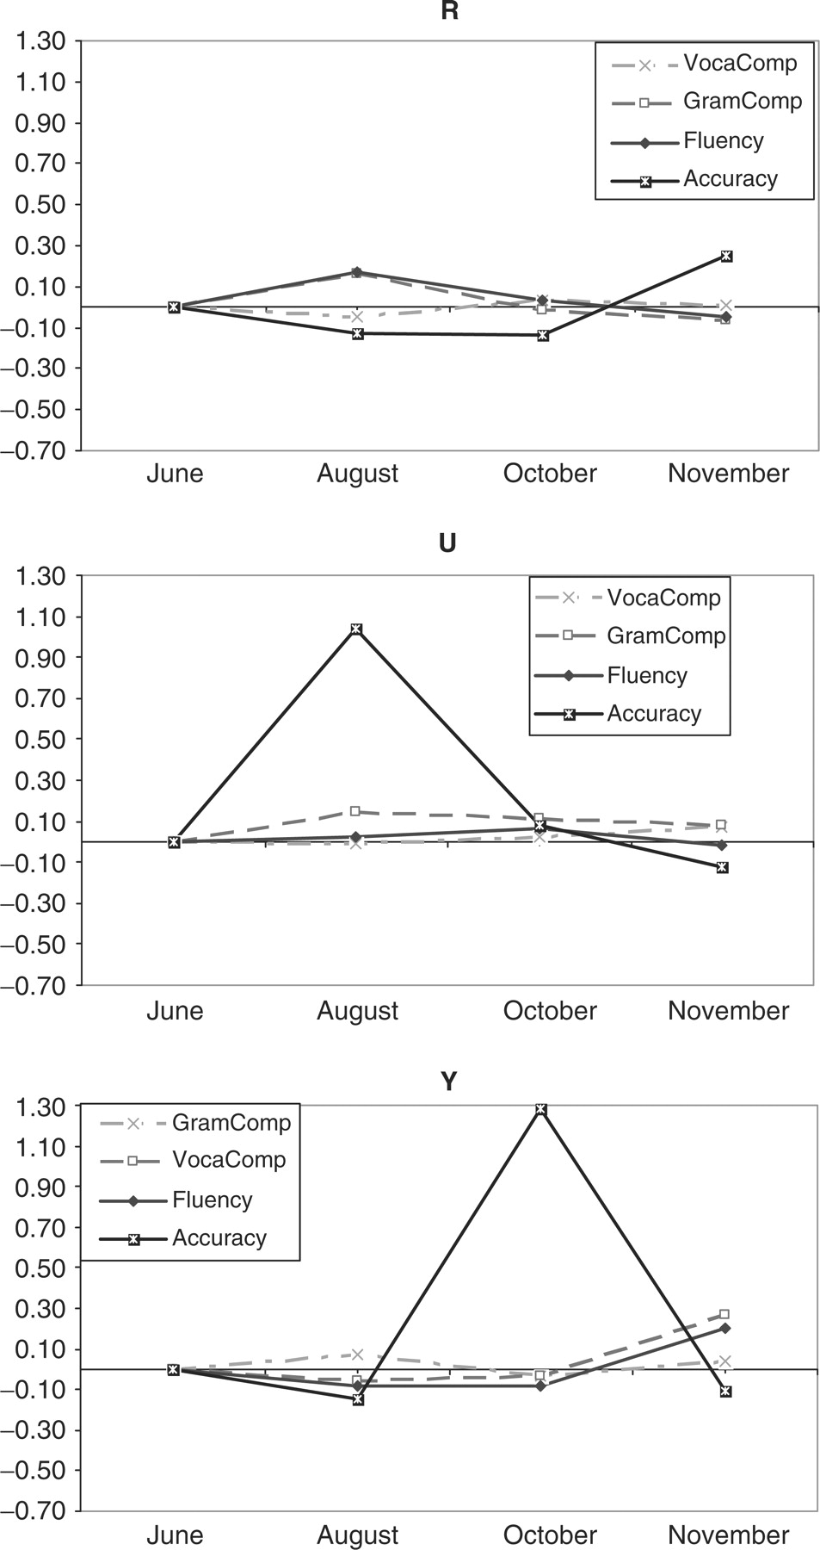
Figure 6: Rate of change on four indices for five participants over time using written data
Notes:
Figure 6: Rate of change on four indices for five participants over time using written data
Unless provided in the caption above, the following copyright applies to the content of this slide: © Oxford University Press 2006

Slide 8
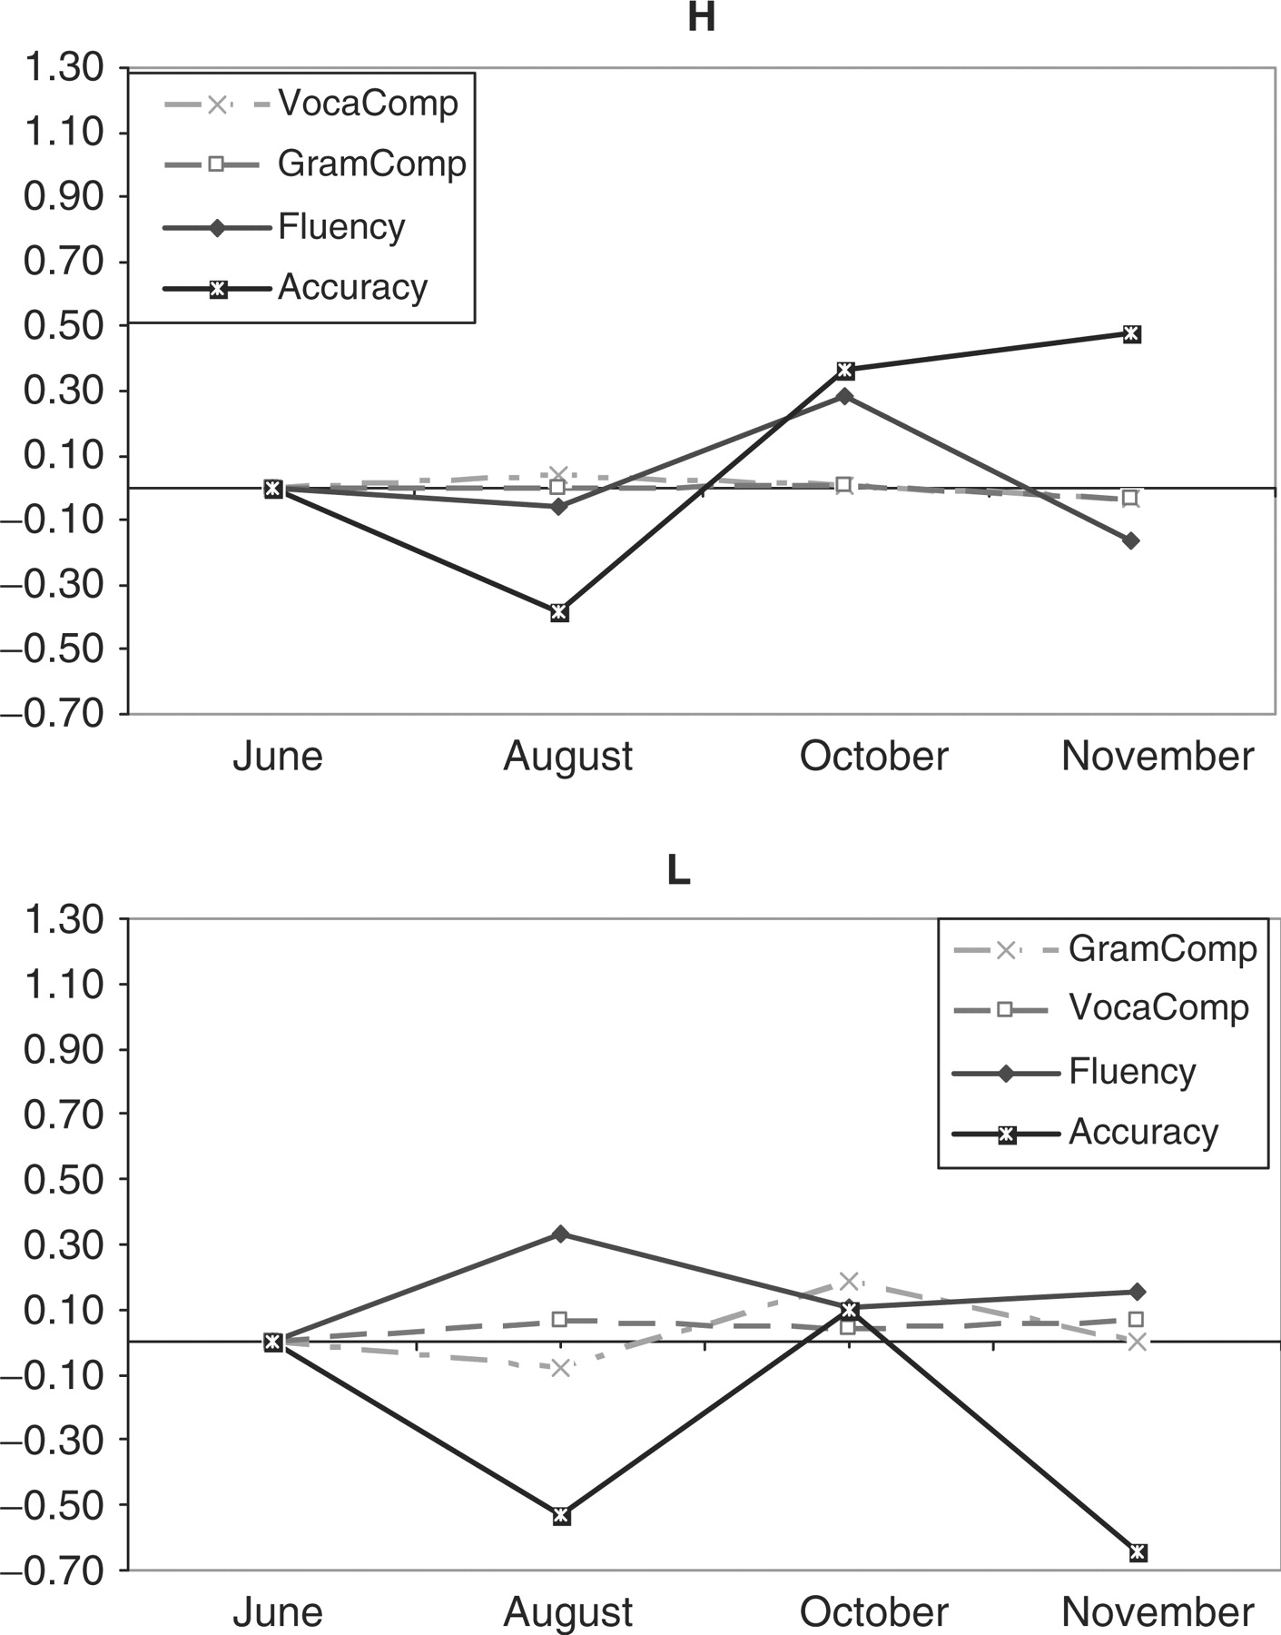
Figure 6: Rate of change on four indices for five participants over time using written data
Notes:
Figure 6: Rate of change on four indices for five participants over time using written data
Unless provided in the caption above, the following copyright applies to the content of this slide: © Oxford University Press 2006

