Slide 1
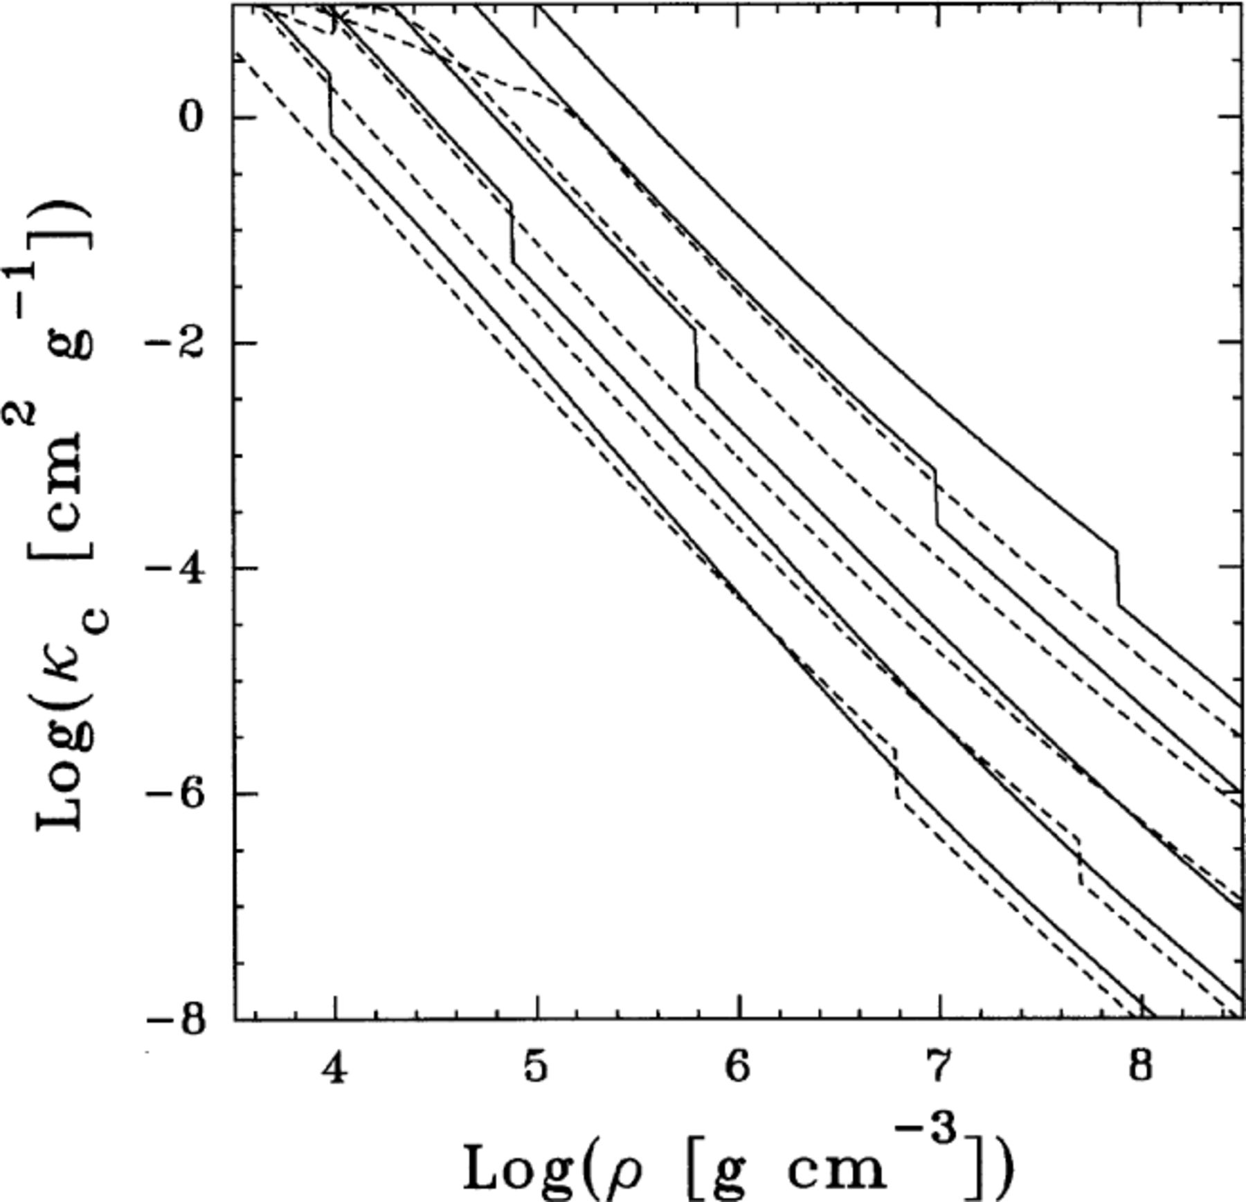
Figure 1. Conductive opacities for iron (solid line), and for 50 per cent carbon−50 per cent oxygen (short dashed ...
Notes:
Figure 1. Conductive opacities for iron (solid line), and for 50 per cent carbon−50 per cent oxygen (short dashed lines) plasmas. Curves correspond, from bottom to top, to temperatures of 5×106, 107, 2×107, 5×107 and 108 K, respectively. Note the steps in the curves that correspond to crystallization of the plasma.
Unless provided in the caption above, the following copyright applies to the content of this slide: © 2000 RAS

Slide 2
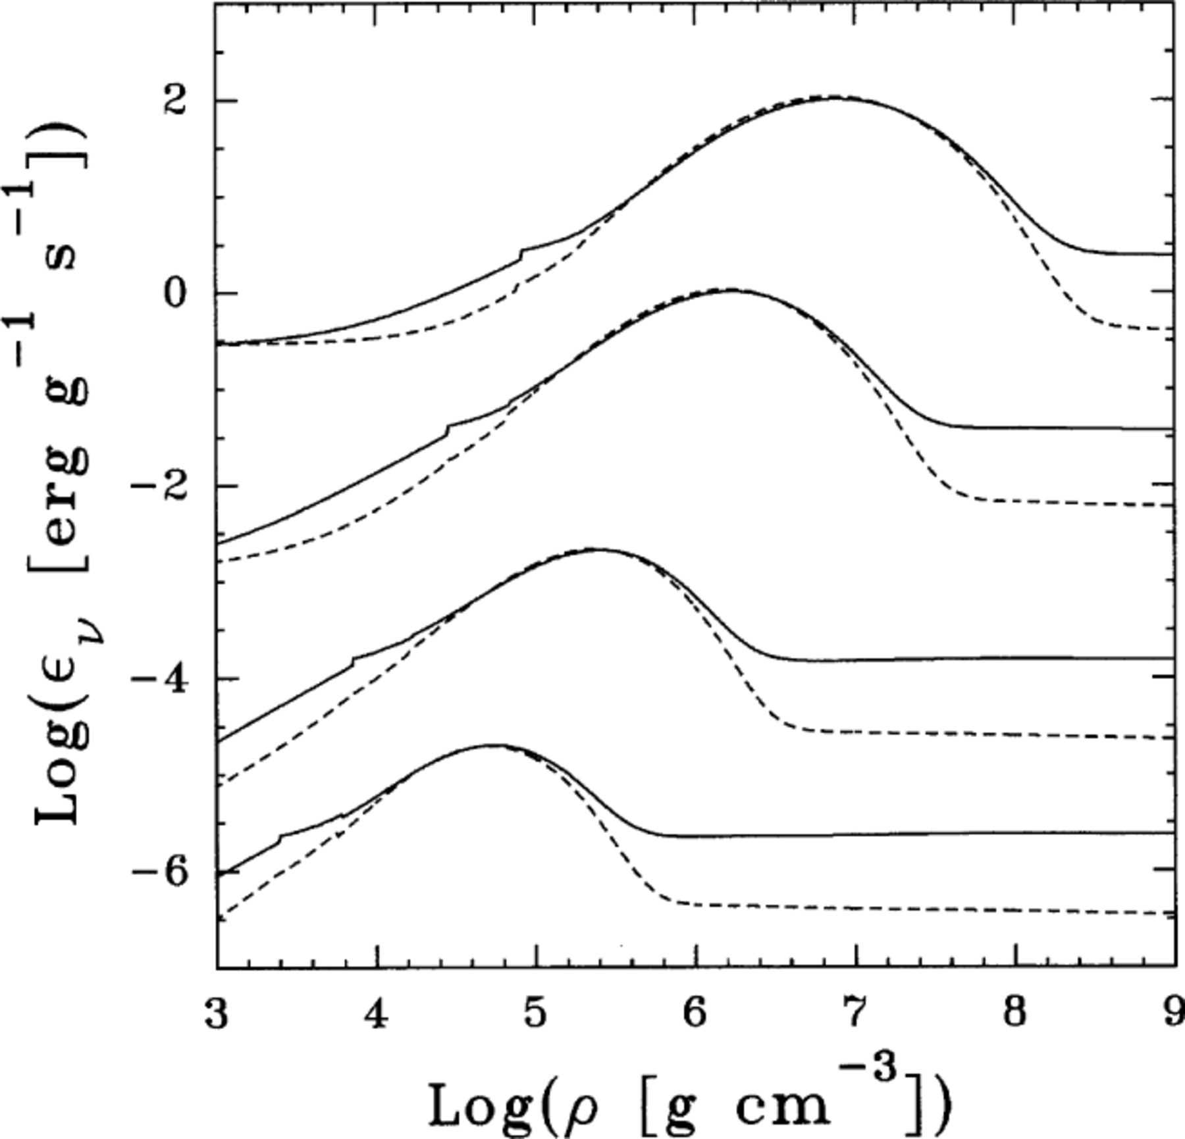
Figure 2. Neutrino energy loss rates for iron (solid line), and for 50 per cent carbon−50 per cent oxygen (short dashed ...
Notes:
Figure 2. Neutrino energy loss rates for iron (solid line), and for 50 per cent carbon−50 per cent oxygen (short dashed lines) plasmas. Curves correspond from bottom to top to temperatures of 107, 2×107, 5×107 and 108 K, respectively. For a given temperature, at low densities, the dominant neutrino emission process is due to photo neutrinos. At higher densities a bump in the emission rate appears due to plasma neutrinos, whereas at highest densities, Bremsstrahlung neutrinos dominate.
Unless provided in the caption above, the following copyright applies to the content of this slide: © 2000 RAS

Slide 3
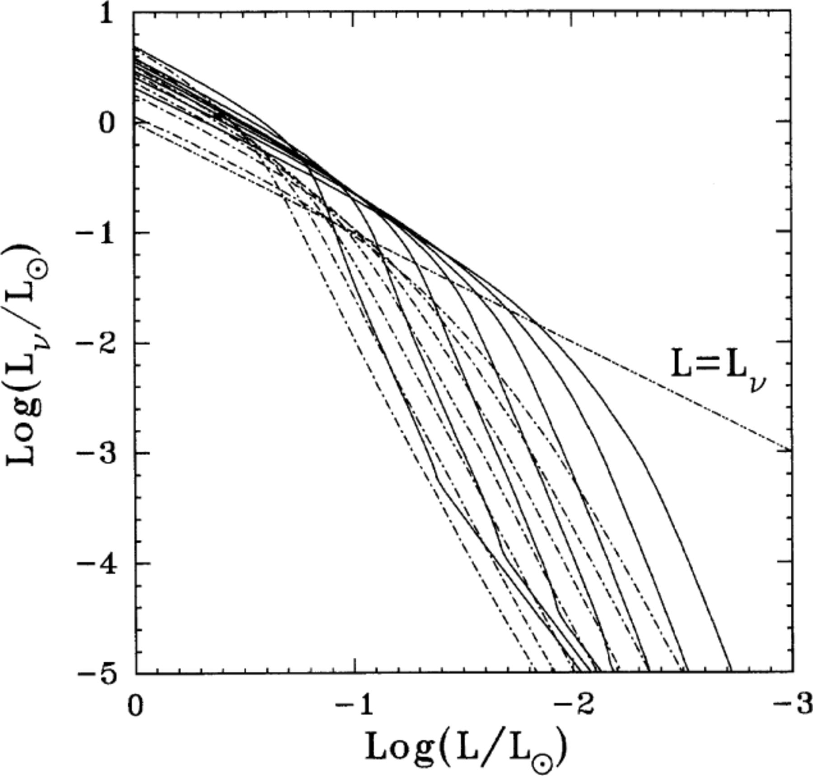
Figure 3. Neutrino luminosity versus photon luminosity corresponding to pure iron (full lines) and CO (dot-dashed ...
Notes:
Figure 3. Neutrino luminosity versus photon luminosity corresponding to pure iron (full lines) and CO (dot-dashed lines) non-DA WD models with stellar masses M/M⊙=0.40, 0.50, 0.60, 0.70, 0.80, 0.90 and 1.0. For the sake of reference, the line LL is also shown. The higher the model mass, the faster the fading in neutrino luminosity. Clearly, iron WDs are much more efficient neutrino energy radiators. In fact, neutrino emission represents the main cooling agent for iron WDs up to luminosities significatively lower than those corresponding to the standard case of CO WDs.
Unless provided in the caption above, the following copyright applies to the content of this slide: © 2000 RAS

Slide 4
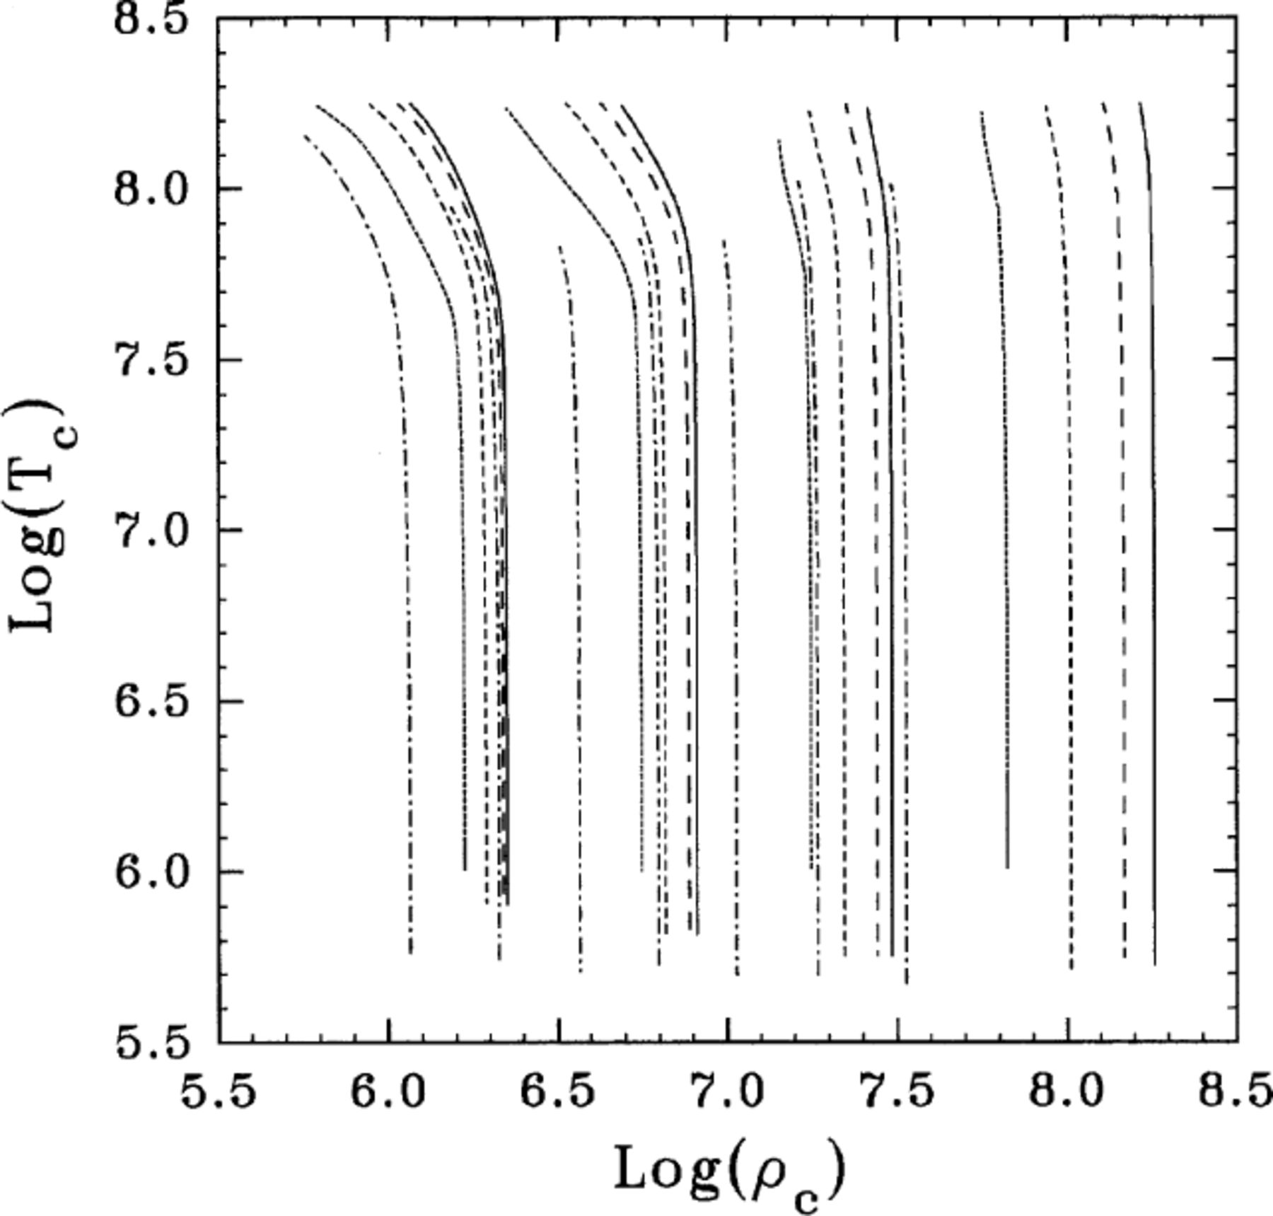
Figure 4. Central temperature versus central density for iron and CO non-DA models with masses of M/M⊙=0.40, ...
Notes:
Figure 4. Central temperature versus central density for iron and CO non-DA models with masses of M/M⊙=0.40, 0.60, 0.80 and 1.0 (the higher the mass the higher the central density). For each stellar mass we depict the results corresponding to CO models (dot-dashed line), and to models with pure iron cores embracing 25, 50 and 75 per cent of the total stellar mass plus a CO envelope (dotted, short-dashed and long-dashed lines, respectively). Finally, full lines correspond to pure iron non-DA models. Notice that for a fixed mass value, iron-rich WDs have asymptotic central density values few times higher than the corresponding to CO WDs.
Unless provided in the caption above, the following copyright applies to the content of this slide: © 2000 RAS

Slide 5
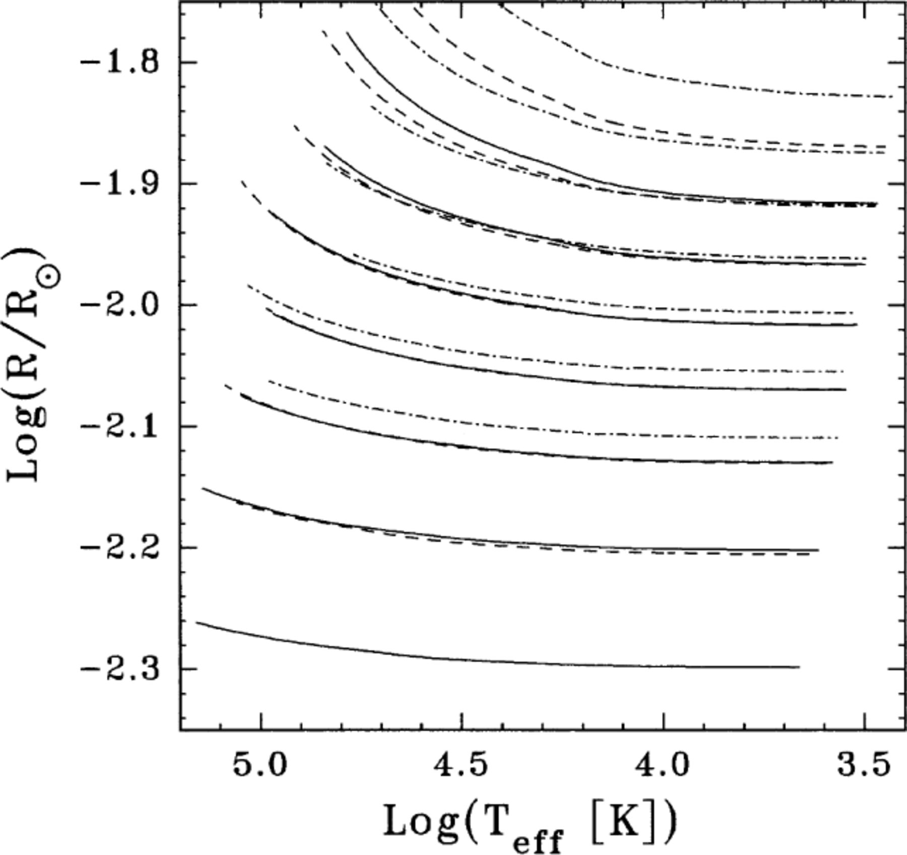
Figure 5. Radii in terms of effective temperature corresponding to pure iron (full lines) and CO (dot-dashed lines) ...
Notes:
Figure 5. Radii in terms of effective temperature corresponding to pure iron (full lines) and CO (dot-dashed lines) non-DA models, and to models with a pure iron core containing half of the total stellar mass (dashed lines) for masses M/M⊙=0.40, 0.50, 0.60, 0.70, 0.80, 0.90 and 1.0 (the higher the mass the smaller the radius).
Unless provided in the caption above, the following copyright applies to the content of this slide: © 2000 RAS

Slide 6
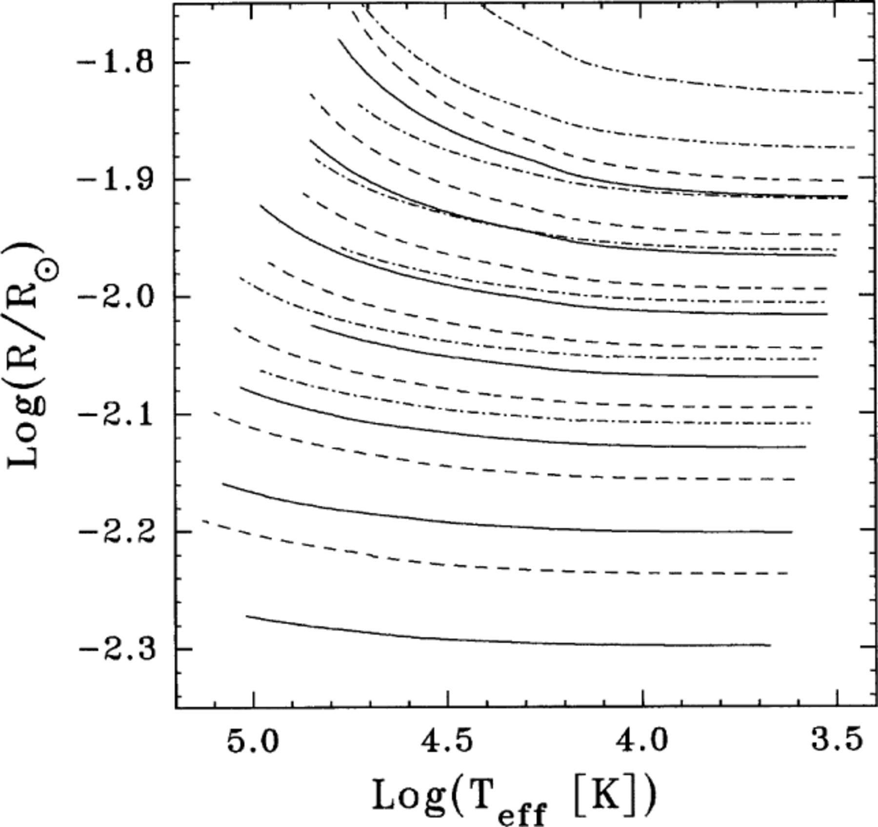
Figure 6. Same as Fig. 5, but now dashed lines show the results for homogeneous iron models with a iron abundance by ...
Notes:
Figure 6. Same as Fig. 5, but now dashed lines show the results for homogeneous iron models with a iron abundance by mass of 0.5.
Unless provided in the caption above, the following copyright applies to the content of this slide: © 2000 RAS

Slide 7
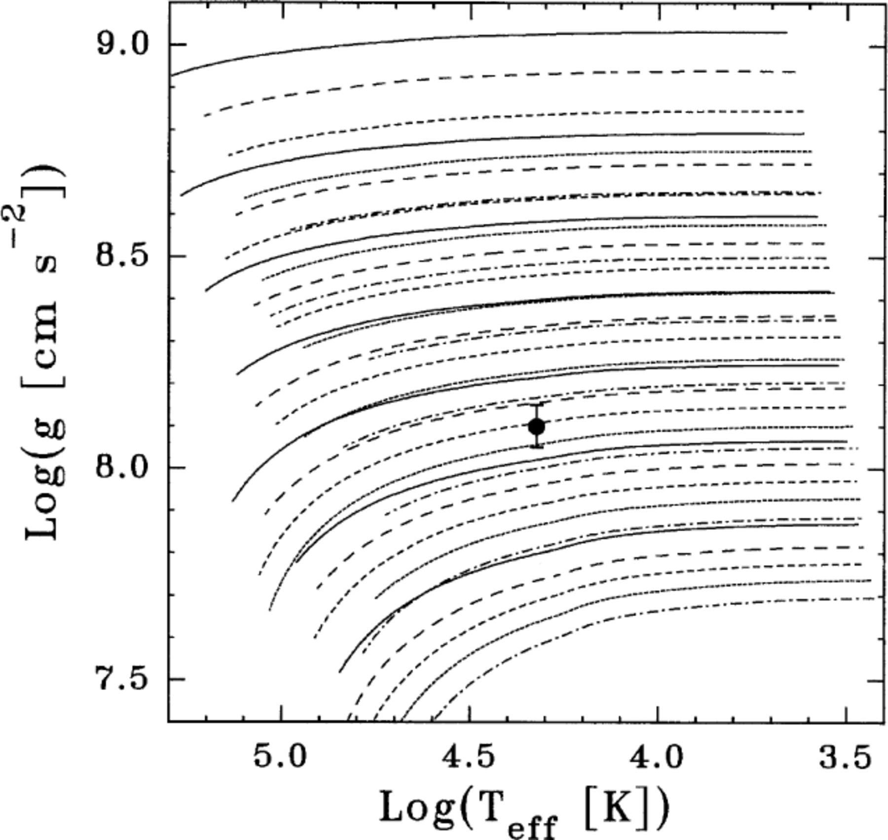
Figure 7. Surface gravities versus effective temperature relation corresponding to pure iron and CO non-DA models with ...
Notes:
Figure 7. Surface gravities versus effective temperature relation corresponding to pure iron and CO non-DA models with masses of M/M⊙=0.40, 0.50, 0.60, 0.70, 0.80, 0.90 and 1.0 (the higher the mass the higher the surface gravity). The meaning of the lines is the same as in Fig. 4. The observational data corresponding to EG 50 are also included.
Unless provided in the caption above, the following copyright applies to the content of this slide: © 2000 RAS

Slide 8
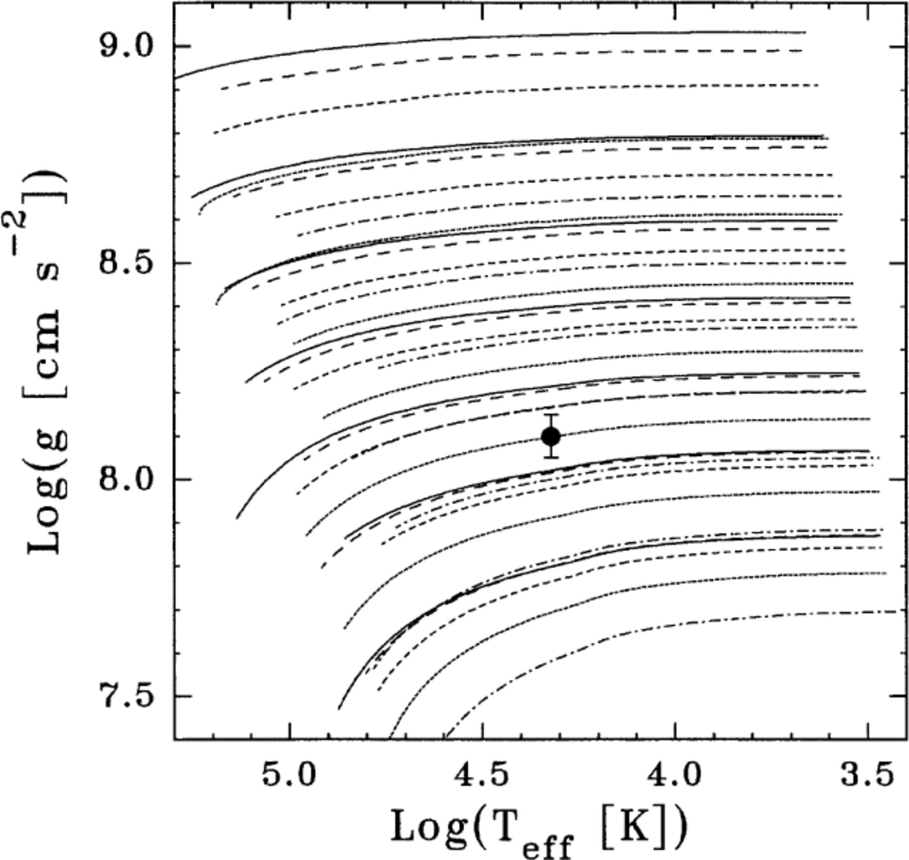
Figure 8. Same as Fig. 7 but for homogeneous iron models.
Notes:
Figure 8. Same as Fig. 7 but for homogeneous iron models.
Unless provided in the caption above, the following copyright applies to the content of this slide: © 2000 RAS

Slide 9
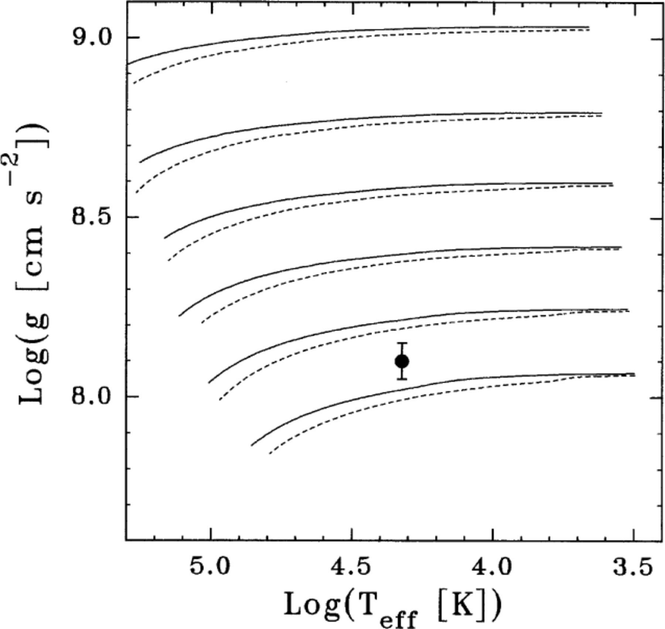
Figure 9. Surface gravity versus effective temperature relation corresponding to pure iron models of type non-DA and DA ...
Notes:
Figure 9. Surface gravity versus effective temperature relation corresponding to pure iron models of type non-DA and DA (solid and dotted lines, respectively) with masses of M/M⊙=0.50, 0.60, 0.70, 0.80, 0.90 and 1.0 (the higher the mass the higher the surface gravity). The inclusion of a hydrogen envelope leads to somewhat smaller gravity values. The observational data corresponding to EG 50 are also included.
Unless provided in the caption above, the following copyright applies to the content of this slide: © 2000 RAS

Slide 10
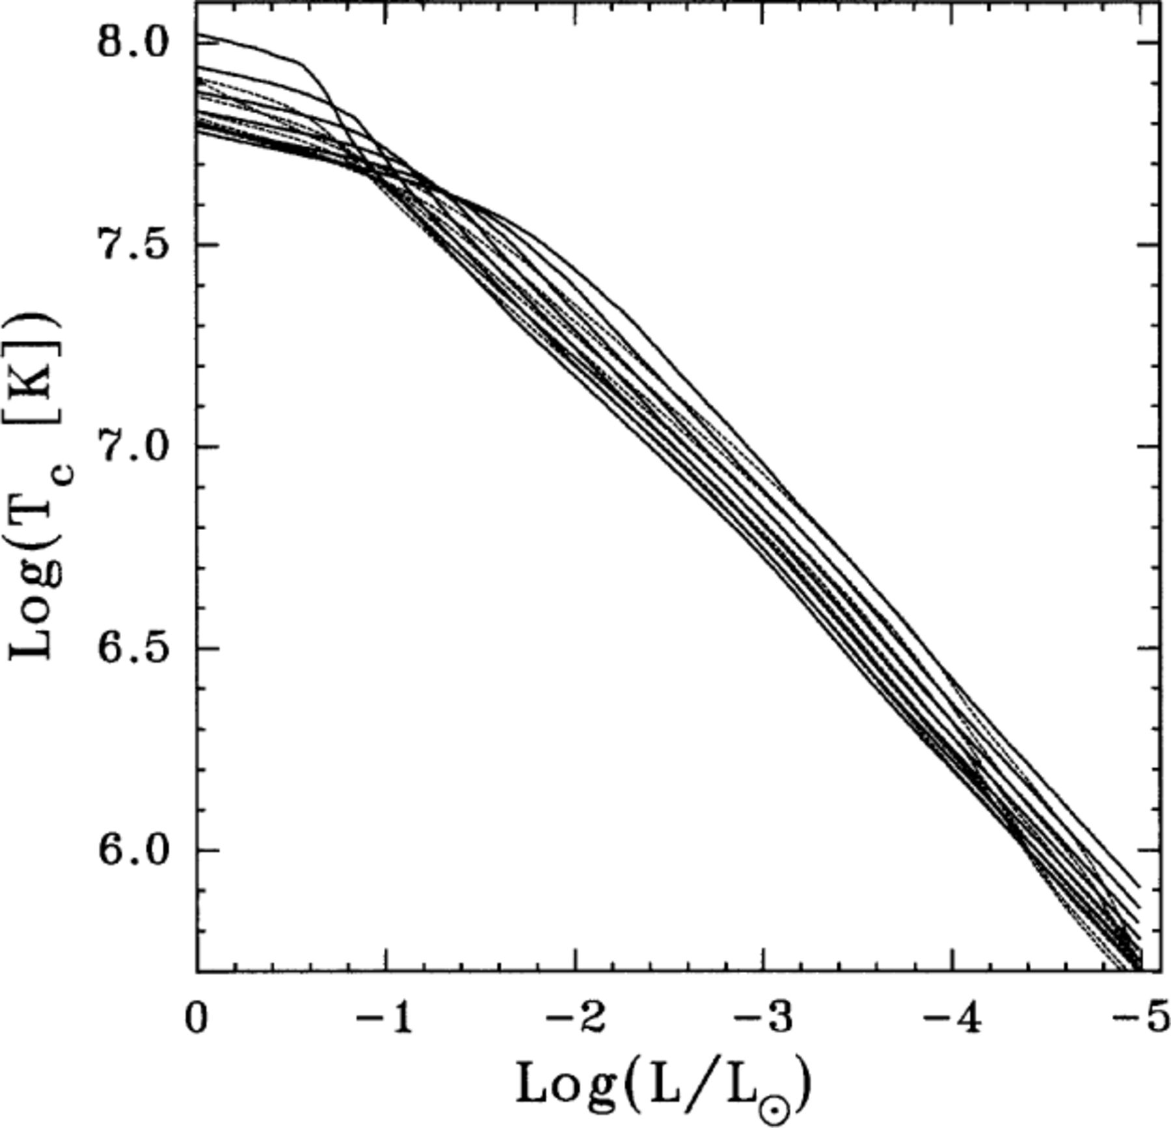
Figure 10. Central temperature as a function of photon luminosity corresponding to pure iron (full lines) and CO (dotted ...
Notes:
Figure 10. Central temperature as a function of photon luminosity corresponding to pure iron (full lines) and CO (dotted lines) non-DA models with masses of M/M⊙=0.40, 0.50, 0.60, 0.70, 0.80, 0.90, and 1.0. At low luminosities, the higher the mass the lower the central temperature.
Unless provided in the caption above, the following copyright applies to the content of this slide: © 2000 RAS

Slide 11
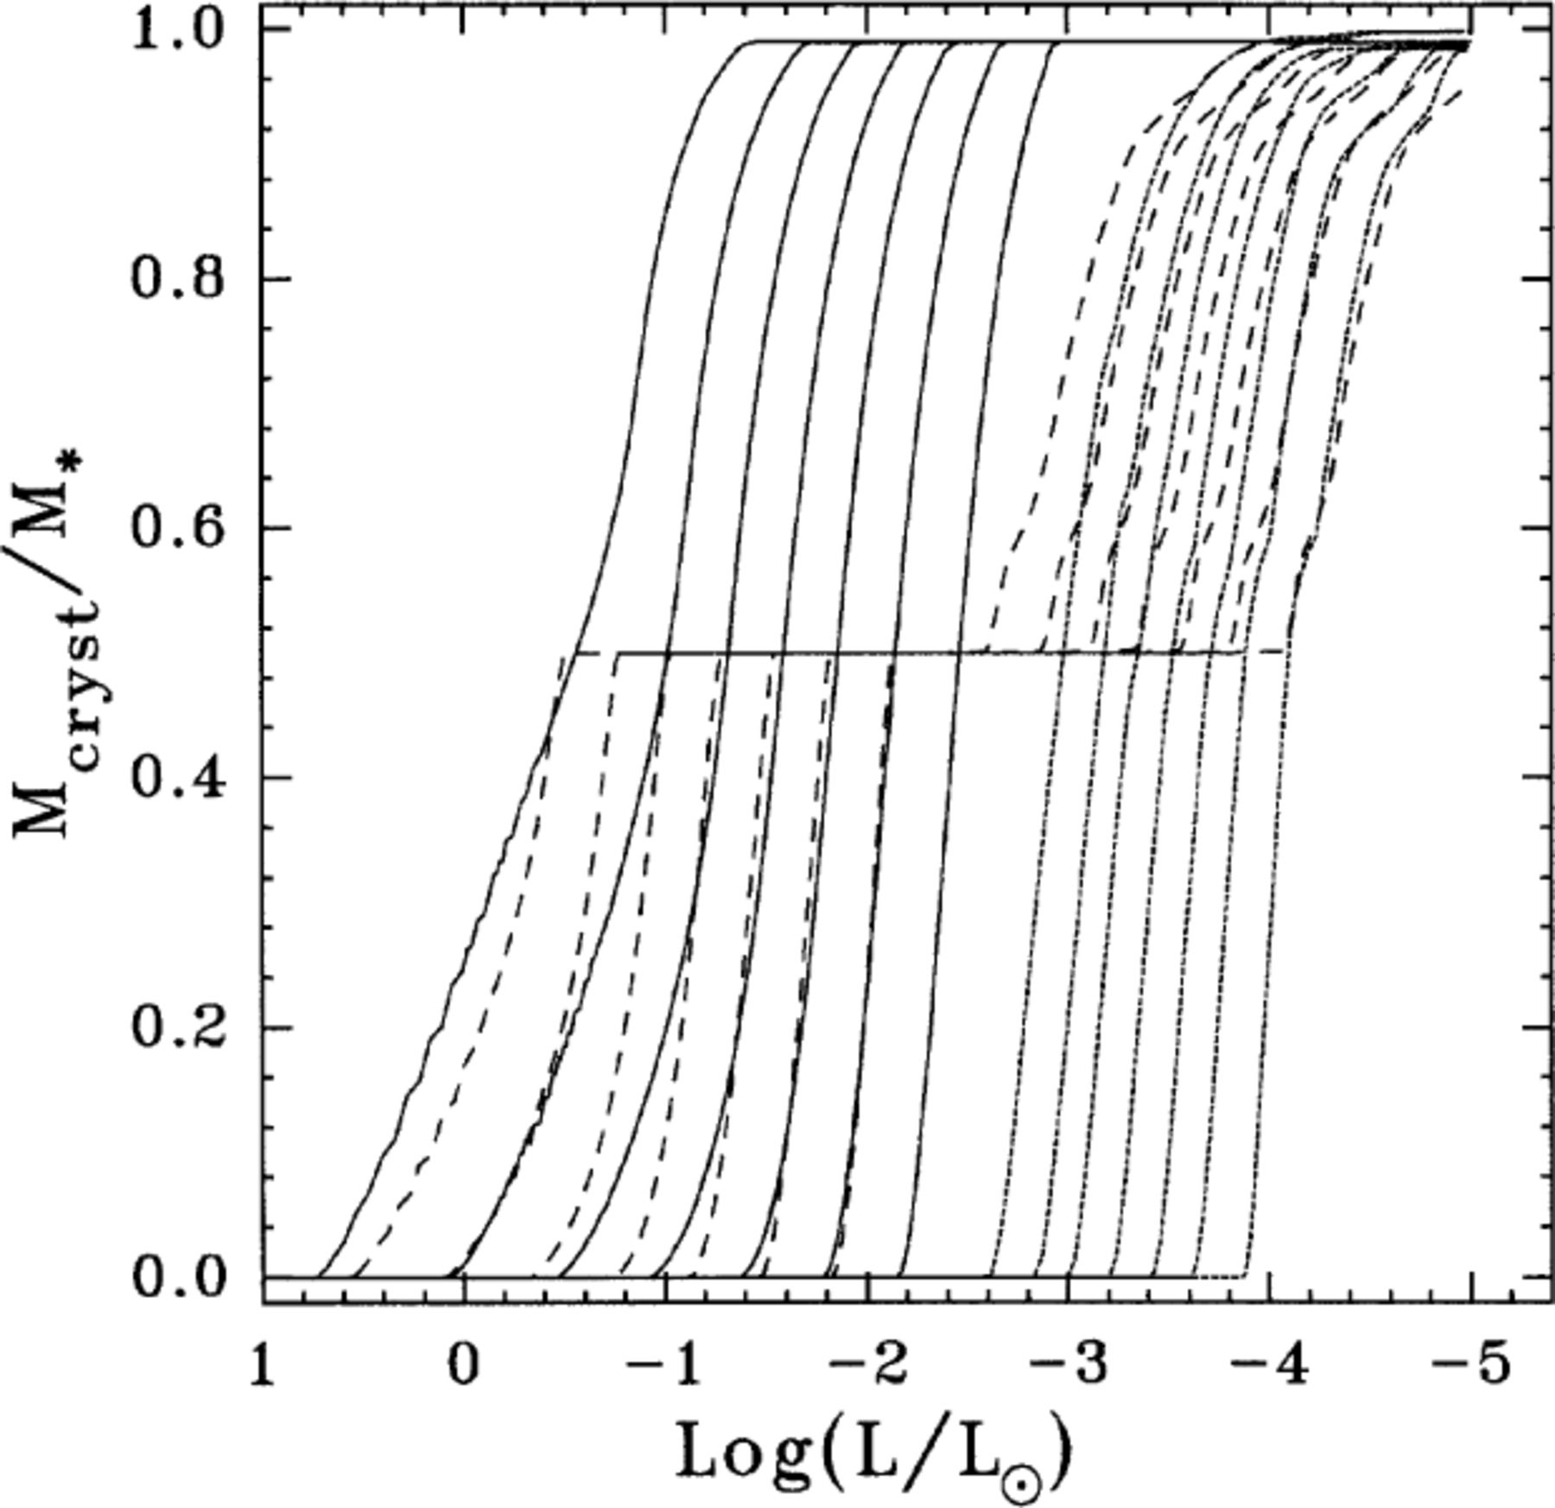
Figure 11. Evolution of the crystallization front in the Lagrangian coordinate as a function of luminosity corresponding ...
Notes:
Figure 11. Evolution of the crystallization front in the Lagrangian coordinate as a function of luminosity corresponding to pure iron (full lines) and CO (dotted lines) non-DA models, and to models with a pure iron core containing half of the total stellar mass (dashed lines) for stellar masses of (from right to left) M/M⊙=0.40, 0.50, 0.60, 0.70, 0.80, 0.90 and 1.0. Note that iron models crystallize at luminosities far higher than those corresponding to their CO counterparts. This is a result of the strong electrostatic coupling of the iron plasma. Note also that once the iron core is completely crystallized, crystallization conditions at the CO plasma are reached only at much later evolutionary stages.
Unless provided in the caption above, the following copyright applies to the content of this slide: © 2000 RAS

Slide 12
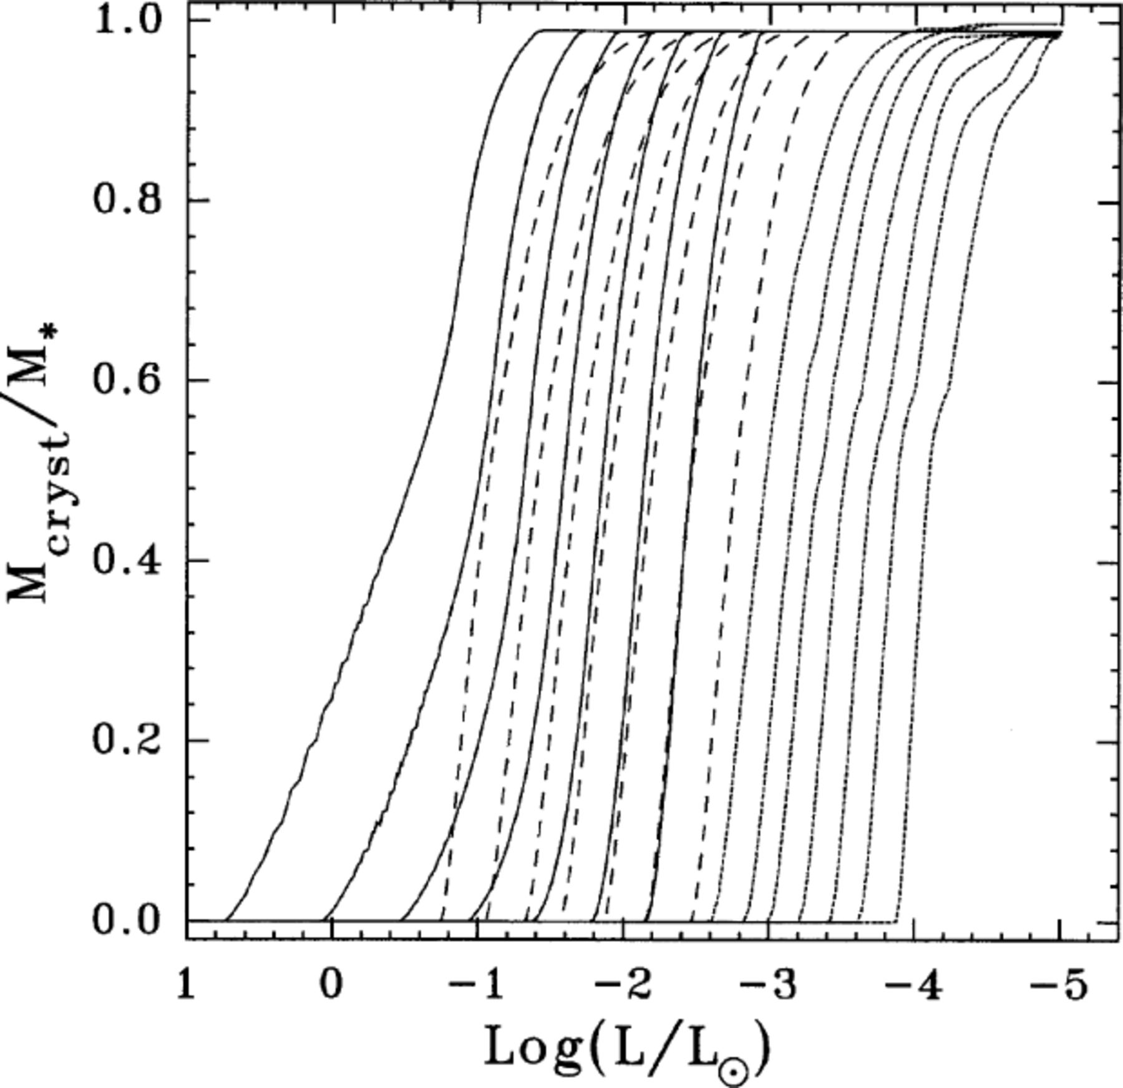
Figure 12. Same as Fig. 11, but now dashed lines show the results for homogeneous iron models with an iron abundance by ...
Notes:
Figure 12. Same as Fig. 11, but now dashed lines show the results for homogeneous iron models with an iron abundance by mass of 0.5.
Unless provided in the caption above, the following copyright applies to the content of this slide: © 2000 RAS

Slide 13
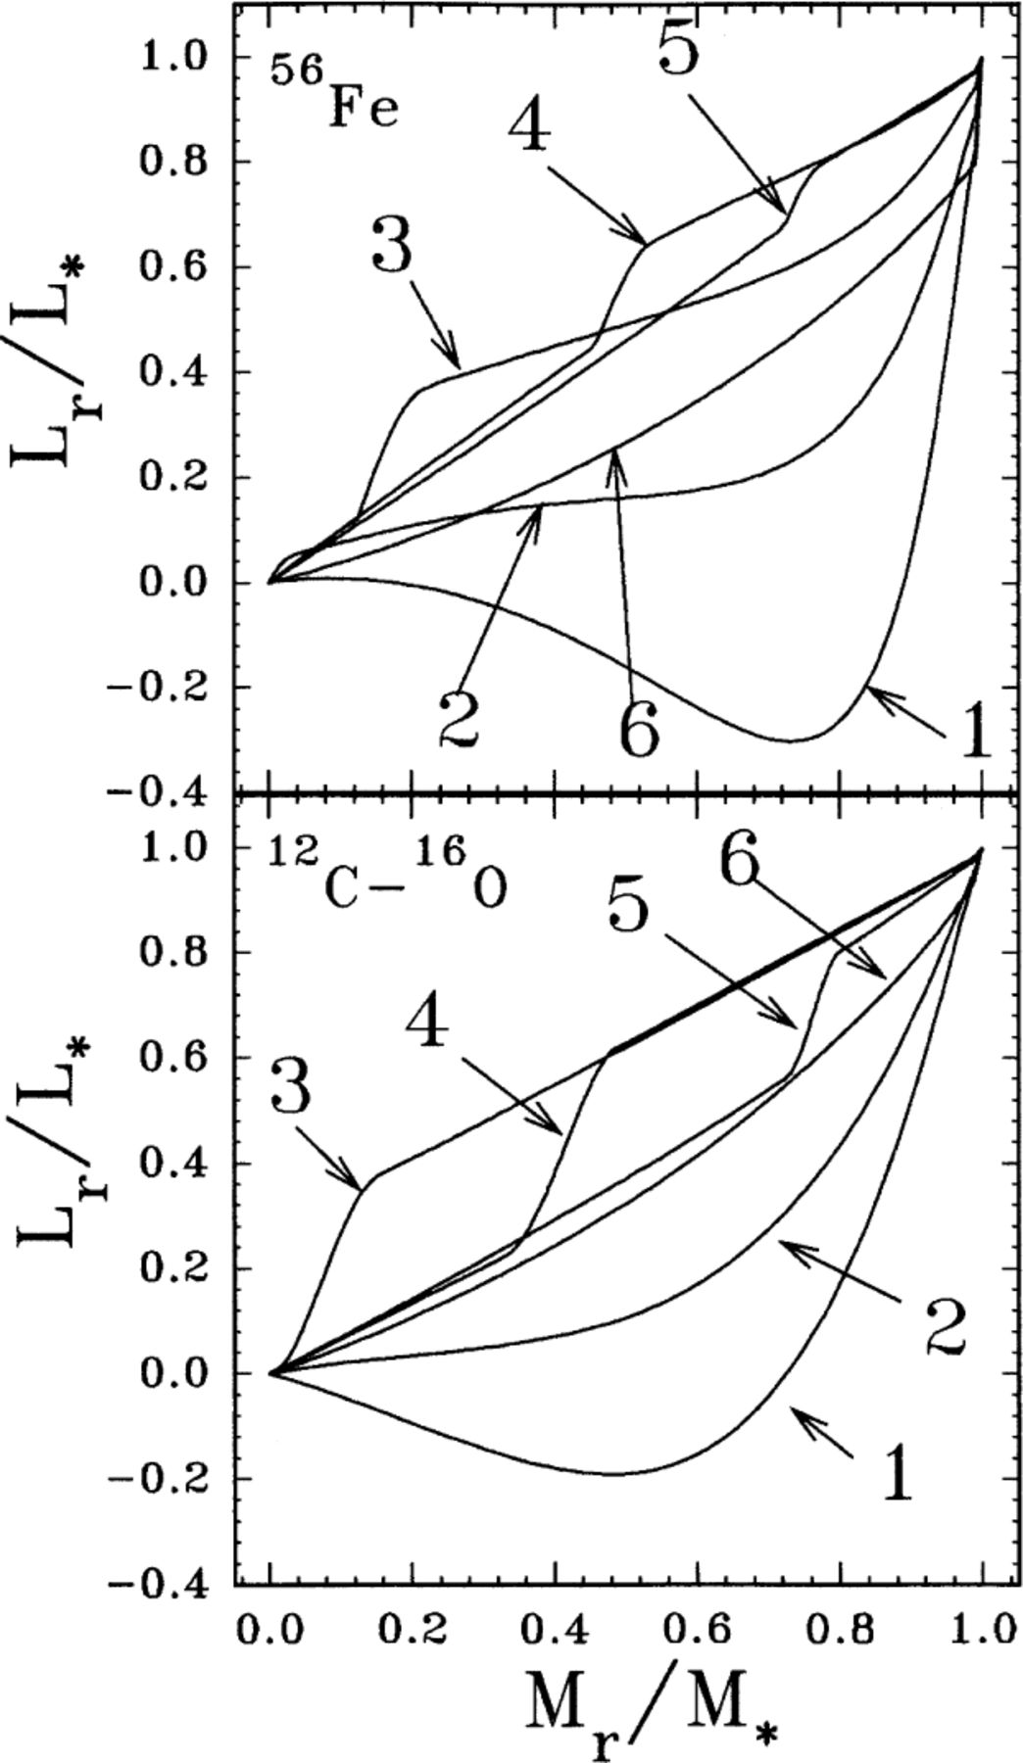
Figure 13. Profile of the relative luminosity versus the fractional mass for non-DA WDs models with 0.6 M⊙ ...
Notes:
Figure 13. Profile of the relative luminosity versus the fractional mass for non-DA WDs models with 0.6 M⊙ having pure iron (upper panel) and CO (lower panel) interiors. For the case of the iron models we have included the profiles corresponding to luminosities of log L/L⊙=−0.9004, −1.4154, −1.6554, −1.8588, −2.0301 and −4.9643 labelled from 1 to 6 respectively; whereas for CO models the luminosities are log L/L⊙=−0.67, −0.95, −3.49, −3.65, −4.00 and −4.90 labelled from 1 to 6, respectively. For details, see text.
Unless provided in the caption above, the following copyright applies to the content of this slide: © 2000 RAS

Slide 14
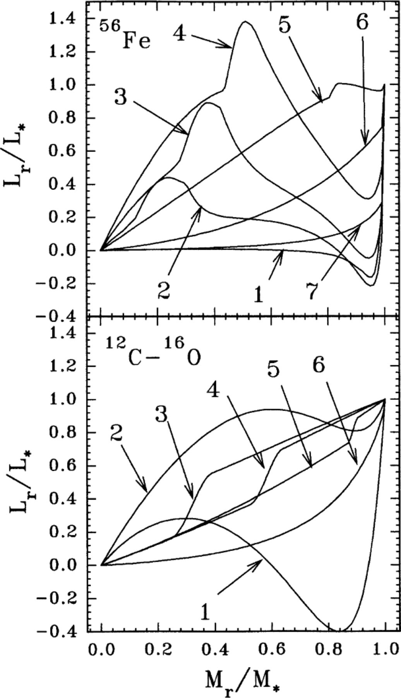
Figure 14. Profile of the relative luminosity versus the fractional mass for non-DA models with 1.0 M⊙ WDs ...
Notes:
Figure 14. Profile of the relative luminosity versus the fractional mass for non-DA models with 1.0 M⊙ WDs having pure iron (upper panel) and CO (lower panel) interiors. For the case of the iron models we have included the profiles corresponding to luminosities of log L/L⊙=1.58447, 0.1668, −0.1771, −0.5043, −0.9652, −3.8293 and −4.9036 labelled from 1 to 7 respectively; whereas for CO models the luminosities are log L/L⊙=−0.12, −0.65, −2.86, −3.05, −3.44 and −5.00 labelled from 1 to 6, respectively. For details, see text.
Unless provided in the caption above, the following copyright applies to the content of this slide: © 2000 RAS

Slide 15
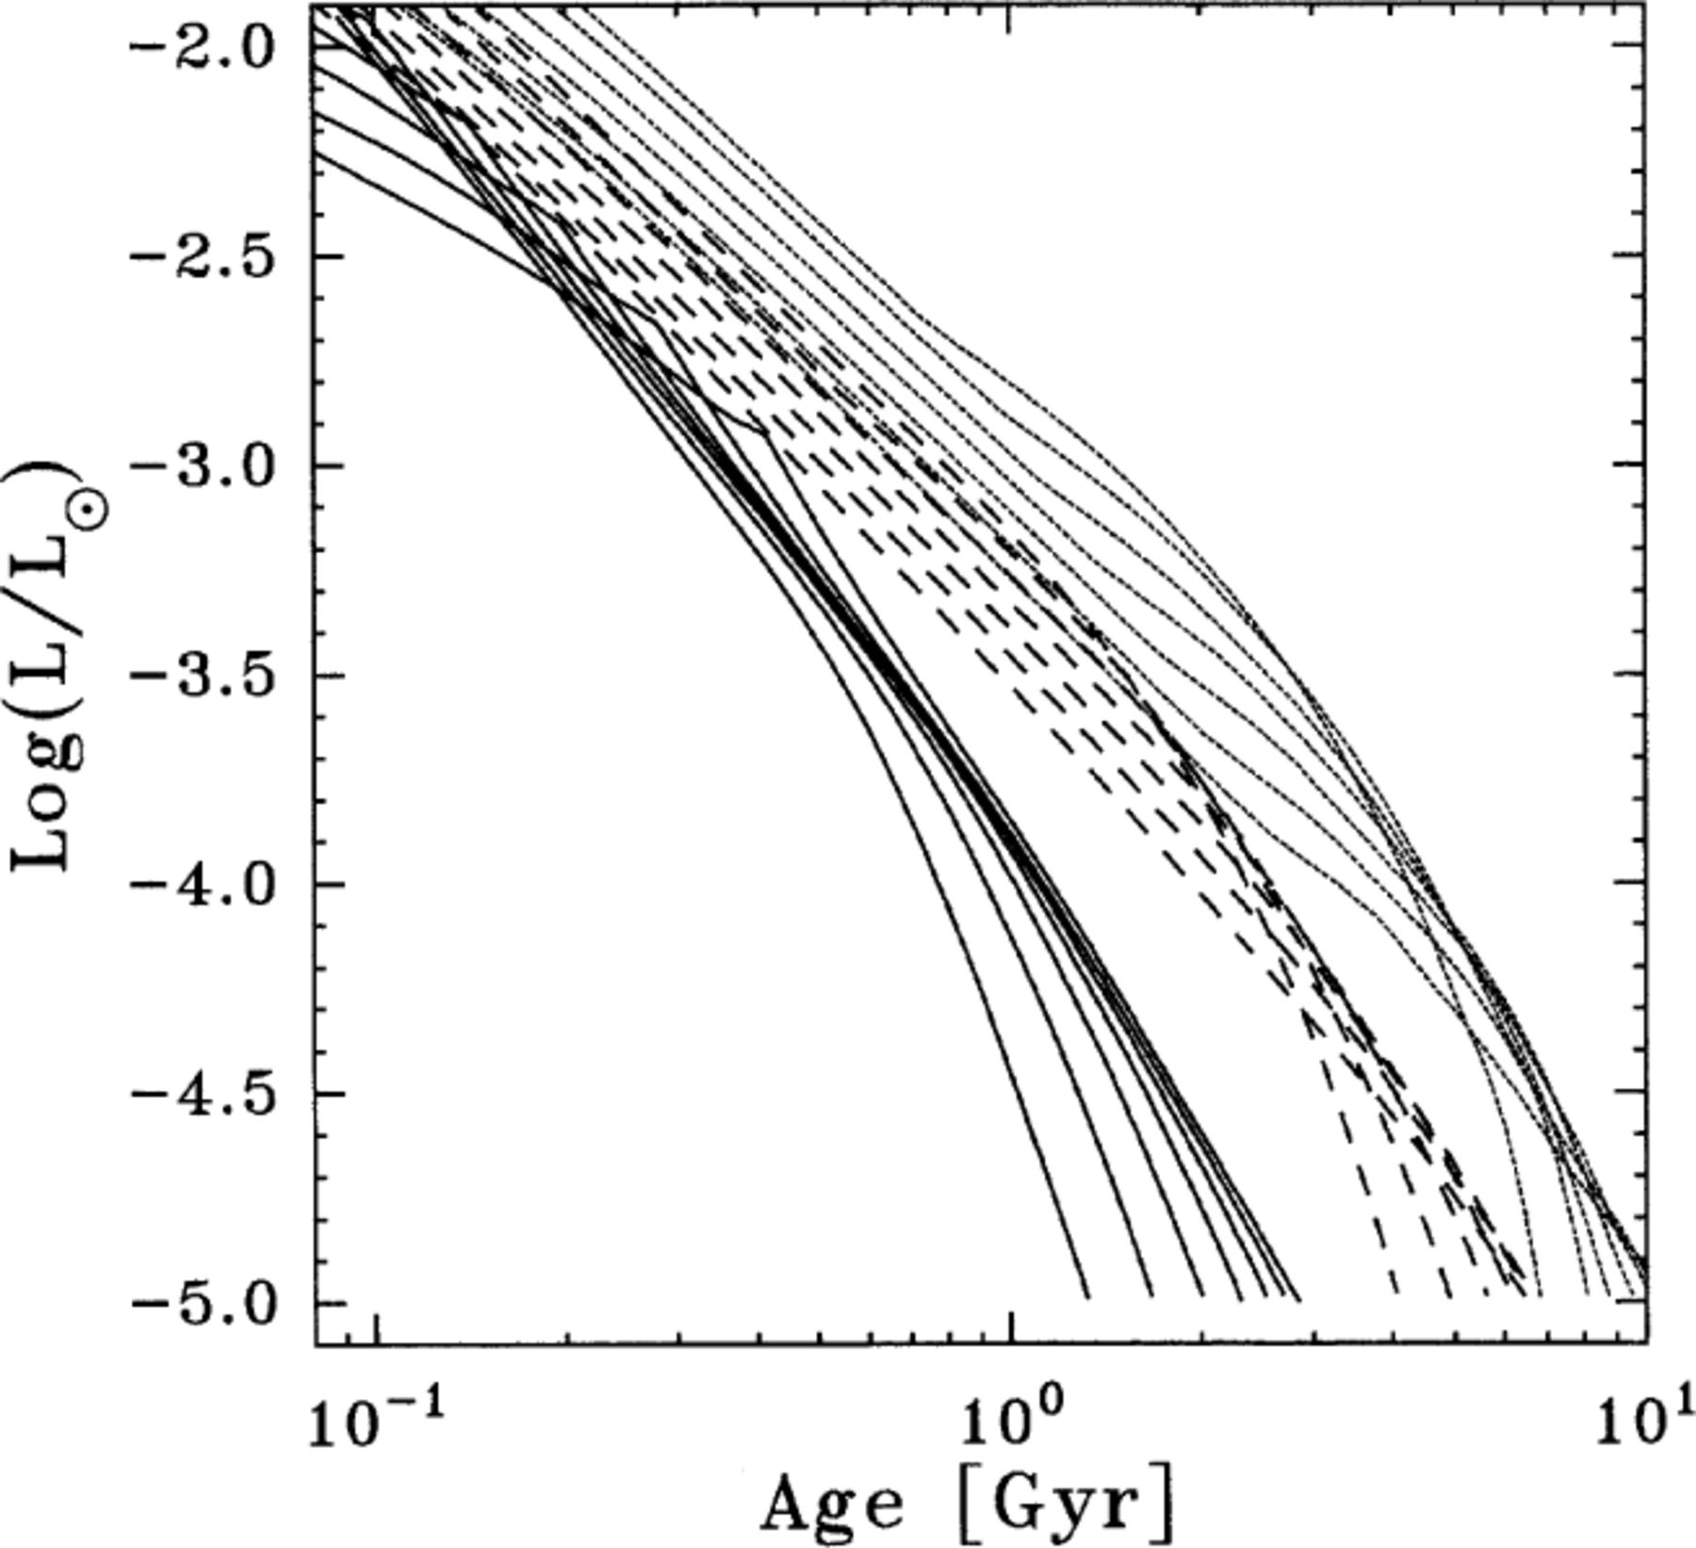
Figure 15. Age versus luminosity relation corresponding to pure iron (full lines) and CO (dotted lines) non-DA models, ...
Notes:
Figure 15. Age versus luminosity relation corresponding to pure iron (full lines) and CO (dotted lines) non-DA models, and to models with a pure iron core containing half of the total stellar mass (dashed lines) for stellar masses of M/M⊙=0.40, 0.50, 0.60, 0.70, 0.80, 0.90 and 1.0. Note that pure iron models cool down about five times faster than standard CO WDs. At the high luminosities of this figure, the change in the slope of pure iron models is a result of the discontinuity of conductive opacity at the crystallization front. See text for details.
Unless provided in the caption above, the following copyright applies to the content of this slide: © 2000 RAS

Slide 16
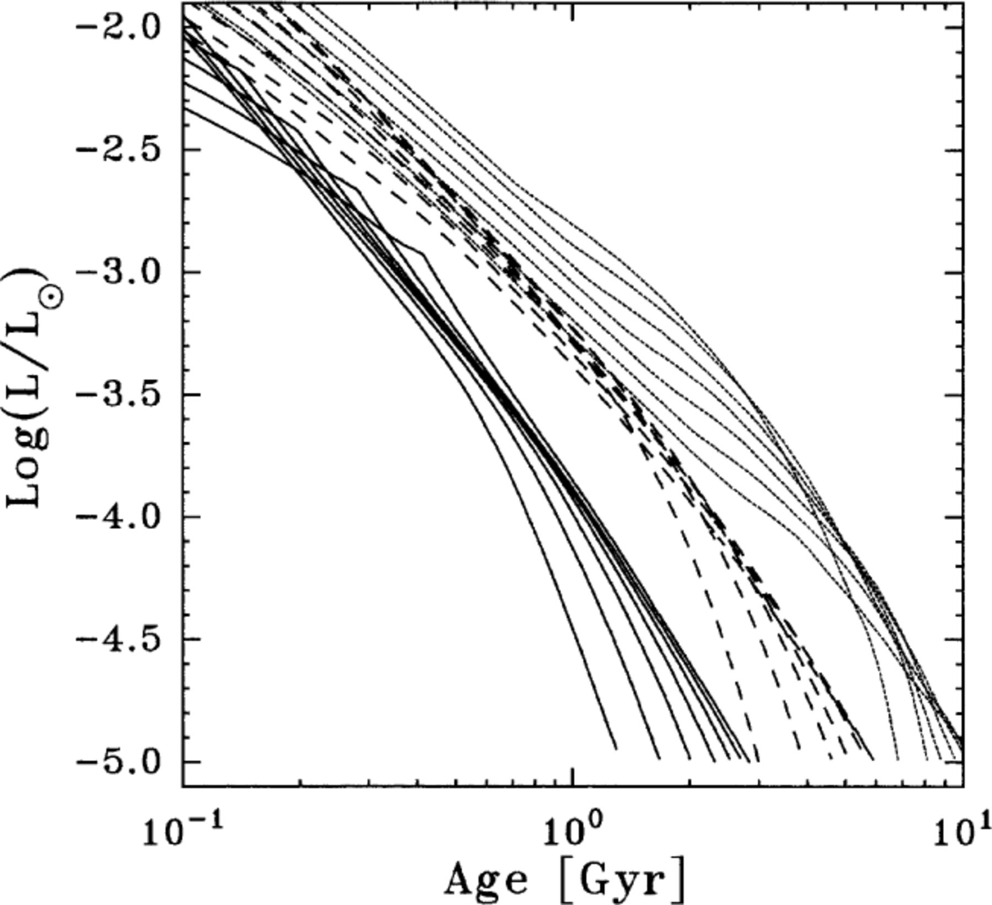
Figure 16. Same as Fig. 15, but now dashed lines show the results for homogeneous iron models with an iron abundance by ...
Notes:
Figure 16. Same as Fig. 15, but now dashed lines show the results for homogeneous iron models with an iron abundance by mass of 0.5.
Unless provided in the caption above, the following copyright applies to the content of this slide: © 2000 RAS

Slide 17
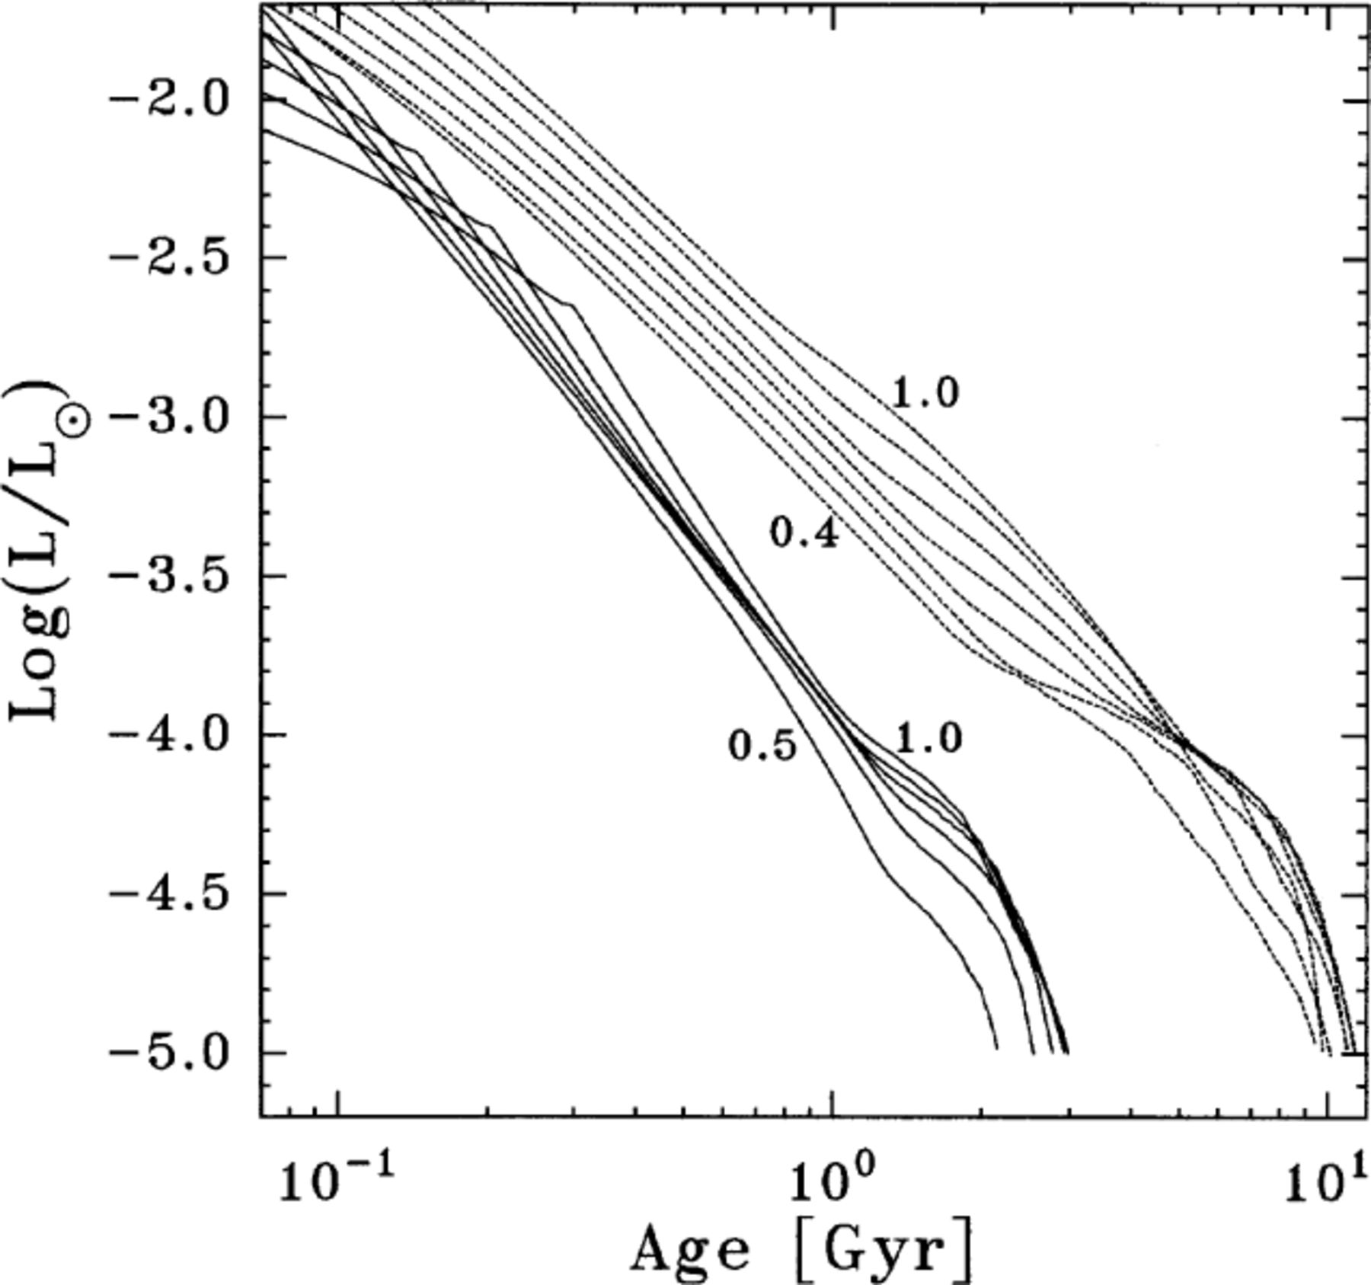
Figure 17. Age versus luminosity relation corresponding to pure iron (full lines) and CO (dotted lines) DA models for ...
Notes:
Figure 17. Age versus luminosity relation corresponding to pure iron (full lines) and CO (dotted lines) DA models for stellar masses of M/M⊙=0.40, 0.50, 0.60, 0.70, 0.80, 0.90 and 1.0 (for iron models the minimum mass value shown is 0.5 M⊙). Note that pure iron models cool down about five times faster than standard CO DA WDs. At the high luminosities of this figure, the change in the slope of pure iron models is a result of the discontinuity of conductive opacity at the crystallization front. See text for details.
Unless provided in the caption above, the following copyright applies to the content of this slide: © 2000 RAS

Slide 18
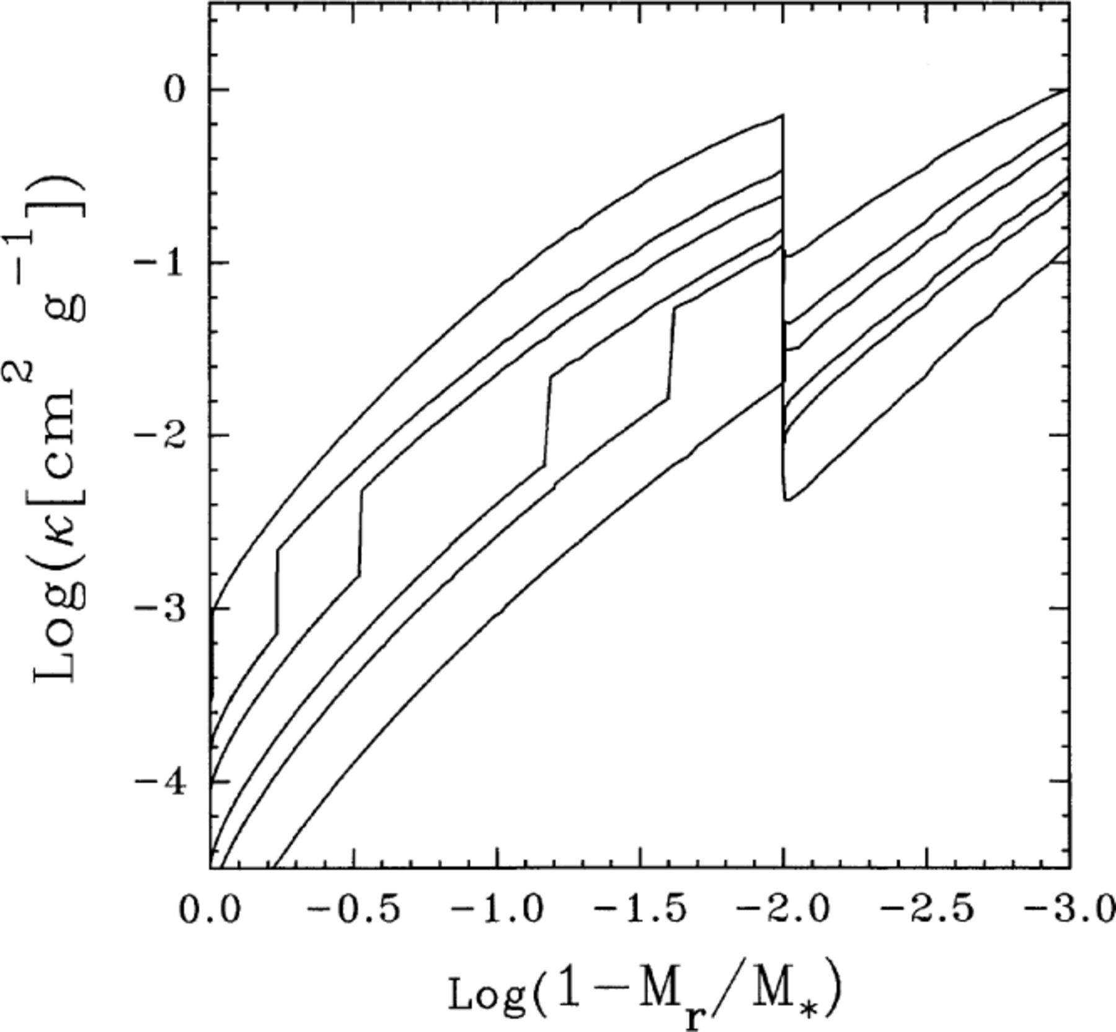
Figure 18. Opacity in terms of the outer mass fraction for pure iron DA models with 0.6 M/M⊙. From top to ...
Notes:
Figure 18. Opacity in terms of the outer mass fraction for pure iron DA models with 0.6 M/M⊙. From top to bottom, curves correspond to different evolutionary stages characterized by log L/L⊙=−1.31, −1.78, −1.95, −2.23, −2.35 and −2.71. Note the change of iron opacity at the crystallization front. At MrM*=0.99, the change in the opacity is due to the presence of helium in the outer layers.
Unless provided in the caption above, the following copyright applies to the content of this slide: © 2000 RAS

Slide 19
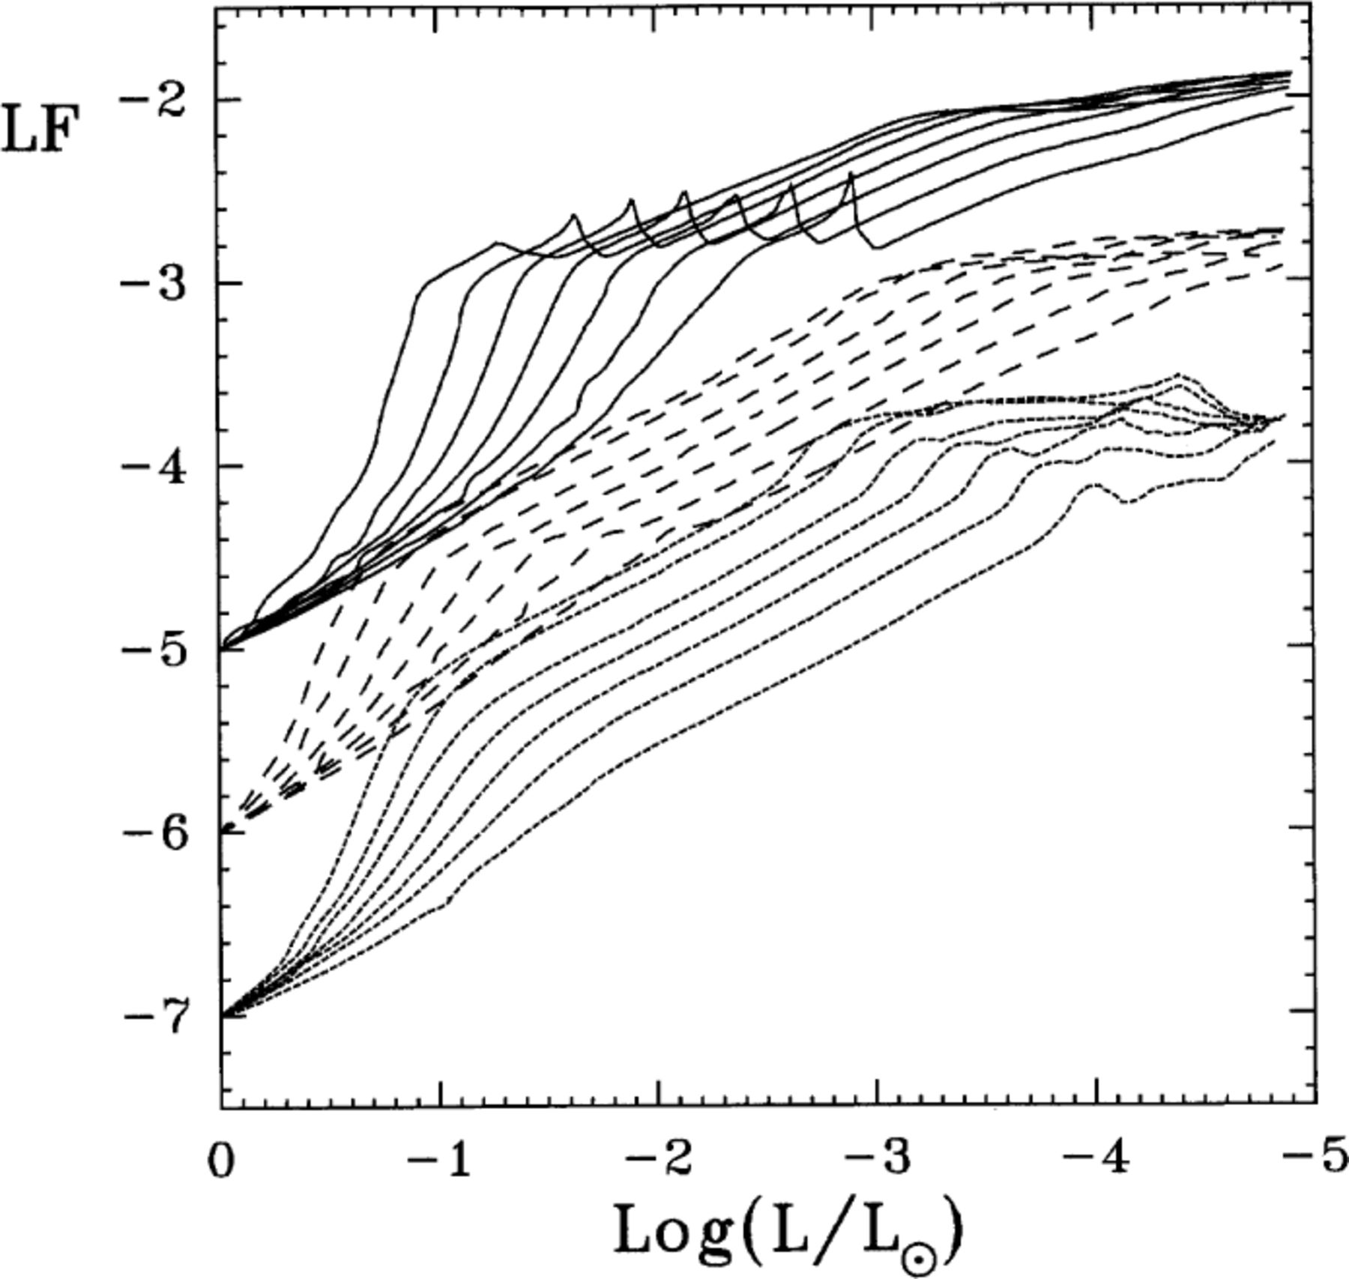
Figure 19. Single luminosity functions (normalized at log L/L⊙=0) in terms of surface luminosity for pure ...
Notes:
Figure 19. Single luminosity functions (normalized at log L/L⊙=0) in terms of surface luminosity for pure iron (full lines) and CO (dotted lines) non-DA models, and to models with a pure iron core containing half of the total stellar mass (dashed lines) for stellar masses with (from bottom to top) M/M⊙=0.40, 0.50, 0.60, 0.70, 0.80, 0.90 and 1.0. For the sake of clarity we have set arbitrarily LF=−5, −6 and −7 for the three set of curves. For the spikes in the iron LFs, see text.
Unless provided in the caption above, the following copyright applies to the content of this slide: © 2000 RAS

Slide 20
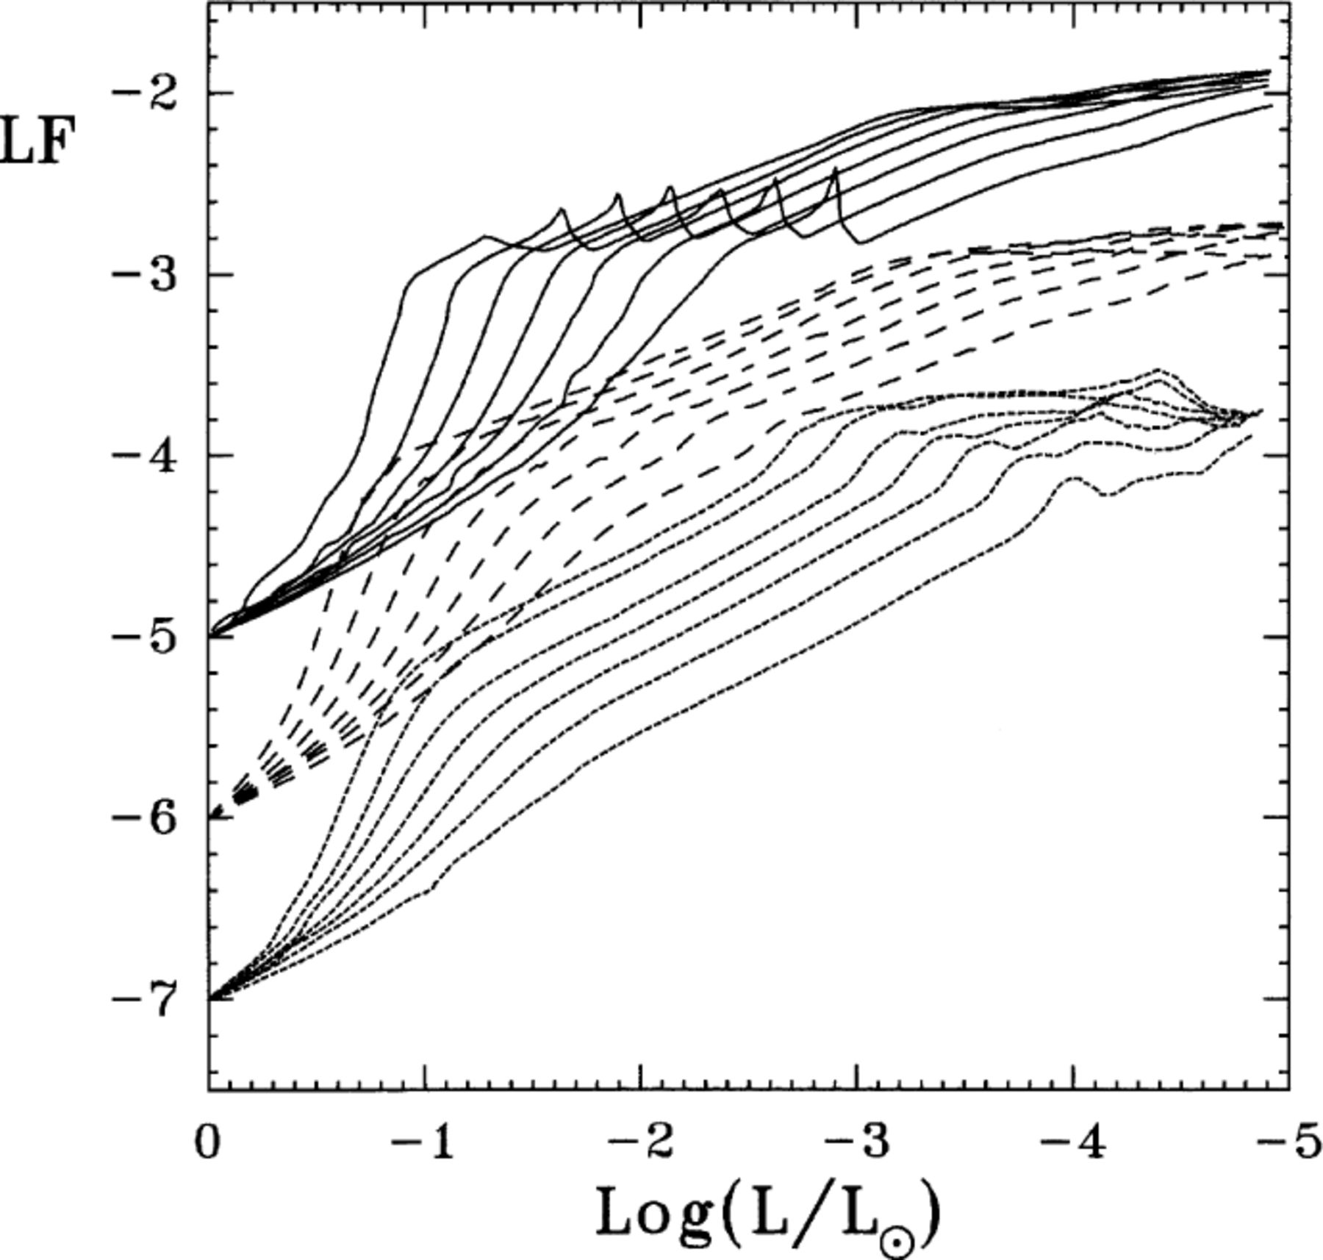
Figure 20. Same as Fig. 19, but now dashed lines show the results for homogeneous iron models with a iron abundance by ...
Notes:
Figure 20. Same as Fig. 19, but now dashed lines show the results for homogeneous iron models with a iron abundance by mass of 0.5.
Unless provided in the caption above, the following copyright applies to the content of this slide: © 2000 RAS

Slide 21
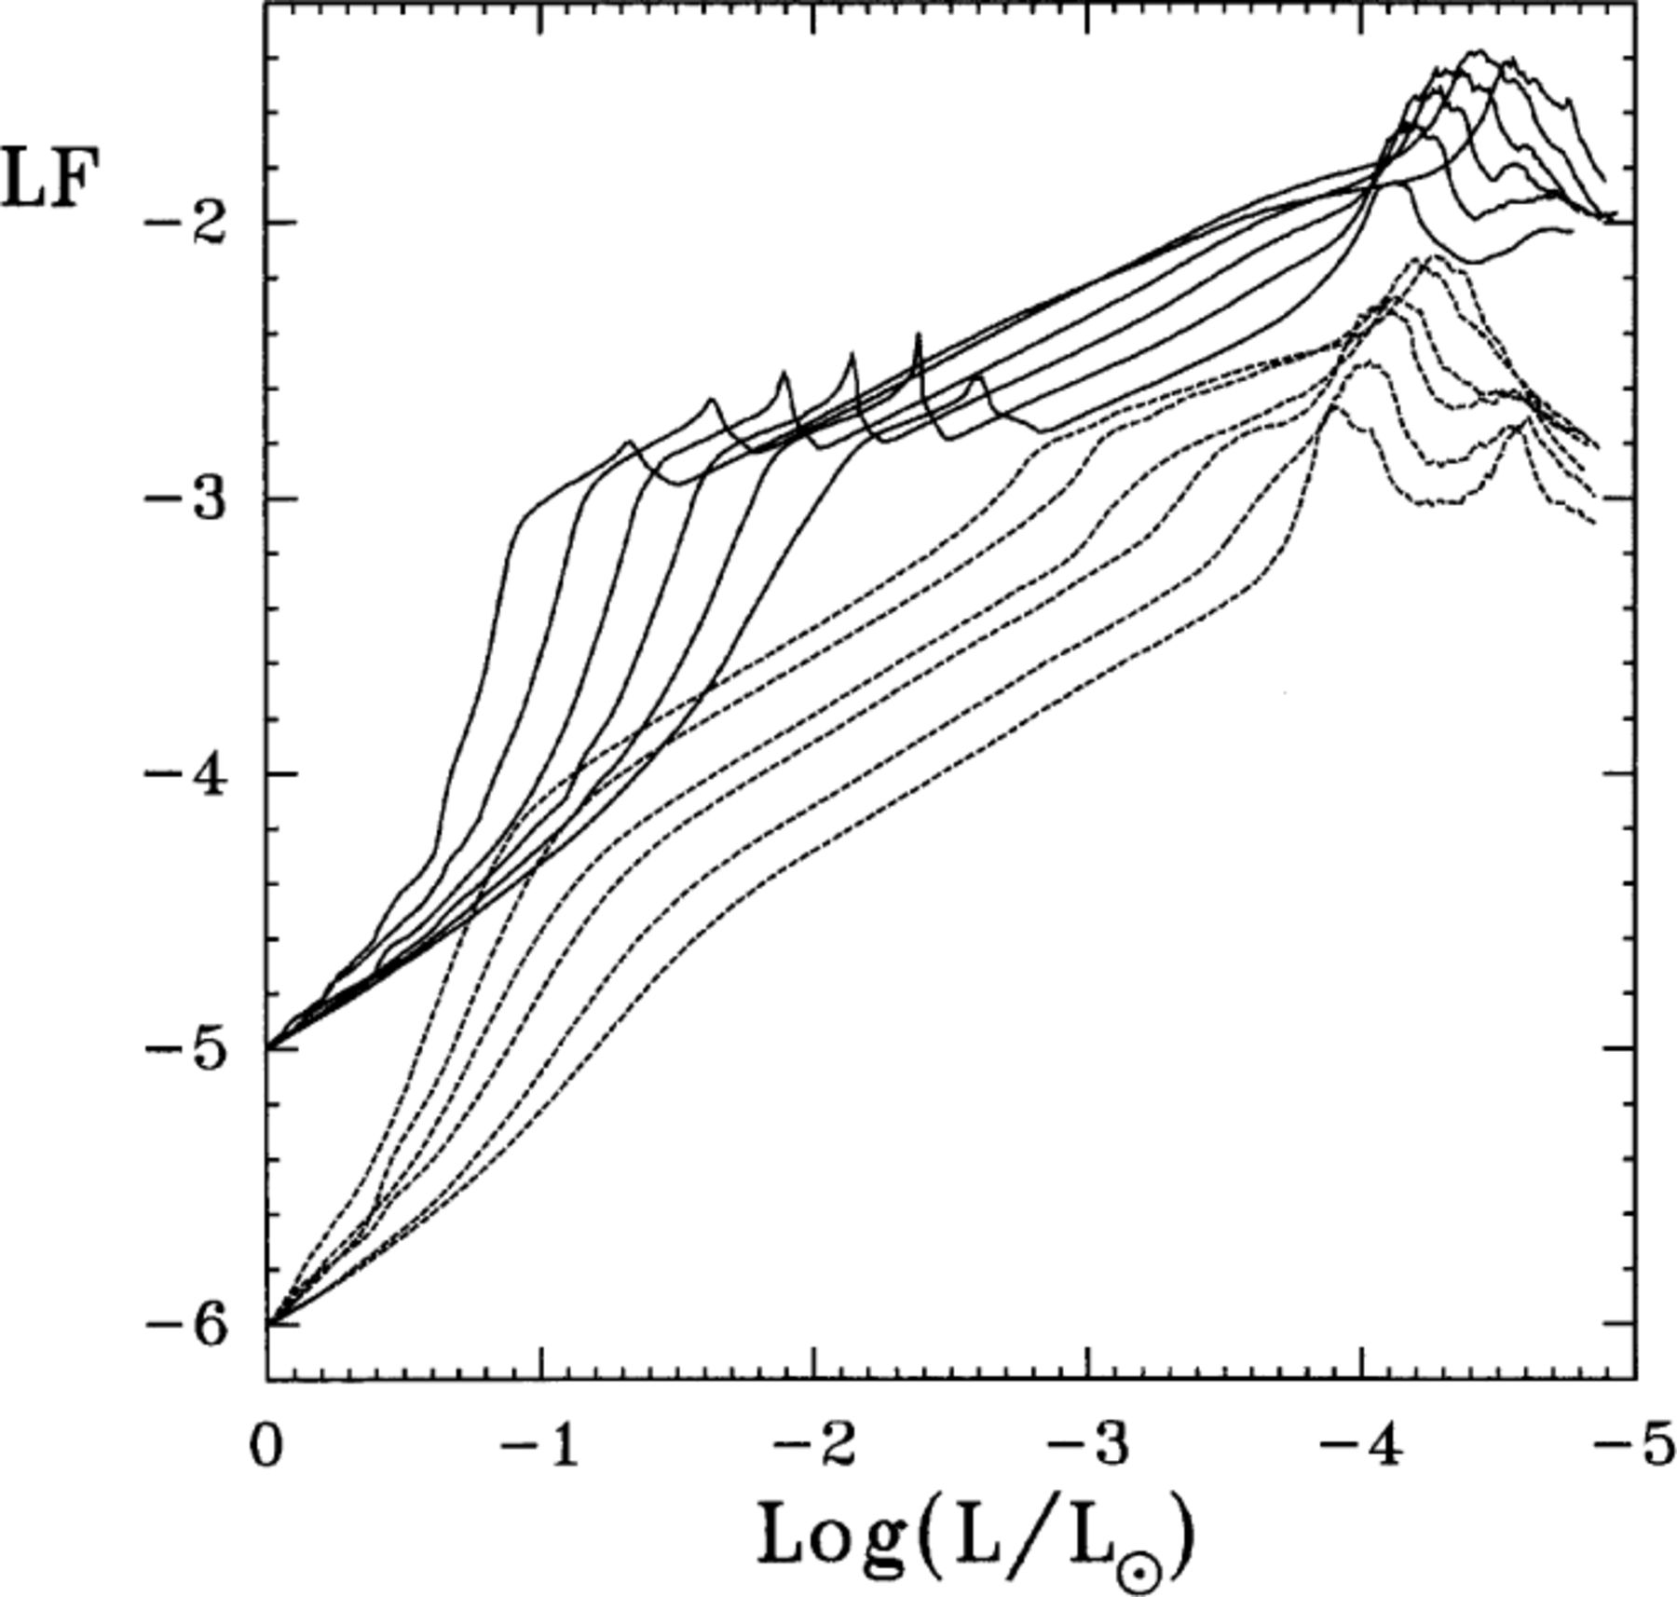
Figure 21. Single luminosity functions (normalized at log L/L⊙=0) in terms of surface luminosity for pure ...
Notes:
Figure 21. Single luminosity functions (normalized at log L/L⊙=0) in terms of surface luminosity for pure iron (full lines) and CO (dotted lines) DA models for stellar masses with (from bottom to top) M/M⊙=0.50, 0.60, 0.70, 0.80, 0.90 and 1.0. For the sake of clarity we have set arbitrarily LF=−5 and −6 for the two set of curves. For the spikes in the iron LFs, see text.
Unless provided in the caption above, the following copyright applies to the content of this slide: © 2000 RAS

