Slide 1
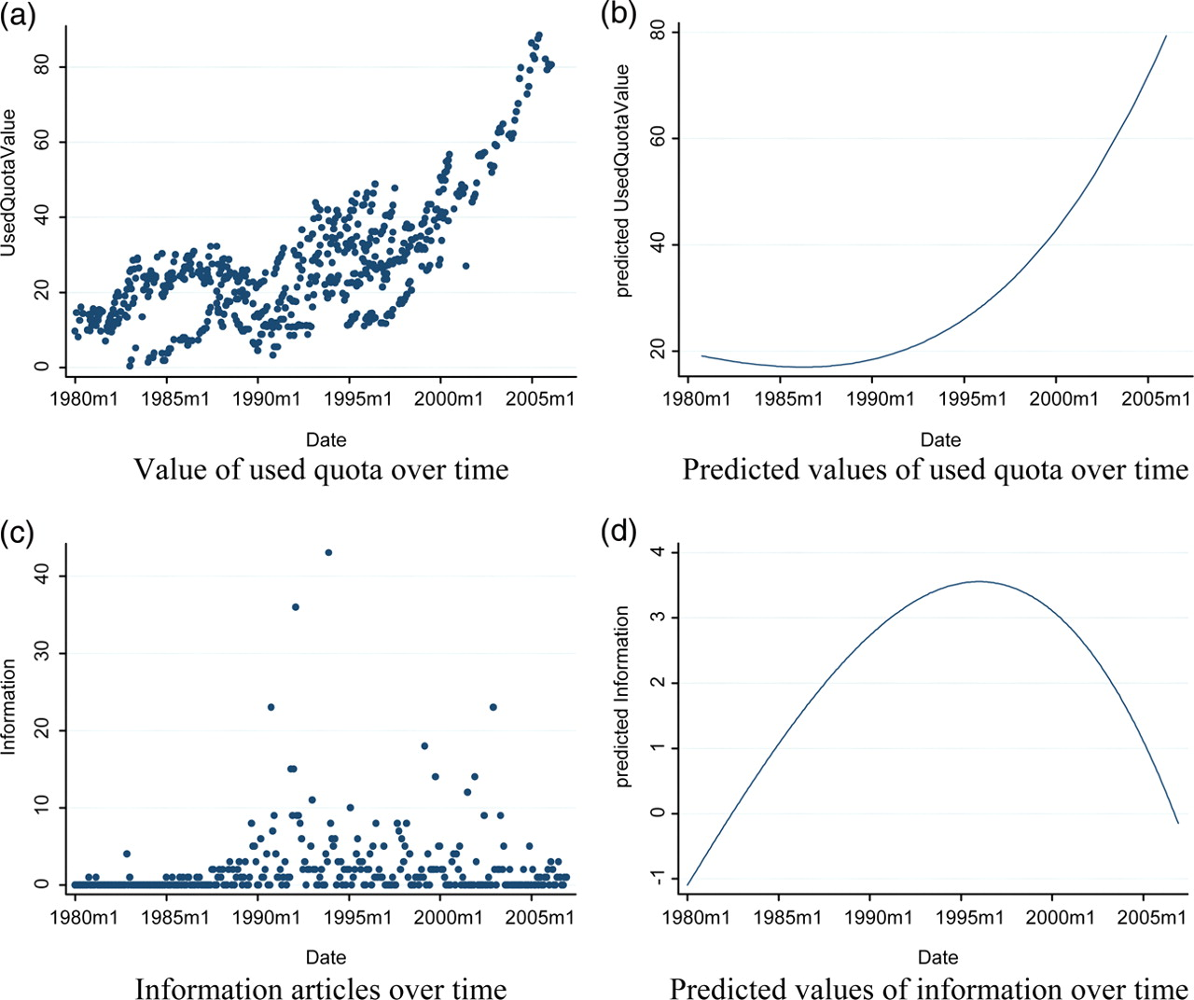
Figure 1. Graphic representation of pre- and post- WTO changes of key variables
Notes:
Figure 1. Graphic representation of pre- and post- WTO changes of key variables
Unless provided in the caption above, the following copyright applies to the content of this slide: © The Author(s) 2012. Published by Oxford University Press, on behalf of Agricultural and Applied Economics Association. All rights reserved. For permissions, please email: journals.permissions@oup.com.

