Slide 1
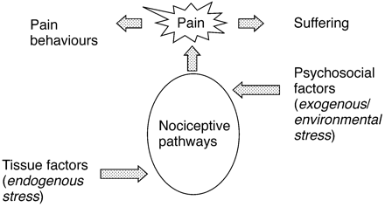
Fig 1 Processes of pain. Activity in nociceptive pathways leads to the experience of pain. Such activity can ...
Notes:
Fig 1 Processes of pain. Activity in nociceptive pathways leads to the experience of pain. Such activity can be stimulated or modified by both endogenous and exogenous stress. Endogenous stressors include damage and/or inflammation within both neuronal and non‐neuronal tissues whereas exogenous stress may be produced by psychosocial factors. The resultant pain behaviours and suffering can be measured and provide useful parameters for clinical assessment.
Unless provided in the caption above, the following copyright applies to the content of this slide:

Slide 2
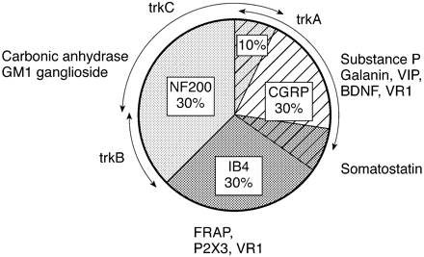
Fig 2 Pie chart summarizing the three main populations of DRG cells observed in rodents and their expression ...
Notes:
Fig 2 Pie chart summarizing the three main populations of DRG cells observed in rodents and their expression of neurotrophin receptors. Large diameter cells give rise to myelinated axons and have high levels of neurofilament (NF200). Small cells, with mainly unmyelinated axons, comprise the remaining two populations. One population of small cells constitutively synthesizes neuropeptides and responds to the growth factor, NGF, whereas the other expresses the lectin IB4 and responds to GDNF. Both small cell populations express the VR‐1 receptor and are thought to be nociceptors (figure kindly provided by J. V. Priestley).
Unless provided in the caption above, the following copyright applies to the content of this slide:

Slide 3
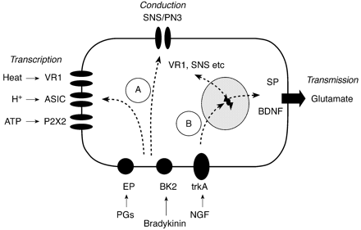
Fig 3 Influences on primary afferent neurones leading to ‘peripheral sensitization’. Under normal ...
Notes:
Fig 3 Influences on primary afferent neurones leading to ‘peripheral sensitization’. Under normal circumstances, high‐intensity stimuli are encoded by specialized membrane‐bound receptors. Conduction of message to central terminals and transmission to spinal neurones is mediated by ion channels and excitatory amino acids, respectively. (a) During the early stages of inflammation, mediators such as prostaglandins (PGs) and bradykinin (BK) change the sensitivity of receptors and reduce activation threshold for conducting ion‐channels. (b) Longer‐term changes include transcriptional events mediated by cytokines and growth factors resulting in enhanced production of receptors, ion channels and central transmitters/modulators (modified from reference 74).
Unless provided in the caption above, the following copyright applies to the content of this slide:

Slide 4
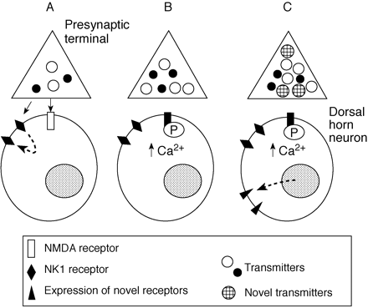
Fig 4 Development of ‘central sensitization’ in the spinal dorsal horn after inflammation of peripheral ...
Notes:
Fig 4 Development of ‘central sensitization’ in the spinal dorsal horn after inflammation of peripheral tissues. (a) Early phase with activation of C fibres: Glutamate (open spheres) and substance P (black spheres) are released from C fibres. Glutamate and substance P NK1 receptors are activated in dorsal horn neurones with the latter undergoing internalization and recirculation to the membrane. (b) Sensitization phase: Pre‐synaptic up‐regulation of neurotransmitter production together with ongoing activity in C fibres results in increased transmitter release with sustained influx of Ca2+ ions into dorsal horn neurones. Phosphorylation of the NMDA receptor by activated kinases allows the NMDA receptor to operate at resting membrane potential level and further enhances the accumulation of intracellular Ca2+. (c) Established phase of chronic inflammatory pain. Synthesis of novel transmitters, growth factors and ion channels may lead to phenotypic changes within the nociceptive system (e.g. production of substance P in large fibres).
Unless provided in the caption above, the following copyright applies to the content of this slide:

