Slide 1
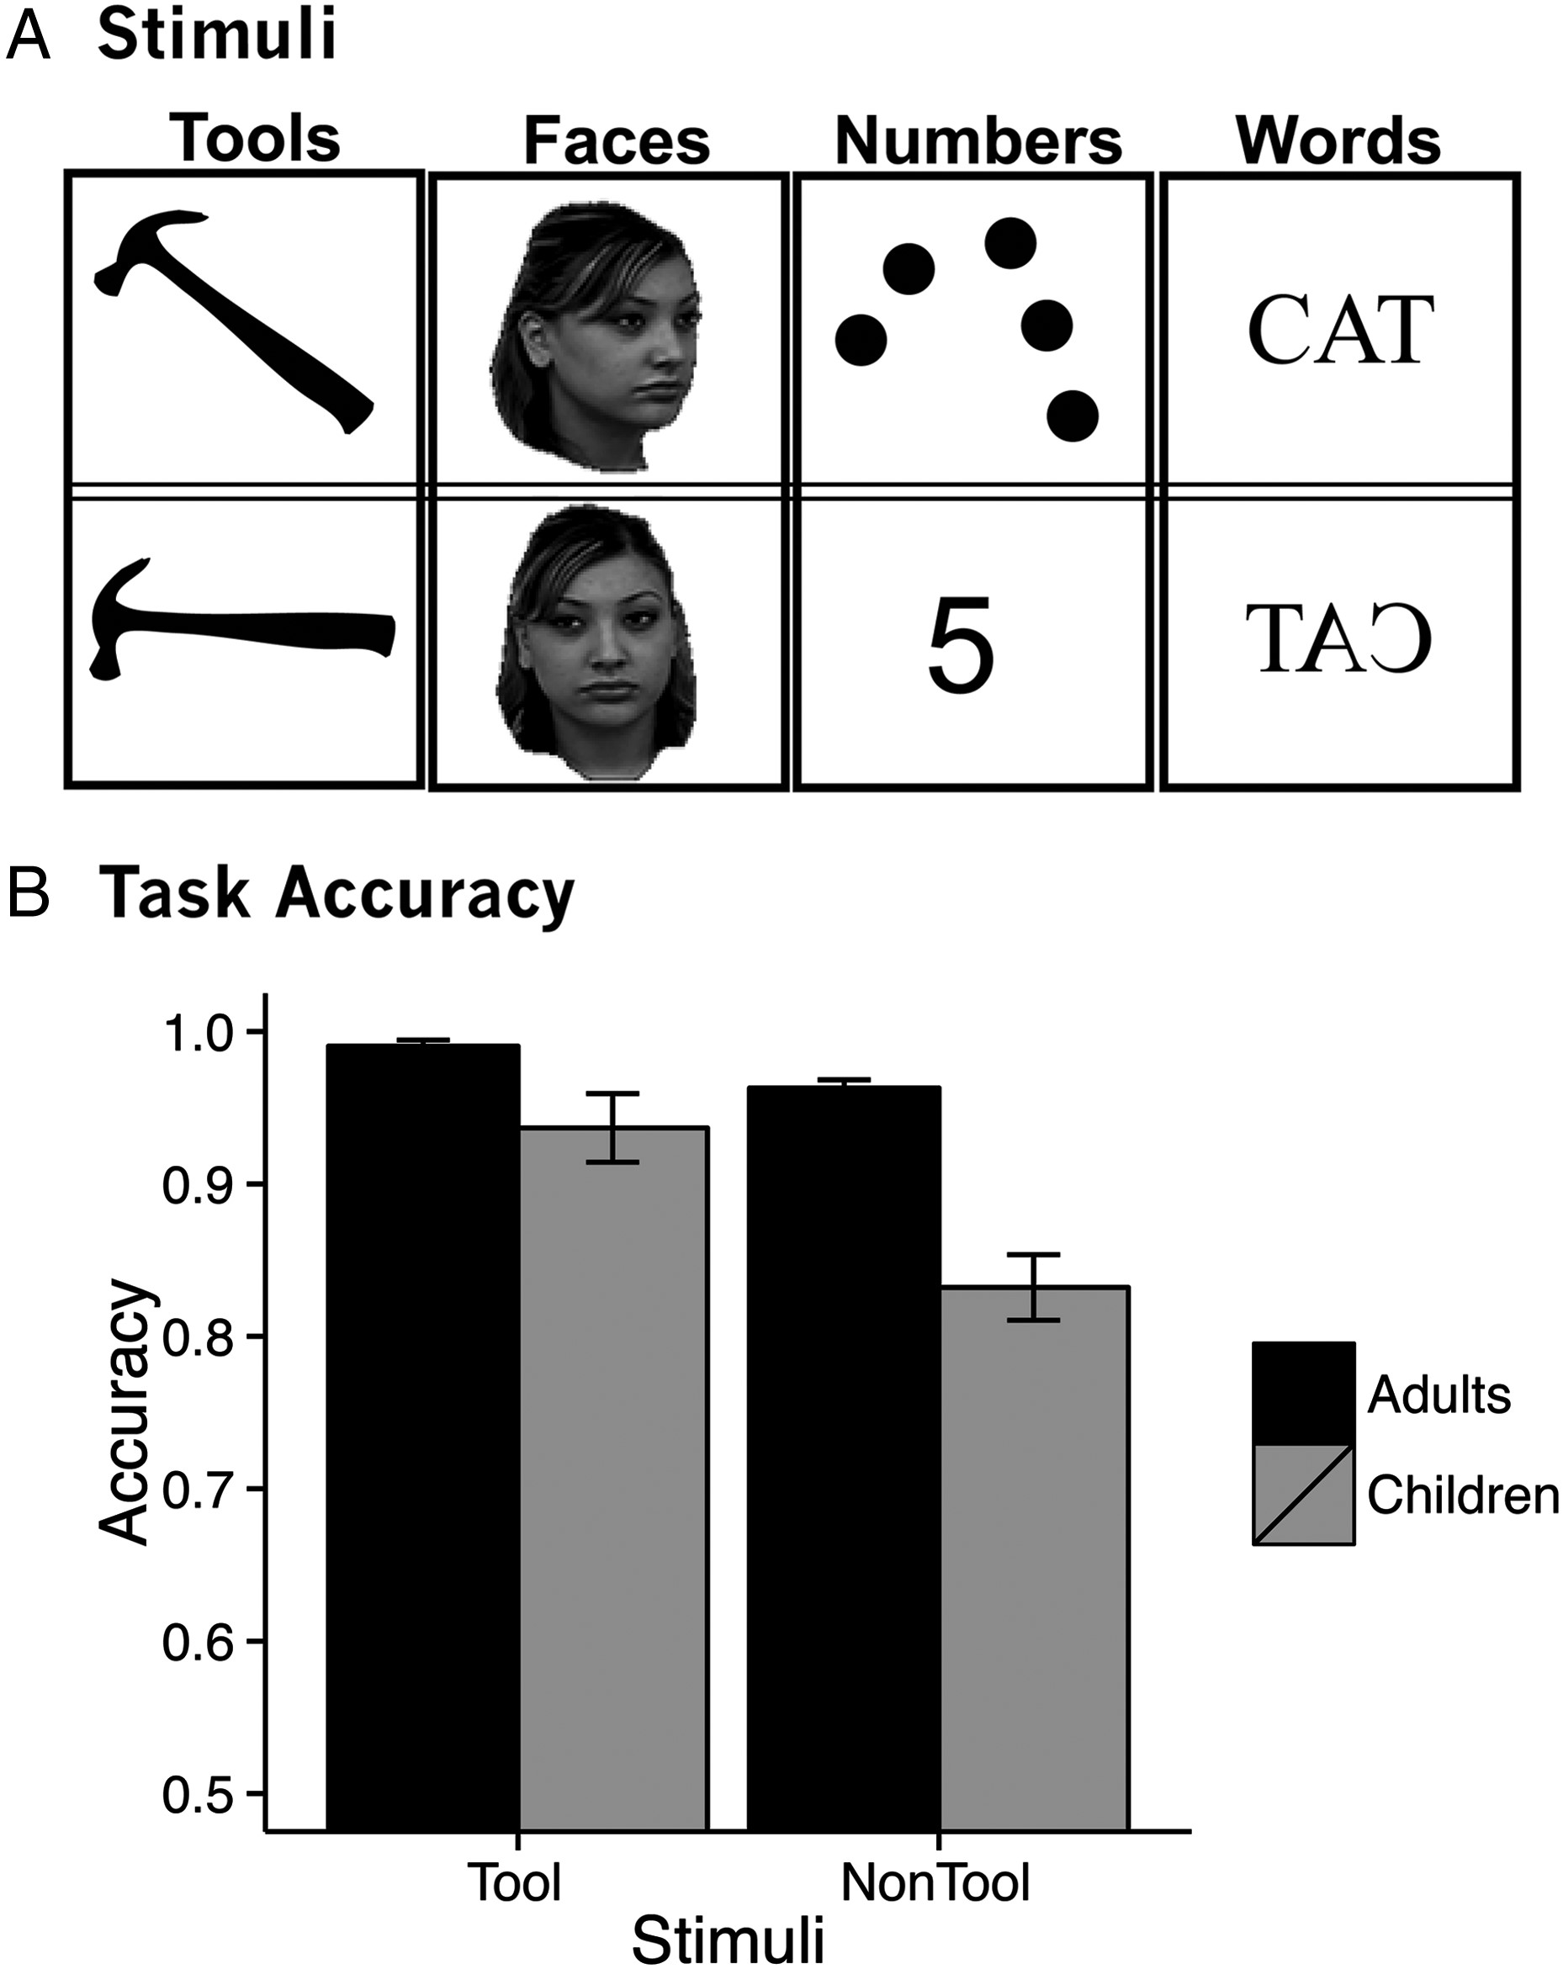
Figure 1. (A) Example stimuli and (B) accuracy from fMRI matching task.
Notes:
Figure 1. (A) Example stimuli and (B) accuracy from fMRI matching task.
Unless provided in the caption above, the following copyright applies to the content of this slide: © The Author 2015. Published by Oxford University Press. All rights reserved. For Permissions, please e-mail: journals.permissions@oup.com

Slide 2
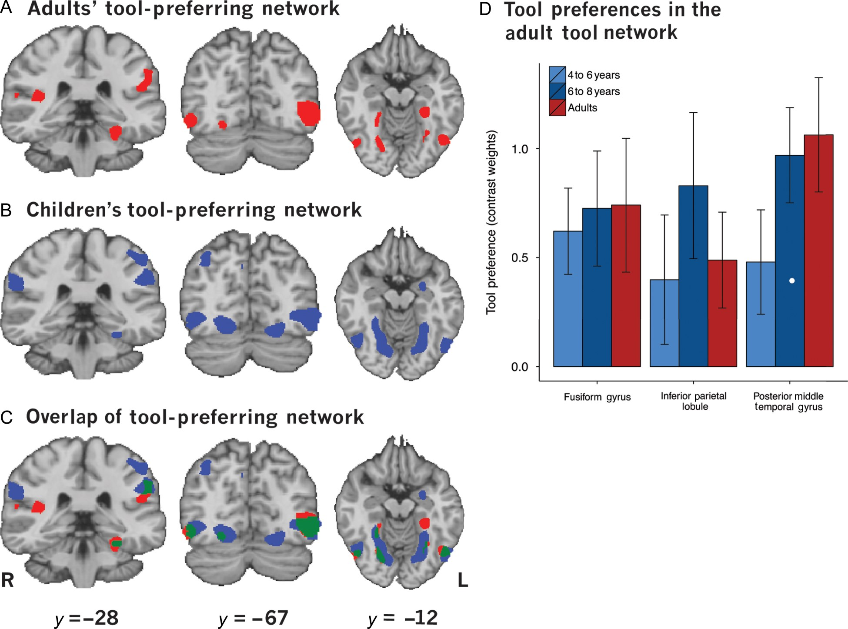
Figure 2. Tool-preferring regions identified by a contrast of tools > faces, numbers, and words at P < 0.005. (A) The ...
Notes:
Figure 2. Tool-preferring regions identified by a contrast of tools > faces, numbers, and words at P < 0.005. (A) The tool-preferring network in adults. (B) The tool-preferring network in children. (C) Overlap of the adult and child tool-preferring networks. (D) Contrast weights in the adult tool network.
Unless provided in the caption above, the following copyright applies to the content of this slide: © The Author 2015. Published by Oxford University Press. All rights reserved. For Permissions, please e-mail: journals.permissions@oup.com

Slide 3
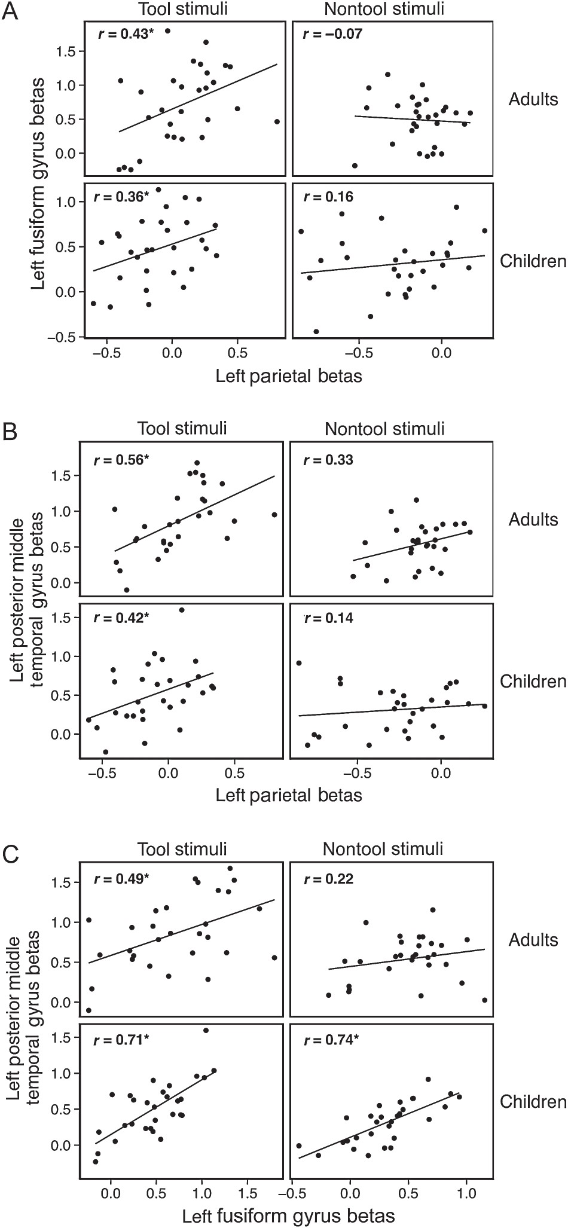
Figure 3. Inter-region correlations for adult data between the left inferior parietal lobule and the left fusiform ...
Notes:
Figure 3. Inter-region correlations for adult data between the left inferior parietal lobule and the left fusiform gyrus (A), the left posterior middle temporal gyrus (B), and between the left fusiform gyrus and the left posterior middle temporal gyrus (C) for tool stimuli (column 1) and nontool stimuli (column 2). Correlation values (r) are indicated on each scatterplot. Significant correlations are indicated by asterisks following the R-values. Adult data are depicted in the top row of each panel, and the data from children are in the bottom row of each panel. Within the adult tool network, significant correlations were observed for tool-related stimuli in children and adults. Nontool stimuli were only correlated for children between the left posterior middle temporal gyrus and the left fusiform gyrus.
Unless provided in the caption above, the following copyright applies to the content of this slide: © The Author 2015. Published by Oxford University Press. All rights reserved. For Permissions, please e-mail: journals.permissions@oup.com

Slide 4
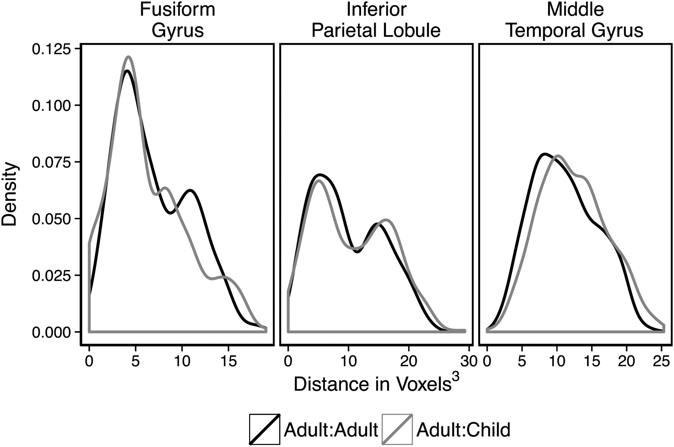
Figure 4. Distributions of distances between peak voxels as calculated from one adult's peak to another's peak and from ...
Notes:
Figure 4. Distributions of distances between peak voxels as calculated from one adult's peak to another's peak and from one adult's peak to a child's peak. Adult-to-child peak distance distributions were similar to adult-to-adult peak distance distributions in the inferior parietal lobule. In the medial fusiform gyrus, average adult-to-child distance was lower than the average for adult-to-adult. However, in the left posterior middle temporal gyrus, the average of adult-to-child was larger than the average for adult-to-adult.
Unless provided in the caption above, the following copyright applies to the content of this slide: © The Author 2015. Published by Oxford University Press. All rights reserved. For Permissions, please e-mail: journals.permissions@oup.com

Slide 5
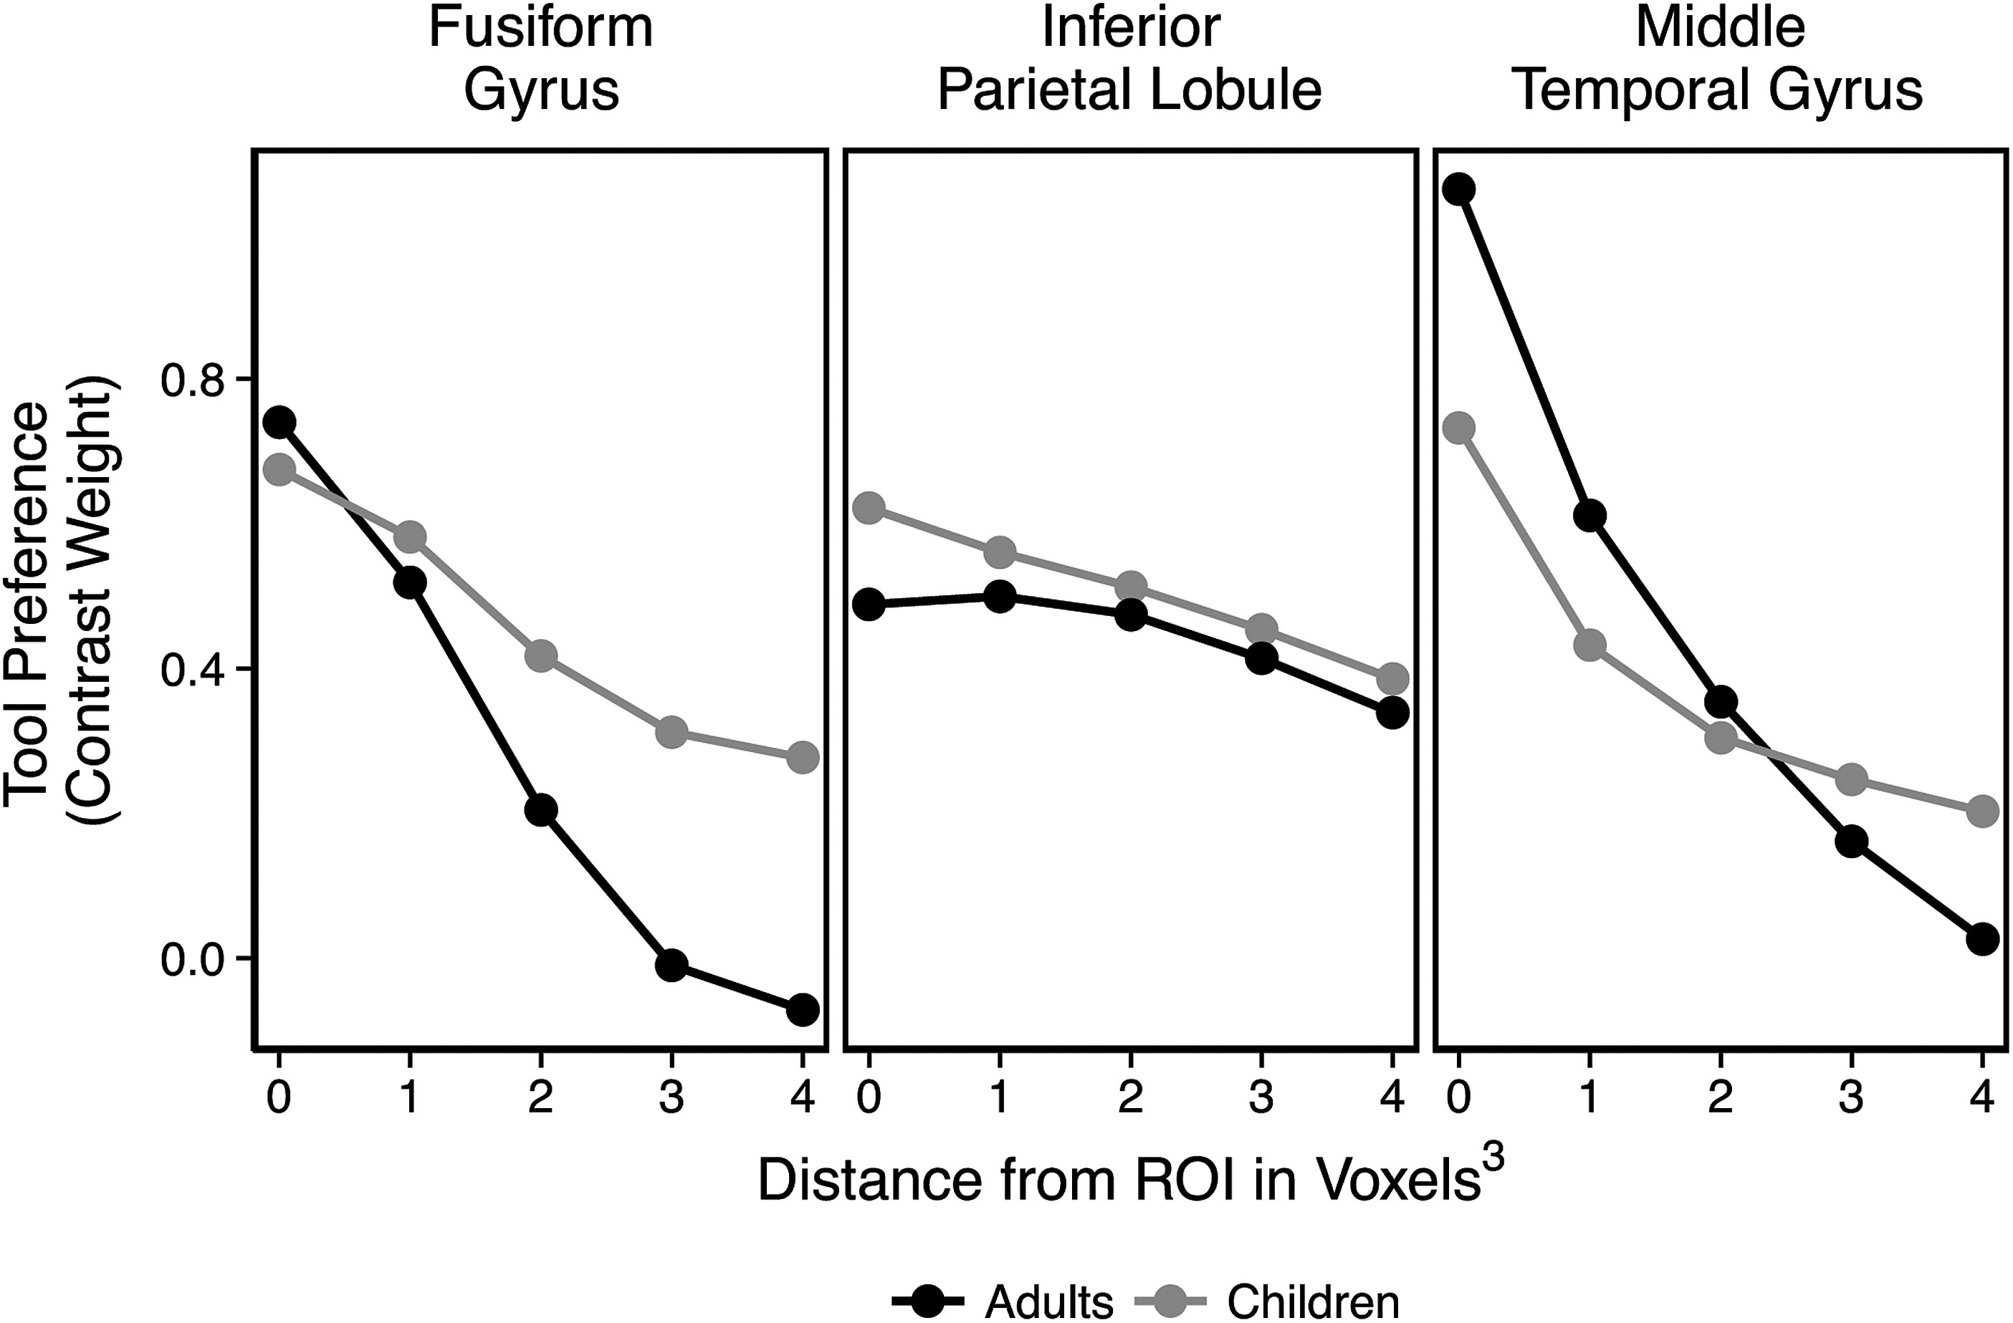
Figure 5. Contrast-weighted t-values in ROIs and surrounding concentric rings of 1–4 voxels from the original ROI. ...
Notes:
Figure 5. Contrast-weighted t-values in ROIs and surrounding concentric rings of 1–4 voxels from the original ROI. Children activated more diffuse regions than adults in the middle temporal gyrus, but not in the inferior parietal lobule or fusiform gyrus. There was a notable, but nonsignificant, trend in the fusiform gyrus for more diffuse tool preferences in children compared with adults.
Unless provided in the caption above, the following copyright applies to the content of this slide: © The Author 2015. Published by Oxford University Press. All rights reserved. For Permissions, please e-mail: journals.permissions@oup.com

