Slide 1
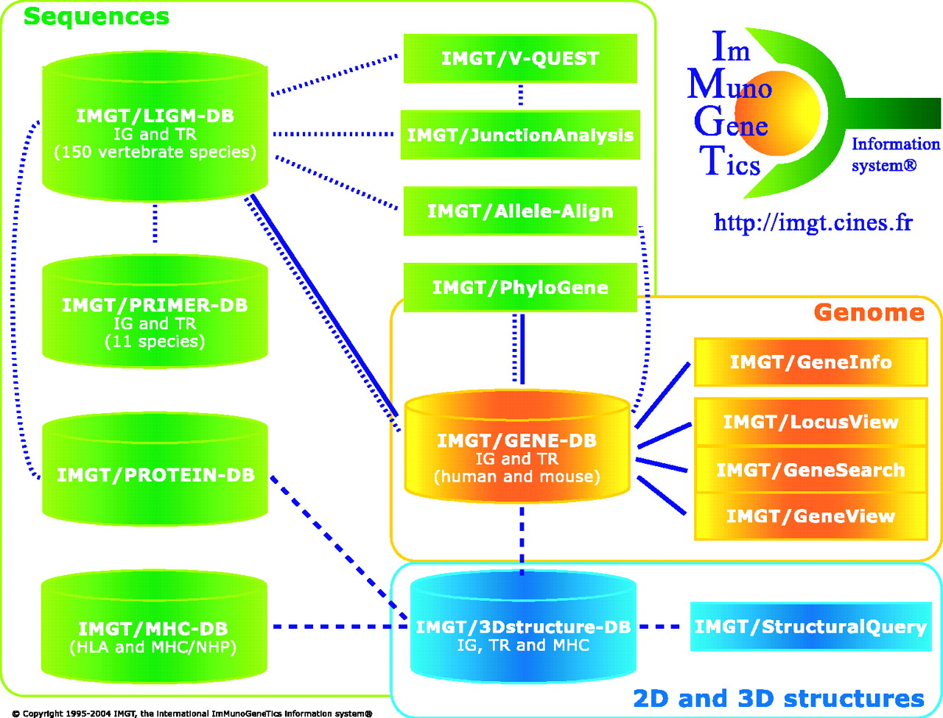
Figure 1. The IMGT international ImMunoGeneTics information system ® ( http://imgt.cines.fr ). Genomics, ...
Notes:
Figure 1. The IMGT international ImMunoGeneTics information system ® ( http://imgt.cines.fr ). Genomics, genetics and structural components (databases and tools) are in yellow, green and blue, respectively. The IMGT Repertoire and other Web resources are not shown. Interactions in the genomics, genetics and structural approaches are represented with continuous, dotted and broken lines, respectively.
Unless provided in the caption above, the following copyright applies to the content of this slide: © 2005, the authors Nucleic Acids Research, Vol. 33, Database issue © Oxford University Press 2005; all rights reserved

