Slide 1
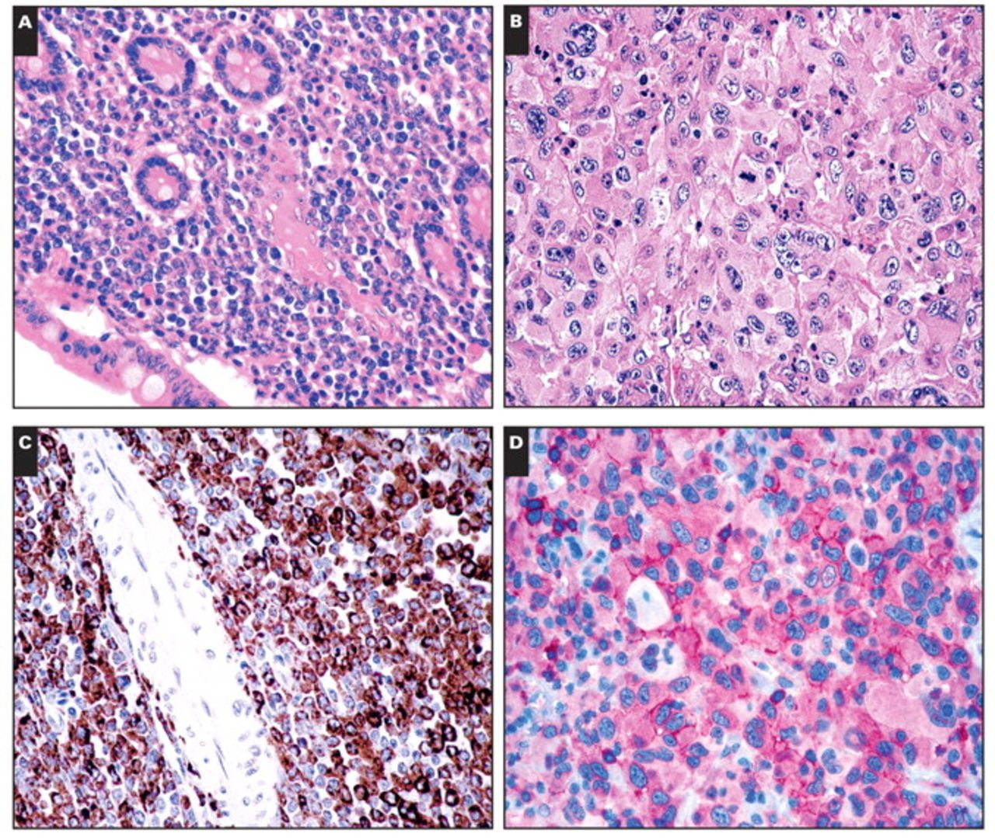
Image 1 A, Myeloid sarcoma (MS) involving the ileum (H&E, ×200). B, MS with megakaryoblastic differentiation. The ...
Notes:
Image 1 A, Myeloid sarcoma (MS) involving the ileum (H&E, ×200). B, MS with megakaryoblastic differentiation. The neoplasm is composed of large cells and multinucleated giant elements with abundant eosinophilic cytoplasm (H&E, ×400). C, MS of the ileum: positivity for CD68-KP1 (immunoperoxidase, ×200). D, Diffuse expression of the linker of activated T lymphocyte molecule in megakaryoblastic MS (immunoalkaline phosphatase, ×400). E, Myelomonocytic MS of the skin. The tumor involves the dermis with perivascular and periadnexal distribution (H&E, ×40). Inset, Cytologic details (H&E, ×400). F, Mediastinal MS with infiltration of the lymphatic vessels (H&E, ×100). Inset, The cells are medium-sized with dispersed chromatin and prominent nucleoli (H&E, ×600).
Unless provided in the caption above, the following copyright applies to the content of this slide: © American Society for Clinical Pathology

Slide 2
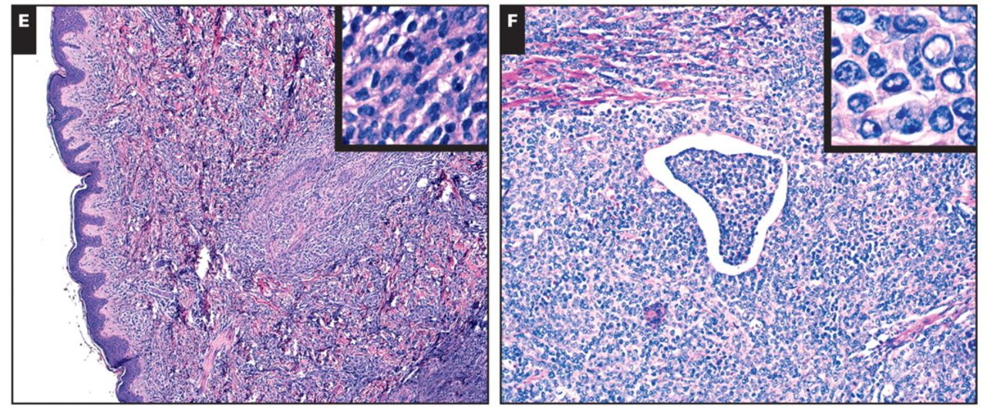
Image 1 A, Myeloid sarcoma (MS) involving the ileum (H&E, ×200). B, MS with megakaryoblastic differentiation. The ...
Notes:
Image 1 A, Myeloid sarcoma (MS) involving the ileum (H&E, ×200). B, MS with megakaryoblastic differentiation. The neoplasm is composed of large cells and multinucleated giant elements with abundant eosinophilic cytoplasm (H&E, ×400). C, MS of the ileum: positivity for CD68-KP1 (immunoperoxidase, ×200). D, Diffuse expression of the linker of activated T lymphocyte molecule in megakaryoblastic MS (immunoalkaline phosphatase, ×400). E, Myelomonocytic MS of the skin. The tumor involves the dermis with perivascular and periadnexal distribution (H&E, ×40). Inset, Cytologic details (H&E, ×400). F, Mediastinal MS with infiltration of the lymphatic vessels (H&E, ×100). Inset, The cells are medium-sized with dispersed chromatin and prominent nucleoli (H&E, ×600).
Unless provided in the caption above, the following copyright applies to the content of this slide: © American Society for Clinical Pathology

Slide 3
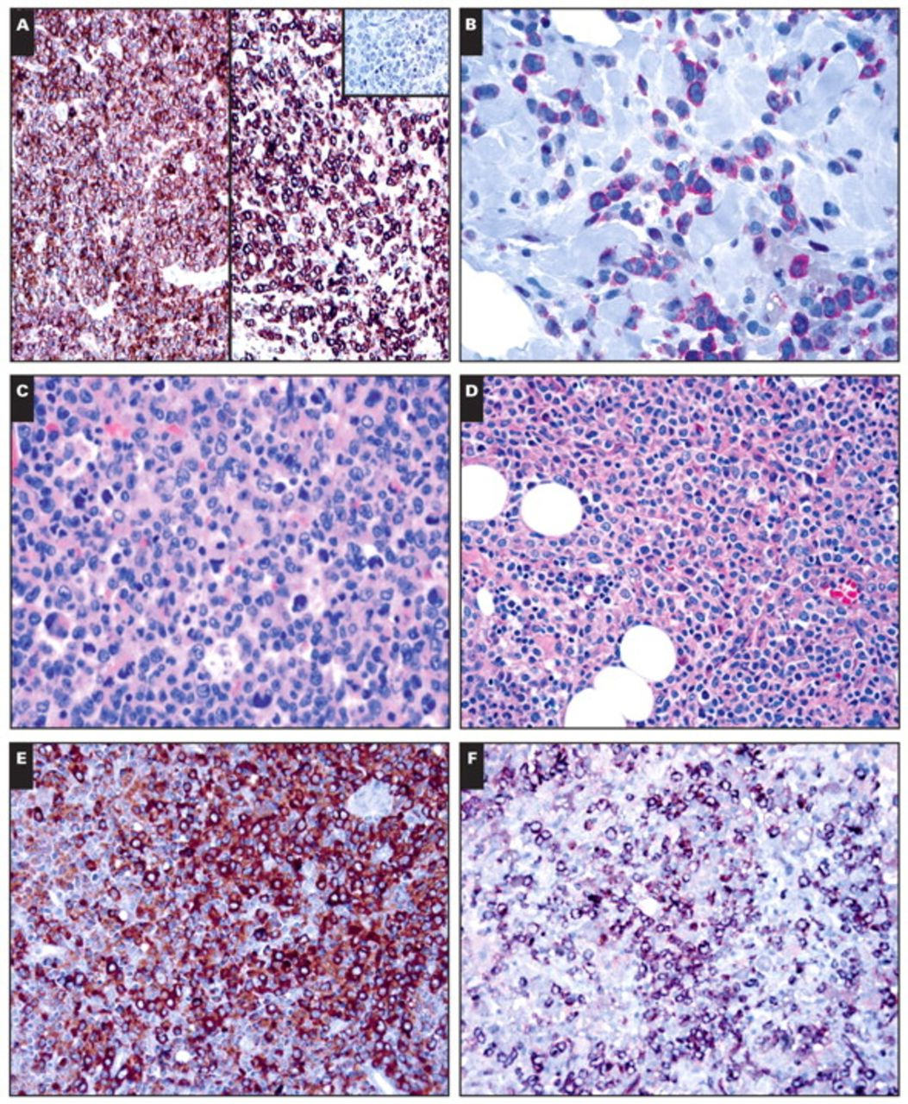
Image 2 A, Myeloid sarcoma (MS) of the mediastinum. The tumor expresses CD33 (left) and CD163 (right) ...
Notes:
Image 2 A, Myeloid sarcoma (MS) of the mediastinum. The tumor expresses CD33 (left) and CD163 (right) (immunoperoxidase, ×200) and is negative for CD123 (inset, ×100). B, Nucleophosmin staining in an MS of the gallbladder. Note the cytoplasmic expression of the protein (immunoalkaline phosphatase, ×400). C, Nodal MS in a patient affected by chronic myelogenous leukemia. The neoplastic population is arranged in sheets of blasts admixed with megakaryocytes (H&E, ×200). D, Nodal MS with myelomonocytic features (H&E, ×200). In the same case, positivity for myeloperoxidase (E) and CD34 (F) (E and F, immunoperoxidase, ×200).
Unless provided in the caption above, the following copyright applies to the content of this slide: © American Society for Clinical Pathology

Slide 4
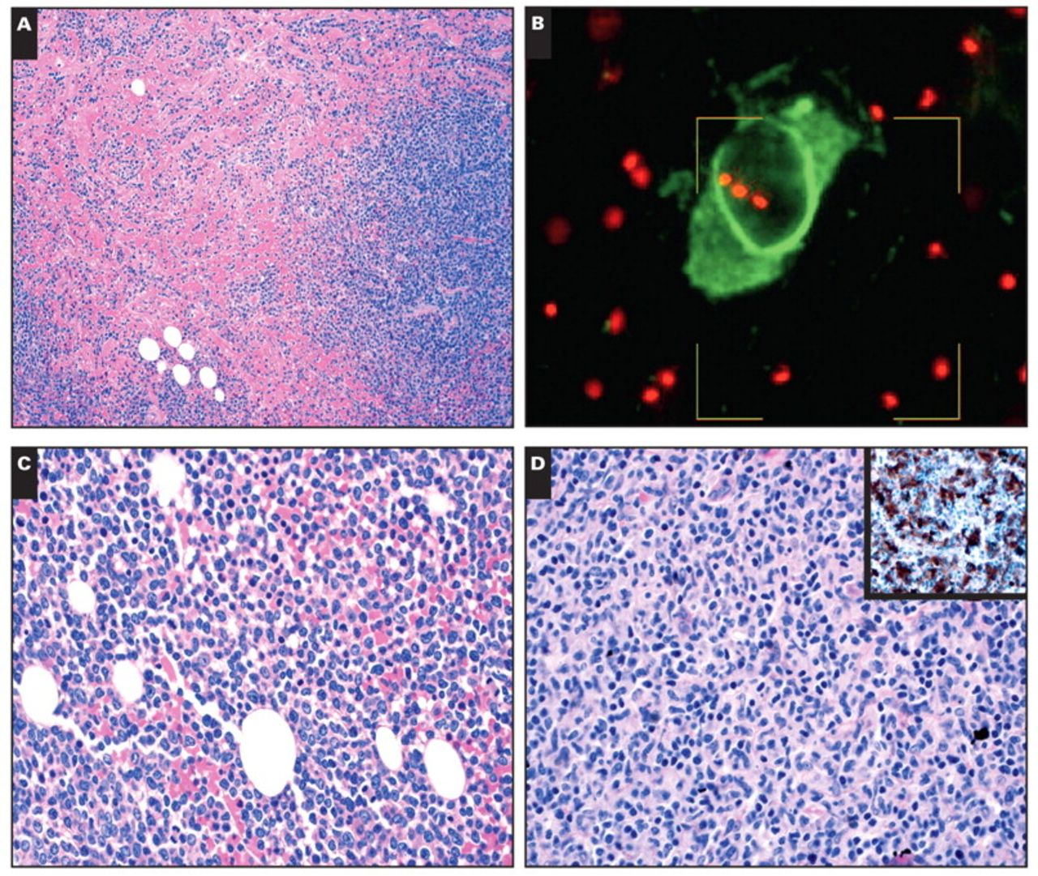
Image 3 A, Myeloid sarcoma (MS) of the breast skin in a woman affected by chronic myelomonocytic leukemia (H&E, ...
Notes:
Image 3 A, Myeloid sarcoma (MS) of the breast skin in a woman affected by chronic myelomonocytic leukemia (H&E, ×100). B, Trisomy 8 detected by fluorescence in situ hybridization analysis in MS and concurrent Langerhans cell histiocytosis. C, Acute myeloid leukemia, M4, in the bone marrow. Blasts have round to folded nuclear contours, finely dispersed chromatin, and agranular cytoplasm (H&E, ×200). D, In the same case, the extramedullary manifestation shows differentiation to interdigitating dendritic cells (H&E, ×200) that is confirmed by S-100 protein expression (inset, ×100). E, Partial effacement of the nodal paracortex by clusters of mature plasmacytoid dendritic cells highlighted by CD68-PGM1 staining (immunoperoxidase, ×100). F, Sheets of basophilic blasts located in the nodal paracortex (H&E, ×100). Inset, Their erythroid nature is demonstrated by glycophorin C immunostain (×400).
Unless provided in the caption above, the following copyright applies to the content of this slide: © American Society for Clinical Pathology

Slide 5
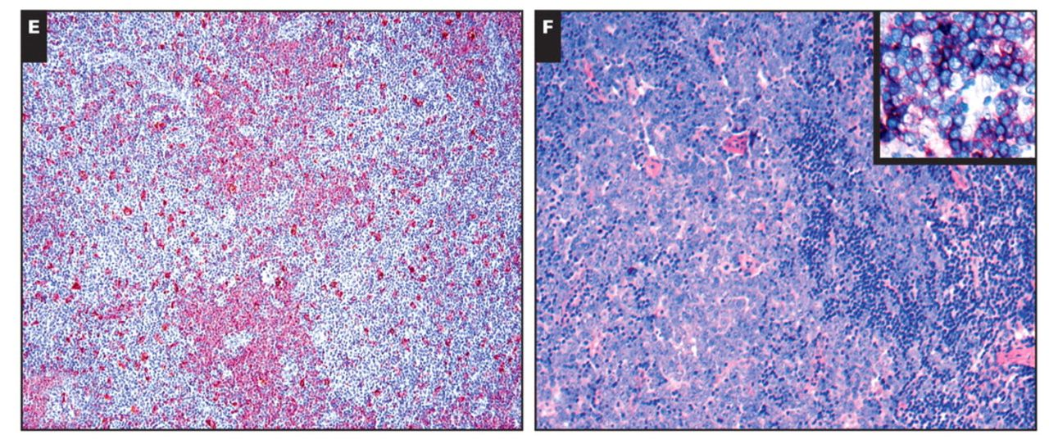
Image 3 A, Myeloid sarcoma (MS) of the breast skin in a woman affected by chronic myelomonocytic leukemia (H&E, ...
Notes:
Image 3 A, Myeloid sarcoma (MS) of the breast skin in a woman affected by chronic myelomonocytic leukemia (H&E, ×100). B, Trisomy 8 detected by fluorescence in situ hybridization analysis in MS and concurrent Langerhans cell histiocytosis. C, Acute myeloid leukemia, M4, in the bone marrow. Blasts have round to folded nuclear contours, finely dispersed chromatin, and agranular cytoplasm (H&E, ×200). D, In the same case, the extramedullary manifestation shows differentiation to interdigitating dendritic cells (H&E, ×200) that is confirmed by S-100 protein expression (inset, ×100). E, Partial effacement of the nodal paracortex by clusters of mature plasmacytoid dendritic cells highlighted by CD68-PGM1 staining (immunoperoxidase, ×100). F, Sheets of basophilic blasts located in the nodal paracortex (H&E, ×100). Inset, Their erythroid nature is demonstrated by glycophorin C immunostain (×400).
Unless provided in the caption above, the following copyright applies to the content of this slide: © American Society for Clinical Pathology

