Slide 1
Figure 1. Subject pairings based upon performance scores from (A) VP (VP: area judgment) and (B) ER (ER: word ...
Notes:
Figure 1. Subject pairings based upon performance scores from (A) VP (VP: area judgment) and (B) ER (ER: word recognition) tasks.
Unless provided in the caption above, the following copyright applies to the content of this slide: © The Author 2007. Published by Oxford University Press. All rights reserved. For permissions, please e-mail: journals.permissions@oxfordjournals.org

Slide 2
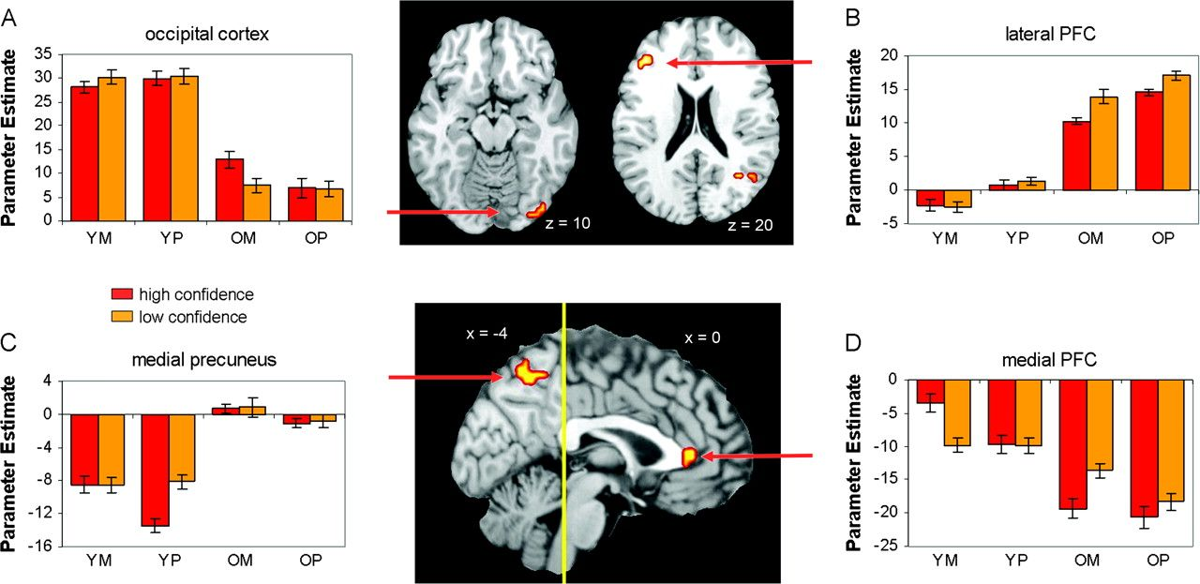
Figure 2. The PASA pattern for activations: across 2 different tasks and 2 levels of confidence, the occipital cortex ...
Notes:
Figure 2. The PASA pattern for activations: across 2 different tasks and 2 levels of confidence, the occipital cortex showed greater activity in younger than in older adults A, whereas PFC showed the opposite pattern (B). The PASA pattern for deactivations: across 2 different tasks and 2 levels of confidence, posterior midline cortex (precuneus, C) showed greater deactivations in younger than older adults, whereas the anterior midline cortex (medial PFC, D) showed the opposite pattern. Notes: Activation bars represent effect size for each modeled effect, and error bars represent standard error for peak activity across participants. For coordinates of peak activity within displayed regions, please see Table 4.
Unless provided in the caption above, the following copyright applies to the content of this slide: © The Author 2007. Published by Oxford University Press. All rights reserved. For permissions, please e-mail: journals.permissions@oxfordjournals.org

Slide 3
Figure 3. (A) Correlation between occipital activations and frontal activations in younger and older adults. Consistent ...
Notes:
Figure 3. (A) Correlation between occipital activations and frontal activations in younger and older adults. Consistent with the compensation account of PASA, older (but not younger) adults showed less occipital activity showed more frontal activity. The general pattern of these correlations also reinforces the main effects presented in Figure 2. (B) Correlation between frontal activity and performance in the ER and VP tasks (based on composite performance). Consistent with the compensation account of PASA, older adults who showed greater frontal recruitment showed better cognitive performance. Notes: Each data point represents one older adult, with activity collapsed across task and confidence.
Unless provided in the caption above, the following copyright applies to the content of this slide: © The Author 2007. Published by Oxford University Press. All rights reserved. For permissions, please e-mail: journals.permissions@oxfordjournals.org

