Slide 1
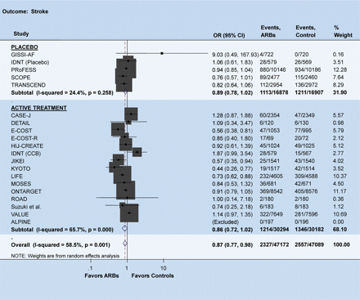
Figure 1 Odds ratio for stroke. There was a significant reduction in the risk of stroke with ARBs compared with ...
Notes:
Figure 1 Odds ratio for stroke. There was a significant reduction in the risk of stroke with ARBs compared with controls. The size of the markers represents the weight of each trial. Meta-analysis was performed using the search terms ‘angiotensin receptor blockers’ with the inclusion criteria of being a randomized comparison with follow-up for at least 1 year, enrolling non-heart failure patients and evaluating outcomes of interest.
Unless provided in the caption above, the following copyright applies to the content of this slide: Published on behalf of the European Society of Cardiology. All rights reserved. © The Author 2009. For permissions please email: journals.permissions@oxfordjournals.org

Slide 2
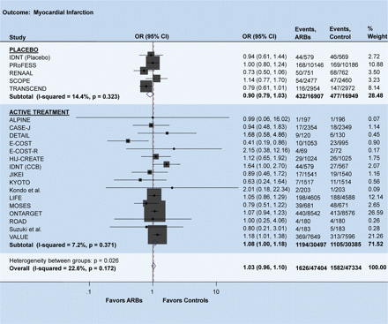
Figure 2 Odds ratio for myocardial infarction. There was a trend towards increased risk of myocardial infarction with ...
Notes:
Figure 2 Odds ratio for myocardial infarction. There was a trend towards increased risk of myocardial infarction with ARBs compared with the active treatment group. The size of the markers represents the weight of each trial.
Unless provided in the caption above, the following copyright applies to the content of this slide: Published on behalf of the European Society of Cardiology. All rights reserved. © The Author 2009. For permissions please email: journals.permissions@oxfordjournals.org

