Slide 1
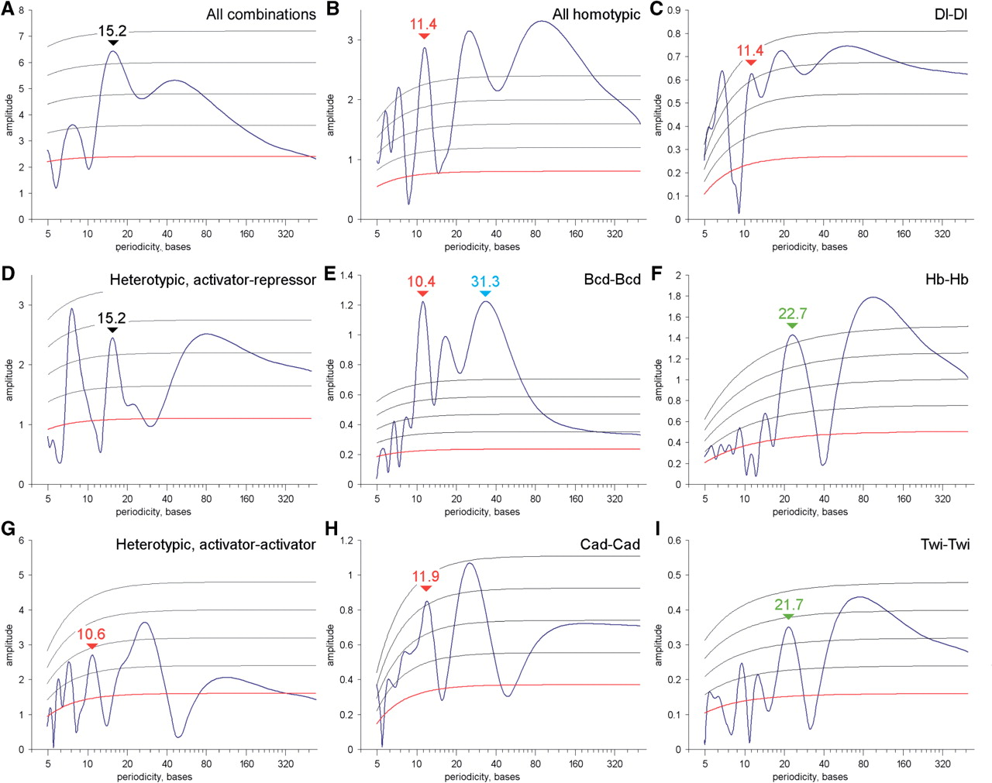
Figure 1. Periodic distribution of binding sites in fly enhancers. Fourier analysis of distance histograms reveals ...
Notes:
Figure 1. Periodic distribution of binding sites in fly enhancers. Fourier analysis of distance histograms reveals periodic distribution of binding sites. All helical signals are marked by red (one DNA turn), green (two turns) or blue (three turns) labels. Black labels mark anti-helical signals, numbers above show periodicities. Red gridline show expectation, grey gridlines show standard deviations, found from bootstrapping positions of the binding site matches in each enhancer. (A) Spectrum for all motif combinations; (B) Spectrum for homotypic motif pairs: Bcd–Bcd, Brk–Brk, Cad–Cad, Dl–Dl, Gt–Gt, Hb–Hb, Kni–Kni, Kr–Kr, Sna–Sna, Twi–Twi, Vnd–Vnd, Zen–Zen. (C, E, F, H and I) Spectra constructed for individual homotypic motif pairs. (D) Spectrum for heterotypic activator–repressor motif pairs combined from AP activators (Bcd, Cad, Hb)—AP repressors (Gt, Kr, Kni), and DV activators (Dl, Twi, Zen)—DV repressors (Brk, Vnd, Sna). (G) Spectrum constructed for relevant heterotypic activator–activator motif pairs: Bcd–Cad, Bcd–Hb, Cad–Hb, Dl–Twi, Dl–Zen, Twi–Zen.
Unless provided in the caption above, the following copyright applies to the content of this slide: © 2009 The Author(s)This is an Open Access article distributed under the terms of the Creative Commons Attribution Non-Commercial License (http://creativecommons.org/licenses/by-nc/2.0/uk/) which permits unrestricted non-commercial use, distribution, and reproduction in any medium, provided the original work is properly cited.

Slide 2
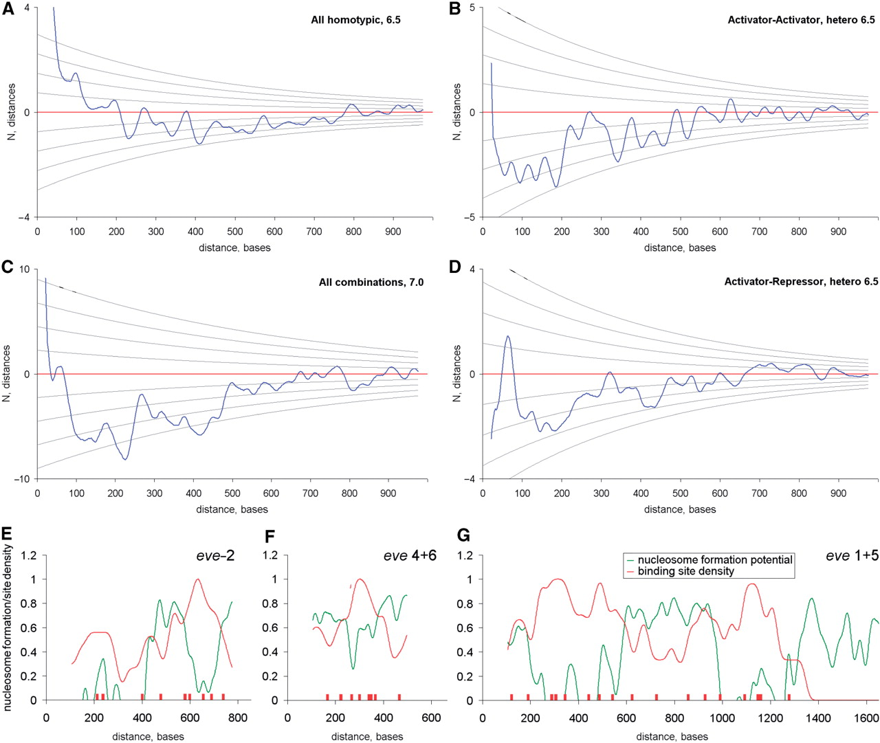
Figure 2. Long-range dependencies in the binding site distributions. (A–D) show differential long-range distance ...
Notes:
Figure 2. Long-range dependencies in the binding site distributions. (A–D) show differential long-range distance histograms (ΔN = Nobserved – Nexpected) for selected homo- and heterotypic motif combinations. Gridlines on A–D show standard deviations, σ. Both ΔN and σ were computed by bootstrapping positions of the binding site matches in each enhancer. Two distance depleted regions in the ranges 100–250 and 300–450 on (C) may represent generalized nucleosomal footprint in all enhancers. (E–G). Enhancers of even-skipped display negative agreement between the site density (red line) and the nucleosome formation potential (green line).
Unless provided in the caption above, the following copyright applies to the content of this slide: © 2009 The Author(s)This is an Open Access article distributed under the terms of the Creative Commons Attribution Non-Commercial License (http://creativecommons.org/licenses/by-nc/2.0/uk/) which permits unrestricted non-commercial use, distribution, and reproduction in any medium, provided the original work is properly cited.

Slide 3
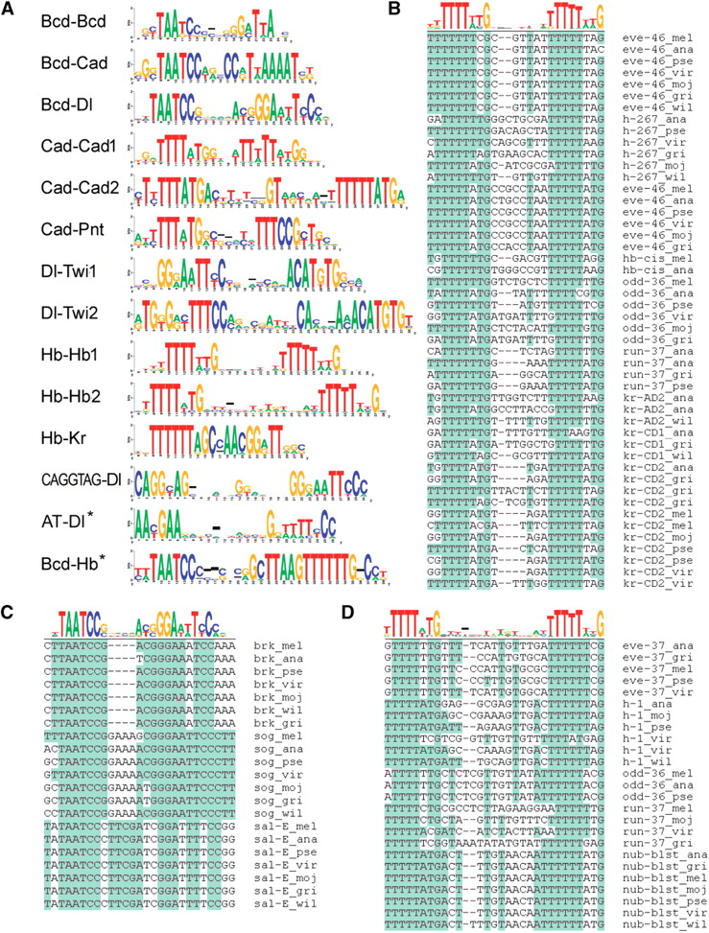
Figure 3. Shared and conserved motif combinations. (A) Sequence logos demonstrate models for the most significant ...
Notes:
Figure 3. Shared and conserved motif combinations. (A) Sequence logos demonstrate models for the most significant shared and conserved motif combinations; some motif combinations produced more than one model. (B–D) Alignment of sequences for three selected combinations: (C) Bcd–Dl, (B) Hb–Hb1 and (D) Hb–Hb2. Alignments for the other motif combinations are available from UC Berkeley web resource. Sequence logos with asterisk on (A) marks previously known motif combinations, which produced low P-value (Bcd–Hb), or were missed in the automatic search (AT–Dl).
Unless provided in the caption above, the following copyright applies to the content of this slide: © 2009 The Author(s)This is an Open Access article distributed under the terms of the Creative Commons Attribution Non-Commercial License (http://creativecommons.org/licenses/by-nc/2.0/uk/) which permits unrestricted non-commercial use, distribution, and reproduction in any medium, provided the original work is properly cited.

Slide 4
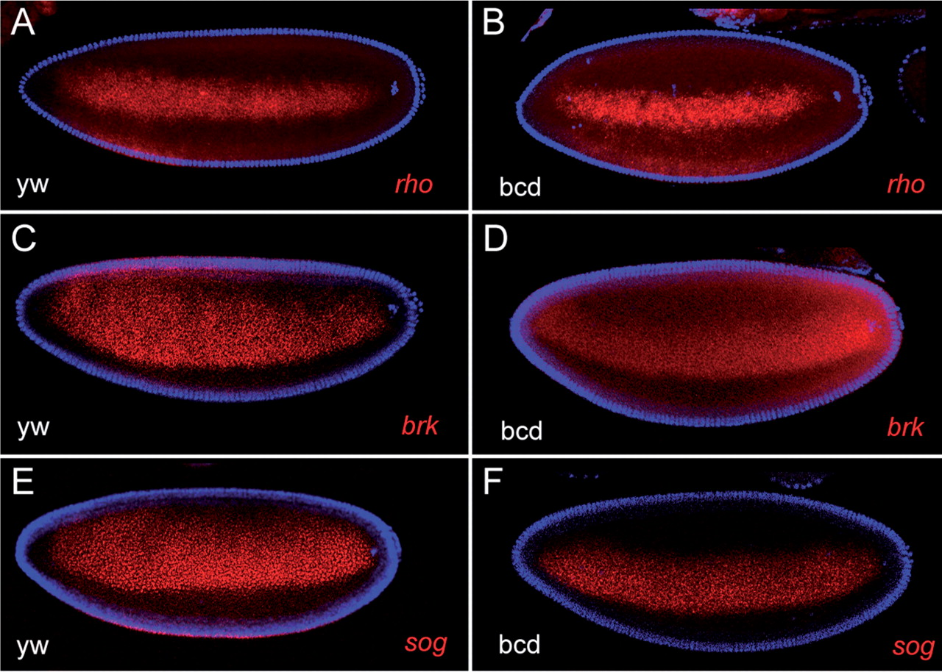
Figure 4. Ap modulation of dv genes. Expression patterns of dv genes brk, rho and sog in wild-type (A, C and E) and in ...
Notes:
Figure 4. Ap modulation of dv genes. Expression patterns of dv genes brk, rho and sog in wild-type (A, C and E) and in bcd– embryos (B, D and F). In the absence of Bcd, all three genes are expressed as lateral stripes, corresponding to future ventral neuroectoderm. In the wild-type embryos, brk and sog, but not rho stripes are significantly broader in the anterior. Bcd–Dl motif combinations were identified in brk and sog, but not in rho enhancers. Embryos oriented anterior-to-posterior from left to right and dorsal-to-ventral from top to bottom.
Unless provided in the caption above, the following copyright applies to the content of this slide: © 2009 The Author(s)This is an Open Access article distributed under the terms of the Creative Commons Attribution Non-Commercial License (http://creativecommons.org/licenses/by-nc/2.0/uk/) which permits unrestricted non-commercial use, distribution, and reproduction in any medium, provided the original work is properly cited.

Slide 5
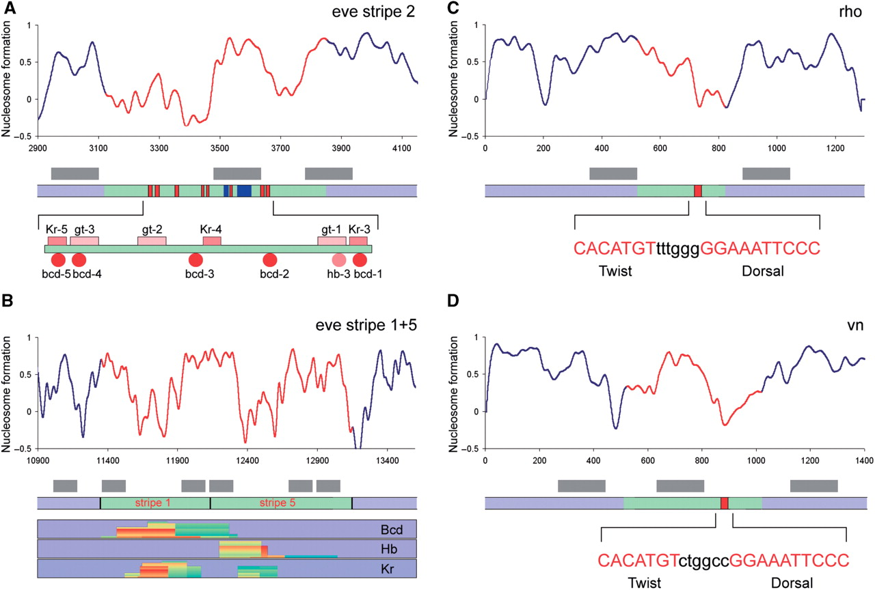
Figure 5. Nucleosome formation potential and enhancer organization. Nucleosome formation potential [‘Recon’ program ...
Notes:
Figure 5. Nucleosome formation potential and enhancer organization. Nucleosome formation potential [‘Recon’ program (53)] is shown in comparison with distribution of binding sites and binding site clusters in enhancers of eve, vn and rho. (A) eve stripe 2 enhancer has two regions with low nucleosome formation potential (see the map below). It is conceivable that two most critical site combinations (Bcd+Kr+Gt) are located in the ‘open windows’ with a nucleosome positioned in between. Blue bars on the map mark positions of fuzzy tandem repeats (63), coinciding with the local maximum of the nucleosome formation potential. Grey bars show predicted position of the positioned nucleosomes. Red line tracing of nucleosome formation potential marks the positions of enhancers. (B) eve stripe 5+1 enhancer region also has two regions with low nucleosome formation potential, possibly corresponding to the stripe 1 and stripe 5 enhancers. Positions of binding site clusters for Bcd, Hb and Kr (see plots below the map) coincide with the nucleosome-depleted regions. Two nucleosomes, separating eve stripe 1 and eve stripe 5 enhancers can prevent mixing of inputs to each enhancer. (C and D) Enhancers rho and vn have an open window coinciding with positions of the most critical Dl–Twi element (66).
Unless provided in the caption above, the following copyright applies to the content of this slide: © 2009 The Author(s)This is an Open Access article distributed under the terms of the Creative Commons Attribution Non-Commercial License (http://creativecommons.org/licenses/by-nc/2.0/uk/) which permits unrestricted non-commercial use, distribution, and reproduction in any medium, provided the original work is properly cited.

Slide 6
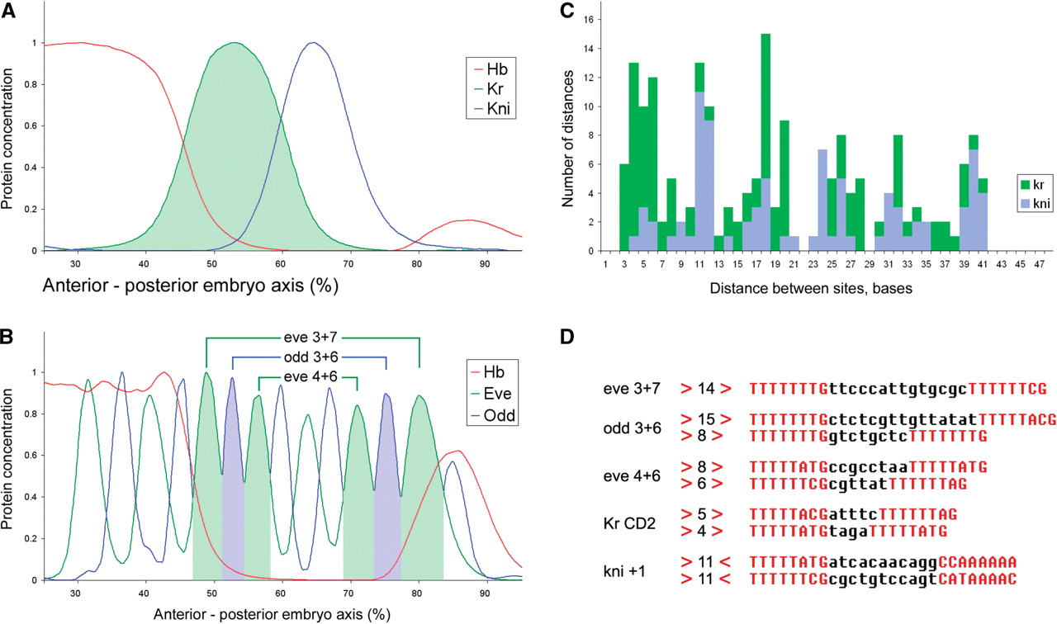
Figure 6. Regulation of gap and pair-rule genes by Hb. Spatial expression patterns of gap (A) and pair-rule genes (B) ...
Notes:
Figure 6. Regulation of gap and pair-rule genes by Hb. Spatial expression patterns of gap (A) and pair-rule genes (B) in comparison with Hb gradient at cell division cycle 14, stage 3 and stage 7 correspondingly. (A) Hb regulates Kr in a concentration-dependent manner, activating it a low concentrations and repressing at high; Hb acts as a dedicated repressor of kni. (B) Pair-rule stripes Eve 3, Odd 3 and Eve 4 overlap different levels of Hb gradient, as well as their ‘mirror’ stripes Eve 6, Odd 6, Eve 7. Single enhancer (see connecting brackets) regulates each pair of such mirror stripes. (C) Kr enhancers (three enhancers, including all orthologs, 21 sequences) contain closely spaced Hb tandems, separated by 4–6 bases; kni enhancers contain Hb palindromes, separated by 11–12 bases. (D) Genes dual regulated by Hb contain conserved tandems of Hb sites (see also Figure 3). There is also a striking reverse correlation between spacing in the Hb tandems and the position of posterior expression borders of the target genes relatively to Hb gradient: the farther the stripe from Hb peak the shorter the spacing between the Hb sites in tandem (compare B and D).
Unless provided in the caption above, the following copyright applies to the content of this slide: © 2009 The Author(s)This is an Open Access article distributed under the terms of the Creative Commons Attribution Non-Commercial License (http://creativecommons.org/licenses/by-nc/2.0/uk/) which permits unrestricted non-commercial use, distribution, and reproduction in any medium, provided the original work is properly cited.

