Slide 1
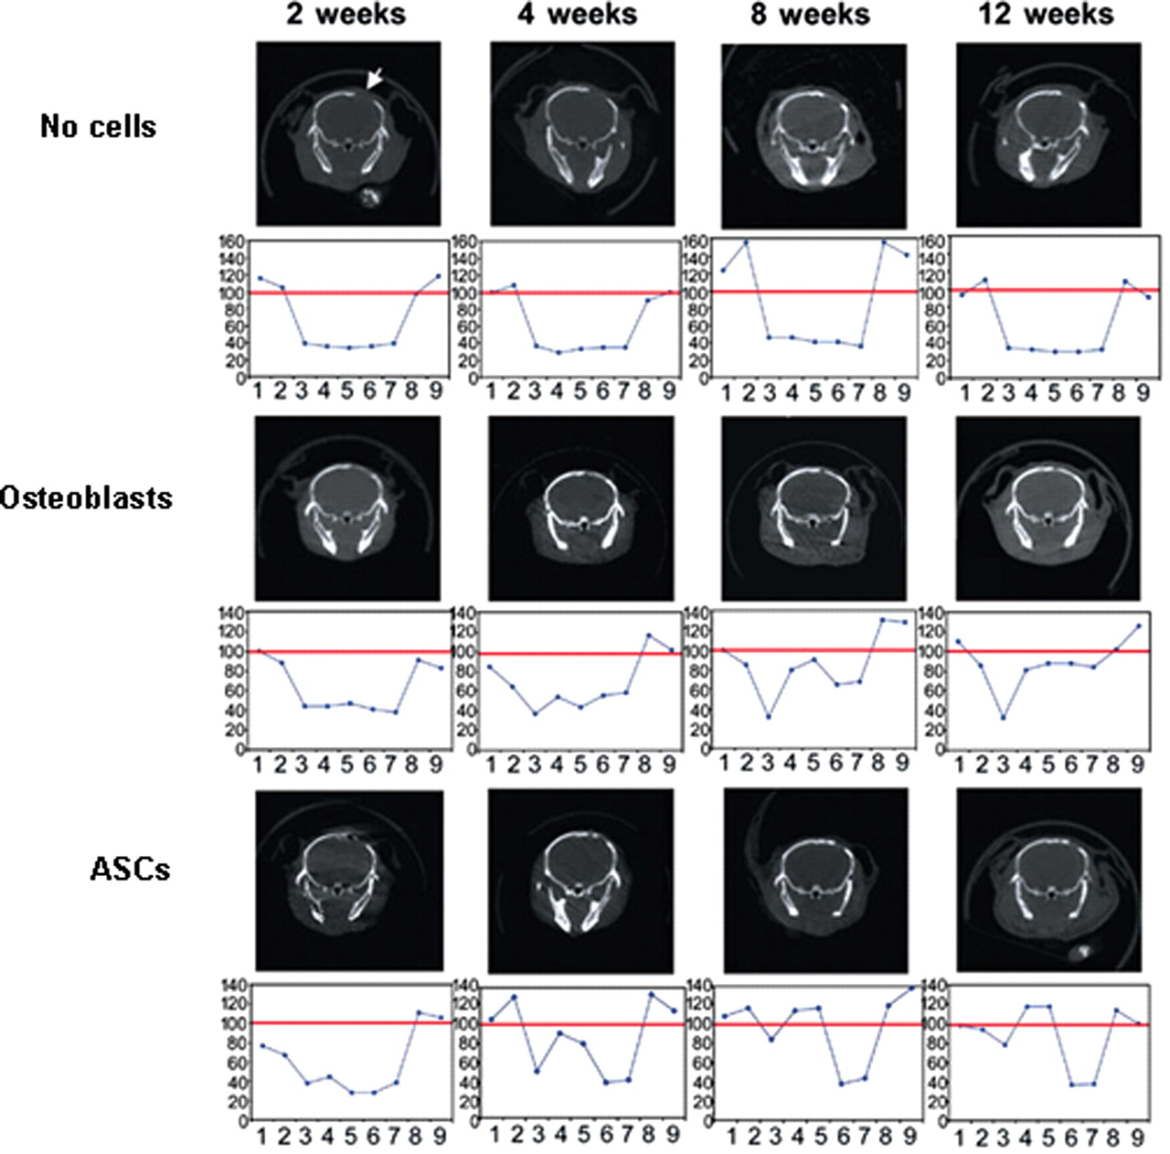
Figure 1. Representative images of the posterior view of coronal micro-CT sections of mouse calvaria are displayed, ...
Notes:
Figure 1. Representative images of the posterior view of coronal micro-CT sections of mouse calvaria are displayed, with their respective densitometric measurements displayed below. Micro-CT scans were performed on the mice 2, 4, 8 and 12 weeks after creation of 4 mm defects in the parietal bone and implantation of scaffold alone (top panel), scaffold with osteoblasts (middle panel) or scaffold with ASCs (bottom panel). Note the defects in the parietal bone are visible on the right side of the image. The area of the defect is indicated in the top left panel with a white arrow; defects are in a similar location in all the remaining specimens. Below each image is a graph demonstrating location on the x-axis and percent density on the y-axis as compared with the uninjured left parietal bone of each animal. The red line at 100% represents the density of the corresponding uninjured left parietal bone. Mice whose defects were implanted with scaffold alone demonstrated minimal osseous healing over the 12 week course, based on denstiometric measurements (see top panel). Mice whose defects were implanted with scaffolds seeded with ASCs (bottom panel) demonstrated more robust healing at the 4 week time point compared with defects implanted with osteoblast-seeded scaffolds, based on densitometric measurements (middle panel). At the 8 and 12 week time points, the osteoblast and ASC treatment groups demonstrated similar osseous healing. Obtained with permission from Cowan et al. (28).
Unless provided in the caption above, the following copyright applies to the content of this slide: © The Author 2008. Published by Oxford University Press. All rights reserved. For Permissions, please email: journals.permissions@oxfordjournals.org

Slide 2
Figure 2. BMP signaling via the BMP receptor type IB (BMPR-IB) is required for osteogenic differentiation of mouse ...
Notes:
Figure 2. BMP signaling via the BMP receptor type IB (BMPR-IB) is required for osteogenic differentiation of mouse ASCs. (A) Gene expression analysis of the BMP receptor isoforms, type IA, type IB and type II, found BMPR-IB transcript levels to be dramatically upregulated in ASCs undergoing osteogenic differentiation (*P < 0.05). (B) RNA interference targeted at BMPR-IB transcripts resulted in significantly decreased expression of BMPR-IB protein (siRNA 1 and 5) relative to the control groups (sham infection and control siRNA), as demonstrated by immunofluorescence. (C) The potential for osteogenic differentiation of ASCs with RNAi-mediated suppression of BMPR-IB (siRNA 1 and 5) was significantly reduced compared with mouse ASCs which had undergone infection by sham virus or control siRNA, as demonstrated by Alizarin red staining (assay for terminal osteogenic differentiation). Obtained with permission from Wan et al. (33).
Unless provided in the caption above, the following copyright applies to the content of this slide: © The Author 2008. Published by Oxford University Press. All rights reserved. For Permissions, please email: journals.permissions@oxfordjournals.org

