Slide 1
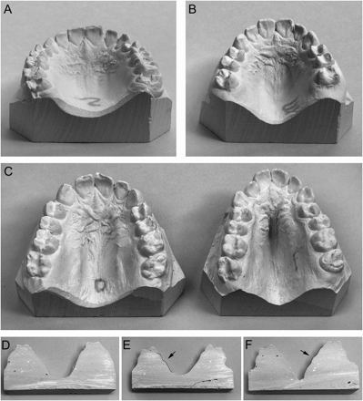
Figure 4 Lateral palatine ridges. A, dental cast demonstrating a normal palate without lateral palatine ridges, group ...
Notes:
Figure 4 Lateral palatine ridges. A, dental cast demonstrating a normal palate without lateral palatine ridges, group 0. B, dental cast showing a palatal vault with small lateral palatine ridges, group 1. C, dental casts of palatal vaults with prominent lateral palatine ridges of two different degrees, group 2. D, transverse section of a dental cast at the level of the first upper molars demonstrating a palatal vault without lateral palatine ridges, group 0. E, transverse section of a dental cast at the level of upper first molars demonstrating a palatal vault with small lateral palatine ridges, group 1. F, transverse section of a dental cast at the level of the upper first molars demonstrating a palatal vault with prominent lateral palatine ridges, group 2.
Unless provided in the caption above, the following copyright applies to the content of this slide: © The Author 2008. Published by Oxford University Press on behalf of the European Orthodontic Society. All rights reserved. For permissions, please email: journals.permissions@oxfordjournals.org.

Slide 2
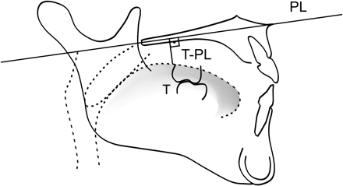
Figure 1 Tongue position. T-PL, the perpendicular distance of the tongue surface from the palatal plane at the distal ...
Notes:
Figure 1 Tongue position. T-PL, the perpendicular distance of the tongue surface from the palatal plane at the distal end of the upper first molar.
Unless provided in the caption above, the following copyright applies to the content of this slide: © The Author 2008. Published by Oxford University Press on behalf of the European Orthodontic Society. All rights reserved. For permissions, please email: journals.permissions@oxfordjournals.org.

Slide 3
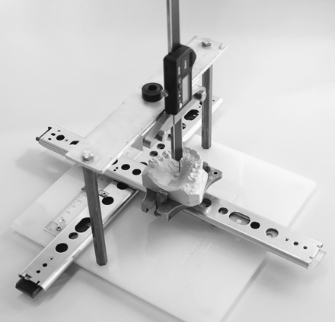
Figure 3 Palatometer. A dental cast is placed on a movable base and positioned so that the pointer of the meter can be ...
Notes:
Figure 3 Palatometer. A dental cast is placed on a movable base and positioned so that the pointer of the meter can be set at the gingival margin of the tooth for calibration to zero. The dental cast is then moved transversally so that the pointer of the meter can be set at the midline of the palate and the palatal height read on the digital display.
Unless provided in the caption above, the following copyright applies to the content of this slide: © The Author 2008. Published by Oxford University Press on behalf of the European Orthodontic Society. All rights reserved. For permissions, please email: journals.permissions@oxfordjournals.org.

Slide 4
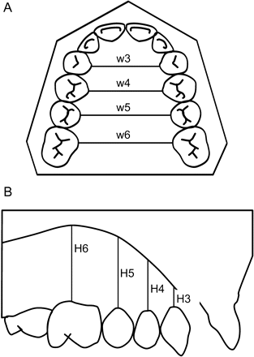
Figure 2 Palatal (A) width (W) and (B) height (H) measurements. W3, palatal width at the level of the canines; W4, ...
Notes:
Figure 2 Palatal (A) width (W) and (B) height (H) measurements. W3, palatal width at the level of the canines; W4, palatal width at the level of the first premolars; W5, palatal width at the level of the second premolars; W6, palatal width at the level of the first molars. H3, palatal height at the level of the canines; H4, palatal height at the level of the first premolars; H5, palatal height at the level of the second premolars; H6, palatal height at the level of the first molars.
Unless provided in the caption above, the following copyright applies to the content of this slide: © The Author 2008. Published by Oxford University Press on behalf of the European Orthodontic Society. All rights reserved. For permissions, please email: journals.permissions@oxfordjournals.org.

