Slide 1
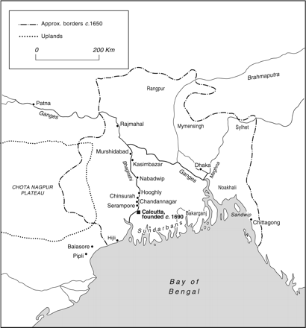
BENGAL IN THE SEVENTEENTH CENTURY
Notes:
BENGAL IN THE SEVENTEENTH CENTURY
Unless provided in the caption above, the following copyright applies to the content of this slide: © The Past and Present Society, Oxford, 2011

