Slide 1
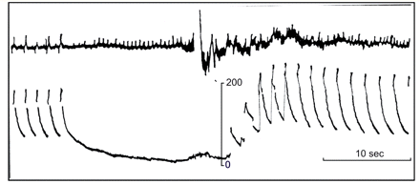
Figure 1 Effects of blood pressure during a Stokes-Adams attack. Above: Lead II of the electrocardiogram. Convulsive ...
Notes:
Figure 1 Effects of blood pressure during a Stokes-Adams attack. Above: Lead II of the electrocardiogram. Convulsive movements produced interference with the record after 16 s asystole. Below: Continuous brachial artery pressure record. Note overshoot of blood pressure during the recovery. Time (top) in seconds. Calibration in mm Hg. Taken with permission from Barlow and Howarth, 1953.
Unless provided in the caption above, the following copyright applies to the content of this slide: © The Author (2009). Published by Oxford University Press on behalf of the Guarantors of Brain. All rights reserved. For Permissions, please email: journals.permissions@oxfordjournals.org

Slide 2
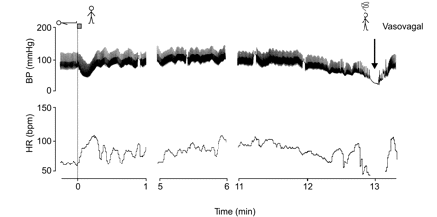
Figure 2 Vasovagal syncope in a healthy 22-year-old male subject. Note normal initial heart rate and blood pressure ...
Notes:
Figure 2 Vasovagal syncope in a healthy 22-year-old male subject. Note normal initial heart rate and blood pressure response and marked increase in heart rate after 6 min standing. After 11–12 min standing, blood pressure and heart rate decrease to very low values ending in a faint; the period when heart rate drops to values below 50 beats/min represents a period of asystole of 7 s. On lying down, heart rate and blood pressure recover quickly, but blood pressure does not overshoot. Blood pressure was measured with a Finapres device. Taken with permission from van Lieshout et al., 1991.
Unless provided in the caption above, the following copyright applies to the content of this slide: © The Author (2009). Published by Oxford University Press on behalf of the Guarantors of Brain. All rights reserved. For Permissions, please email: journals.permissions@oxfordjournals.org

Slide 3
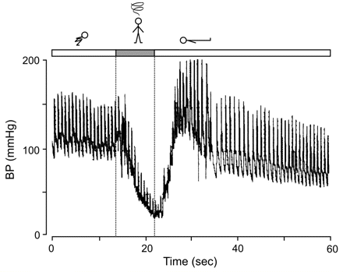
Figure 4 Effect of the fainting lark on finger arterial pressure. See text for details about the procedure. Tracing ...
Notes:
Figure 4 Effect of the fainting lark on finger arterial pressure. See text for details about the procedure. Tracing obtained in a 54-year-old subject (WW). Note instantaneous, deep fall in arterial pressure on arising. At the nadir of blood pressure the subject experienced seeing black and than did fall on the floor. On lying down, blood pressure recovers almost immediately and did overshoot. The time between standing up from the squatting position until onset of the faint amounts to 7 s. The duration of the loss of consciousness was short. Finger arterial pressure was measured at heart level with a Finapres device (N. van Dijk and W. Wieling, unpublished results).
Unless provided in the caption above, the following copyright applies to the content of this slide: © The Author (2009). Published by Oxford University Press on behalf of the Guarantors of Brain. All rights reserved. For Permissions, please email: journals.permissions@oxfordjournals.org

Slide 4
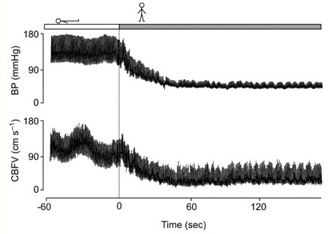
Figure 3 Blood Pressure and cerebral blood flow velocity in autonomic failure. Changes in finger blood pressure and ...
Notes:
Figure 3 Blood Pressure and cerebral blood flow velocity in autonomic failure. Changes in finger blood pressure and cerebral blood flow in the medial cerebral artery in a 54-year-old patient with pure autonomic failure. Despite the very low blood pressure the patient experienced no symptoms (M.P. Harms and W. Wieling, unpublished results).
Unless provided in the caption above, the following copyright applies to the content of this slide: © The Author (2009). Published by Oxford University Press on behalf of the Guarantors of Brain. All rights reserved. For Permissions, please email: journals.permissions@oxfordjournals.org

Slide 5
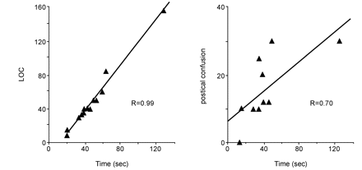
Figure 5 Determinant of duration of unconsciousness and confusion. Left panel shows the relation between duration of ...
Notes:
Figure 5 Determinant of duration of unconsciousness and confusion. Left panel shows the relation between duration of loss of consciousness (LOC) and that of induced arrhythmia. There is a close correlation between these two measurements (r = 0.99). Right panel shows the relation between duration of induced ventricular tachycardia and fibrillation (VT/VF) and duration of postictal confusion. Duration of postictal confusion ranged from 0 to 30 s and was related to the duration of the arrhythmia (r = 0.70). Taken with permission from Aminoff et al. (1988).
Unless provided in the caption above, the following copyright applies to the content of this slide: © The Author (2009). Published by Oxford University Press on behalf of the Guarantors of Brain. All rights reserved. For Permissions, please email: journals.permissions@oxfordjournals.org

Slide 6
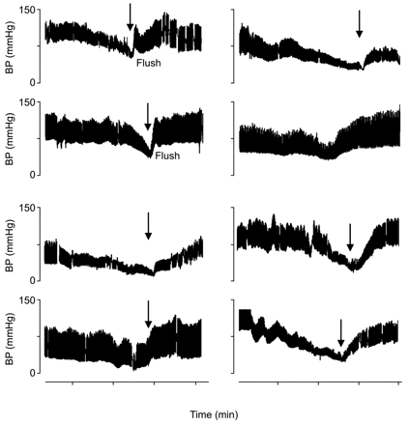
Figure 7 Blood pressure after vasovagal syncope. Recovery of blood pressure on tilting back in eight subjects with a ...
Notes:
Figure 7 Blood pressure after vasovagal syncope. Recovery of blood pressure on tilting back in eight subjects with a tilt-induced impending vasovagal faint. Arrows indicate the moment of tilt back. A flush is observed in the two subjects with a rapid recovery and overshoot of blood pressure. Blood pressure was measured with a Finapres device. Taken with permission from Wieling et al. (2006).
Unless provided in the caption above, the following copyright applies to the content of this slide: © The Author (2009). Published by Oxford University Press on behalf of the Guarantors of Brain. All rights reserved. For Permissions, please email: journals.permissions@oxfordjournals.org

Slide 7
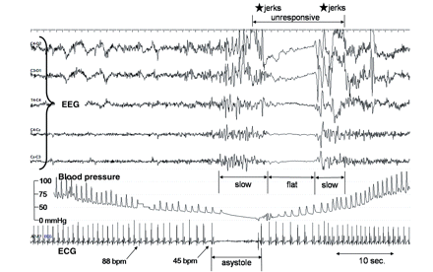
Figure 6 EEG in vasovagal syncope. A 1-min segment of a tilt-table test with a typical vasovagal syncope is shown of a ...
Notes:
Figure 6 EEG in vasovagal syncope. A 1-min segment of a tilt-table test with a typical vasovagal syncope is shown of a 40-year-old man. No nitro-glycerine was used. Finger blood pressure was recorded continuously using a Finometer. A selection of EEG channels is shown. The patient was tilted back during asystole (not indicated). At the beginning of the segment he had already complained of nausea, sweating and light-headedness, and blood pressure had started to drop. EEG slowing starts when systolic blood pressure drops to ∼50 mm Hg; heart rate is then about 45 beats per minute. Asystole occurred, lasting about 8 s. The EEG flattens for a similar period, but with a delay. Transient loss of consciousness was observed, starting with sagging of the face and dropping of the head to one side. The eyes remained open and the patient was unresponsive for about 14 s. There were muscle jerks just before and just after the flat period of the EEG (J.G. van Dijk, unpublished results).
Unless provided in the caption above, the following copyright applies to the content of this slide: © The Author (2009). Published by Oxford University Press on behalf of the Guarantors of Brain. All rights reserved. For Permissions, please email: journals.permissions@oxfordjournals.org

