Slide 1
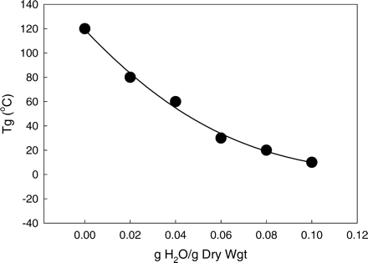
Fig. 1. The relationship between the glass transition temperature (Tg) and water content of trehalose, known ...
Notes:
Fig. 1. The relationship between the glass transition temperature (Tg) and water content of trehalose, known as a state diagram. Below Tg membrane vesicles are rigidly held in the glassy matrix, but above Tg mobility of the system increases such that the vesicles may come in contact and undergo fusion. Data for Tg from Crowe et al. (1996). Fusion studies from Crowe et al. (1996) and Sun et al. (1996)
Unless provided in the caption above, the following copyright applies to the content of this slide: The Society for Integrative and Comparative Biology

Slide 2
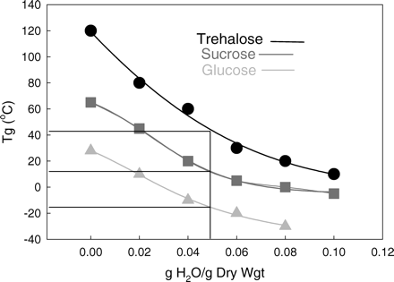
Fig. 2. Comparison of state diagrams for trehalose, sucrose, and glucose. Data from Crowe et al. (1996)
Notes:
Fig. 2. Comparison of state diagrams for trehalose, sucrose, and glucose. Data from Crowe et al. (1996)
Unless provided in the caption above, the following copyright applies to the content of this slide: The Society for Integrative and Comparative Biology

Slide 3
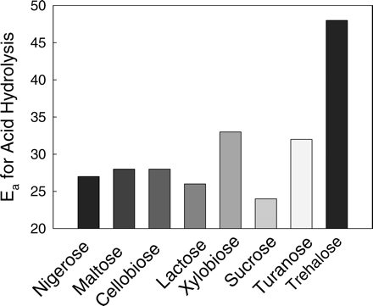
Fig. 3. Activation energies for acid hydrolysis of disaccharides. Adapted from BeMiller (1967)
Notes:
Fig. 3. Activation energies for acid hydrolysis of disaccharides. Adapted from BeMiller (1967)
Unless provided in the caption above, the following copyright applies to the content of this slide: The Society for Integrative and Comparative Biology

Slide 4
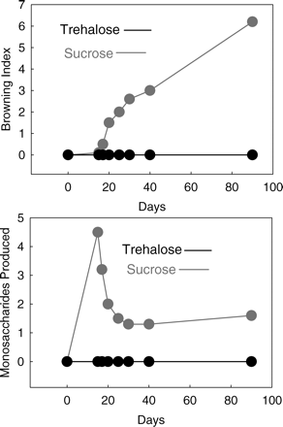
Fig. 4. Browning of dry proteins (top) and release of monosaccharides by trehalose and sucrose during ...
Notes:
Fig. 4. Browning of dry proteins (top) and release of monosaccharides by trehalose and sucrose during storage. Adapted from Schebor et al. (1999)
Unless provided in the caption above, the following copyright applies to the content of this slide: The Society for Integrative and Comparative Biology

Slide 5
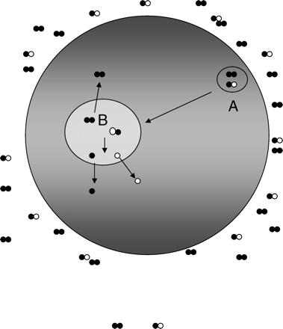
Fig. 5. Proposed mechanism for loading disaccharides into cell, based on data of Oliver et al., 2004 and ...
Notes:
Fig. 5. Proposed mechanism for loading disaccharides into cell, based on data of Oliver et al., 2004 and unpublished data of Auh et al. A. endocytic vesicle. B. secondary lysosome. Trehalose (solid double dots, representing two glucose monomers) and sucrose (open and solid mixed dots, representing glucose and fructose monomers) enter the cell by fluid phase endocytosis (A) and are passed down the lysosomal pathway (B). We suggest that the stability of the glycosidic bond in trehalose will permit trehalose to survive at lysosomal pH, but that sucrose might be hydrolyzed. We further propose that trehalose, sucrose, glucose, and fructose will all leak into the cytoplasm due to the known effects of pH on permeability of phospholipid bilayers (Hays et al., 2001)
Unless provided in the caption above, the following copyright applies to the content of this slide: The Society for Integrative and Comparative Biology

Slide 6
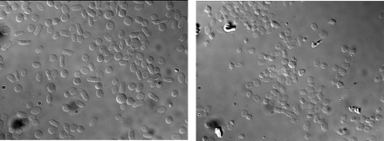
Fig. 6. Fresh dog platelets (left) and dog platelets that had been loaded with trehalose, freeze-dried, and ...
Notes:
Fig. 6. Fresh dog platelets (left) and dog platelets that had been loaded with trehalose, freeze-dried, and rehydrated (right).
Unless provided in the caption above, the following copyright applies to the content of this slide: The Society for Integrative and Comparative Biology

Slide 7
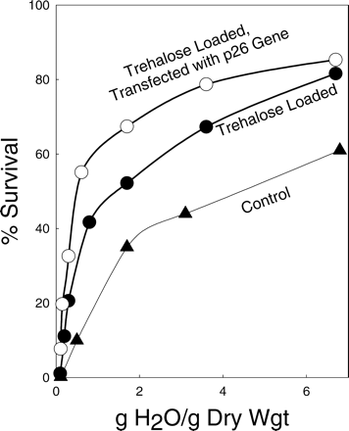
Fig. 7. Survival of 293 cells during progressive drying, under the indicated conditions. Adapted from Ma et ...
Notes:
Fig. 7. Survival of 293 cells during progressive drying, under the indicated conditions. Adapted from Ma et al. (2005)
Unless provided in the caption above, the following copyright applies to the content of this slide: The Society for Integrative and Comparative Biology

Slide 8
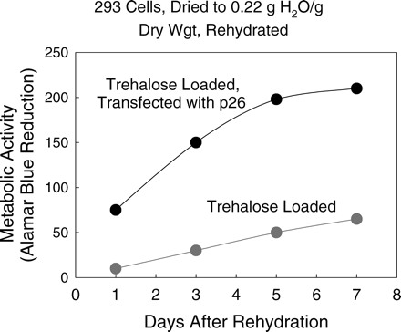
Fig. 8. Changes in metabolic activity in 293 cells previously freeze-dried under the indicated conditions. ...
Notes:
Fig. 8. Changes in metabolic activity in 293 cells previously freeze-dried under the indicated conditions. Adapted from Ma et al. (2005)
Unless provided in the caption above, the following copyright applies to the content of this slide: The Society for Integrative and Comparative Biology

