Slide 1
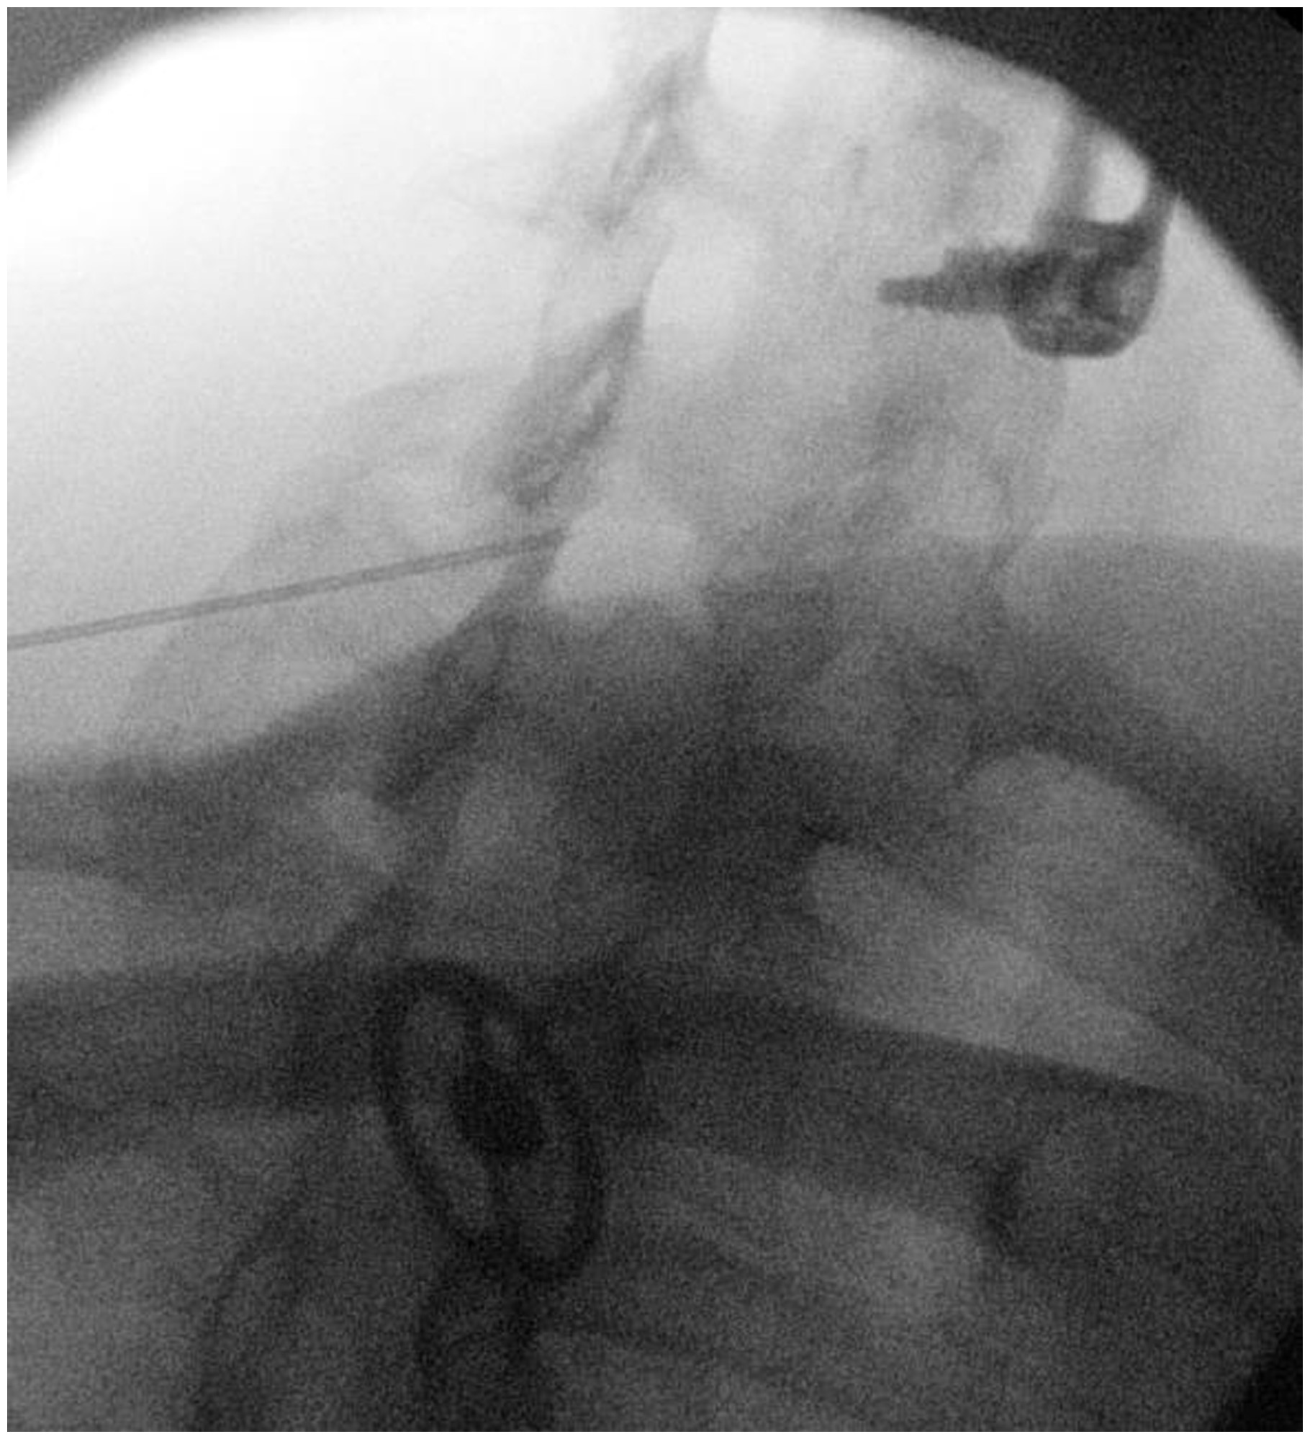
Figure 1 Contralateral oblique view of C7/T1 interlaminar injection (pre-contrast).
Notes:
Figure 1 Contralateral oblique view of C7/T1 interlaminar injection (pre-contrast).
Unless provided in the caption above, the following copyright applies to the content of this slide: © 2016 American Academy of Pain Medicine. All rights reserved. For permissions, please e-mail: journals.permissions@oup.com

Slide 2
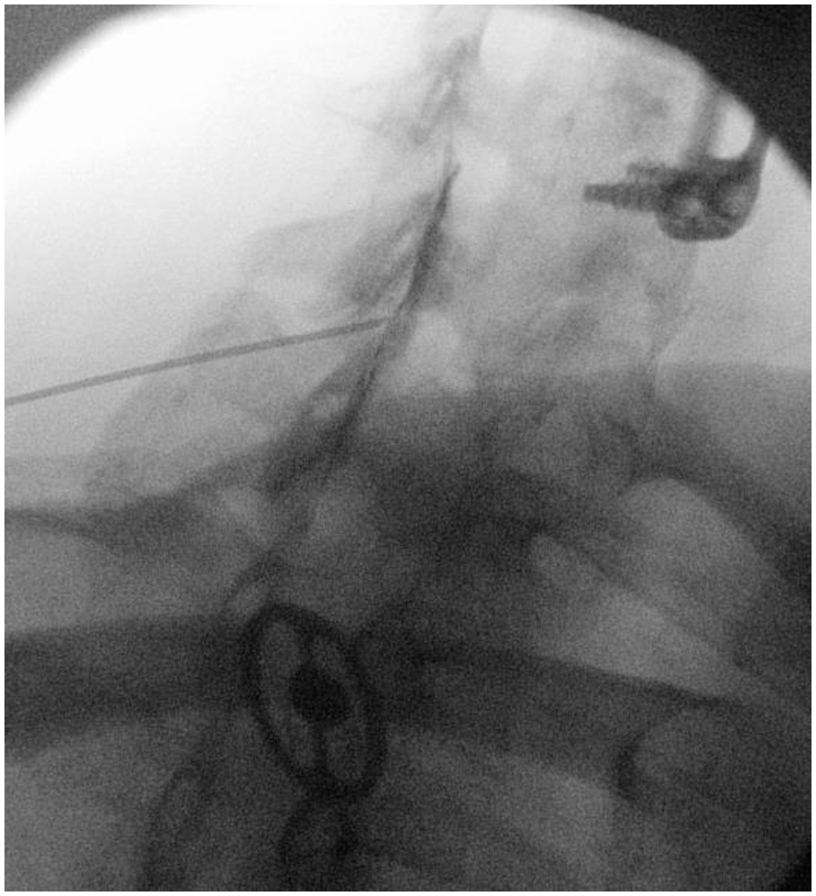
Figure 2 Contralateral oblique view of C7/T1 interlaminar injection (post-contrast).
Notes:
Figure 2 Contralateral oblique view of C7/T1 interlaminar injection (post-contrast).
Unless provided in the caption above, the following copyright applies to the content of this slide: © 2016 American Academy of Pain Medicine. All rights reserved. For permissions, please e-mail: journals.permissions@oup.com

Slide 3
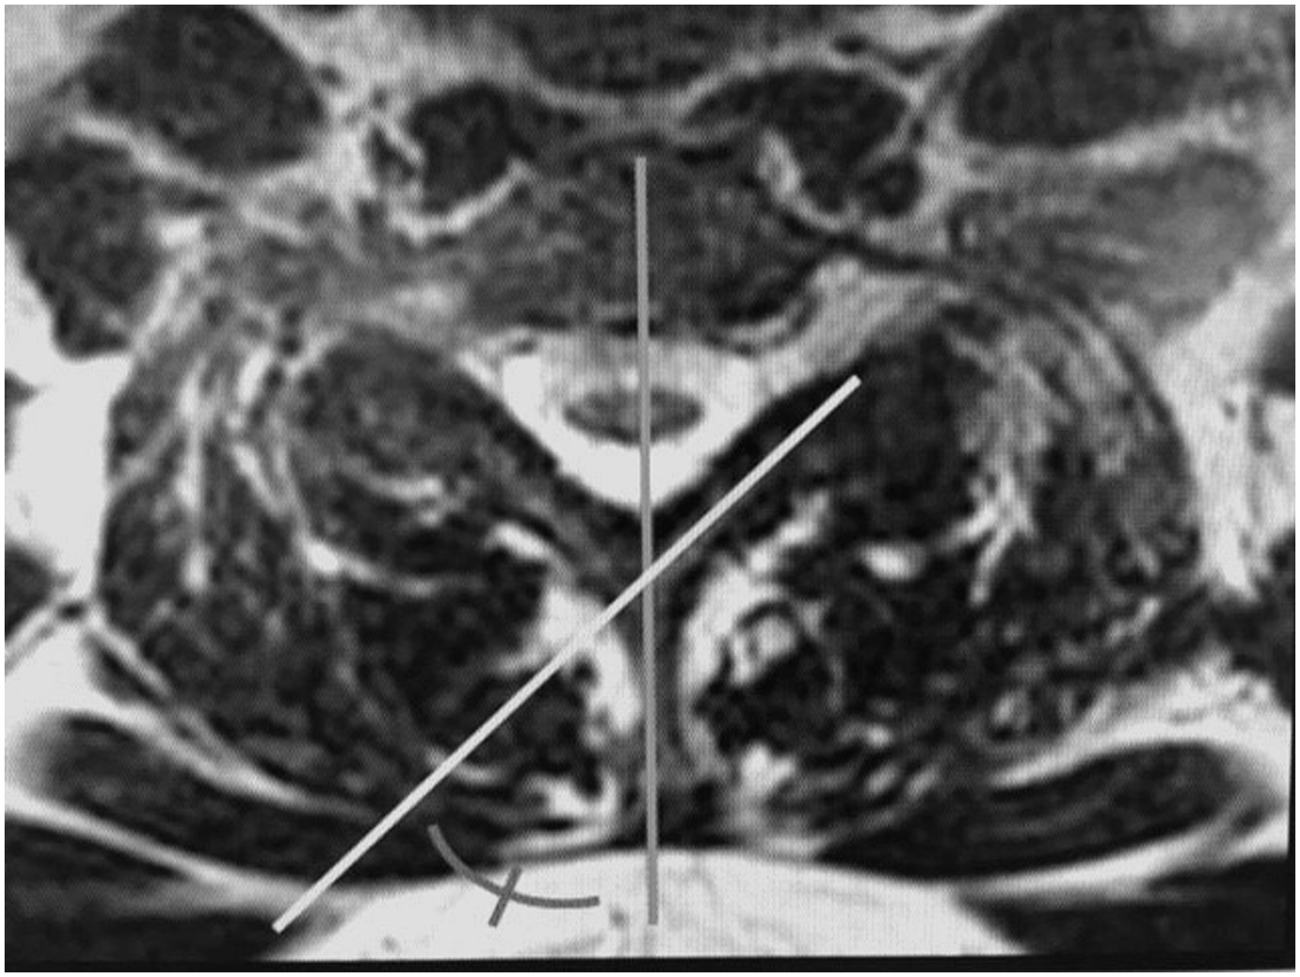
Figure 3 Axial MRI of C7 level. Contralateral oblique angle determination for left C7/T1 interlaminar ESI. Segment A ...
Notes:
Figure 3 Axial MRI of C7 level. Contralateral oblique angle determination for left C7/T1 interlaminar ESI. Segment A (vertical line) bisects the vertebral body and spinous process. Segment B (oblique line) is drawn along the long axis of the C7 lamina. The corresponding contralateral oblique angle is measured.
Unless provided in the caption above, the following copyright applies to the content of this slide: © 2016 American Academy of Pain Medicine. All rights reserved. For permissions, please e-mail: journals.permissions@oup.com

Slide 4
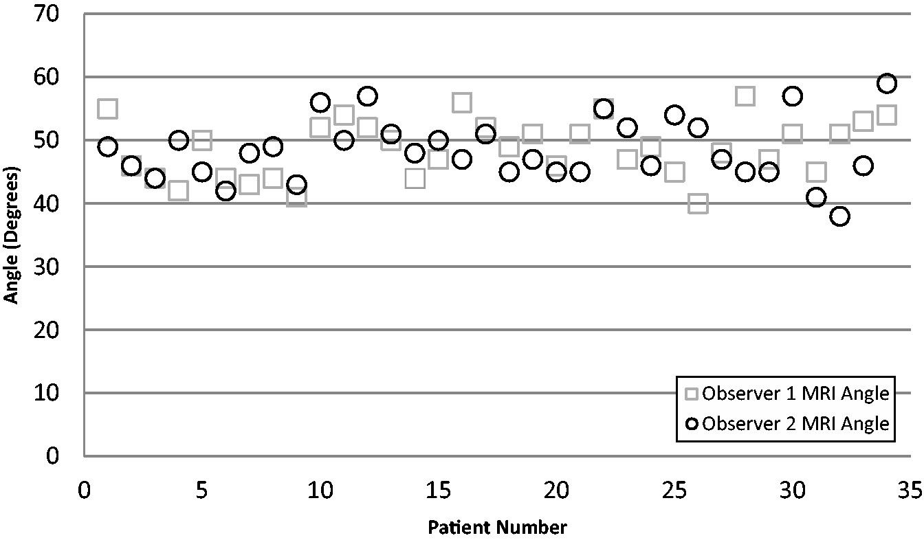
Figure 4 Observer 1 compared with observer 2 MRI laminar angle measurement.
Notes:
Figure 4 Observer 1 compared with observer 2 MRI laminar angle measurement.
Unless provided in the caption above, the following copyright applies to the content of this slide: © 2016 American Academy of Pain Medicine. All rights reserved. For permissions, please e-mail: journals.permissions@oup.com

Slide 5
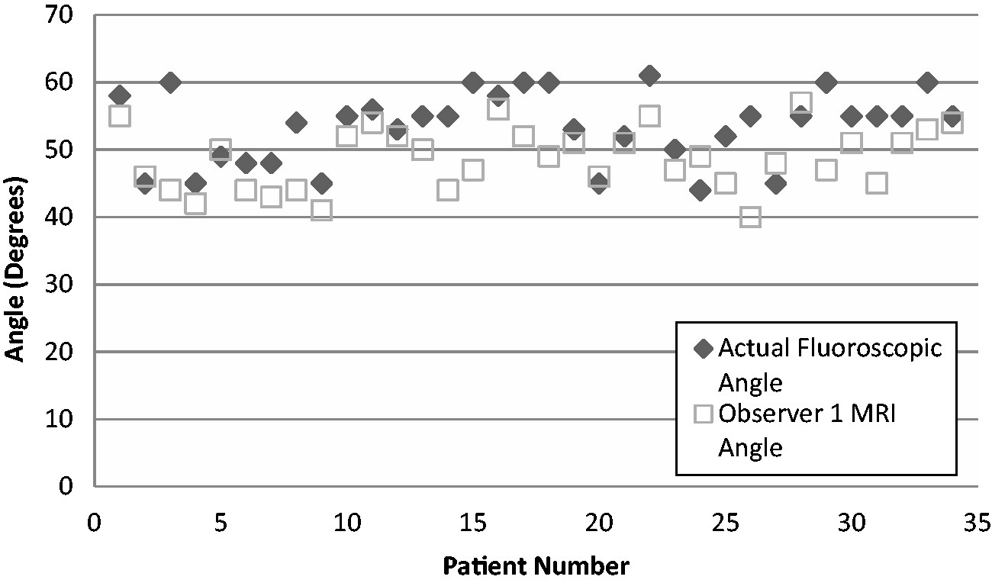
Figure 5 Actual fluoroscopic contralateral oblique angle determined during the injection procedure compared with ...
Notes:
Figure 5 Actual fluoroscopic contralateral oblique angle determined during the injection procedure compared with observer 1 MRI laminar angle measurement.
Unless provided in the caption above, the following copyright applies to the content of this slide: © 2016 American Academy of Pain Medicine. All rights reserved. For permissions, please e-mail: journals.permissions@oup.com

Slide 6
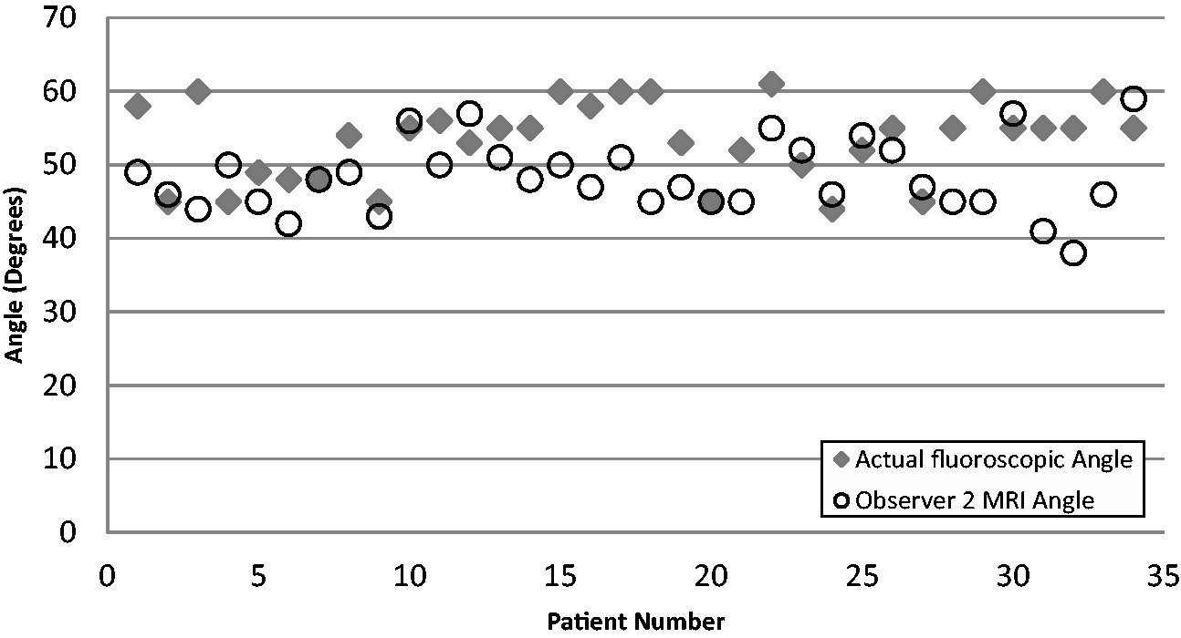
Figure 6 Actual fluoroscopic contralateral oblique angle determined during the injection procedure compared with ...
Notes:
Figure 6 Actual fluoroscopic contralateral oblique angle determined during the injection procedure compared with observer 2 MRI laminar angle measurement.
Unless provided in the caption above, the following copyright applies to the content of this slide: © 2016 American Academy of Pain Medicine. All rights reserved. For permissions, please e-mail: journals.permissions@oup.com

