Slide 1
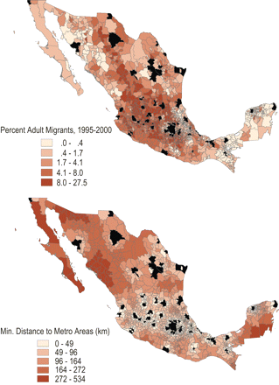
Figure 1. Spatial Patterns of U.S. Emigration Rates and Proximity to Metropolitan Areas (in black) for Non-metropolitan ...
Notes:
Figure 1. Spatial Patterns of U.S. Emigration Rates and Proximity to Metropolitan Areas (in black) for Non-metropolitan Mexican Municipalities, 1995-2000 Note: Metropolitan areas are colored in black.
Unless provided in the caption above, the following copyright applies to the content of this slide: © The Author 2011. Published by Oxford University Press on behalf of the University of North Carolina at Chapel Hill. All rights reserved. For permissions, please e-mail: journals.permissions@oup.com.

Slide 2
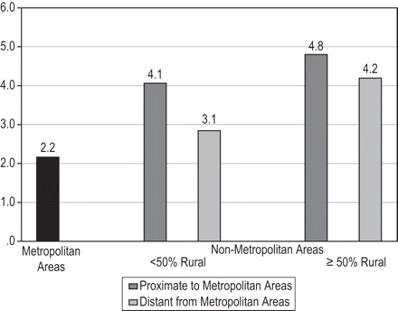
Figure 2. Average Adult U.S. Emigration Rate by Level of Urbanization and Proximity to Metropolitan Areas among Mexican ...
Notes:
Figure 2. Average Adult U.S. Emigration Rate by Level of Urbanization and Proximity to Metropolitan Areas among Mexican Municipalities, 1995-2000 Sources: 2000 Mexican Census and the 1995 Mid-Census Population Count.
Unless provided in the caption above, the following copyright applies to the content of this slide: © The Author 2011. Published by Oxford University Press on behalf of the University of North Carolina at Chapel Hill. All rights reserved. For permissions, please e-mail: journals.permissions@oup.com.

