Slide 1
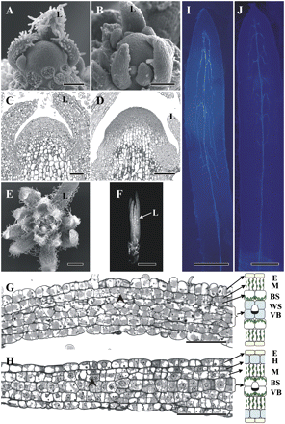
Fig. 1. Vegetative shoot tip structure and longitudinal sections showing early stages of leaf development in S. ...
Notes:
Fig. 1. Vegetative shoot tip structure and longitudinal sections showing early stages of leaf development in S. taxifolia (A, C, E, G, I) and S. eltonica (B, D, F, H, J). (A, B) Scanning electron microscopy of shoot apices. (C, D) Light microscopy of longitudinal sections of shoot apical meristem showing alternate and approximate initiation of leaf primordia. (E, F) General view of shoot tip showing patterns of leaf development. (E) Top view of S. taxifolia shoot tip. (F) Side view imaging of S. eltonica shoot tip with tightly packed leaves. (G, H) Longitudinal sections showing the formation of cell lineages at the base of young leaves (with direction of maturation from left to right). Right panels represent schemes of mature leaf anatomy to show the origin of leaf tissues from precursor lineages of cell files. The arrowheads mark the origin of two layers as the result of periclinal divisions of subepidermal cells. (I, J) Cleared leaves under UV light showing the basipetal direction of lateral vascular vein development in young leaves. E, epidermis; BS, bundle sheath; H, water storage hypoderm; L, leaf; M, mesophyll; VB, vascular bundles; WS, water storage tissue. Scale bars: 100 μm for A, B; 50 μm for C, D, G, H; 0.5 mm for E, I; 0.25 mm for J; 2 mm for F.
Unless provided in the caption above, the following copyright applies to the content of this slide: © The Author [2011]. Published by Oxford University Press [on behalf of the Society for Experimental Biology]. All rights reserved. For Permissions, please e-mail: journals.permissions@oup.com

Slide 2
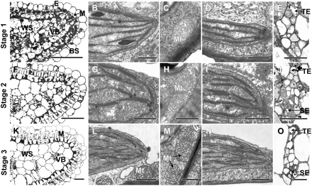
Fig. 2. Structural features of stages of development of Kranz anatomy in S. taxifolia shown by light and electron ...
Notes:
Fig. 2. Structural features of stages of development of Kranz anatomy in S. taxifolia shown by light and electron microscopy of leaf cross-sections in the middle part of young, intermediate, and mature leaves. (A, F, K) Light micrographs showing the development of leaf structure from young to mature stage. Note chlorenchyma layers distributed around the leaf periphery. (B, G, L) The thylakoid system in BS chloroplasts. (C, H, M) BS mitochondria ultrastructure. Note the specific cristae in mitochondria in mature BS cells. (D, I, N) Structure of M chloroplasts. (E, J, O) Cross-sections of the lateral vascular bundles. E, epidermis; BS, bundle sheath; M, mesophyll; Mt, mitochondria; SE, sieve element of phloem; TE, tracheary element of xylem; VB, vascular bundle; WS, water storage tissue. Scale bars: 100 μm for A, F, K; 0.5 μm for B, C, D, G, H, I, N; 1 μm for L, M; 20 μm for E, J, O.
Unless provided in the caption above, the following copyright applies to the content of this slide: © The Author [2011]. Published by Oxford University Press [on behalf of the Society for Experimental Biology]. All rights reserved. For Permissions, please e-mail: journals.permissions@oup.com

Slide 3
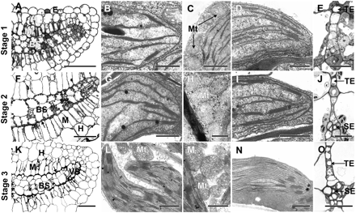
Fig. 3. Structural features of stages of development of Kranz anatomy in S. eltonica shown by light and electron ...
Notes:
Fig. 3. Structural features of stages of development of Kranz anatomy in S. eltonica shown by light and electron microscopy of leaf cross-sections in the middle part of young, intermediate, and mature leaves. (A, F, K) Light micrographs showing the development of leaf structure from young to mature stage. Note chlorenchyma layers distributed around vascular bundles in the middle part of the leaf. Arrows in (F) and (K) show BS chloroplasts at centrifugal position. (B, G, L) The thylakoid system in BS chloroplasts. (C, H, M) BS mitochondria ultrastructure. Note the specific cristae in mitochondria in mature BS cells. (D, I, N) Structure of M chloroplasts. (E, J, O) Cross-sections of the lateral vascular bundles. H, water storage hypoderm; for other labels see Fig. 2. Scale bars: 100 μm for A, K; 50 μm for F; 0.5 μm for B, D, G, N; 1 μm for C, L, M; 10 μm for E, J; 20 μm for O.
Unless provided in the caption above, the following copyright applies to the content of this slide: © The Author [2011]. Published by Oxford University Press [on behalf of the Society for Experimental Biology]. All rights reserved. For Permissions, please e-mail: journals.permissions@oup.com

Slide 4
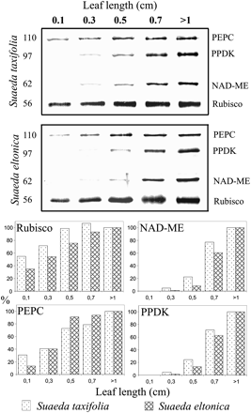
Fig. 4. Western blot analysis from very young up to mature leaves showing accumulation of C₄ enzymes and ...
Notes:
Fig. 4. Western blot analysis from very young up to mature leaves showing accumulation of C4 enzymes and Rubisco LSU during leaf development in two Suaeda species. Total soluble proteins were extracted from leaves of different ages of S. taxifolia and S. eltonica. Blots were probed with antibodies raised against PEPC, PPDK, NAD-ME, and Rubisco LSU, respectively. Top: representative Western blots showing detection of each protein. Numbers at the left indicate molecular mass in kDa. Bottom: quantitative representation of Western blot data. 100% on the y axis refers to the level achieved in mature leaves.
Unless provided in the caption above, the following copyright applies to the content of this slide: © The Author [2011]. Published by Oxford University Press [on behalf of the Society for Experimental Biology]. All rights reserved. For Permissions, please e-mail: journals.permissions@oup.com

Slide 5
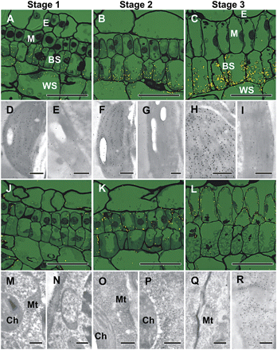
Fig. 5. In situ immunolocalization of Rubisco LSU (A–I) and PEPC (J–R) in leaves of S. taxifolia at different stages ...
Notes:
Fig. 5. In situ immunolocalization of Rubisco LSU (A–I) and PEPC (J–R) in leaves of S. taxifolia at different stages of development. Reflected/transmitted confocal imaging of base, middle, and tip of longitudinal leaf sections show Rubisco LSU (A–C) selectively localized to BS cells beginning from stage 1. Labelling also occurs in WS chloroplasts but not in M. Appearance of PEPC (J–L) preferentially localized to M cells at stages 2–3. Immunogold labelling at the TEM level in cross-sections of young, intermediate, and mature leaves shows Rubisco localized within BS chloroplasts (D, F, H), and the absence of this protein in M chloroplasts (E, G, I) at stages 1–3. PEPC is selectively localized in the cytosol of M cells beginning from stage 2 (P) and continuing through stage 3 (R). The number of gold particles in the cytosol of BS cells (M, O, Q) at all developmental stages and in M cells at stage 1 (N) is comparable to the background level in control samples (not shown). Antibody labelling appears as yellow particles in the confocal images and as black dots on TEM micrographs. BS, bundle sheath; Ch, chloroplast; E, epidermis; M, mesophyll; Mt, mitochondria; WS, water storage. Scale bars: 50 μm for A–C, J–L; 0.5 μm for D–I, M–R.
Unless provided in the caption above, the following copyright applies to the content of this slide: © The Author [2011]. Published by Oxford University Press [on behalf of the Society for Experimental Biology]. All rights reserved. For Permissions, please e-mail: journals.permissions@oup.com

Slide 6
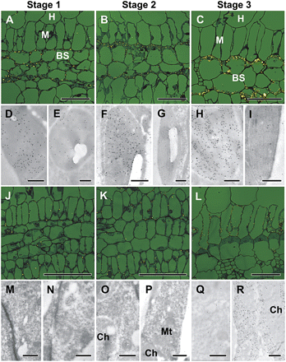
Fig. 6. In situ immunolocalization of Rubisco LSU (A–I) and PEPC (J–R), in leaves of S. eltonica at different stages ...
Notes:
Fig. 6. In situ immunolocalization of Rubisco LSU (A–I) and PEPC (J–R), in leaves of S. eltonica at different stages of development. Reflected/transmitted confocal imaging of base, middle, and tip of longitudinal leaf sections shows Rubisco LSU (A–C) selectively localized to BS cells at developmental stages 1–3, and the appearance of PEPC (J–L) specifically in M cells at stage 2. TEM micrographs of immunogold labelling in cross-sections of young, intermediate, and mature leaves from stages 1, 2, and 3 show Rubisco localized within BS chloroplasts at each stage (D, F, H). Low-level LSU labelling was observed within M chloroplasts at stage 1 (E), but none was detected in M plastids at stage 2 or 3 (G, I). PEPC was not detected in M cells at stage 1 (N), but was observed within the cytosol of M cells at stage 2 (P) and stage 3 (R). Gold particles were not present in M cell cytosol at stage 1 (N) or in cytosol of BS cells (M, O, Q) at any of the developmental stages. Antibody labelling appears as yellow particles in the confocal images and as black dots in TEM micrographs. BS, bundle sheath; Ch, chloroplast; E, epidermis; H, water storage hypoderm; M, mesophyll; Mt, mitochondria. Scale bars: 50 μm for A–C, J–L; 0.5 μm for D–I, M–R.
Unless provided in the caption above, the following copyright applies to the content of this slide: © The Author [2011]. Published by Oxford University Press [on behalf of the Society for Experimental Biology]. All rights reserved. For Permissions, please e-mail: journals.permissions@oup.com

Slide 7
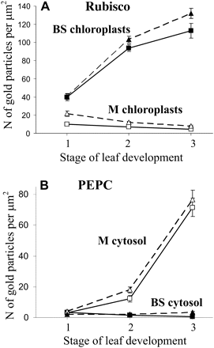
Fig. 7. Graphical representation of data from Figs 5 and 6 showing the density of immunolabelling for Rubisco LSU (A) ...
Notes:
Fig. 7. Graphical representation of data from Figs 5 and 6 showing the density of immunolabelling for Rubisco LSU (A) in BS versus M chloroplasts and PEPC (B) in BS versus M cytosol from cross-sections of young, intermediate, and mature leaves of S. taxifolia (squares) and S. eltonica (triangles). In both graphs the y axis represents the number of gold particles per μm2 of chloroplast or cytosol area, and the x axis represents the developmental stage. For each cell type and stage of development, 10–15 cell areas were used for counting.
Unless provided in the caption above, the following copyright applies to the content of this slide: © The Author [2011]. Published by Oxford University Press [on behalf of the Society for Experimental Biology]. All rights reserved. For Permissions, please e-mail: journals.permissions@oup.com

Slide 8
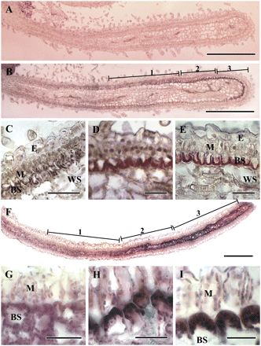
Fig. 8. In situ hybridization of rbcL mRNA with longitudinal leaf sections of S. taxifolia (A–E, from a leaf 0.3 cm ...
Notes:
Fig. 8. In situ hybridization of rbcL mRNA with longitudinal leaf sections of S. taxifolia (A–E, from a leaf 0.3 cm long) and S. eltonica (F–I, from a leaf 0.5 cm long). The dark purple signal indicates the specific hybridization to antisense mRNA probes. (A) Sense probe control is presented only for S. taxifolia to show the low background staining that occurred in these reactions. (B, F) Basipetal gradient of rbcL transcript accumulation from tip (right) to base (left). Preferential localization of rbcL mRNA in BS cells is shown for stage 1 (C, G), stage 2 (D, H), and stage 3 (E, I) of leaf development. BS, bundle sheath; E, epidermis; M, mesophyll; WS, water storage. Scale bars: 500 μm for A, B, F; 25 μm for C, G–I; 50 μm for D, E.
Unless provided in the caption above, the following copyright applies to the content of this slide: © The Author [2011]. Published by Oxford University Press [on behalf of the Society for Experimental Biology]. All rights reserved. For Permissions, please e-mail: journals.permissions@oup.com

