Slide 1
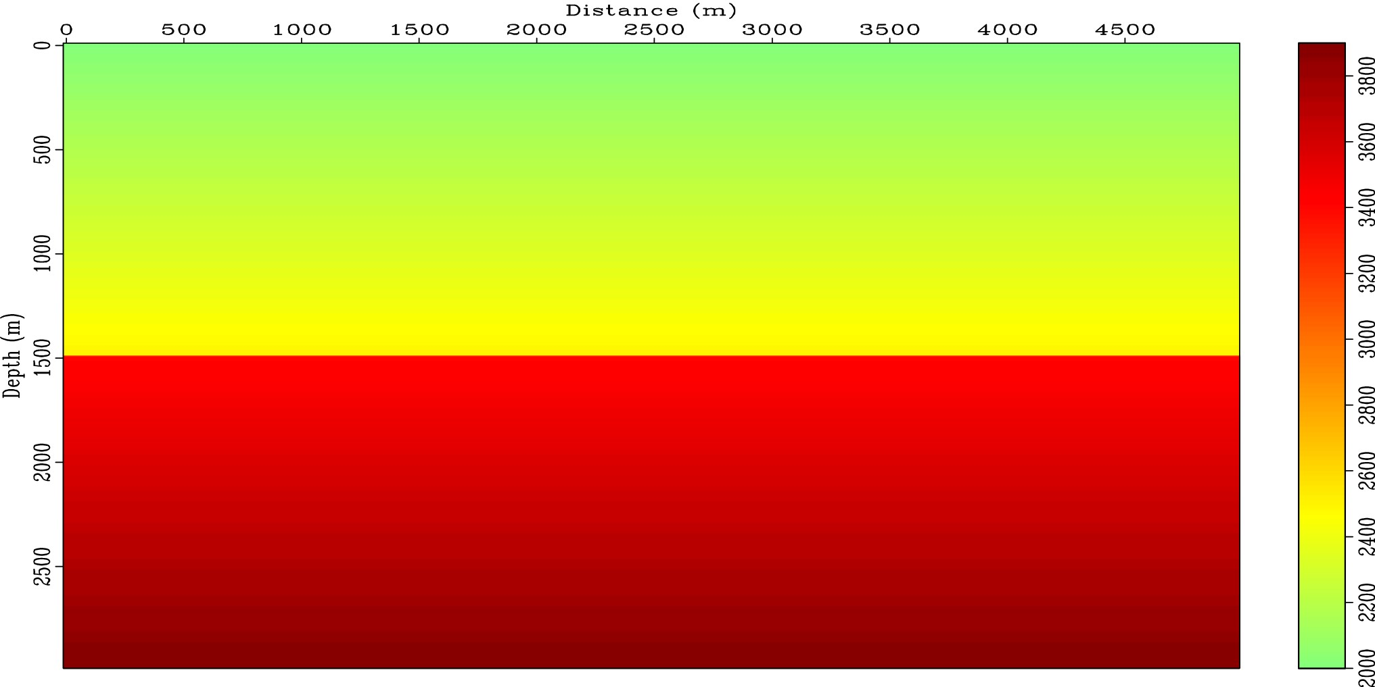
Figure 1. Exact velocity for two layer problem.
Notes:
Figure 1. Exact velocity for two layer problem.
Unless provided in the caption above, the following copyright applies to the content of this slide: © The Authors 2016. Published by Oxford University Press on behalf of The Royal Astronomical Society.

Slide 2
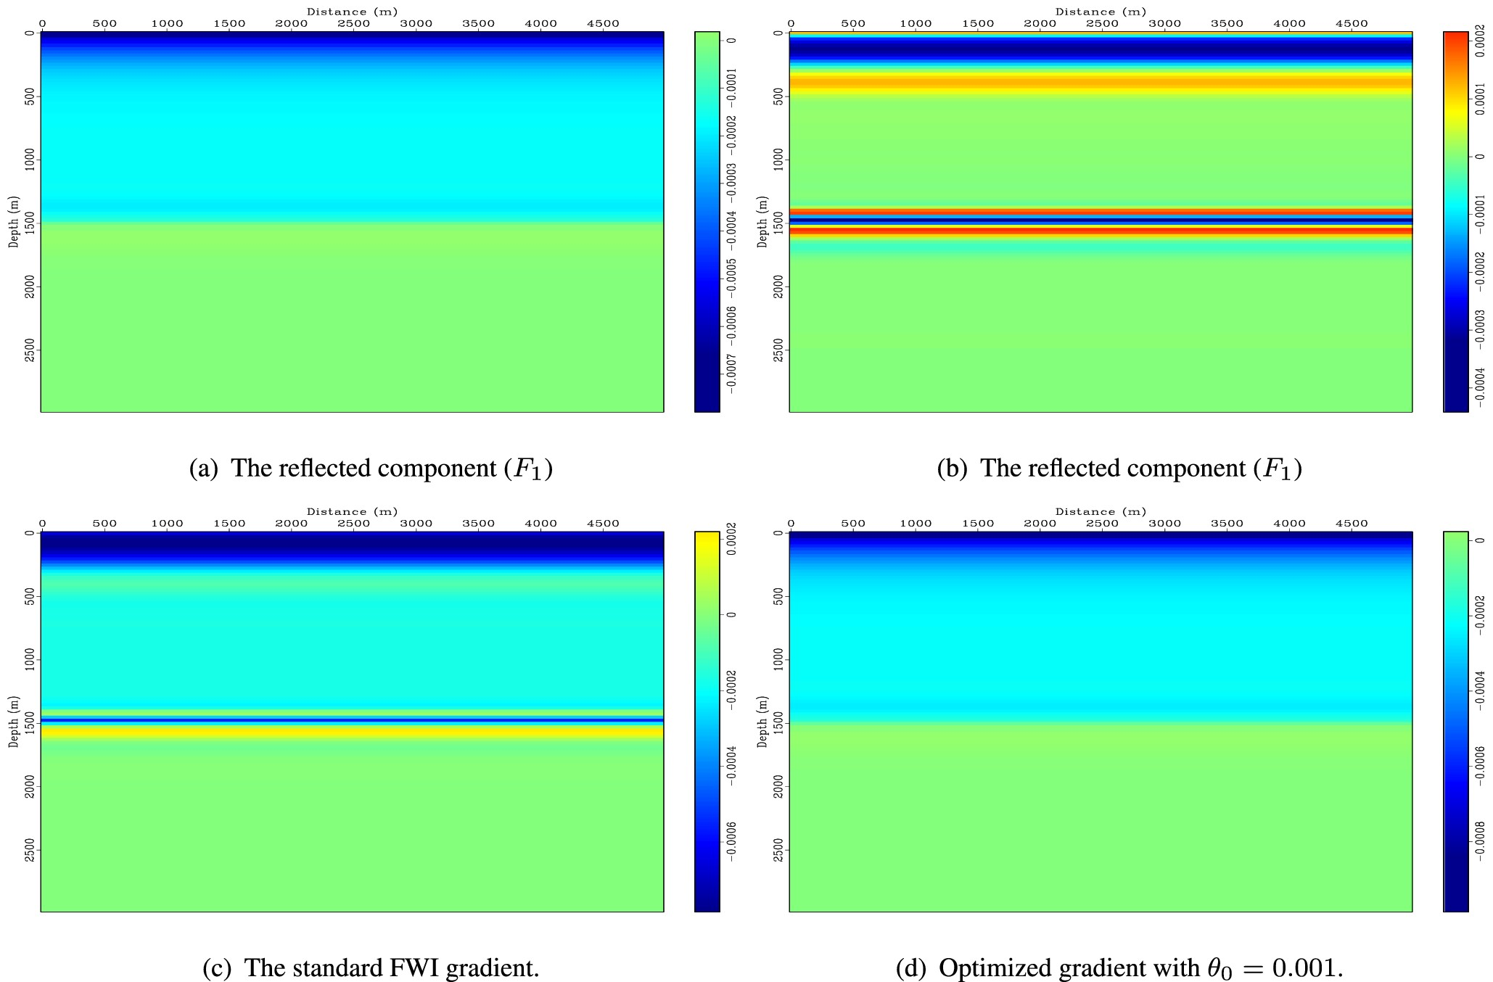
Figure 2. The gradient analysis for a lower background velocity.
Notes:
Figure 2. The gradient analysis for a lower background velocity.
Unless provided in the caption above, the following copyright applies to the content of this slide: © The Authors 2016. Published by Oxford University Press on behalf of The Royal Astronomical Society.

Slide 3
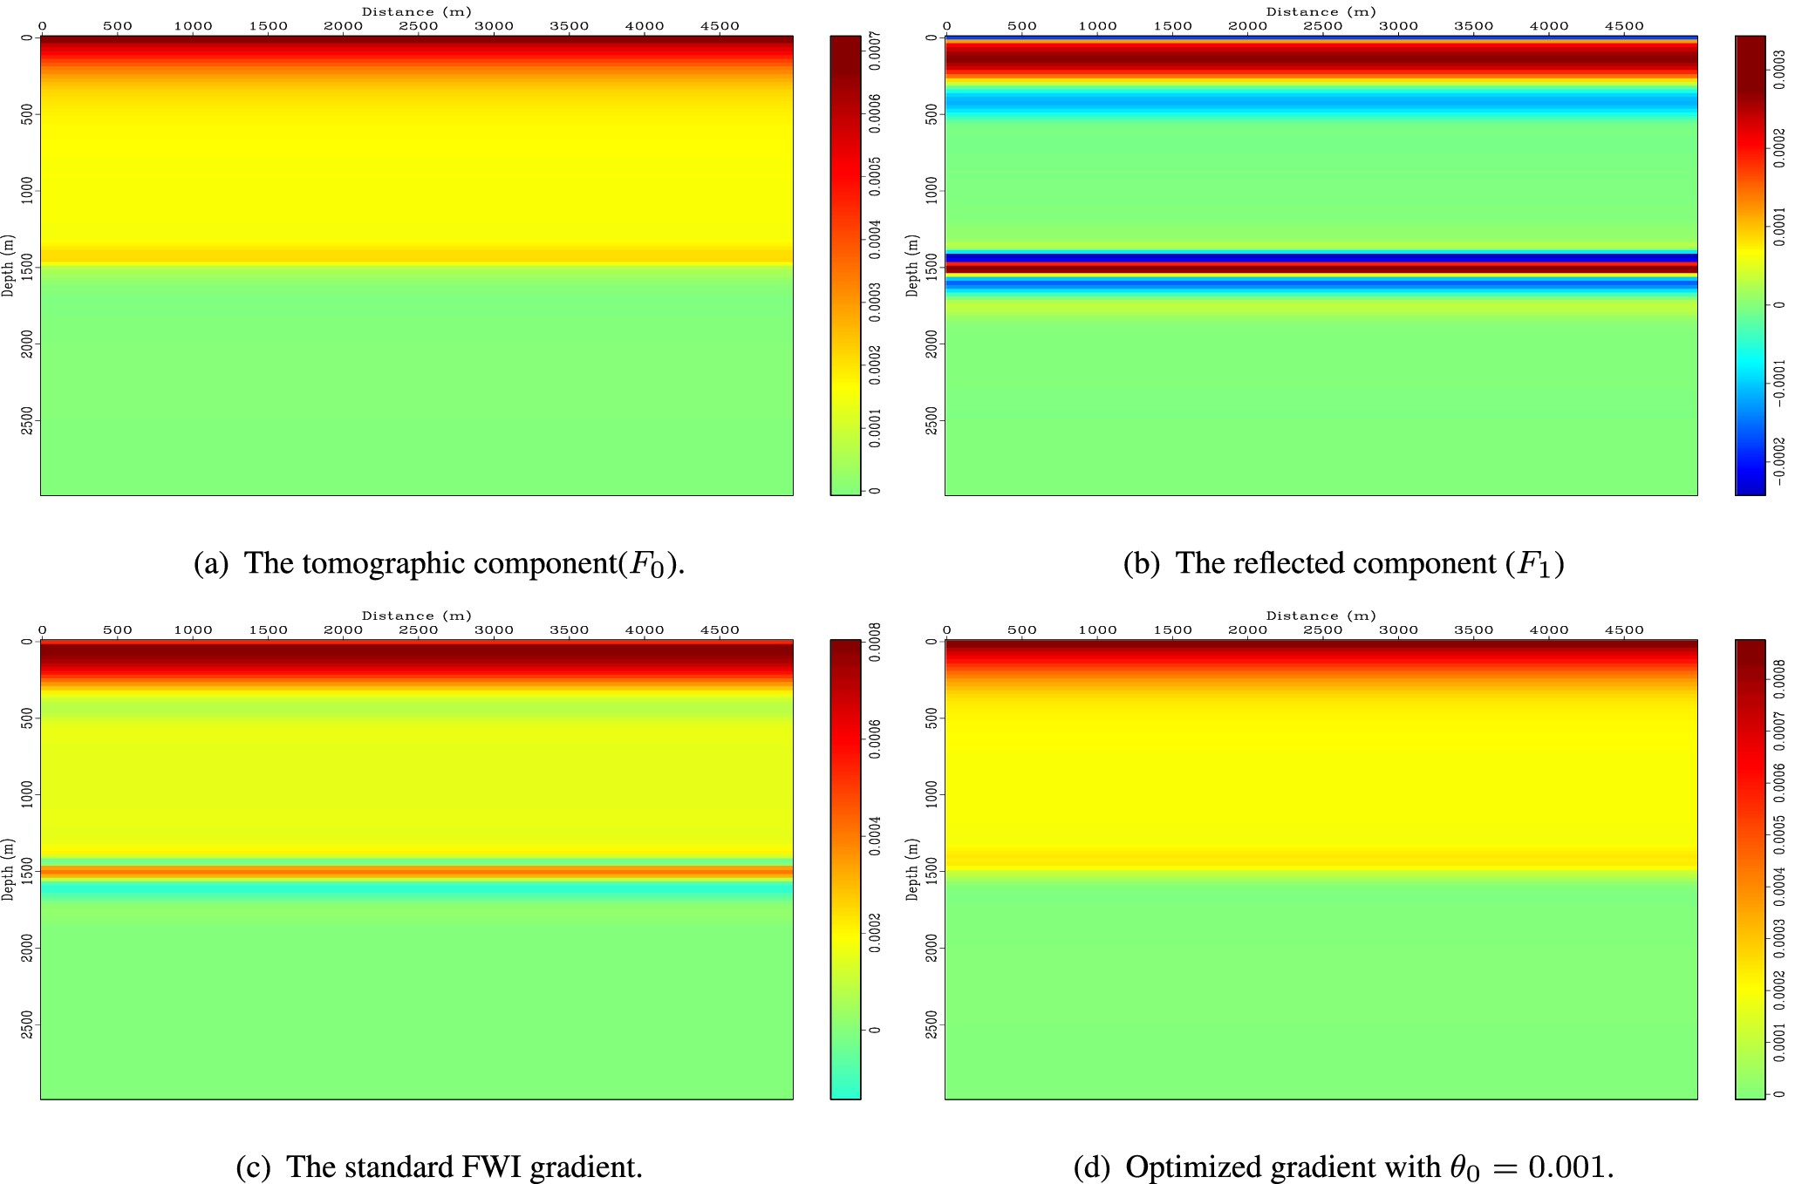
Figure 3. The gradient analysis for a higher background velocity.
Notes:
Figure 3. The gradient analysis for a higher background velocity.
Unless provided in the caption above, the following copyright applies to the content of this slide: © The Authors 2016. Published by Oxford University Press on behalf of The Royal Astronomical Society.

Slide 4
Figure 4. The source wavelet for generating the data set.
Notes:
Figure 4. The source wavelet for generating the data set.
Unless provided in the caption above, the following copyright applies to the content of this slide: © The Authors 2016. Published by Oxford University Press on behalf of The Royal Astronomical Society.

Slide 5
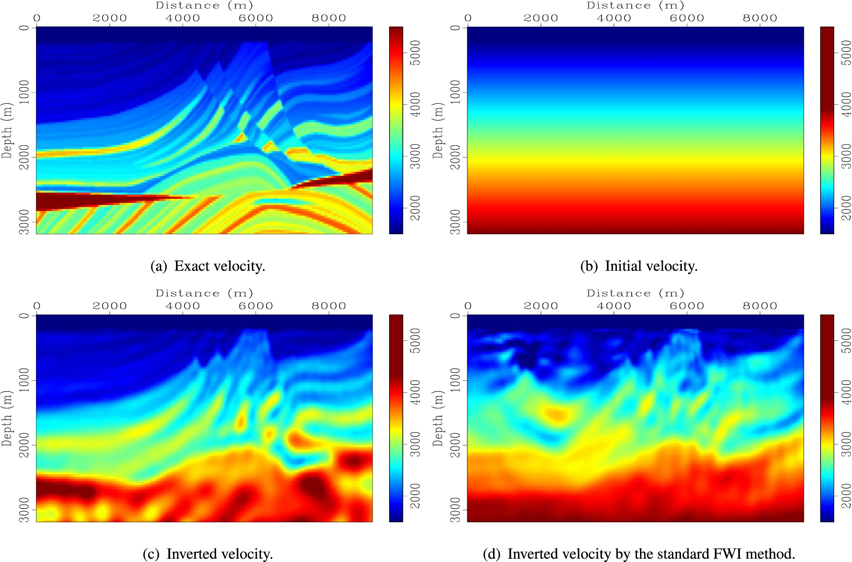
Figure 5. The velocity comparison.
Notes:
Figure 5. The velocity comparison.
Unless provided in the caption above, the following copyright applies to the content of this slide: © The Authors 2016. Published by Oxford University Press on behalf of The Royal Astronomical Society.

Slide 6
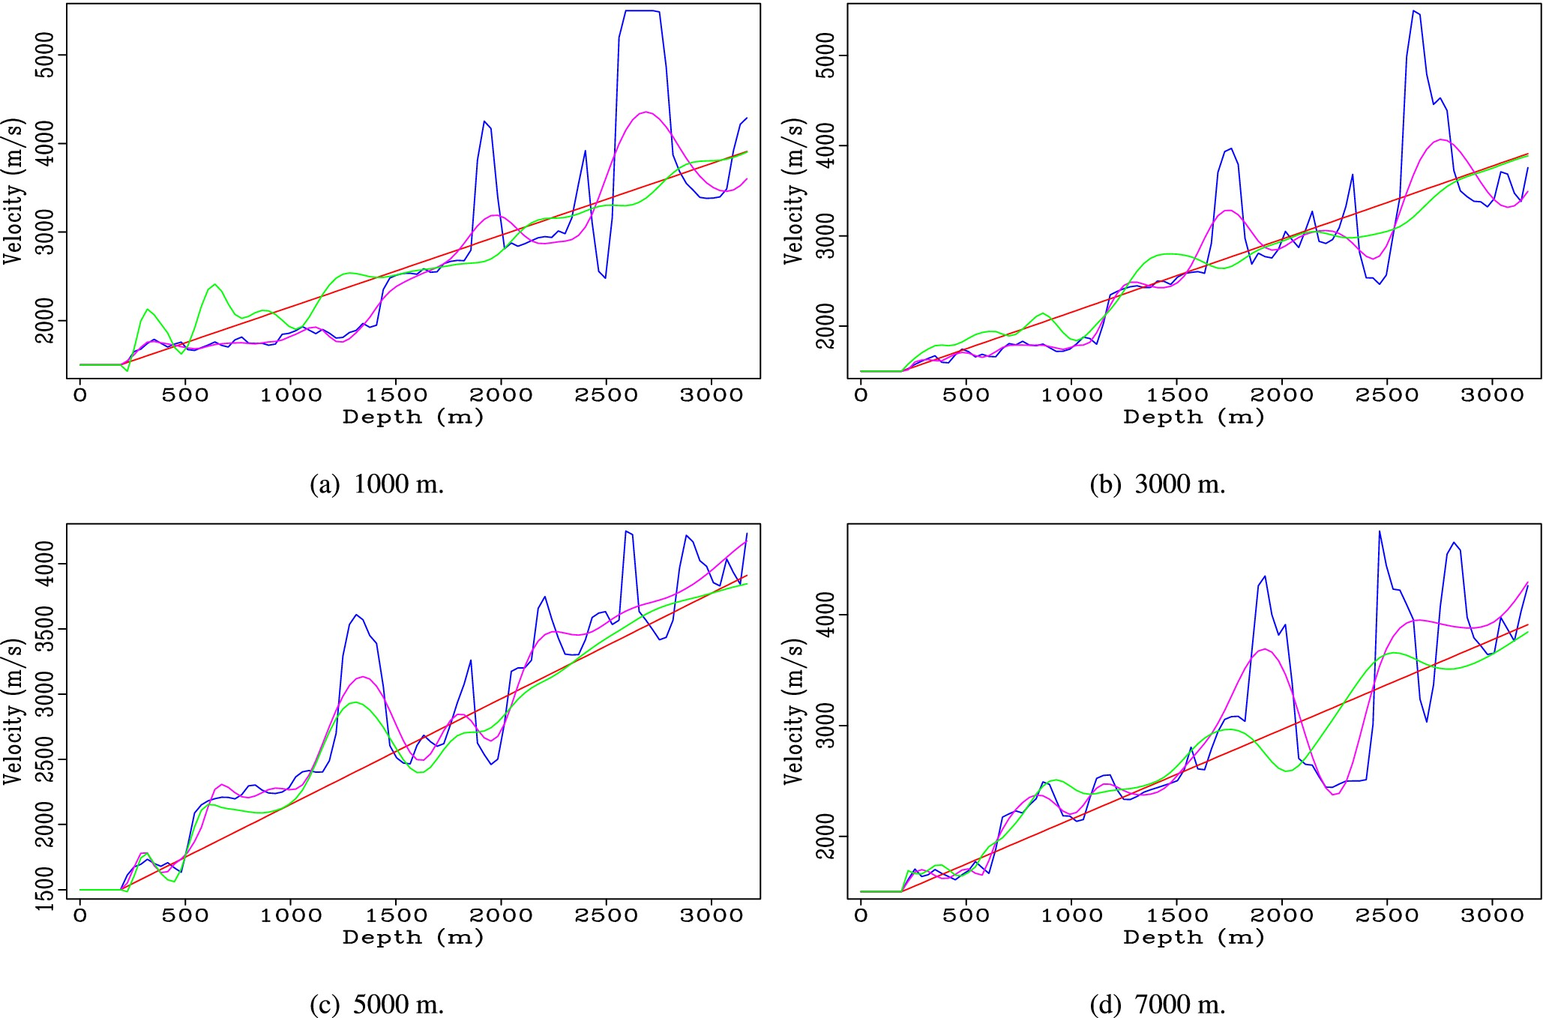
Figure 6. The velocity profile comparison. Pink: inverted velocity. Green: inverted velocity by standard FWI method. ...
Notes:
Figure 6. The velocity profile comparison. Pink: inverted velocity. Green: inverted velocity by standard FWI method. Blue: exact velocity. Red: initial velocity.
Unless provided in the caption above, the following copyright applies to the content of this slide: © The Authors 2016. Published by Oxford University Press on behalf of The Royal Astronomical Society.

Slide 7
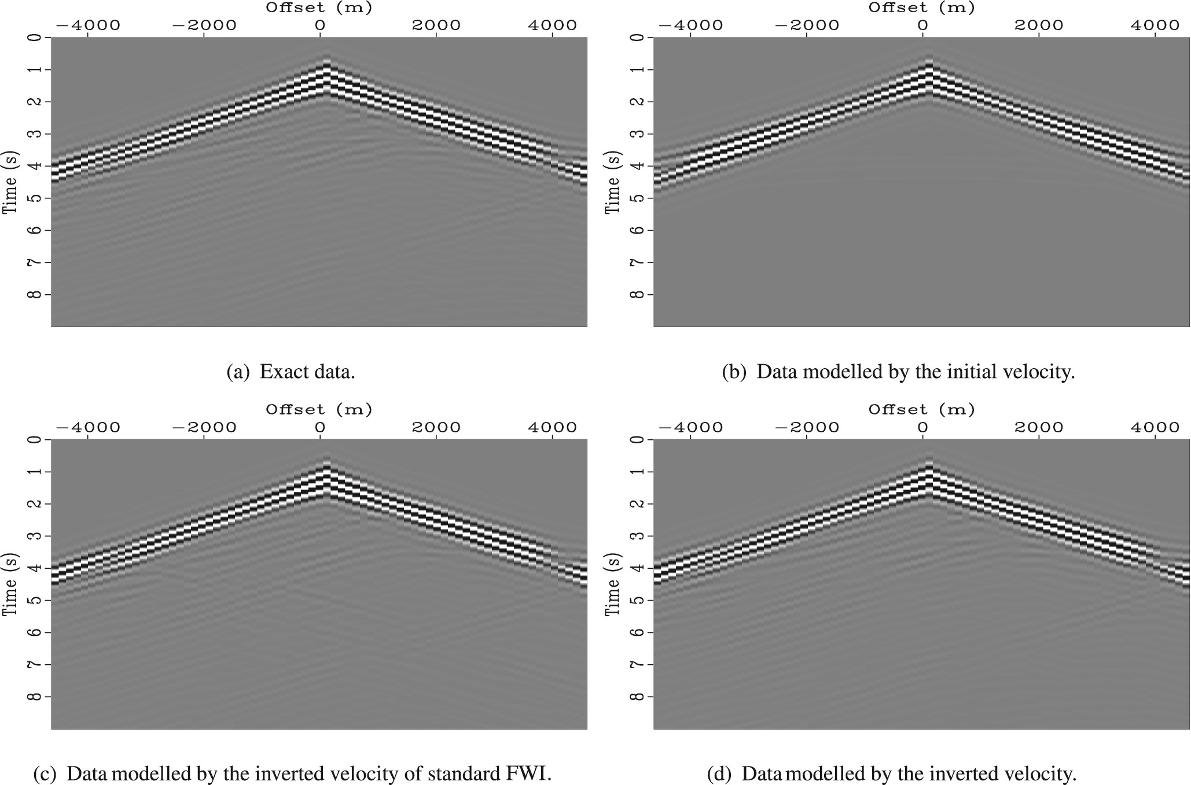
Figure 7. Data comparison.
Notes:
Figure 7. Data comparison.
Unless provided in the caption above, the following copyright applies to the content of this slide: © The Authors 2016. Published by Oxford University Press on behalf of The Royal Astronomical Society.

Slide 8
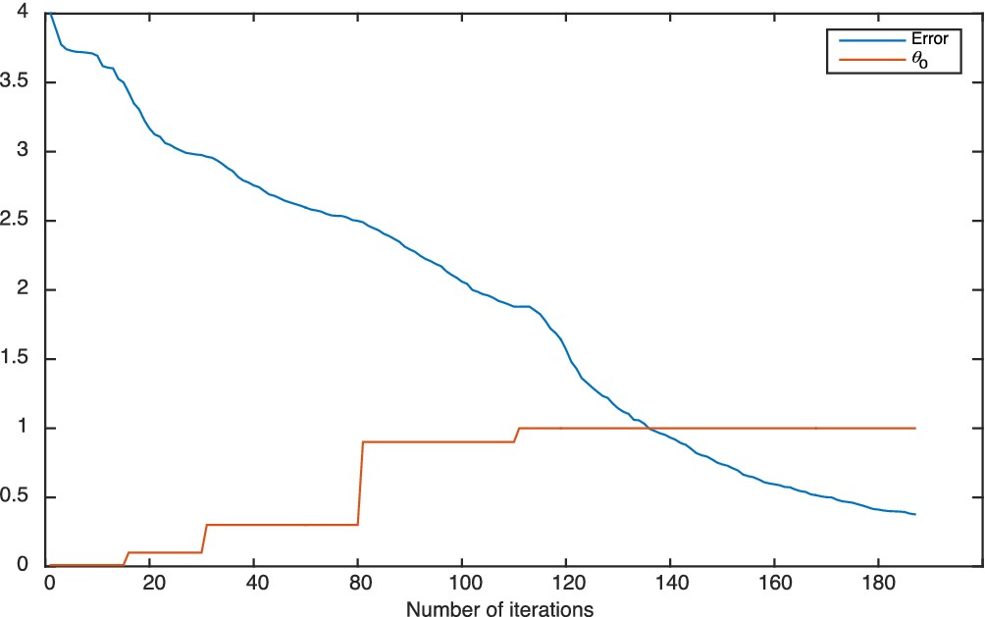
Figure 8. The history of convergence. Red curve: $\log _{10}{\frac{J}{\max J}}+4$. Blue curve: θ₀.
Notes:
Figure 8. The history of convergence. Red curve: $\log _{10}{\frac{J}{\max J}}+4$. Blue curve: θ0.
Unless provided in the caption above, the following copyright applies to the content of this slide: © The Authors 2016. Published by Oxford University Press on behalf of The Royal Astronomical Society.

