Slide 1
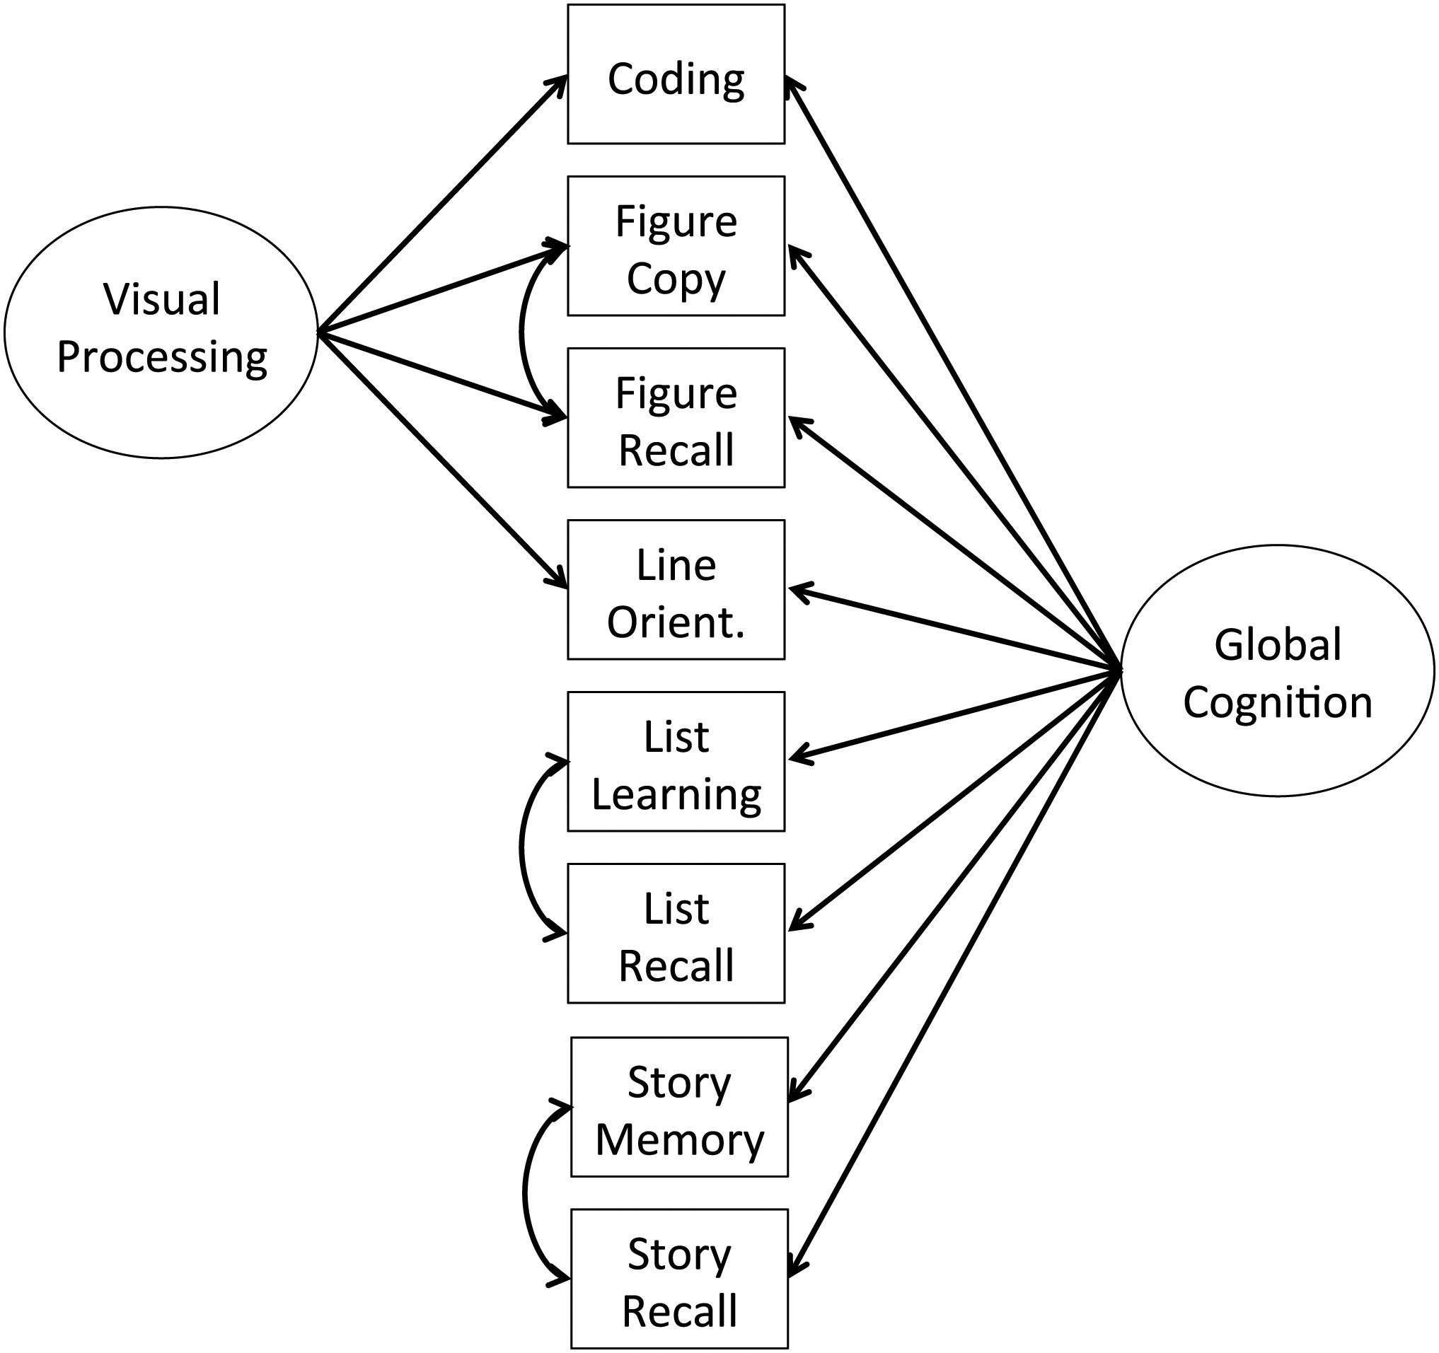
Fig. 1. The best fitting model was a bifactor version of the Duff and colleagues (2006) model, modified to account ...
Notes:
Fig. 1. The best fitting model was a bifactor version of the Duff and colleagues (2006) model, modified to account for method effects (curved double-headed arrows) and to eliminate the List Recognition test and Verbal Processing factor from the model.
Unless provided in the caption above, the following copyright applies to the content of this slide: © The Author 2015. Published by Oxford University Press. All rights reserved. For permissions, please e-mail: journals.permissions@oup.com.

Slide 2
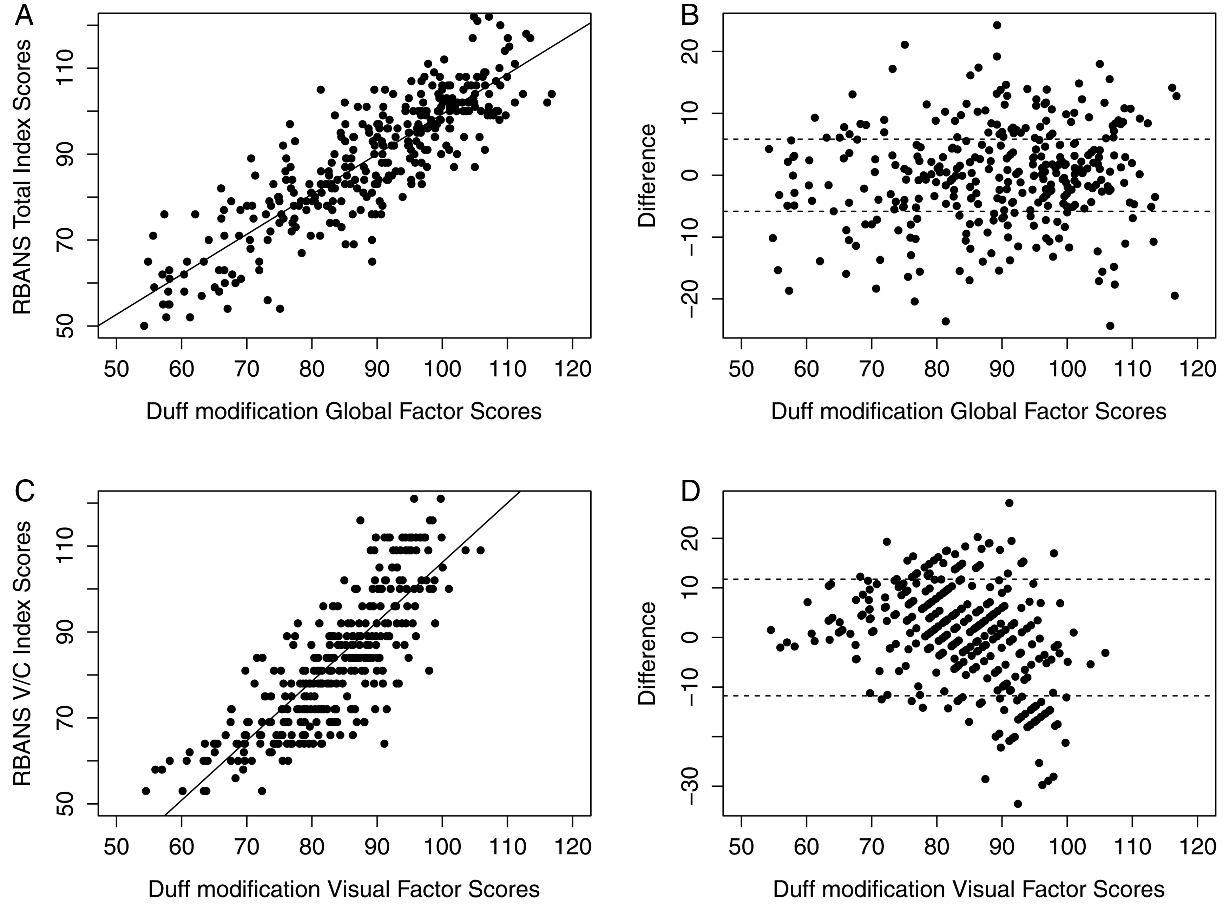
Fig. 2. Agreement between factor scores estimated from the alternative model (the bifactor modification of the Duff ...
Notes:
Fig. 2. Agreement between factor scores estimated from the alternative model (the bifactor modification of the Duff et al., 2006 model) and the Repeatable Battery for the Assessment of Neuropsychological Status (RBANS) Index Scores for global cognition (A and B) and visuospatial functioning (C and D). Panels on the left (A and C) show scatterplots between the alternative model factor scores on x axis and RBANS Index scores on y axis, with an ordinary least squares line of best fit drawn through the data. Panels on the right (B and D) show how differences between alternative model factor scores and RBANS Index scores (y axis) vary according to the alternative model factor scores (x axis). Higher difference scores are produced when alternative model factor scores are larger than RBANS Index scores. Dashed lines represent ±1 standard error of the estimate.
Unless provided in the caption above, the following copyright applies to the content of this slide: © The Author 2015. Published by Oxford University Press. All rights reserved. For permissions, please e-mail: journals.permissions@oup.com.

