Slide 1
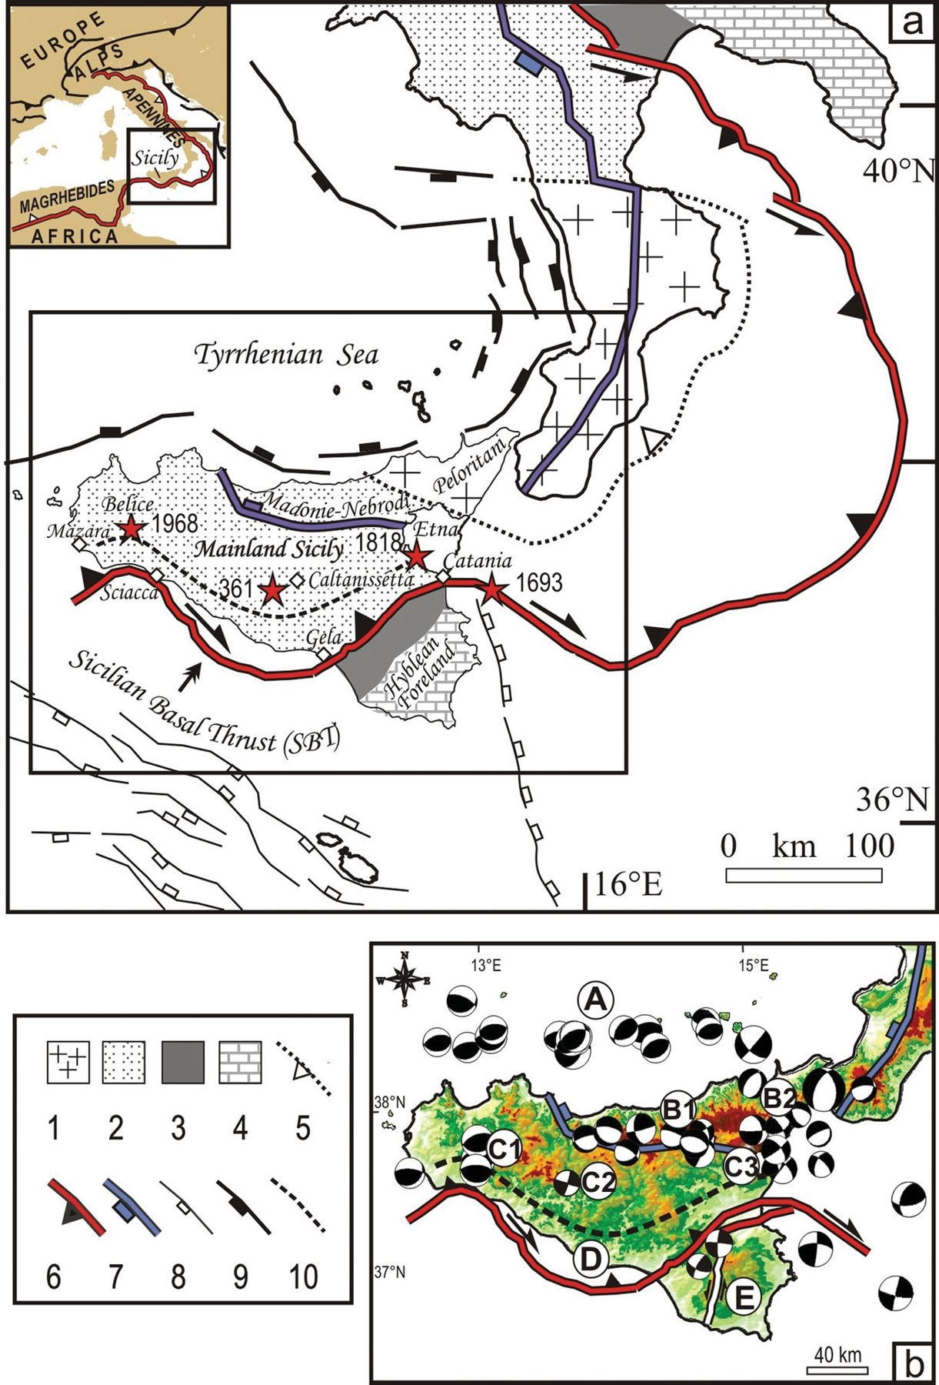
Figure 1 (a) Tectonic framework of the study area with the major structural domains of southern Italy (from Lavecchia ...
Notes:
Figure 1 (a) Tectonic framework of the study area with the major structural domains of southern Italy (from Lavecchia et al. 2007a). Key: (1) Calabria–Peloritani metamorphic thrust units; (2) Apennine–Maghrebide early Miocene to Quaternary fold-and-thrust system; (3) Plio-Quaternary deformed foredeep deposits; (4) Hyblean and Apulian foreland; (5) thrust front of the Alpine-derived Calabria–Peloritani units; (6) Outer thrust front of the Apennine–Maghrebide chain; (7) Outer extensional front of the intra-Apennine and Sicilian, Plio-Quaternary normal and normal-oblique faults; (8) Sicily Channel normal fault system and Malta Escarpment fault trace; (9) Tyrrhenian Sea normal faults; (10) southern boundary of the Mainland Sicily active compressional domain. The red stars refer to major Sicilian historical earthquakes (Mw≥ 6; Working Group CPTI 2004). (b) Fault plane solutions mechanisms for events with Mw≥ 4 in the period 1978–2010 at depths ≤40 km (Pondrelli et al. 2006 and references therein; RCMT database available online at http://www.bo.ingv.it/RCMT/Italydataset.html) integrated with the Belice 1968 and Reggio Calabria 1908 focal mechanisms as reported by Anderson & Jackson (1987). Five seismotectonic domains are labelled, from north to south: (A) southern Tyrrhenian compressive domain; (B) northern Sicily extensional domain including the Madonie-Nebrodi (B1) and the Peloritani (B2) areas; (C) mainland Sicily compressive domain, including the Mazara-Belice (C1), Caltanissetta (C2) and Etna (C3) areas; (D) Southern Sicily compressive domain from Sciacca to Gela and Catania and (E) Hyblean Foreland strike slip domain.
Unless provided in the caption above, the following copyright applies to the content of this slide: © The Authors Geophysical Journal International © 2012 RAS

Slide 2
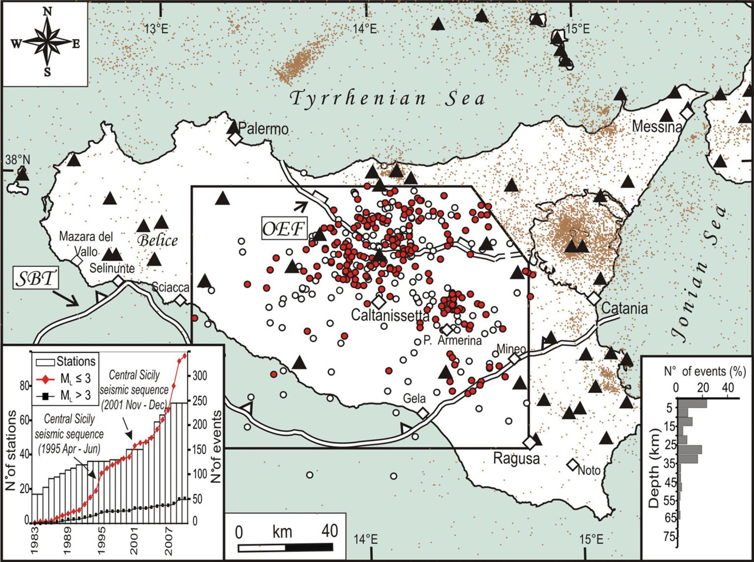
Figure 2 Preliminary relocations of 392 earthquakes (white and red circles) occurring within the central Sicily study ...
Notes:
Figure 2 Preliminary relocations of 392 earthquakes (white and red circles) occurring within the central Sicily study area from 1983 to 2010 (1.0 ≤ML≤ 4.7); the red circles are the epicentres of the 215 best-quality events. The brown dots represent the earthquakes that occurred in Sicily from 1983 to 2010 (Castello et al. 2005; ISB 2003–2010) and which were not analysed in this paper. The permanent seismic stations are reported with black triangles. The histogram within the bottom right inset shows the depth distribution of the preliminary relocated events. The diagram within the bottom left inset shows the number of seismic stations and cumulative number of earthquakes per year and per two ranges of magnitude. OEF and SBT stand for Outer Extensional Front and Sicilian Basal Thrust, respectively.
Unless provided in the caption above, the following copyright applies to the content of this slide: © The Authors Geophysical Journal International © 2012 RAS

Slide 3
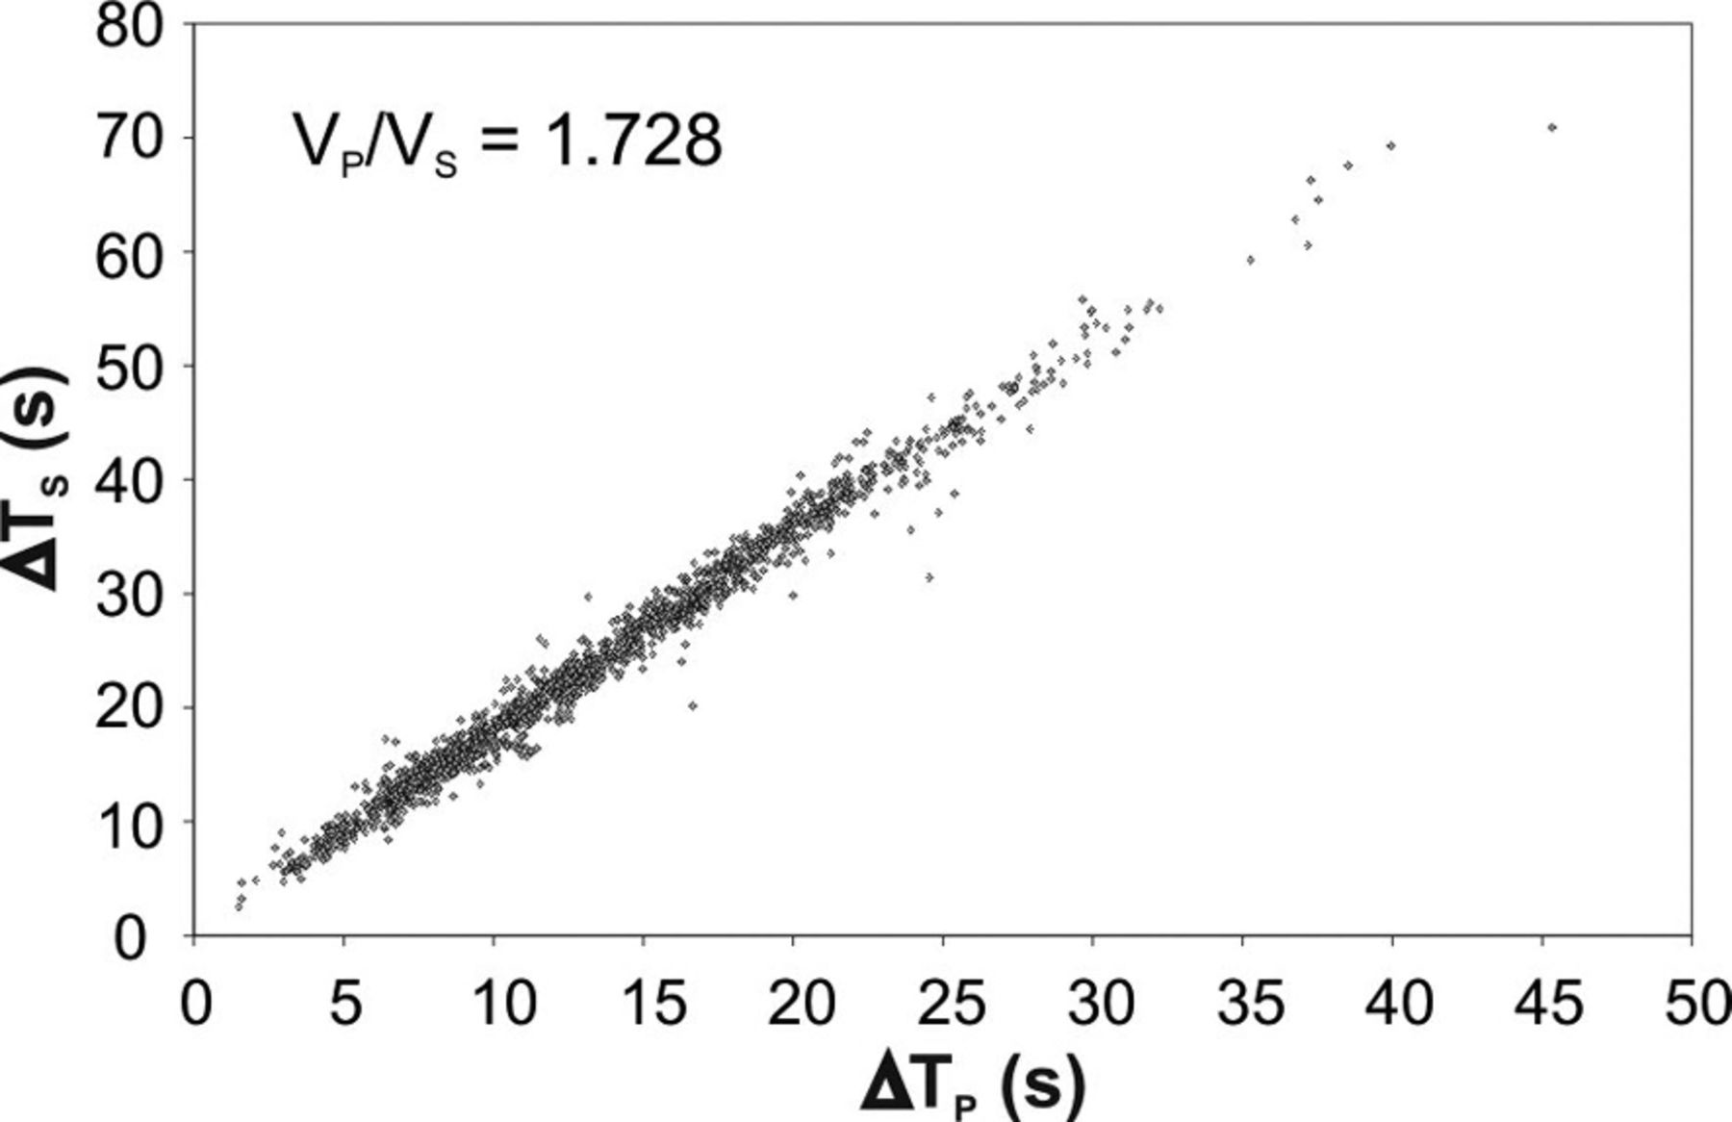
Figure 3 Cumulative Wadati diagram; the data set consists in 1565 P- and S-phase arrival times associated to 215 ...
Notes:
Figure 3 Cumulative Wadati diagram; the data set consists in 1565 P- and S-phase arrival times associated to 215 selected earthquakes (red circles in Fig. 2).
Unless provided in the caption above, the following copyright applies to the content of this slide: © The Authors Geophysical Journal International © 2012 RAS

Slide 4
Figure 4 Compilation of P-wave velocity models from the literature for Sicily, computed by Chiarabba & Frepoli 1997 ...
Notes:
Figure 4 Compilation of P-wave velocity models from the literature for Sicily, computed by Chiarabba & Frepoli 1997 (model a); Chironi et al. 2000 (models b and c); Lavecchia et al. 2007a (model d), Barberi et al. 2004 and Billi et al. 2010 (models e–g).
Unless provided in the caption above, the following copyright applies to the content of this slide: © The Authors Geophysical Journal International © 2012 RAS

Slide 5
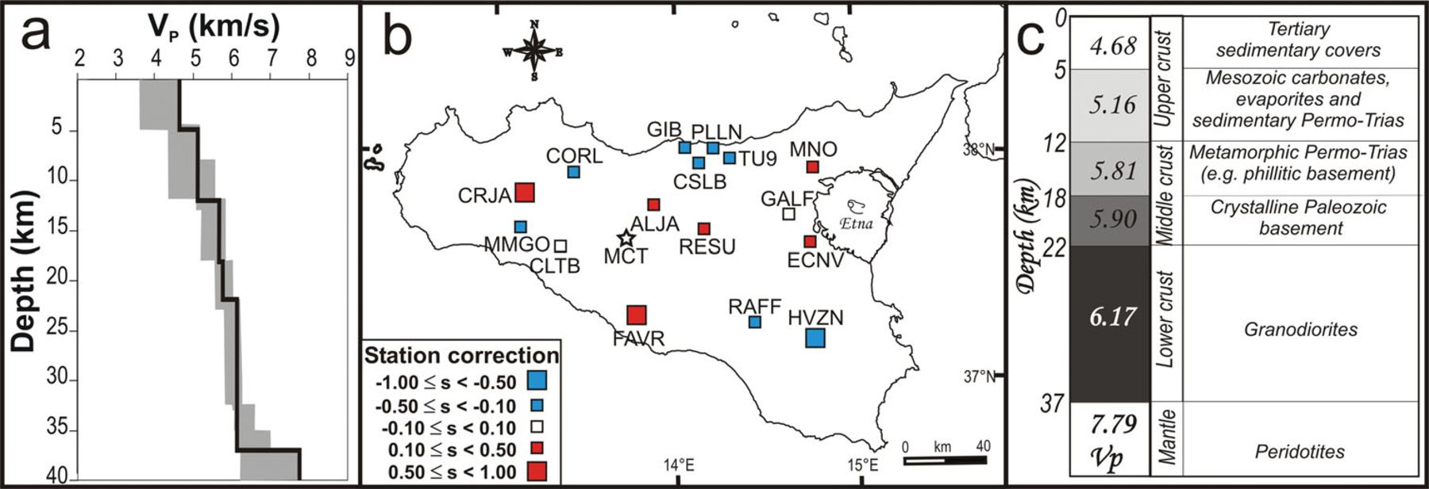
Figure 5 1-D velocity model and crustal structure in central Sicily. (a) New 1-D velocity model (black line) ...
Notes:
Figure 5 1-D velocity model and crustal structure in central Sicily. (a) New 1-D velocity model (black line) calculated in this work, enclosing in the grey area representing the range of variability of the output velocity model. (b) Station corrections computed from the inversion; positive values, observed mostly in central Sicily and near the Mt Etna volcanic area indicate low velocities; negative values, observed mostly outward of the study area, indicate high velocities. (c) Lithostratigraphic interpretation of the new velocity model.
Unless provided in the caption above, the following copyright applies to the content of this slide: © The Authors Geophysical Journal International © 2012 RAS

Slide 6
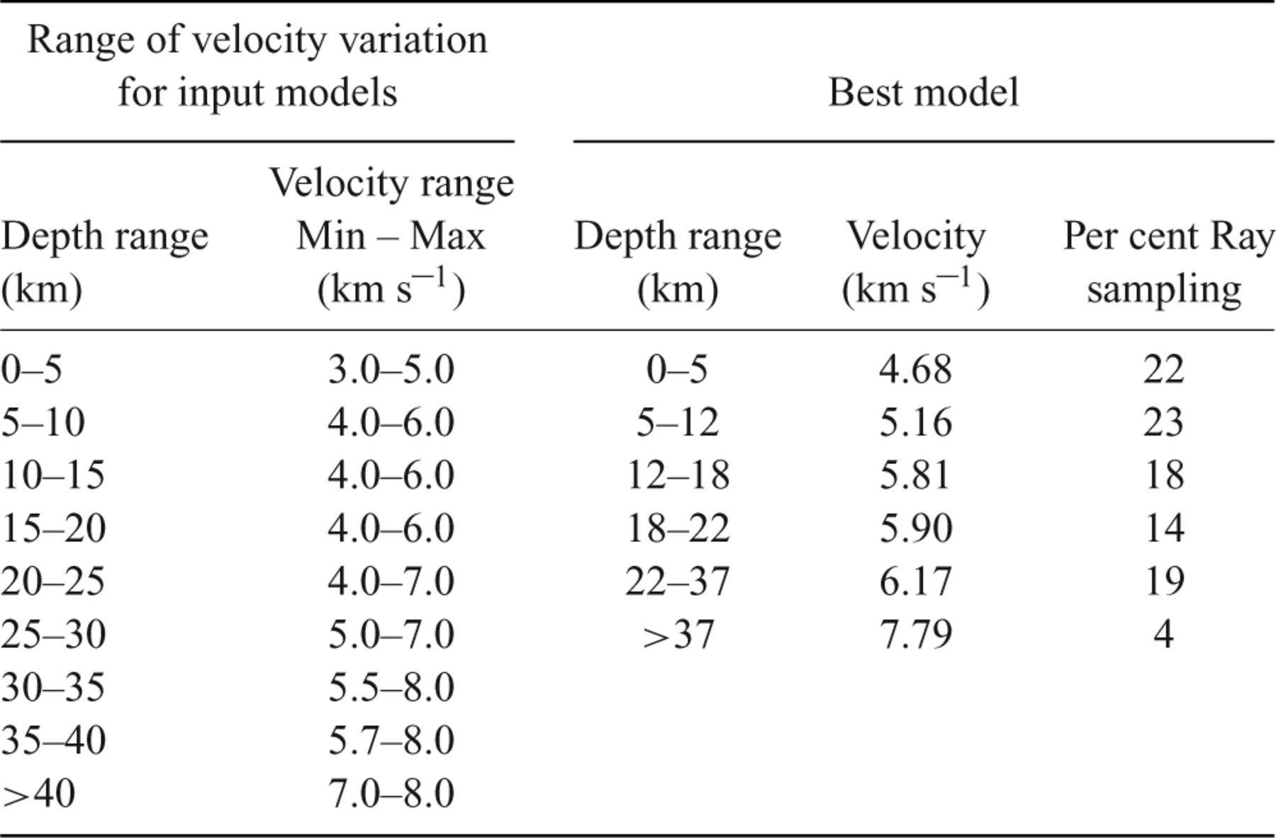
Table 1 Range of velocity variation for input models, velocity values of the best model for the central Sicily ...
Notes:
Table 1 Range of velocity variation for input models, velocity values of the best model for the central Sicily computed with VELEST code and percentage of ray sampling within the layers of the best model.
Unless provided in the caption above, the following copyright applies to the content of this slide: © The Authors Geophysical Journal International © 2012 RAS

Slide 7
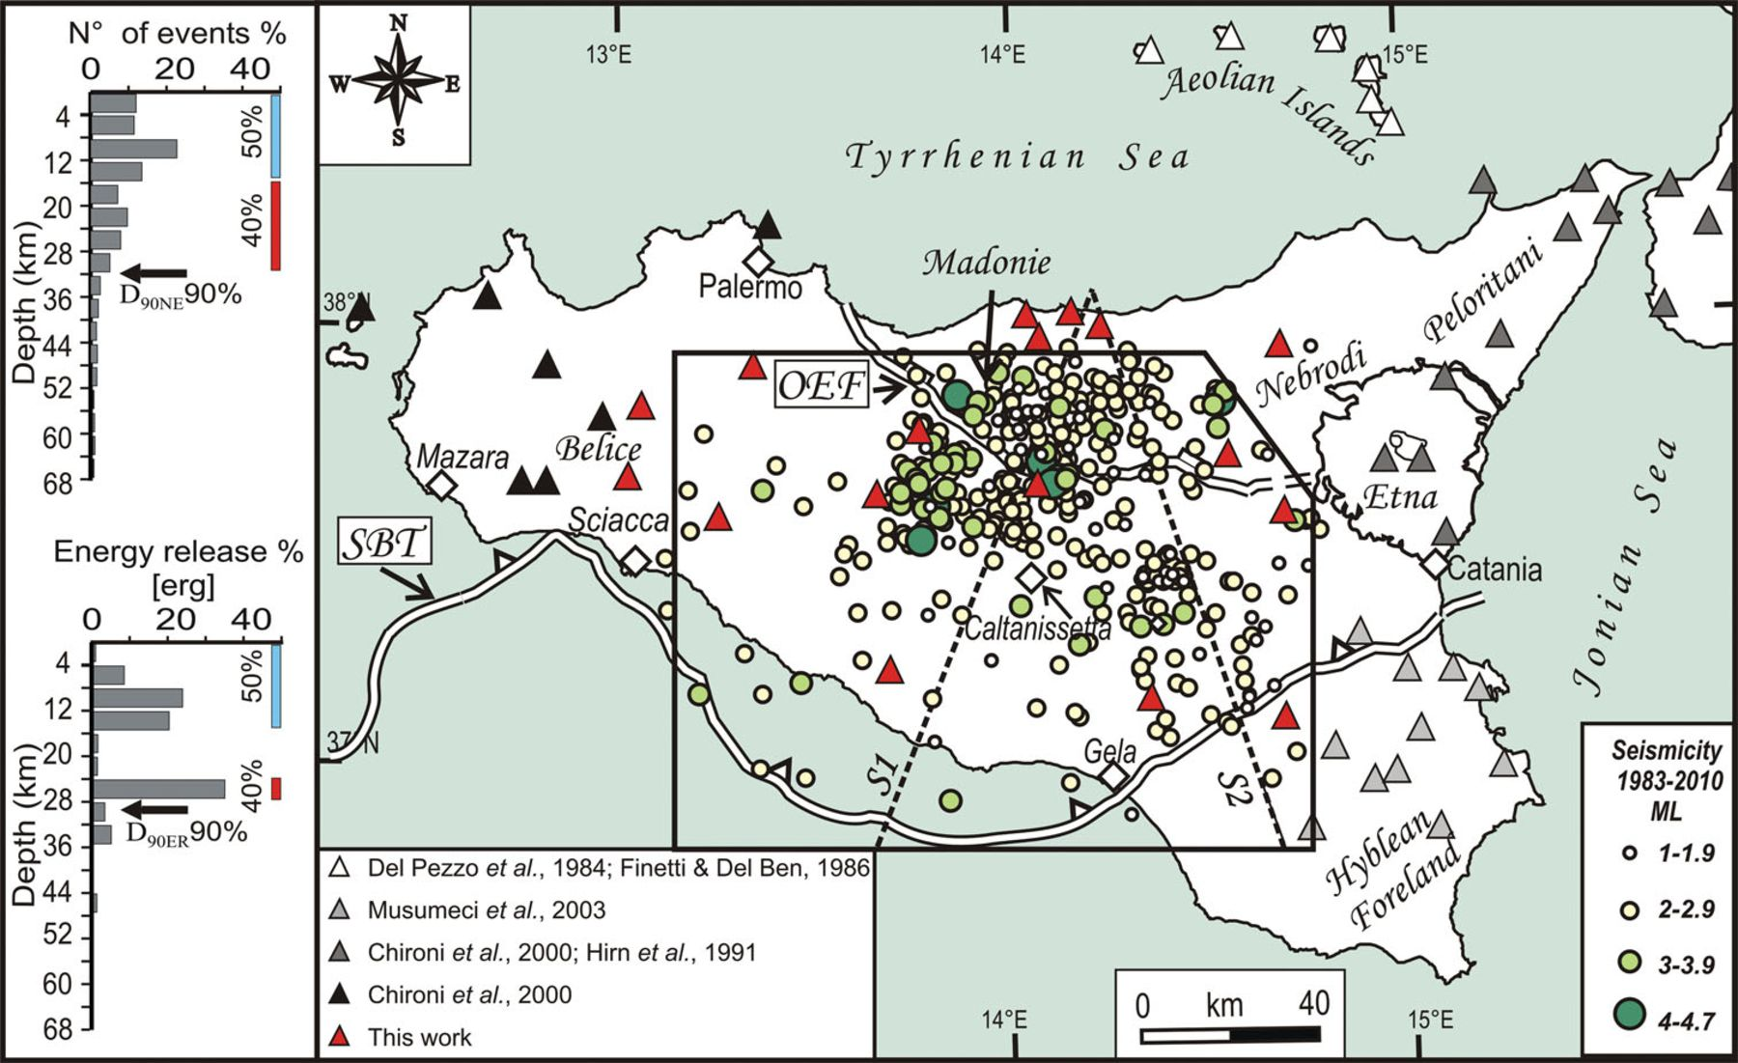
Figure 6 Final relocation of 392 earthquakes that occurred from 1983 December to 2010 April within the study area; ...
Notes:
Figure 6 Final relocation of 392 earthquakes that occurred from 1983 December to 2010 April within the study area; magnitude scales are also reported. The triangles represent the seismic stations, and their colours are related to the different velocity models used for the relocation, depending on the seismotectonic domain where the stations are placed. The dotted black lines (S1 and S2) show the trace of the sections in Figs 7 and 9. The insets at the left side represent the depth distribution and the energy release versus depth of the best relocated events (quality A and B).
Unless provided in the caption above, the following copyright applies to the content of this slide: © The Authors Geophysical Journal International © 2012 RAS

Slide 8
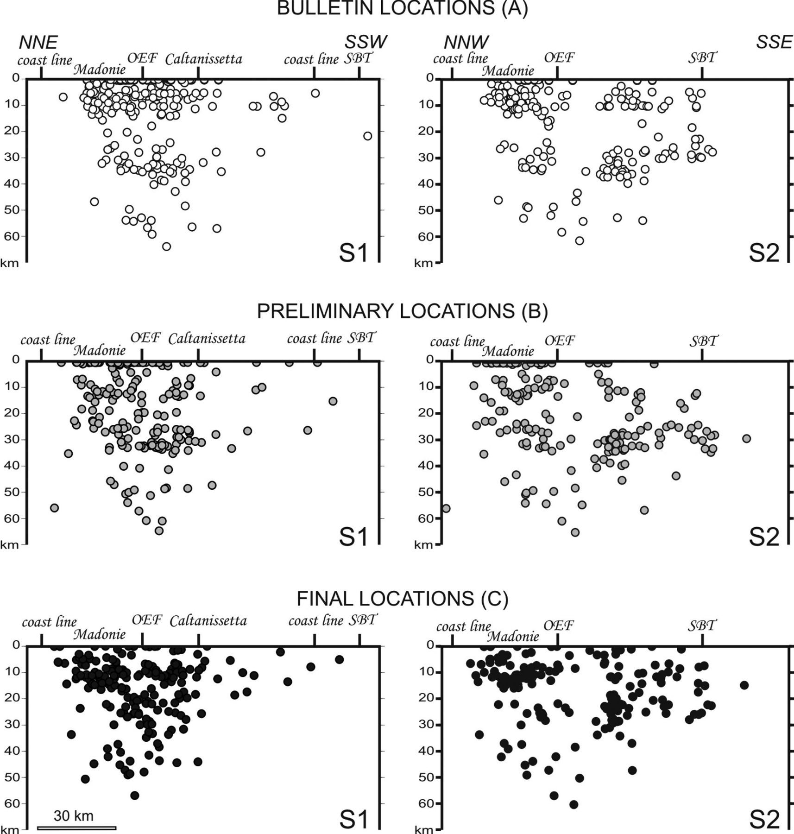
Figure 7 Section view of the 1983 December–2010 April central Sicily instrumental seismicity and projected along the ...
Notes:
Figure 7 Section view of the 1983 December–2010 April central Sicily instrumental seismicity and projected along the traces of the S1 and S2 sections of Fig. 6, assuming a semiwidth of 20 km. Bulletin locations (A) were extracted from national seismic bulletins (Castello et al. 2005; ISB 2003–2010); preliminary locations (B) were obtained assuming the velocity model of Chiarabba et al. (2005); final locations (C) are the ones that were relocated here, using the new velocity model calculated for central Sicily and the velocity models taken from the literature for the surrounding seismotectonic domains. The positions along the profiles of the Outer Extensional Front (OEF) and of the Sicilian Basal Thrust (SBT) front are also shown.
Unless provided in the caption above, the following copyright applies to the content of this slide: © The Authors Geophysical Journal International © 2012 RAS

Slide 9
Table 2 Location parameters: limit value for GAP, rms and horizontal and vertical errors used to determine the ...
Notes:
Table 2 Location parameters: limit value for GAP, rms and horizontal and vertical errors used to determine the location quality.
Unless provided in the caption above, the following copyright applies to the content of this slide: © The Authors Geophysical Journal International © 2012 RAS

Slide 10
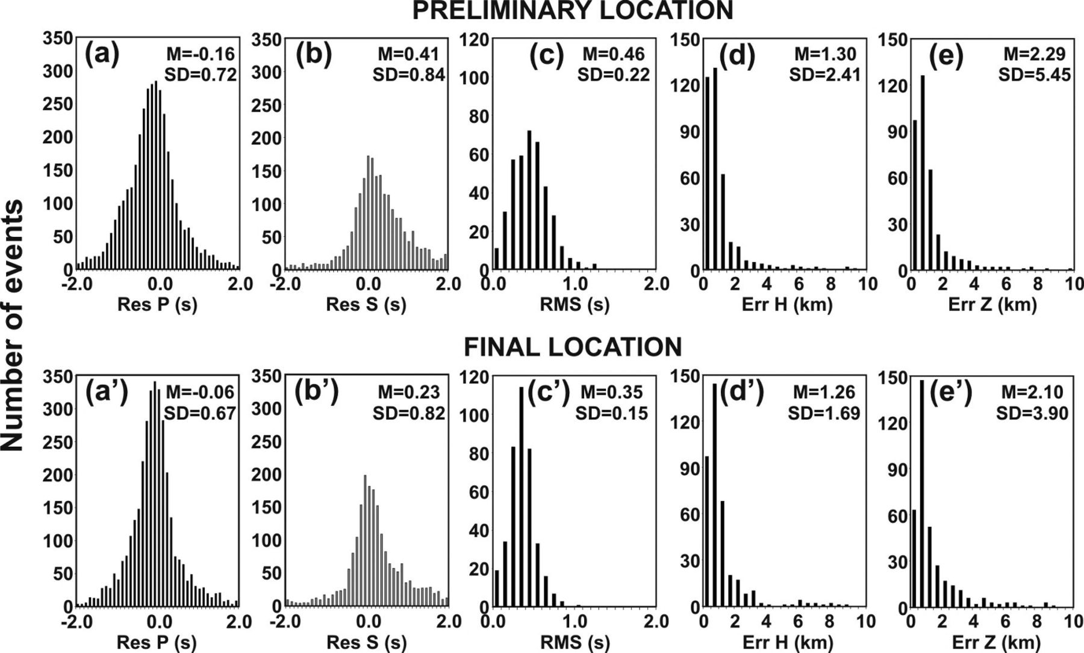
Figure 8 Comparison of quality parameters between the preliminary relocations and the final relocations; the ...
Notes:
Figure 8 Comparison of quality parameters between the preliminary relocations and the final relocations; the histograms show P- (a and a′) and S-phase (b and b′) residuals, rms (seconds, c and c′), horizontal (d and d′) and vertical (e and e′) errors (kilometres) versus the number of events obtained from the preliminary and the final relocation procedure. Within each box, the values of mean (M) and standard deviation (SD) are also reported to highlight the improvement in the location procedure from the preliminary to the final locations.
Unless provided in the caption above, the following copyright applies to the content of this slide: © The Authors Geophysical Journal International © 2012 RAS

Slide 11
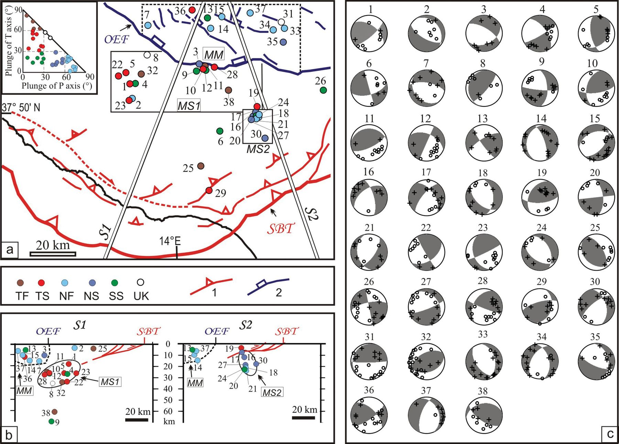
Figure 9 New fault plane solutions in central Sicily. (a) Location map of the focal mechanisms computed in this study. ...
Notes:
Figure 9 New fault plane solutions in central Sicily. (a) Location map of the focal mechanisms computed in this study. The different colours of the epicentres refer to the kinematic classification as derived from the Frohlich (1992) diagram based on the plunge of T and P axes (uppermost left side inset); Key: TF, thrust fault; TS, thrust-strike fault; NF, normal fault; NS, normal-strike fault; SS, strike slip; UK, unknown kinematics. The three areas labelled as MS1 (Mainland Sicily 1), MS2 (Mainland Sicily 2) and MM (Madonie Mountains) refer to the grouping of focal mechanisms used in Fig. 10 to compute the average focal solutions. Also shown on the map are the major Plio-Quaternary tectonic structures within the epicentral area: normal and normal-oblique faults in northern Sicily (blue lines), dip-slip and oblique thrust in southern Sicily (red lines). The Outer Extensional Front (OEF) and the Sicilian Basal Trust (SBT) are also indicated. (b) Depth distribution of the new mechanisms projected along the traces of the sections S1 and S2; the hypocentral colours refer to the kinematic classification. (c) New focal mechanism solutions; the source parameters, the quality and the kinematics of the focal mechanisms are listed in Table 3.
Unless provided in the caption above, the following copyright applies to the content of this slide: © The Authors Geophysical Journal International © 2012 RAS

Slide 12
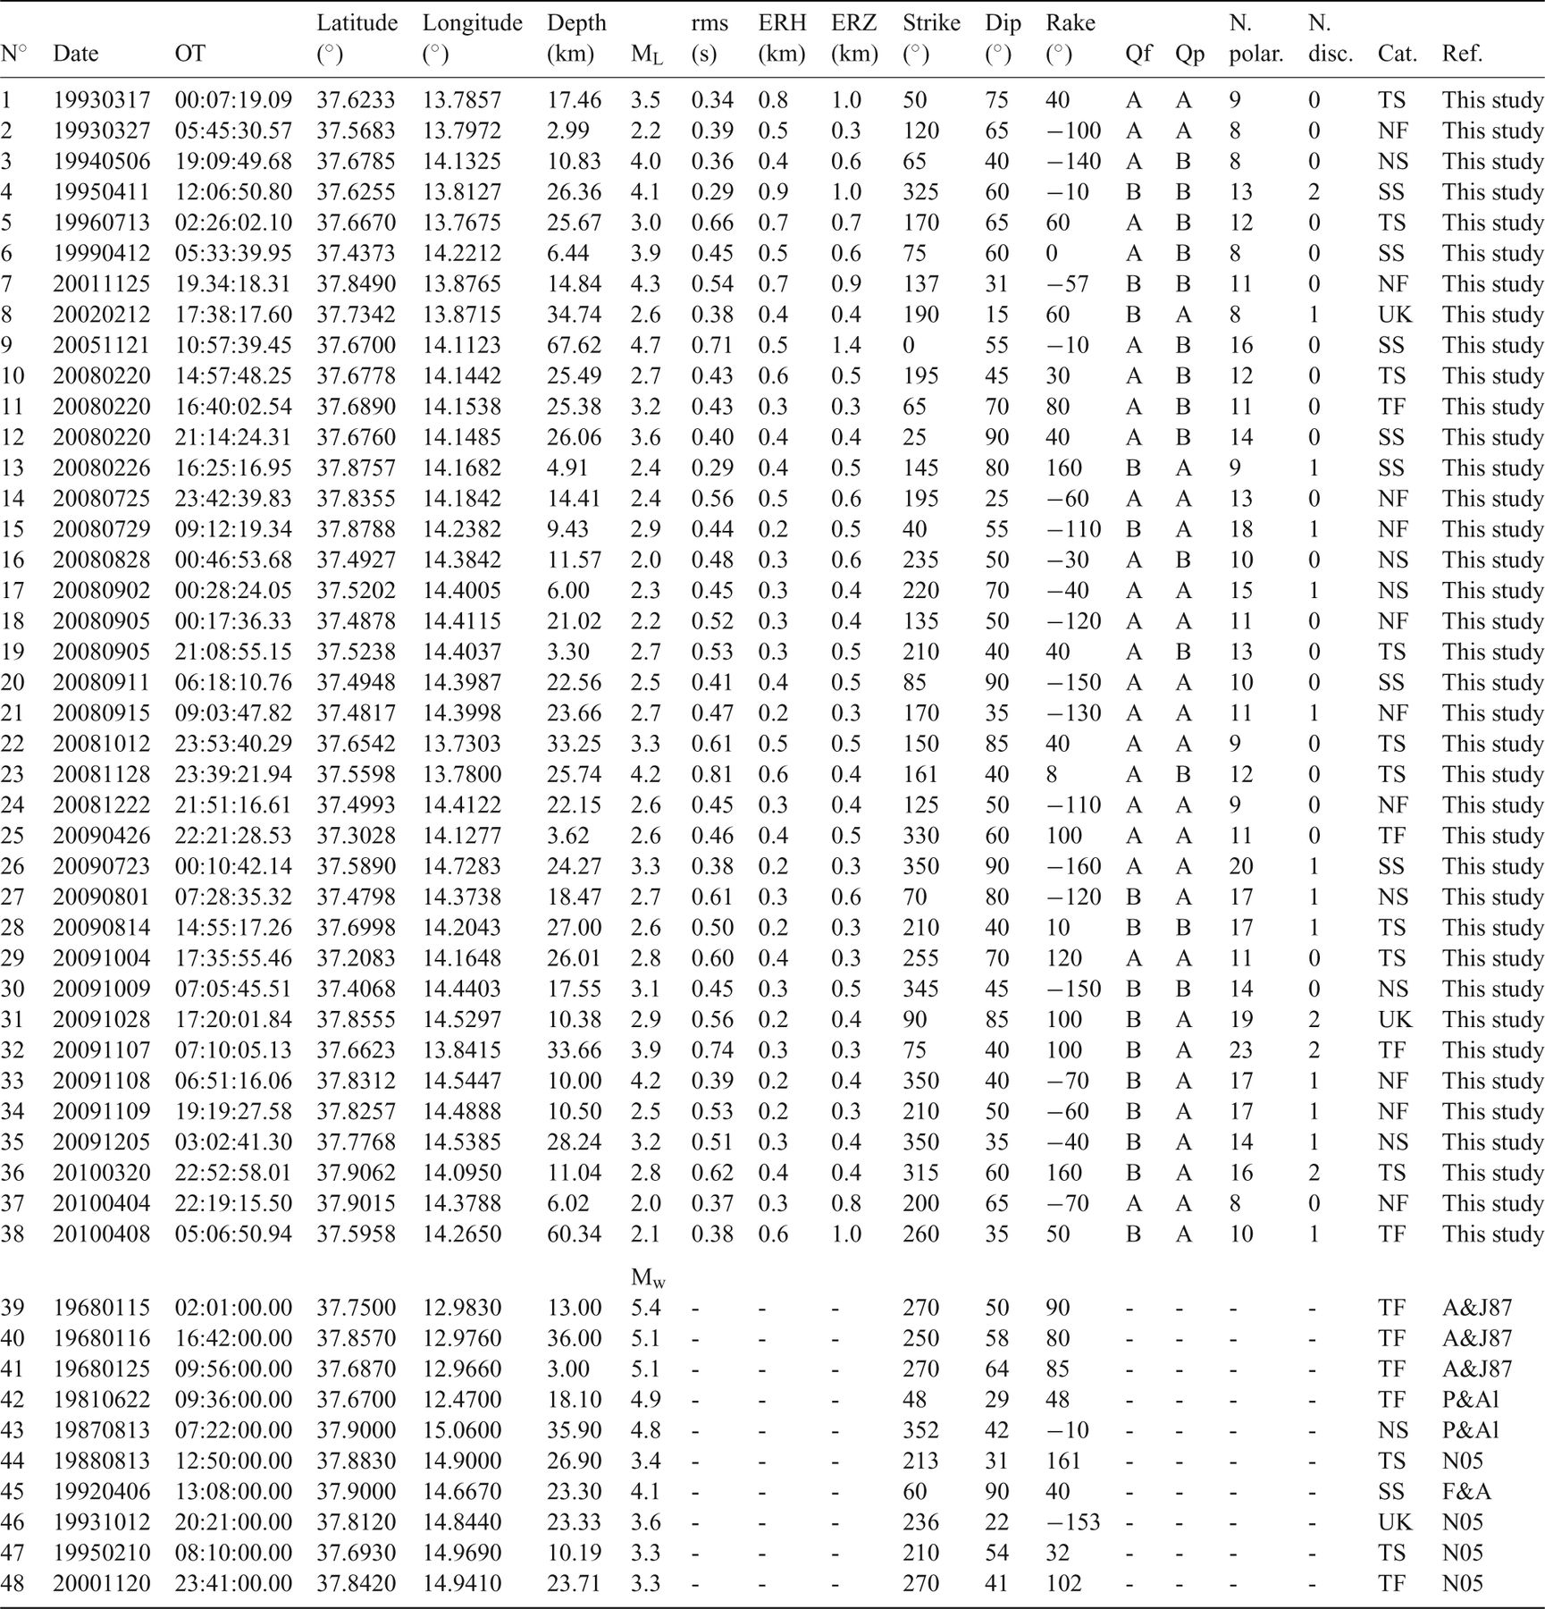
Table 3
Notes:
Table 3
Unless provided in the caption above, the following copyright applies to the content of this slide: © The Authors Geophysical Journal International © 2012 RAS

Slide 13
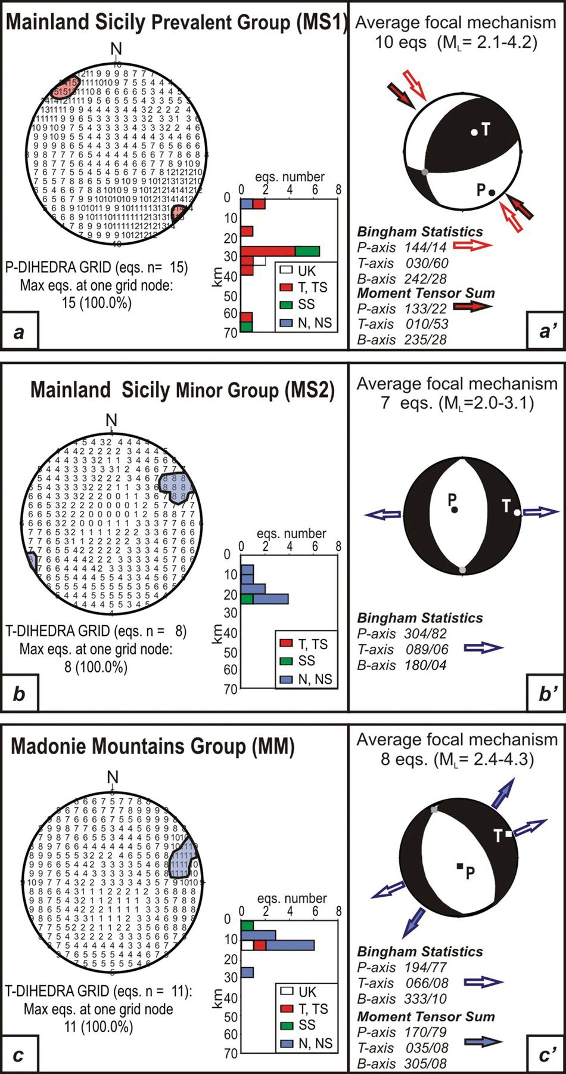
Figure 10 Strain axes and average focal mechanisms in central Sicily. The dihedral grid construction (after Angelier & ...
Notes:
Figure 10 Strain axes and average focal mechanisms in central Sicily. The dihedral grid construction (after Angelier & Mechler 1977) is applied to the three groups of focal mechanisms (MS1, MS2 and MM as in Fig. 9) The red and blue areas in the projection grids (a, b, c) highlight the P- and T-axes distribution; the histograms report the number of focal mechanisms for each group and the corresponding kinematics versus depths. The average focal mechanisms (a′, b′ and c′) are evaluated with the focal solutions related to the prevalent kinematics in each group, through application of the linked Bingham statistics (data not weighted for seismic moment) and/or of the moment tensor summation. The red and blue arrows represent the maximum shortening and stretching direction, respectively.
Unless provided in the caption above, the following copyright applies to the content of this slide: © The Authors Geophysical Journal International © 2012 RAS

Slide 14
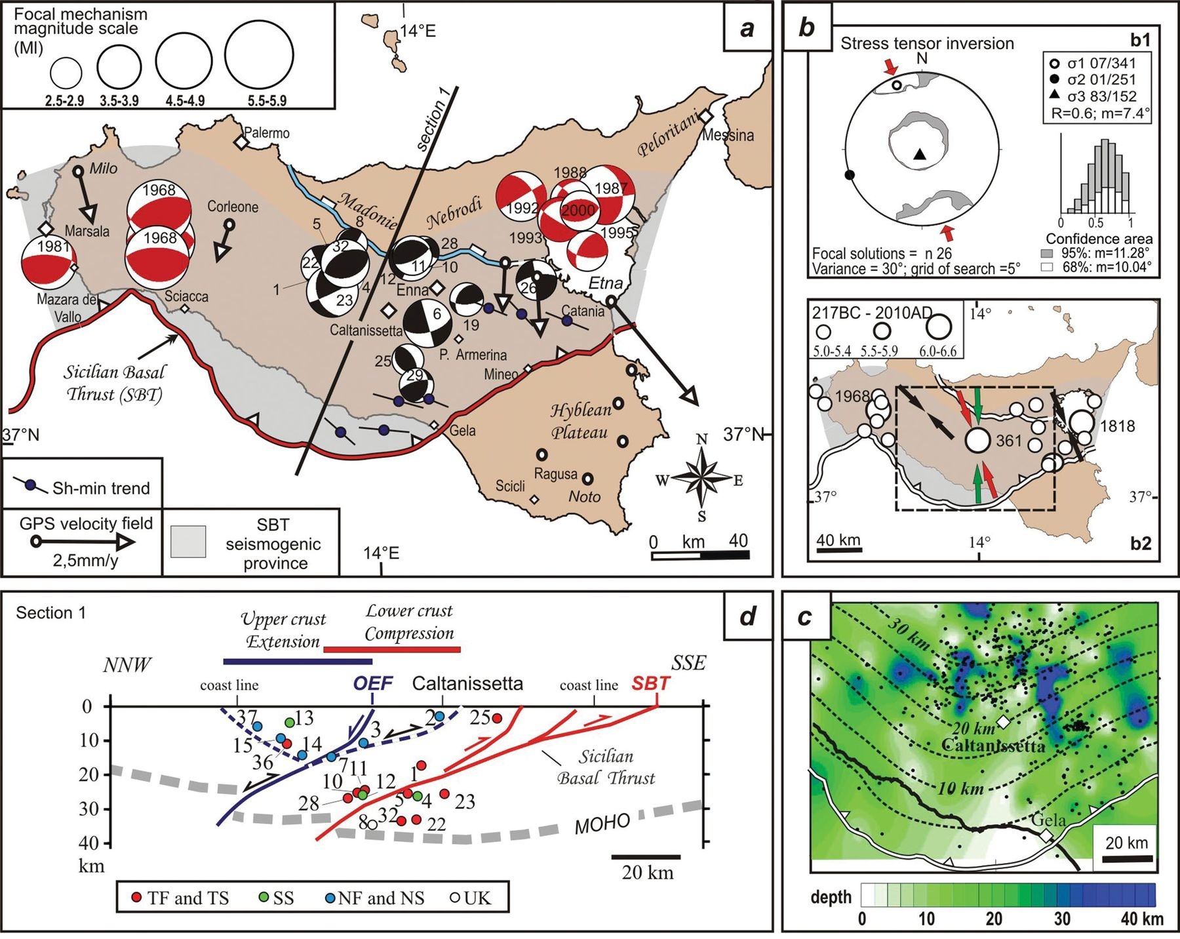
Figure 11 Summary of the results and the seismotectonic interpretation of central Sicily. (a) Distribution of focal ...
Notes:
Figure 11 Summary of the results and the seismotectonic interpretation of central Sicily. (a) Distribution of focal mechanisms within the boundary of the SBT seismogenic province (grey transparent area, after Lavecchia et al. 2007a). The black beach balls are the new focal mechanisms computed in this study; the red ones are those available in the literature (see text and Table 3). The black arrows represent the velocity field measured from continuous GPS stations within the boundary of the SBT seismogenic province with respect to fixed sites (white circles) within the Hyblean foreland (from Devoti et al. 2011); the shear-minimum (Shmin) axes refer to the borehole breakout data (from Montone et al. 2004). (b) Stress tensor inversion results from the 26 focal mechanisms reported on the map. (b1) Stereographic lower-hemisphere projection of the best-fitting principal stress axes (σ1, σ2 and σ3) and of their 68 and 95 per cent confidence ranges; the histogram refers to the distribution of the number of tested stress models within the 68 and 95 per cent confidence ranges referring to the dimensionless R shape factor. (b2) Comparison among the calculated minimum principal stress axis (σ1; red arrows in b1 and b2) are the ones proposed by Neri et al. (2005) (black arrows) and the direction of the horizontal contractional component of the average strain tensor computed by Visini et al. (2010) (green arrows). The epicentres (white circles) of the historical and instrumental earthquakes with Mw≥ 5.0 and depths ≤40 km located within the boundary of the SBT seismogenic province are also reported. (c) Contour depth lines of the central Sicily final relocations compared with the contour depth lines of the Sicilian Basal Thrust as reconstructed by Lavecchia et al. 2007a. (d) Interpretative depth view of the central Sicily seismicity; the hypocentres of the focal mechanisms computed in this paper, coloured on the basis of their kinematics (see key in Fig. 9), are projected along the trace of Section 1 and compared with the crustal geometry of the major tectonic structures as interpreted by Lavecchia et al. 2007(a).
Unless provided in the caption above, the following copyright applies to the content of this slide: © The Authors Geophysical Journal International © 2012 RAS

