Slide 1
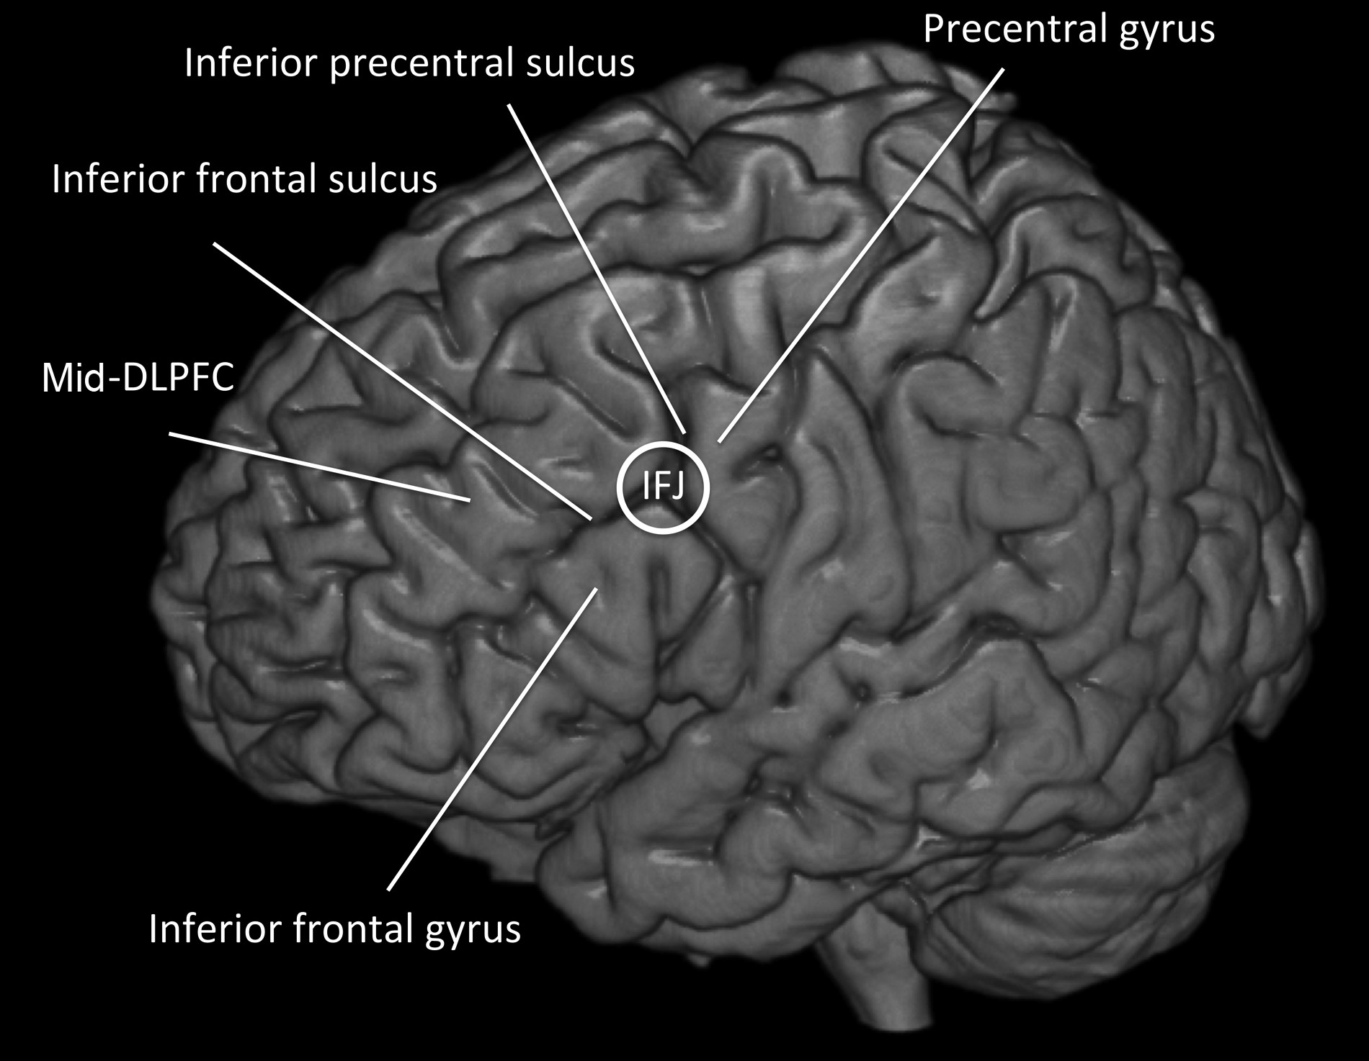
Figure 1. Illustration of the anatomical locations of the IFJ and adjacent areas within the LPFC.
Notes:
Figure 1. Illustration of the anatomical locations of the IFJ and adjacent areas within the LPFC.
Unless provided in the caption above, the following copyright applies to the content of this slide: © The Author 2015. Published by Oxford University Press. All rights reserved. For Permissions, please e-mail: journals.permissions@oup.com

Slide 2
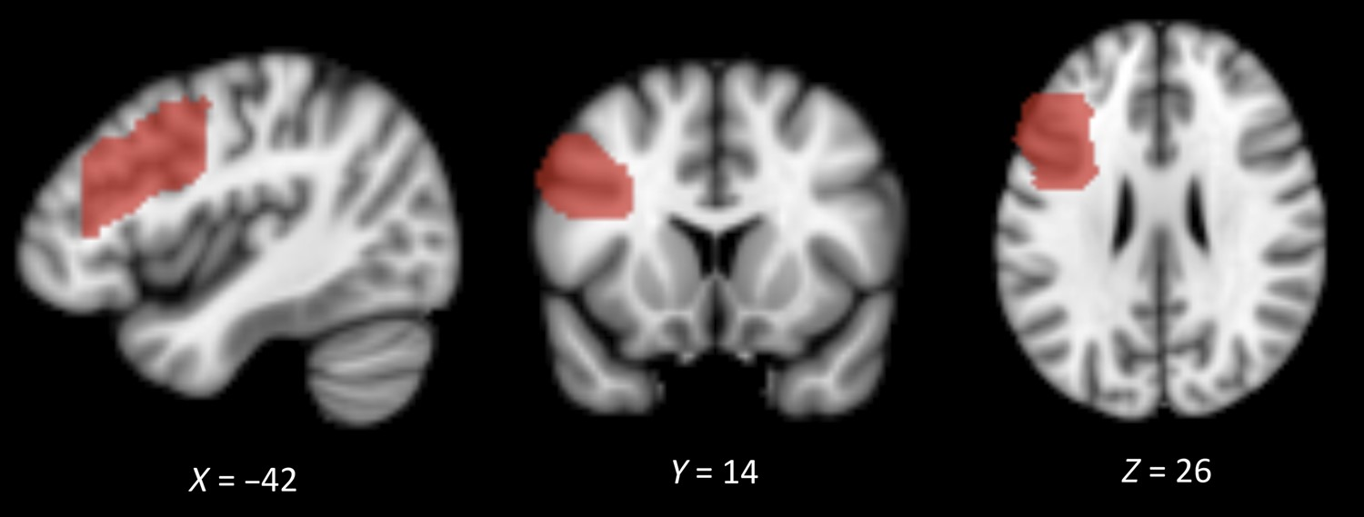
Figure 2. Illustration of the seed VOI in the sagittal, coronal, and transversal plane.
Notes:
Figure 2. Illustration of the seed VOI in the sagittal, coronal, and transversal plane.
Unless provided in the caption above, the following copyright applies to the content of this slide: © The Author 2015. Published by Oxford University Press. All rights reserved. For Permissions, please e-mail: journals.permissions@oup.com

Slide 3
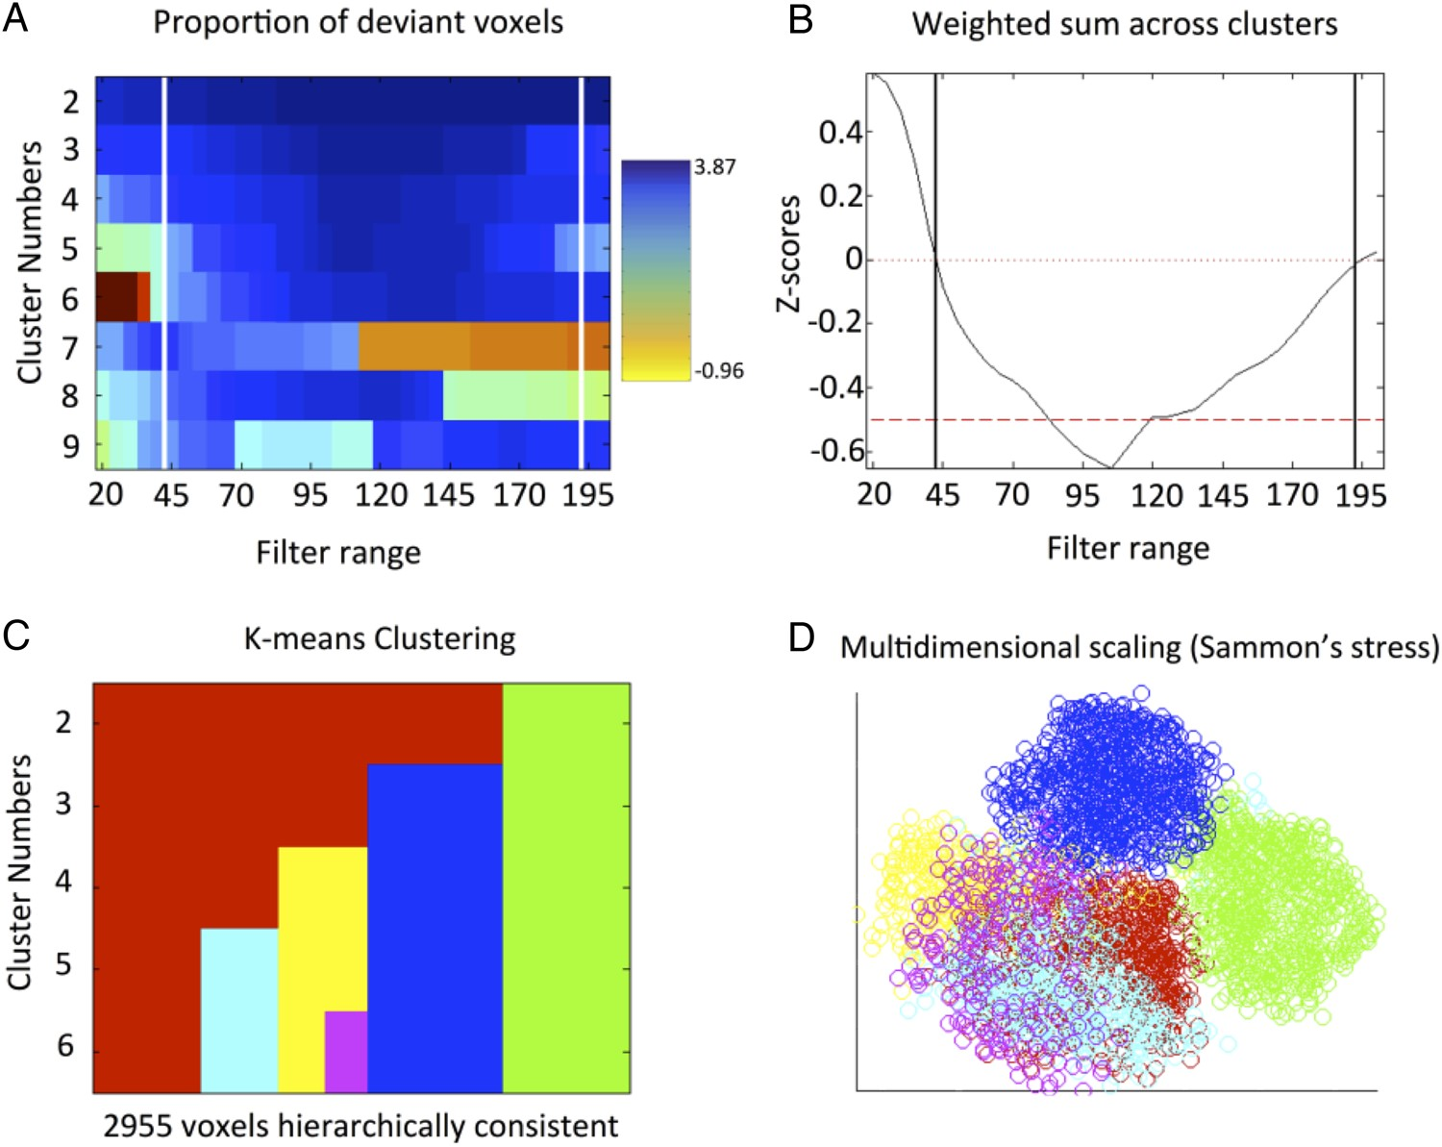
Figure 3. The upper panel displays the stability of different cluster solution. (A) Illustration of the consistency in ...
Notes:
Figure 3. The upper panel displays the stability of different cluster solution. (A) Illustration of the consistency in the assignment of individual voxels to clusters as a function of the filter size and the number of clusters. Warm colors indicate high numbers of deviant voxels (i.e., instable solutions) and cold colors indicate a low number of deviant voxels (i.e., stable solutions). The vertical line represents the ultimately selected filter range that yielded the most stable clustering. (B) Z-scores on median filtered deviants (normalized for K). The bottom panel illustrates the optimal cluster solution (K=6). (C) Pattern of cluster assignment and cluster splitting at different levels of K. (D) Visualization of the six-cluster solution by the means of multidimensional scaling. The axes represent dimensionless factors representing the two-dimensional projection of the data. Points represent voxels and their proximity indicates the similarity of their co-activation profiles. Color coding: red = Cluster 1, green = Cluster 2, blue = Cluster 3, yellow = Cluster 4, cyan = Cluster 5, violet = Cluster 6.
Unless provided in the caption above, the following copyright applies to the content of this slide: © The Author 2015. Published by Oxford University Press. All rights reserved. For Permissions, please e-mail: journals.permissions@oup.com

Slide 4
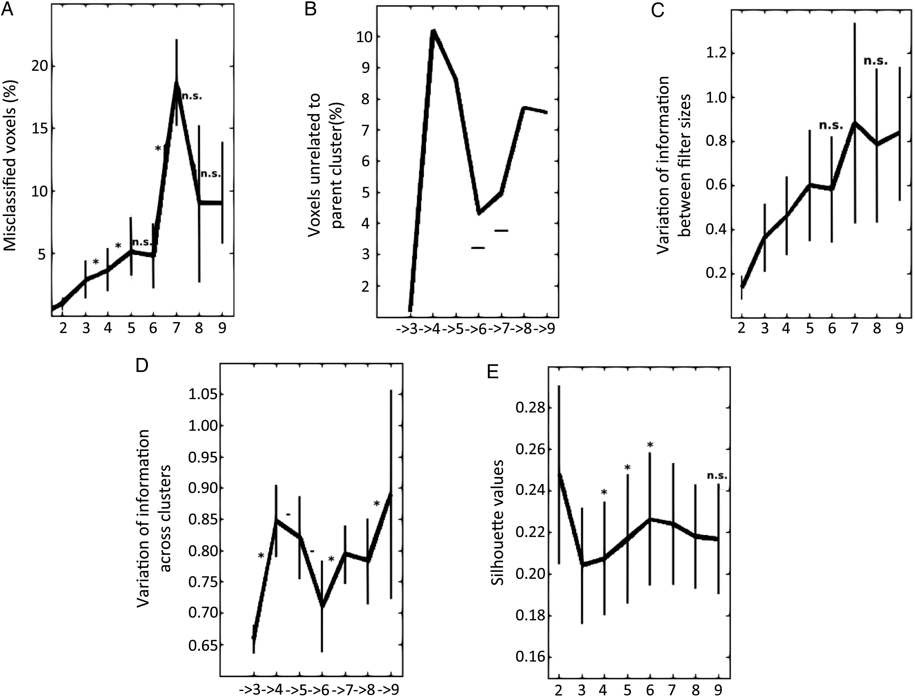
Figure 4. Cluster metrics that were used for the identification of the optimal solution K. (A) Percentage of ...
Notes:
Figure 4. Cluster metrics that were used for the identification of the optimal solution K. (A) Percentage of misclassified voxels: The six-cluster solution is considered a good solution because it does not lead to a significant increase in the percentage of misclassified voxels (n.s.) when compared with the K − 1 solution, and the subsequent K + 1 solution yields a significant increase (asterisks). (B) Percentage of voxels that are not related to the parent cluster: The six- and seven-cluster solutions are considered good solutions because the percentages of lost voxels are lower than the median across all solutions (horizontal bar). (C) VI between filter sizes: The six- and the eight-cluster solutions are considered good solutions because they do not show an increase in VI compared with the previous solution (n.s.). (D) VI across cluster solutions: The six-cluster solution is considered the optimal solution because it displays a significant decrease in VI compared with the previous solution (−) and the subsequent solution leads to a significant increase in VI (asterisks). (E) Silhouette values: The six-cluster solution is considered the optimal solution, as it displays a significantly higher silhouette value than the previous solution (asterisks) and the subsequent solution leads to significant decrease. Each cluster metric is described in detail in the Materials and Methods section.
Unless provided in the caption above, the following copyright applies to the content of this slide: © The Author 2015. Published by Oxford University Press. All rights reserved. For Permissions, please e-mail: journals.permissions@oup.com

Slide 5
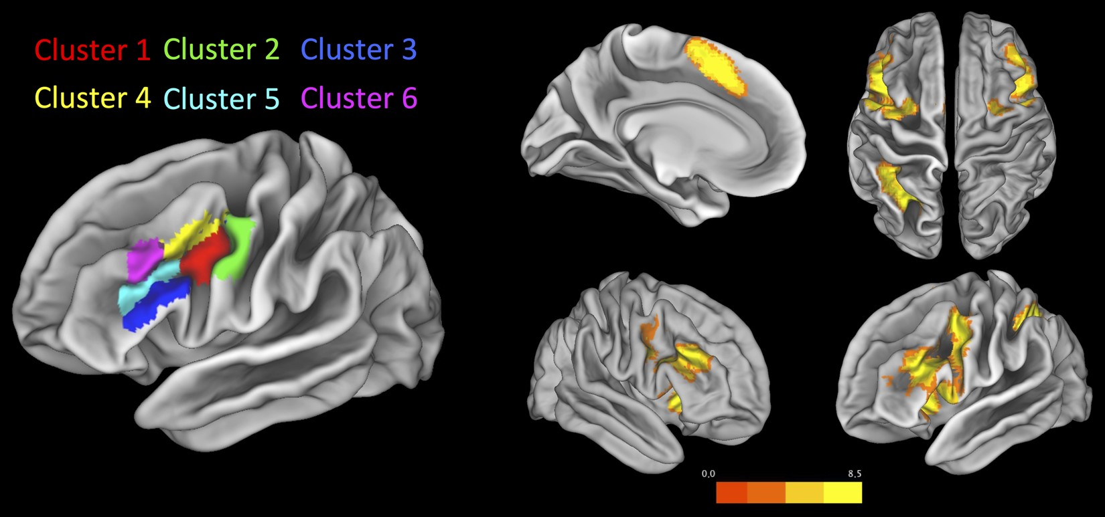
Figure 5. Left: Anatomical location of the 6 clusters that resulted from the K-means clustering of the L IFS VOI. ...
Notes:
Figure 5. Left: Anatomical location of the 6 clusters that resulted from the K-means clustering of the L IFS VOI. Right: Conjunction map of the co-activation patterns across all 6 clusters.
Unless provided in the caption above, the following copyright applies to the content of this slide: © The Author 2015. Published by Oxford University Press. All rights reserved. For Permissions, please e-mail: journals.permissions@oup.com

Slide 6
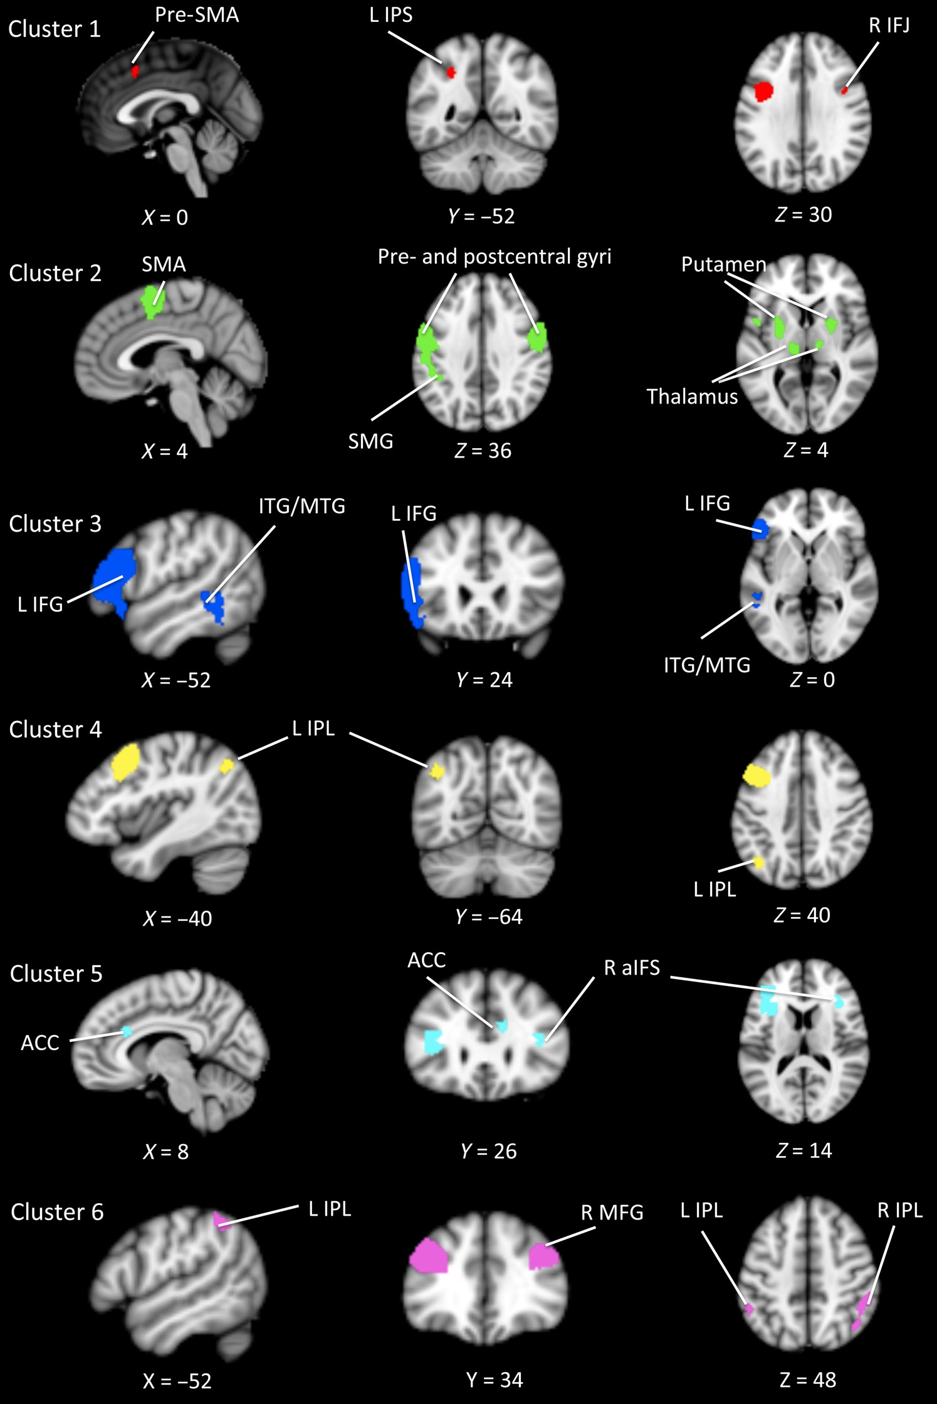
Figure 6. Specific patterns of co-activation for each cluster (i.e., regions that show significantly stronger ...
Notes:
Figure 6. Specific patterns of co-activation for each cluster (i.e., regions that show significantly stronger co-activation with a given cluster than with all other 5 clusters). Patterns for the Clusters 1–6 are displayed from top to bottom.
Unless provided in the caption above, the following copyright applies to the content of this slide: © The Author 2015. Published by Oxford University Press. All rights reserved. For Permissions, please e-mail: journals.permissions@oup.com

Slide 7
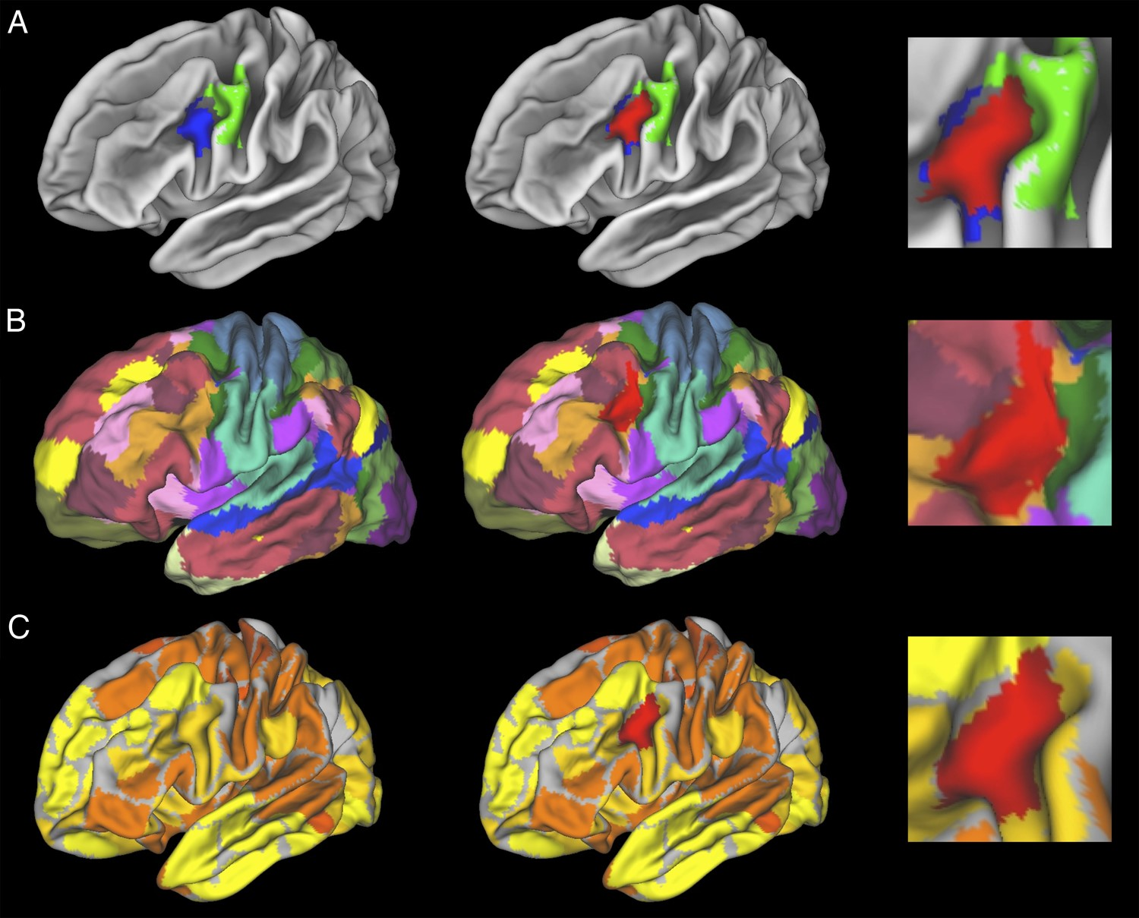
Figure 7. Comparison of Cluster 1 in the present study with existing parcellation schemes. (A) Parcellation of the IFJ ...
Notes:
Figure 7. Comparison of Cluster 1 in the present study with existing parcellation schemes. (A) Parcellation of the IFJ (blue) and ventral premotor cortex (green) by Neubert et al. (2014). (B) Parcellation of the neocortex by Yeo et al. (2011). (C) Parcellation of the neocortex by Gordon et al. (2016). Note: Figures on the left shows the clusters/parcels from the respective studies alone. Figures in the middle display Cluster 1 from the present study (red) overlaid on the respective parcellation. Figures on the right display in high resolution the overlap between the cluster from the present study and the respective external parcellation schemes.
Unless provided in the caption above, the following copyright applies to the content of this slide: © The Author 2015. Published by Oxford University Press. All rights reserved. For Permissions, please e-mail: journals.permissions@oup.com

Slide 8
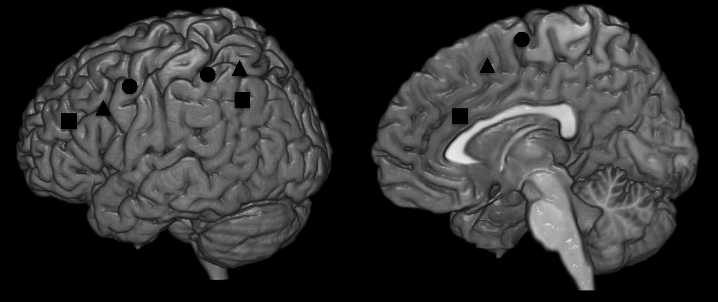
Figure 8. Schematic illustration of functional gradients in frontolateral, frontomedian, and parietal cortices. Circles ...
Notes:
Figure 8. Schematic illustration of functional gradients in frontolateral, frontomedian, and parietal cortices. Circles refer to concrete “first-order” control functions, triangles refer to intermediate “second-order” control functions, and squares refer to abstract “third-order” control functions (see text for details). Note that the parietal component of third-order control is based on the specific co-activation of Cluster 6.
Unless provided in the caption above, the following copyright applies to the content of this slide: © The Author 2015. Published by Oxford University Press. All rights reserved. For Permissions, please e-mail: journals.permissions@oup.com

