Slide 1
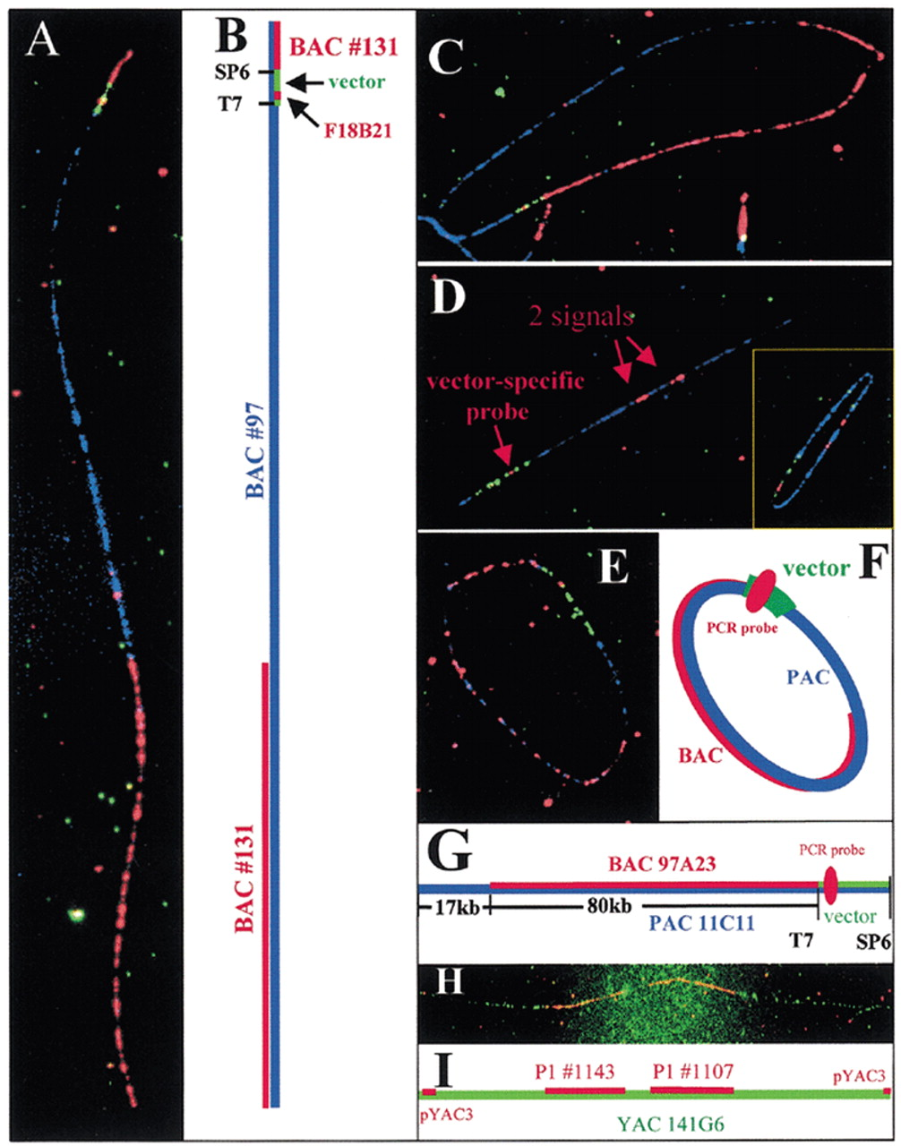
Figure 1. (A–C) BAC clone #131 mapped to BAC clone #97. (A) A linear DNA fiber of BAC #97 fiber (blue), BAC ...
Notes:
Figure 1. (A–C) BAC clone #131 mapped to BAC clone #97. (A) A linear DNA fiber of BAC #97 fiber (blue), BAC #131 hybridization domain (red) and the PCR-synthesized vector-specific probes hybridization signals (green/red). (B) A schematic illustration of the different hybridization domains for the linear BAC molecule. (C) A circular molecule from the same hybridization mixture with all the hybridization domains as explained in (B). (D) A plasmid clone hybridized to a P1 clone (#41, blue). The hybridization shows two domains (red) indicating chimerism of the clone. The vector-specific probes (green/red) appeared on the lower left corner of the picture. (Insert) A comparison of hybridization signals recorded from either randomly broken linear or circular DNA molecules. (E–G) Mapping of a BAC clone 97A23 onto a PAC clone 11C11. (E) A circular PAC clone 11C11 DNA fiber (blue) was hybridized with BAC clone 97A23 (red) and PAC vector-specific probes (green/red). (F) A schematic drawing of each hybridization domain and the extent of overlap. (G) A schematic of hybridization domains. The PCR synthesized vector-specific probe (red) is located near the T7 end of the vector pAd10SacBII (green). (H–I) Hybridization of two P1 clones #1107 and #1143 onto YAC clone 141G6. (H) Probes of two P1 clones #1107 and #1143 (red) and the pYAC3 vector (red) were hybridized onto a YAC clone 141G6 DNA fiber (green). The hybridization of the vector probe pYAC3 (red dots at both ends) indicates a complete YAC DNA fiber. (I) A schematic drawing showing the extent of the hybridization domains and the pYAC3 vector probe signals (red) on both ends.
Unless provided in the caption above, the following copyright applies to the content of this slide:

