Slide 1
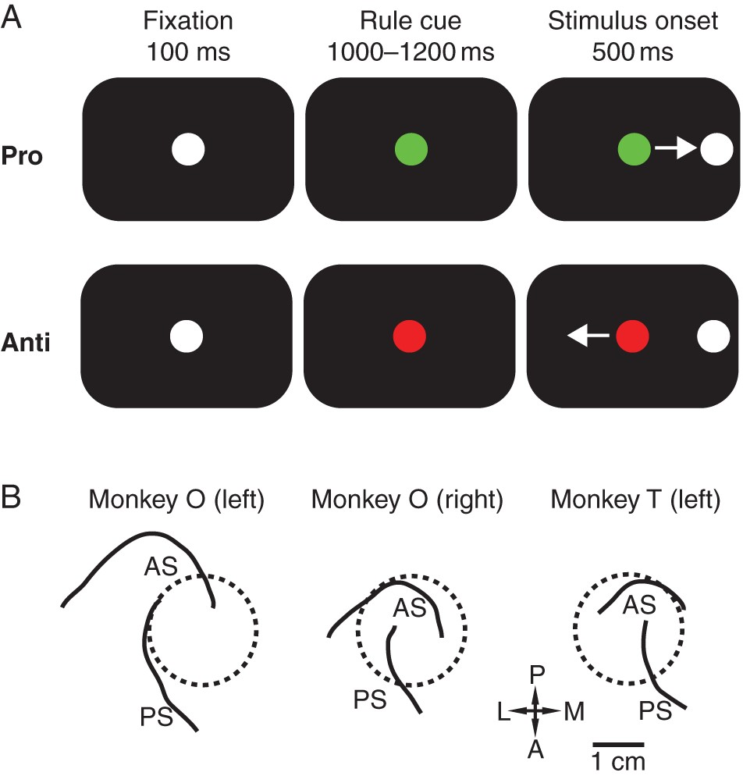
Figure 1. Task and recording locations. (A) Organization of antisaccade task. Monkey O was trained with a green rule ...
Notes:
Figure 1. Task and recording locations. (A) Organization of antisaccade task. Monkey O was trained with a green rule cue indicating a prosaccade trial and a red rule cue indicating an antisaccade trial. The colors were inversed for Monkey T. After a correct saccade, the animal was rewarded and the screen was blanked for 500 ms before the fixation cue appeared again. (B) Reconstruction of chamber placements. Monkey O had bilateral recording chamber implantation and had 2 sessions recorded from the right hemisphere and 3 sessions recorded from the left hemisphere. Monkey T had all 3 sessions recorded from his unilateral left hemisphere chamber. as, arcuate sulcus; ps, principal sulcus; P, posterior; A, anterior; L, lateral; M, medial.
Unless provided in the caption above, the following copyright applies to the content of this slide: © The Author 2015. Published by Oxford University Press. All rights reserved. For Permissions, please e-mail: journals.permissions@oup.com

Slide 2
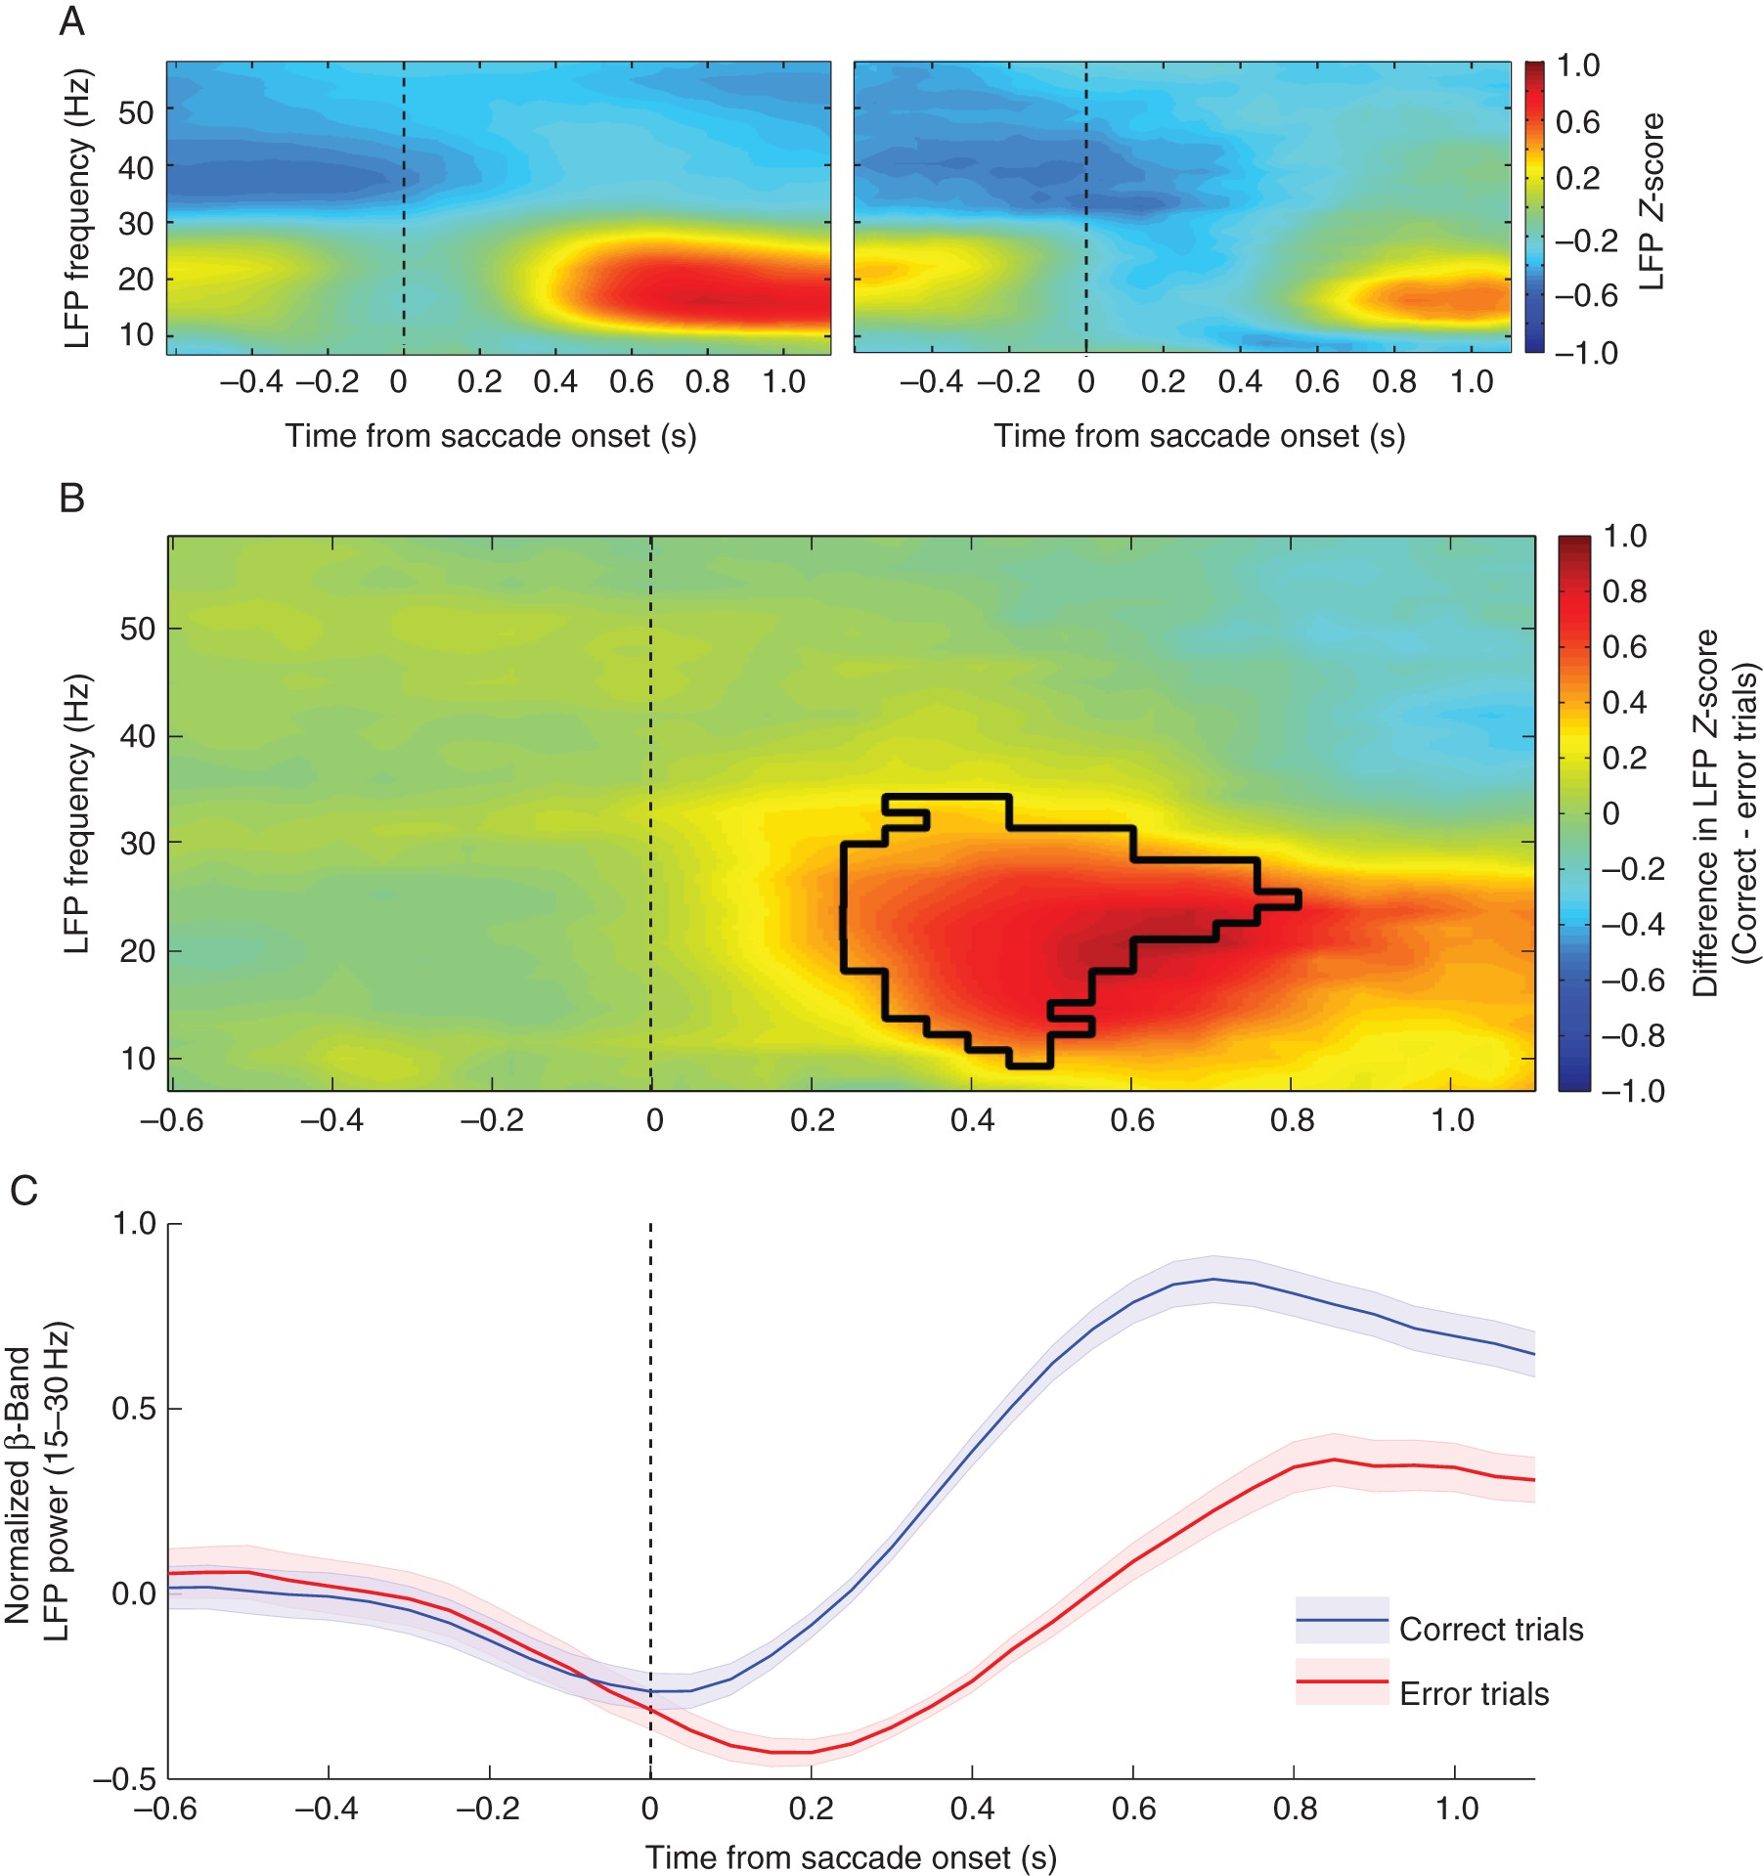
Figure 2. Performance-selective differences in beta-band LFP power. (A) Heatmaps displaying the trial time from saccade ...
Notes:
Figure 2. Performance-selective differences in beta-band LFP power. (A) Heatmaps displaying the trial time from saccade onset (x-axis) and frequencies (y-axis) for correct (left) and error (right) responses. The color bar indicates the mean LFP z-score value for trials with that outcome. (B) The larger heatmap displays the difference between the mean activity following a correct trial versus an error trial. The color bar indicates the z-score value obtained from (correct trials – error trials) baseline normalized z-score. Positive values indicate stronger activity during correct trials while negative values show time–frequency points with stronger activity for error trials. The black outline indicates the region in which statistical significance was found via cluster-based analysis. (C) Mean Z-score ± SEM for the beta-band frequency range (15–30 Hz) aligned on saccade onset for correct (blue) and error (red) trials.
Unless provided in the caption above, the following copyright applies to the content of this slide: © The Author 2015. Published by Oxford University Press. All rights reserved. For Permissions, please e-mail: journals.permissions@oup.com

Slide 3
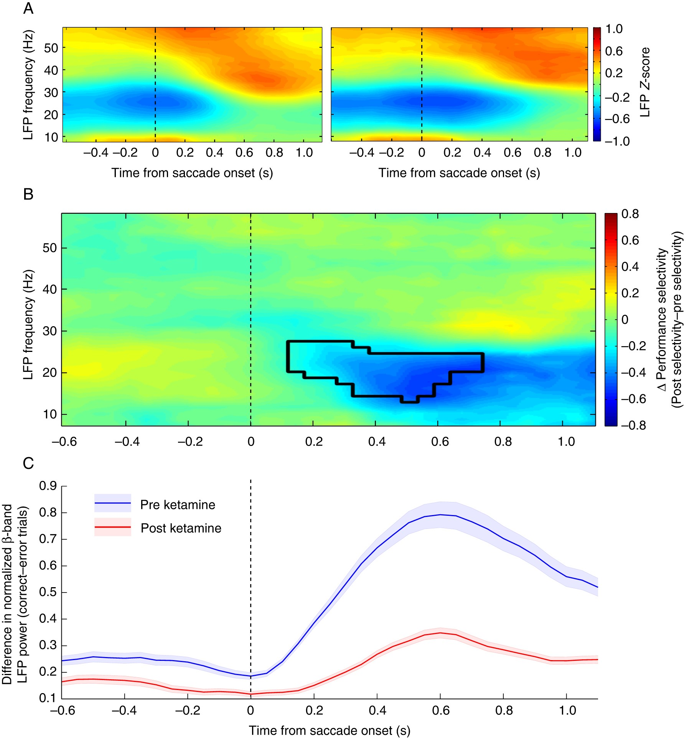
Figure 3. Difference in performance selectivity following ketamine administration. (A) Heatmaps for correct (left) and ...
Notes:
Figure 3. Difference in performance selectivity following ketamine administration. (A) Heatmaps for correct (left) and error (right) responses following ketamine administration with trial time from saccade onset (x-axis) and frequencies (y-axis). The color bar indicates the mean LFP z-score for the corresponding trial outcome. (B) Heatmap displays the trial time from saccade onset (x-axis) and frequencies (y-axis) with the color bar indicating the difference in absolute selectivity calculated as (absolute difference between correct and error trials after ketamine) – (absolute difference between correct and error trials before ketamine). Thus, a positive value indicates a time–frequency area in which the difference between correct and error trials was greater after ketamine injection, whereas a negative value indicates the performance selectivity was greater before ketamine. The epoch found to be statistically significant through cluster-based analyses is outlined in black. (C) Mean difference between correct and error trials ± SEM in the beta-band range (15–30 Hz) is plotted for both preketamine values (blue) and postketamine values (red).
Unless provided in the caption above, the following copyright applies to the content of this slide: © The Author 2015. Published by Oxford University Press. All rights reserved. For Permissions, please e-mail: journals.permissions@oup.com

Slide 4
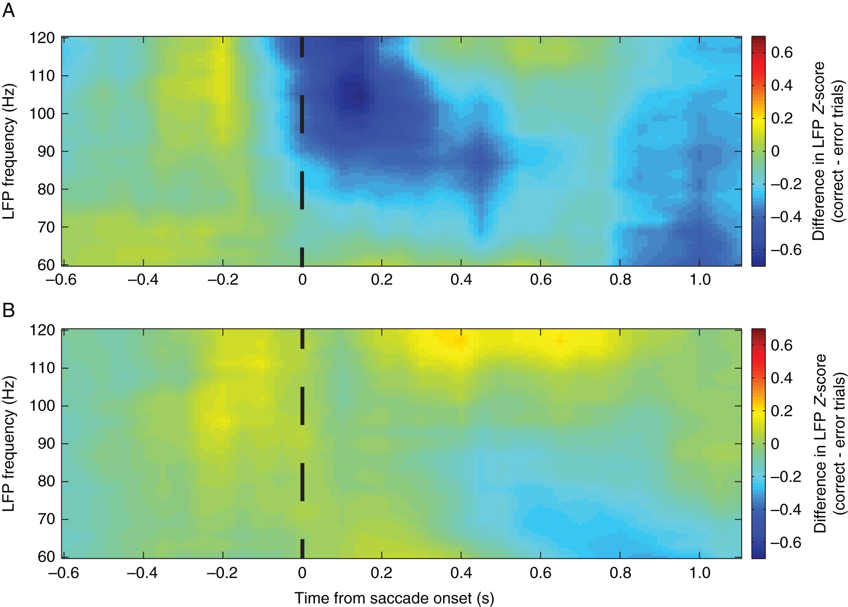
Figure 4. Outcome-specific heat maps for gamma-band frequencies. The mean difference between correct and error trials ...
Notes:
Figure 4. Outcome-specific heat maps for gamma-band frequencies. The mean difference between correct and error trials for preketamine trials (A) and postketamine trials (B) are displayed, with positive values indicating stronger activity for correct trials and negative values showing stronger activity for error trials. No significance was found through the cluster-based analyses for the preketamine selectivity map; however, overall gamma-band activity was significant increased between preketamine and postketamine values.
Unless provided in the caption above, the following copyright applies to the content of this slide: © The Author 2015. Published by Oxford University Press. All rights reserved. For Permissions, please e-mail: journals.permissions@oup.com

Slide 5
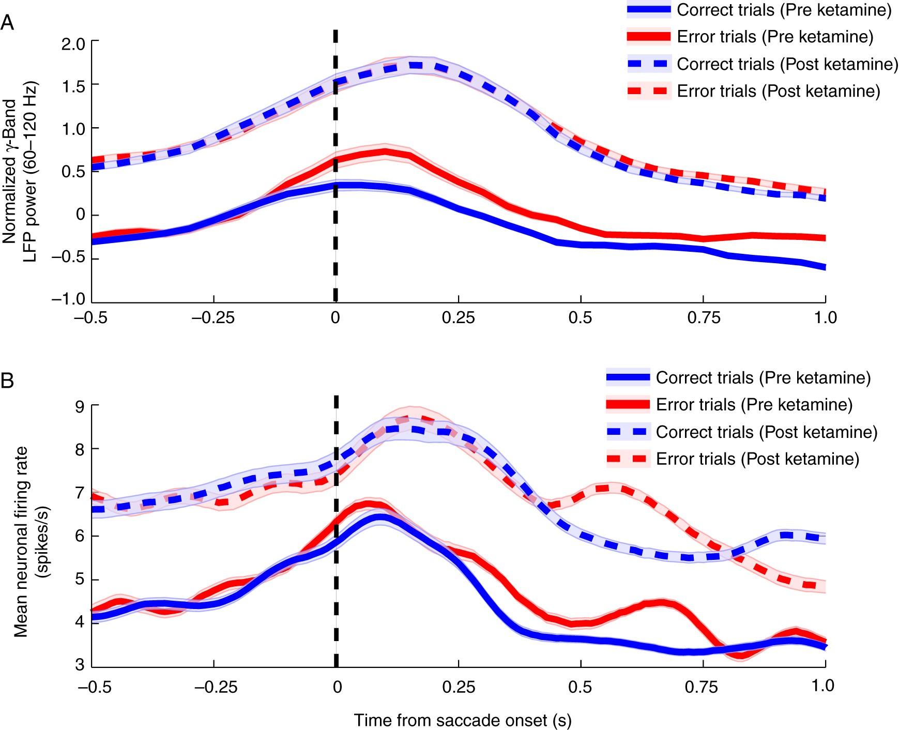
Figure 5. Gamma-band LFP power and corresponding neuronal firing rates. (A) Mean high-gamma-band (60–120 Hz) activity ± ...
Notes:
Figure 5. Gamma-band LFP power and corresponding neuronal firing rates. (A) Mean high-gamma-band (60–120 Hz) activity ± SEM is plotted contrasting both preketamine (solid lines) correct trials (blue) and error trials (red) with postketamine (dashed lines) values. The pattern of activity is notably similar to the mean spiking activity simultaneously measured from neurons in the PFC (B) in both their peak activity epoch and their response to ketamine administration.
Unless provided in the caption above, the following copyright applies to the content of this slide: © The Author 2015. Published by Oxford University Press. All rights reserved. For Permissions, please e-mail: journals.permissions@oup.com

