Slide 1
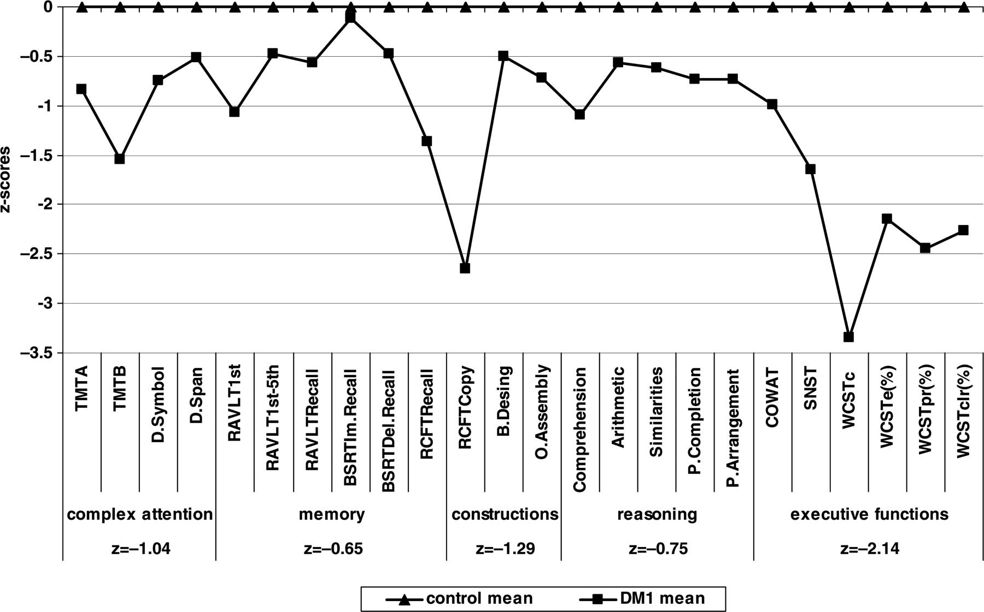
Fig. 1. Neuropsychological profile of DM1 patients compared to healthy controls expressed in z-scores. ...
Notes:
Fig. 1. Neuropsychological profile of DM1 patients compared to healthy controls expressed in z-scores. (Neuropsychological tests are grouped and outlined within each of the five relative cognitive domains, for which five average z-scores are also presented.)
Unless provided in the caption above, the following copyright applies to the content of this slide: © The Author 2010. Published by Oxford University Press. All rights reserved. For permissions, please e-mail: journals.permissions@oxfordjournals.org.

