Slide 1
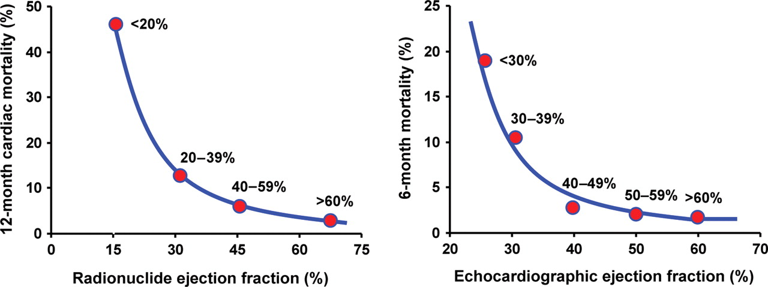
Figure 1 Hyperbolic curves relating mortality and radionuclide (left panel) and echocardiographic (right panel) ...
Notes:
Figure 1 Hyperbolic curves relating mortality and radionuclide (left panel) and echocardiographic (right panel) assessed left ventricular ejection fraction in patients recovering from an acute myocardial infarction. Below 40%, even small changes in ejection fraction determine marked increase in mortality. Modified from Refs.1,2
Unless provided in the caption above, the following copyright applies to the content of this slide: Published on behalf of the European Society of Cardiology. All rights reserved. © The Author 2011. For permissions please email: journals.permissions@oup.com

Slide 2
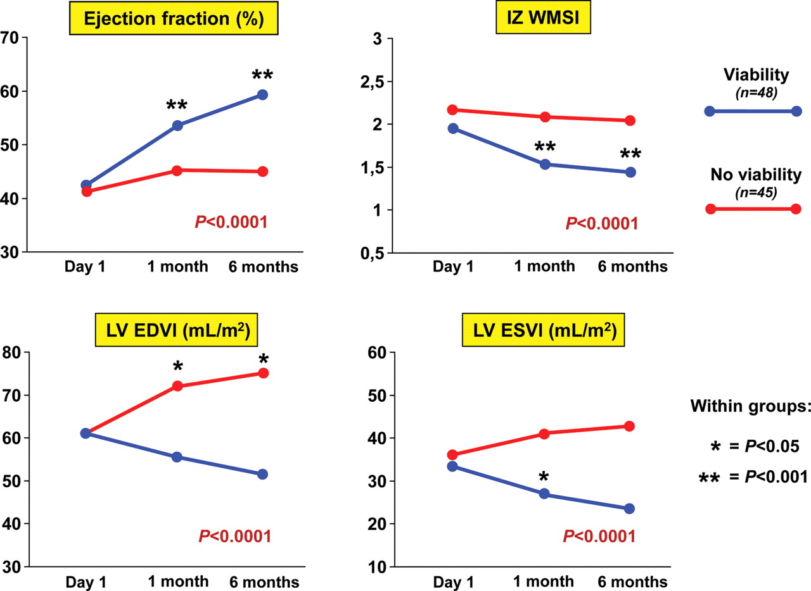
Figure 2 Left ventricular ejection fraction, infarct-zone wall-motion score index, end-diastolic volume index, and ...
Notes:
Figure 2 Left ventricular ejection fraction, infarct-zone wall-motion score index, end-diastolic volume index, and end-systolic volume index in patients with a first acute myocardial infarction treated with primary coronary angioplasty separated on the basis of presence (blue lines) or absence (red lines) of infarct-zone viability at dobutamine stress echo. During follow-up, left ventricular ejection fraction increases, whereas infarct-zone wall-motion score index, left ventricular end-diastolic volume index, and left ventricular end-systolic volume index decrease in patients with infarct-zone viability. Modified from Refs.13
Unless provided in the caption above, the following copyright applies to the content of this slide: Published on behalf of the European Society of Cardiology. All rights reserved. © The Author 2011. For permissions please email: journals.permissions@oup.com

Slide 3
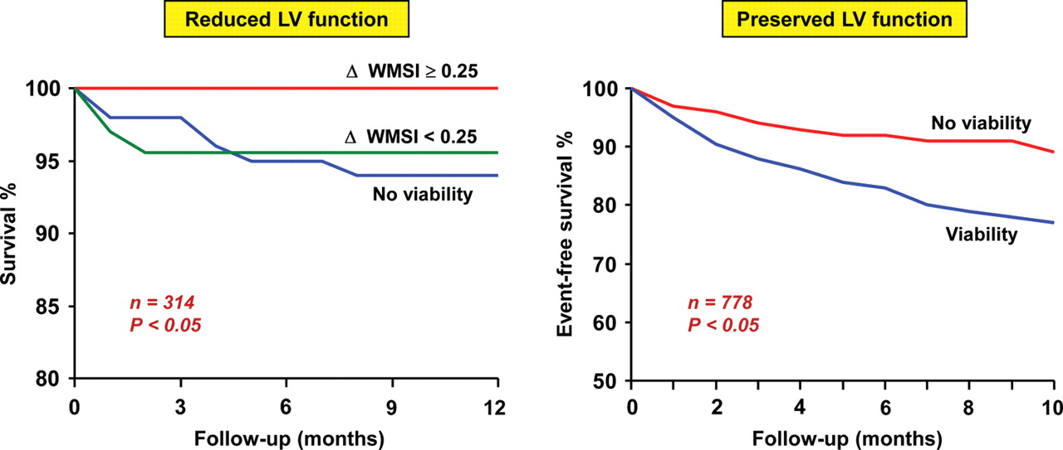
Figure 3 On the left panel the survival curves in patients with post-infarction left ventricular dysfunction who were ...
Notes:
Figure 3 On the left panel the survival curves in patients with post-infarction left ventricular dysfunction who were not revascularized separated on the basis of presence or absence of myocardial viability at dobutamine stress echo are reported. The extent of viable myocardium is expressed as improvement of wall motion score index from resting conditions to peak stress >0.25 or <0.25. Absence of viability is associated with greater (P< 0.05) risk of cardiac death. In addition, survival in patients with small extent of viability (ΔWMSI <0.25) is similar to that of patients without viability. Modified from Ref.17 On the right panel the survival rates free of spontaneously cardiac events (death, reinfarction, and unstable angina) in patients with post-infarction preserved left ventricular function separated on the basis of presence or absence of myocardial viability at dobutamine stress echo are reported. The presence of viable myocardium is associated with increased (P< 0.05) incidence of cardiac events. Modified from Ref.18
Unless provided in the caption above, the following copyright applies to the content of this slide: Published on behalf of the European Society of Cardiology. All rights reserved. © The Author 2011. For permissions please email: journals.permissions@oup.com

Slide 4
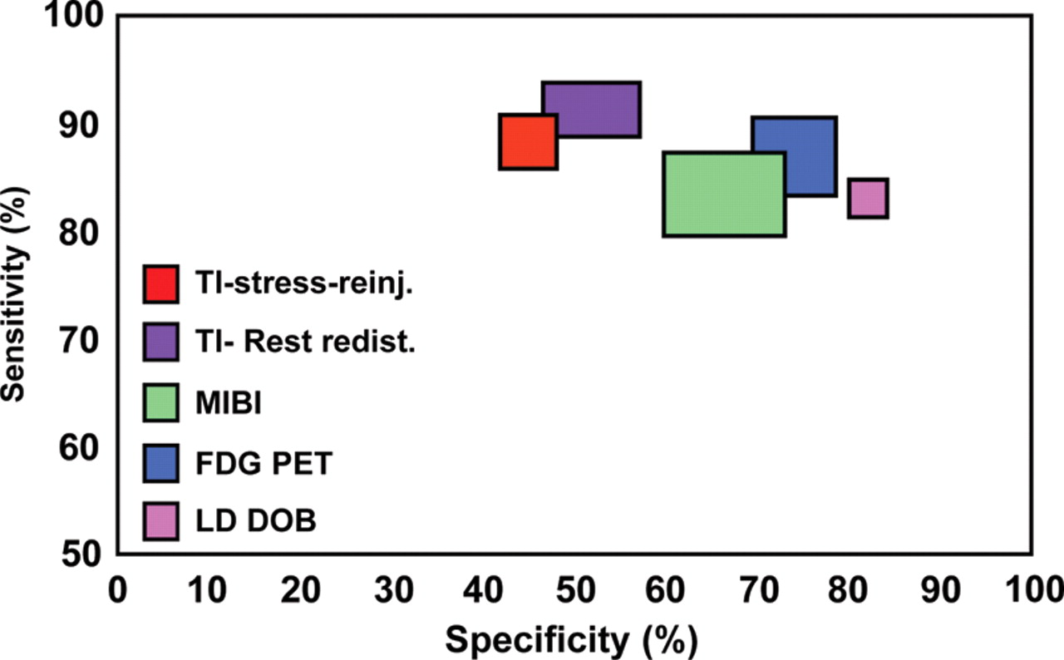
Figure 4 Sensitivity and specificity of nuclear techniques and low-dose dobutamine stress echocardiography in ...
Notes:
Figure 4 Sensitivity and specificity of nuclear techniques and low-dose dobutamine stress echocardiography in predicting functional recovery after revascularization in patients with ischaemic left ventricular dysfunction. Dobutamine stress echocardiography has a better specificity and slightly lower sensitivity than nuclear techniques. FDG PET, fluorodeoxyglucose positron emission tomography; LD DOB, low-dose dobutamine. Modified from Ref.36
Unless provided in the caption above, the following copyright applies to the content of this slide: Published on behalf of the European Society of Cardiology. All rights reserved. © The Author 2011. For permissions please email: journals.permissions@oup.com

Slide 5
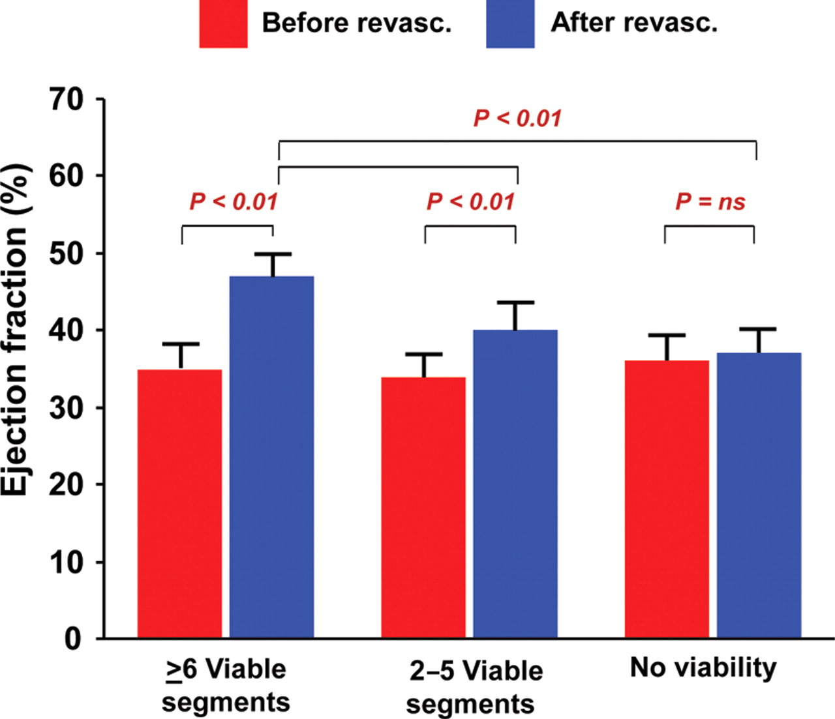
Figure 5 Effect of the extent of viable myocardium assessed during dobutamine stress echo on post-revascularization ...
Notes:
Figure 5 Effect of the extent of viable myocardium assessed during dobutamine stress echo on post-revascularization left ventricular ejection fraction in patients with ischaemic cardiomyopathy. The greater improvement in the ejection fraction is observed in patients with >6 dysfunctional but viable left ventricular segments. Conversely, no change in the ejection fraction is observed in patients without viability. Modified from Ref.51
Unless provided in the caption above, the following copyright applies to the content of this slide: Published on behalf of the European Society of Cardiology. All rights reserved. © The Author 2011. For permissions please email: journals.permissions@oup.com

Slide 6
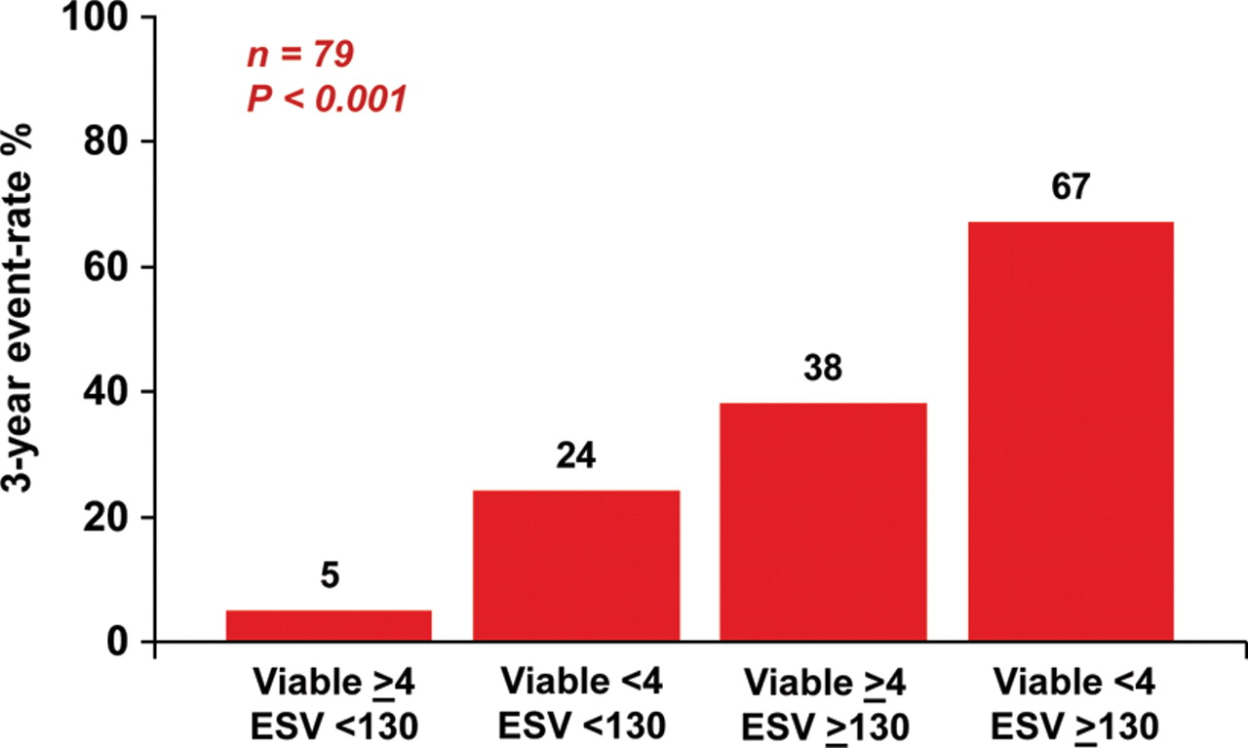
Figure 6 Cardiac events (cardiac death, myocardial infarction, and hospitalization for heart failure) at 3-year ...
Notes:
Figure 6 Cardiac events (cardiac death, myocardial infarction, and hospitalization for heart failure) at 3-year follow-up for four different patient categories with ischaemic left ventricular dysfunction according to the presence of substantial viable myocardium (>4 segments) at dobutamine stress echo and the left ventricular end-systolic volume. Patients with small ESV (130 mL) and no viability have the worst prognosis. Modified from Ref.35
Unless provided in the caption above, the following copyright applies to the content of this slide: Published on behalf of the European Society of Cardiology. All rights reserved. © The Author 2011. For permissions please email: journals.permissions@oup.com

Slide 7
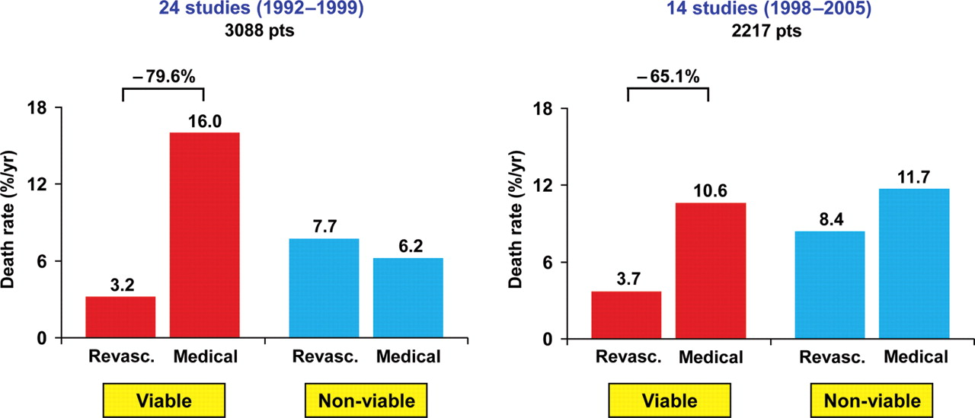
Figure 7 Results of two meta-analysis on 3088 and 2217 patients with ischaemic cardiomyopathy, respectively, assessing ...
Notes:
Figure 7 Results of two meta-analysis on 3088 and 2217 patients with ischaemic cardiomyopathy, respectively, assessing the effect of revascularization and medical therapy according to the presence or absence of viability at dobutamine stress echo or nuclear techniques. A 79.6 and 65.1% reduction in mortality for patients with viable myocardium treated by revascularization is shown. Conversely, no relevant prognostic difference between the two therapeutic strategies is reported for patients without viability. Modified from Refs.66,67
Unless provided in the caption above, the following copyright applies to the content of this slide: Published on behalf of the European Society of Cardiology. All rights reserved. © The Author 2011. For permissions please email: journals.permissions@oup.com

Slide 8
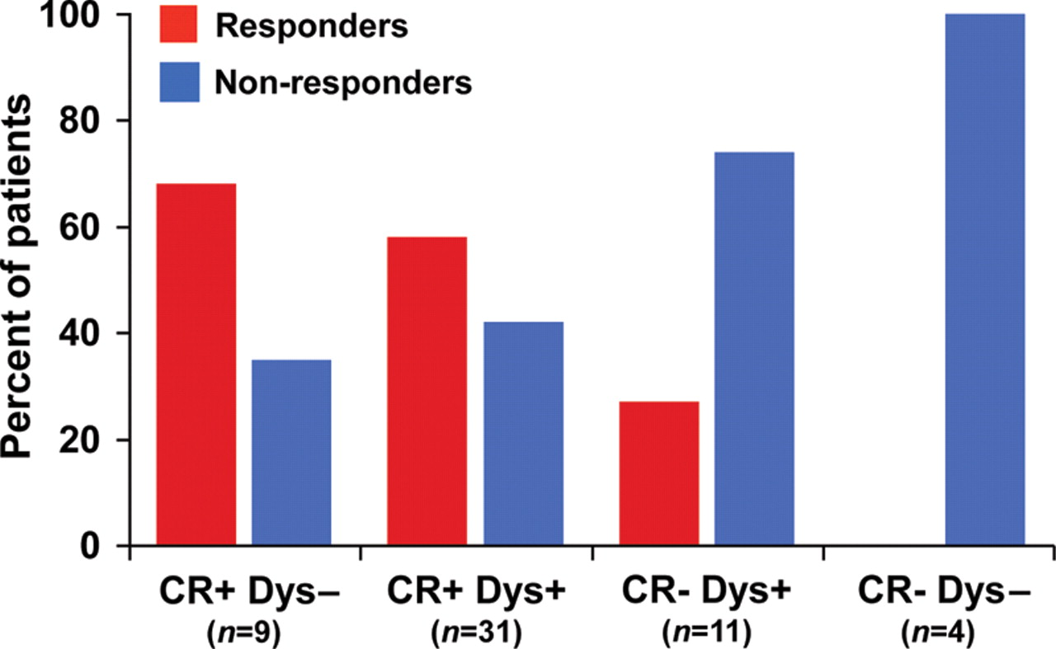
Figure 8 Percentages of responders to cardiac resynchronization therapy for four different patient categories ...
Notes:
Figure 8 Percentages of responders to cardiac resynchronization therapy for four different patient categories according to the presence (+) or absence (−) of contractile reserve at dobutamine stress echo in combination with the presence (+) or absence (−) of baseline tissue Doppler criteria of intraventricular dyssynchrony. Myocardial contractile reserve is more often associated with response to therapy, whereas dyssynchrony criteria are equally distributed in the two groups. Modified from Ref.72
Unless provided in the caption above, the following copyright applies to the content of this slide: Published on behalf of the European Society of Cardiology. All rights reserved. © The Author 2011. For permissions please email: journals.permissions@oup.com

