Slide 1
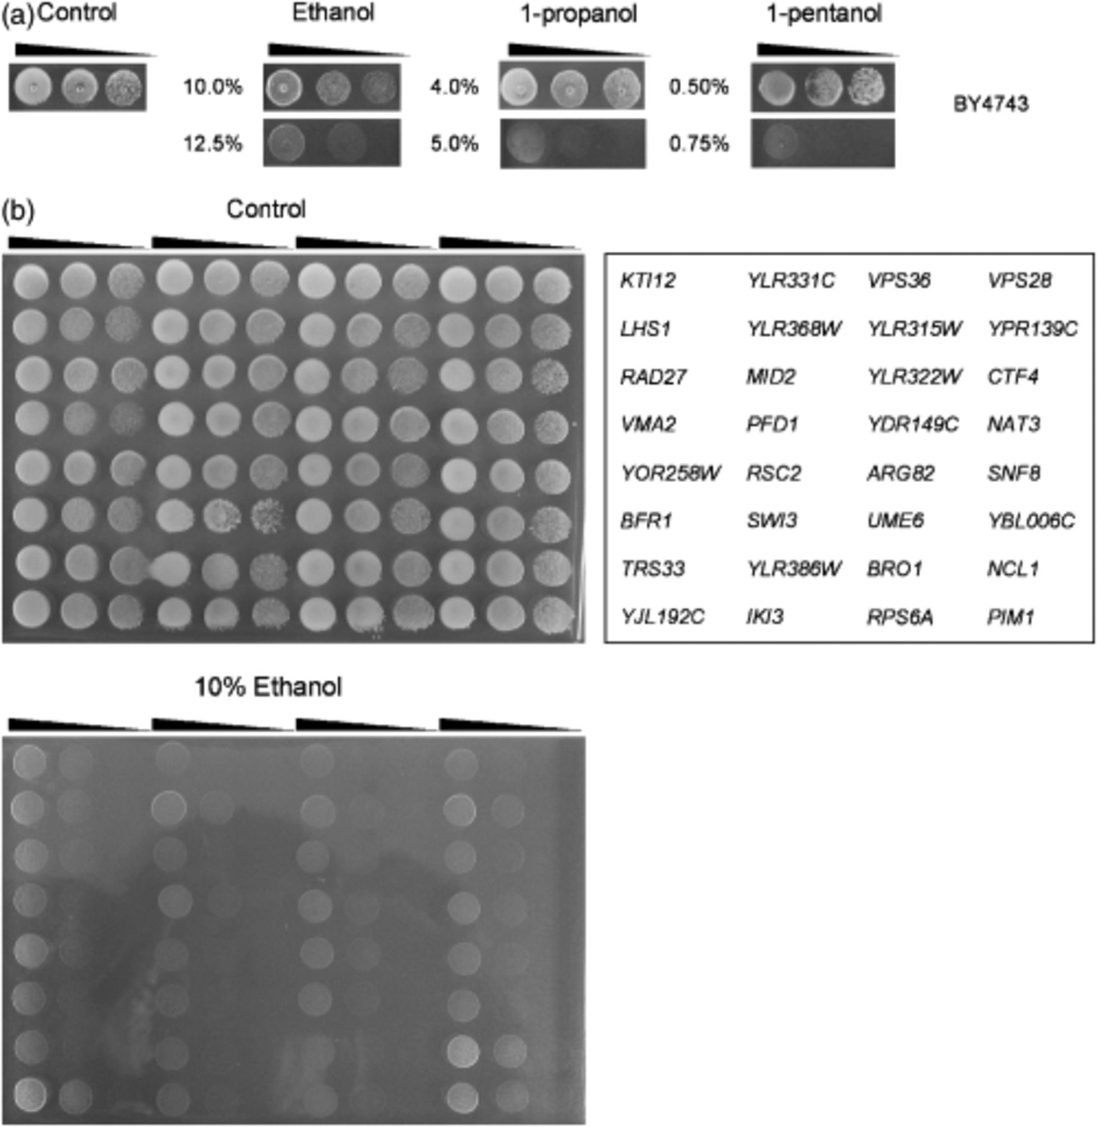
1 Screening for alcohol-sensitive deletion mutants. The definition of alcohol concentrations for mutant ...
Notes:
1 Screening for alcohol-sensitive deletion mutants. The definition of alcohol concentrations for mutant screening (a). The parental strain BY4743 was spotted onto 1% Difco yeast extract, 2% peptone, 2% glucose (YPD) agar media containing different concentrations of ethanol, 1-propanol or 1-pentanol, and grown for 3 days at 30°C. Shown are representative examples of mutants that conferred sensitivity to 10% (v/v) ethanol (b). Five microlitres of serial 10-fold diluted aliquots were spotted onto YPD agar plates, ethanol-supplemented or not. In this example, all of the strains exhibiting no growth were classified as ethanol-sensitive deletion mutants, except YJL192C, YPR139C, NCL1 and PIM1 deletion mutants.
Unless provided in the caption above, the following copyright applies to the content of this slide: © 2006 Federation of European Microbiological Societies Published by Blackwell Publishing Ltd. All rights reserved

Slide 2
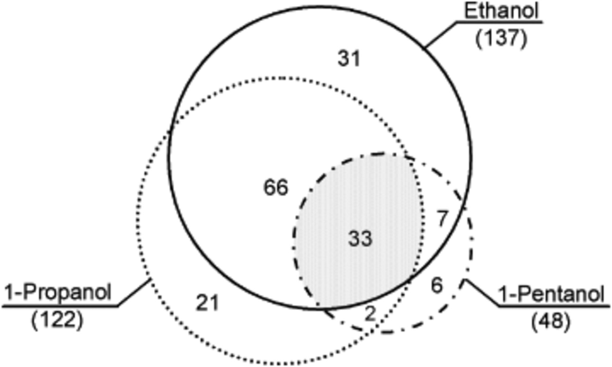
2 Diagrammatic representation of the distribution of deletion mutants sensitive to ethanol, 1-propanol, and ...
Notes:
2 Diagrammatic representation of the distribution of deletion mutants sensitive to ethanol, 1-propanol, and 1-pentanol.
Unless provided in the caption above, the following copyright applies to the content of this slide: © 2006 Federation of European Microbiological Societies Published by Blackwell Publishing Ltd. All rights reserved

Slide 3
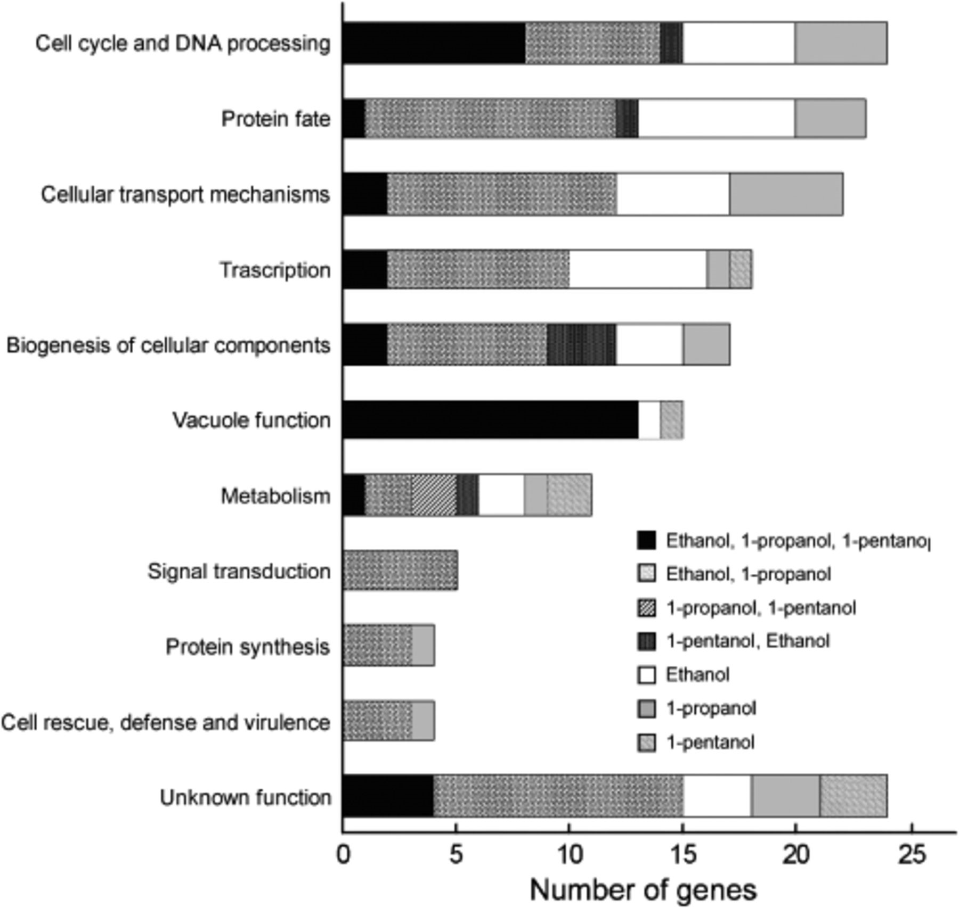
3 Genetic analysis of the deletion mutants sensitive to ethanol, 1-propanol and 1-pentanol. The y-axis shows ...
Notes:
3 Genetic analysis of the deletion mutants sensitive to ethanol, 1-propanol and 1-pentanol. The y-axis shows the biological process categories provided by the Munich Information Center for Protein Sequences (MIPS) and Saccharomyces Genome Database (SGD).
Unless provided in the caption above, the following copyright applies to the content of this slide: © 2006 Federation of European Microbiological Societies Published by Blackwell Publishing Ltd. All rights reserved

