Slide 1
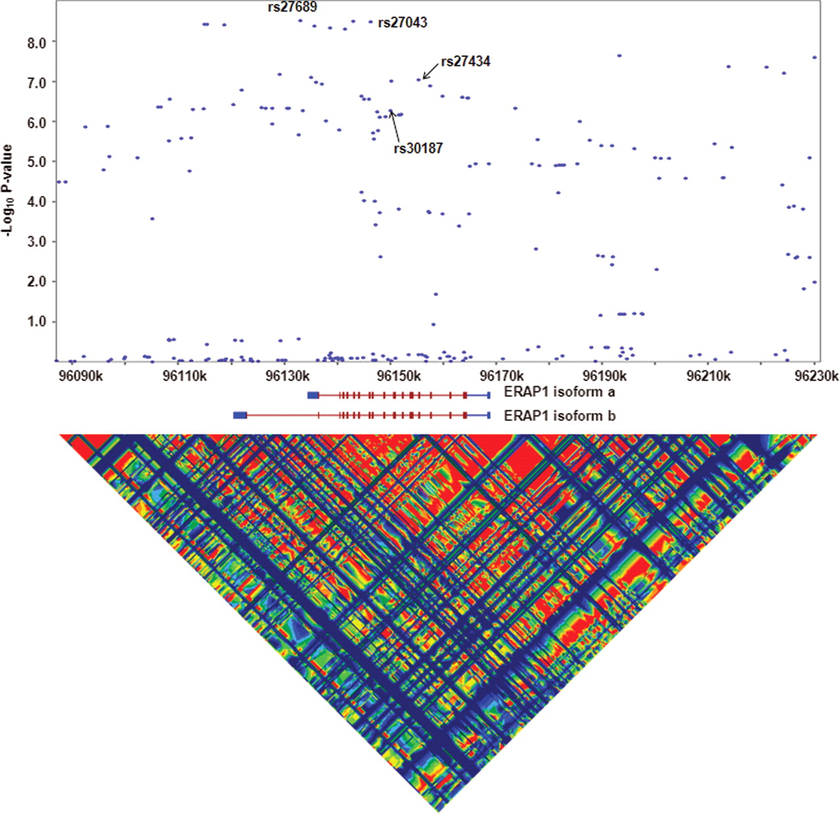
Figure 1. SNP association with AS against genomic location. Log ₁₀P -value for imputed and genotyped SNPs ...
Notes:
Figure 1. SNP association with AS against genomic location. Log 10P -value for imputed and genotyped SNPs plotted against physical distance. Aligned to the plot are the genomic location of two ERAP1 isoforms and LD that exists in this region, red regions indicating high LD and blue indicating low LD.
Unless provided in the caption above, the following copyright applies to the content of this slide: © 2009 The Author(s).This is an Open Access article distributed under the terms of the Creative Commons Attribution Non-Commercial License (http://creativecommons.org/licenses/by-nc/2.0/uk/) which permits unrestricted non-commercial use, distribution, and reproduction in any medium, provided the original work is properly cited.

Slide 2
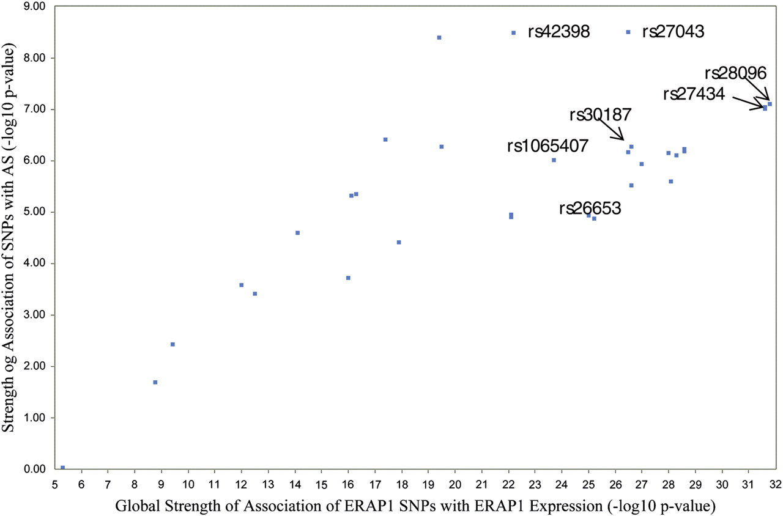
Figure 2. Comparison of the strength of association of various ERAP1 SNPs with AS and their influence on ERAP1 ...
Notes:
Figure 2. Comparison of the strength of association of various ERAP1 SNPs with AS and their influence on ERAP1 expression. P -values for association of SNPs with AS generated by genotyping or imputation in our extended cases–control study were compared with P -values for SNP association with ERAP1 transcript abundance from a previous study (using data from probe 209788_s_at) ( 18 ). Only a subset of 32 SNPs are plotted which were used in both studies.
Unless provided in the caption above, the following copyright applies to the content of this slide: © 2009 The Author(s).This is an Open Access article distributed under the terms of the Creative Commons Attribution Non-Commercial License (http://creativecommons.org/licenses/by-nc/2.0/uk/) which permits unrestricted non-commercial use, distribution, and reproduction in any medium, provided the original work is properly cited.

Slide 3
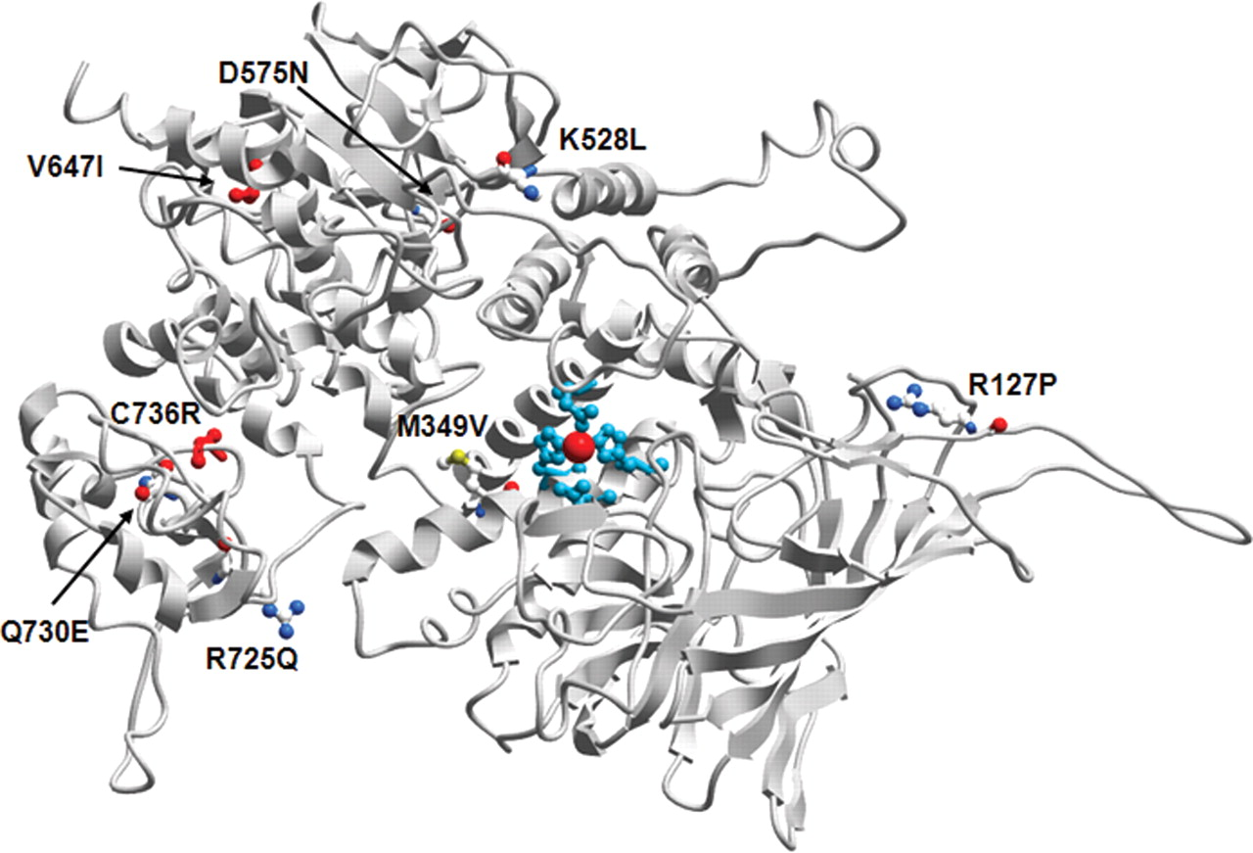
Figure 3. Ribbon model of putative ERAP1 structure. Highlighted are the active site around the central Zn atom (red ...
Notes:
Figure 3. Ribbon model of putative ERAP1 structure. Highlighted are the active site around the central Zn atom (red sphere) in cyan and the positions of residues affected by non-synonymous polymorphisms associated with AS in this study, including rare novel variants V647I and C736R.
Unless provided in the caption above, the following copyright applies to the content of this slide: © 2009 The Author(s).This is an Open Access article distributed under the terms of the Creative Commons Attribution Non-Commercial License (http://creativecommons.org/licenses/by-nc/2.0/uk/) which permits unrestricted non-commercial use, distribution, and reproduction in any medium, provided the original work is properly cited.

