Slide 1
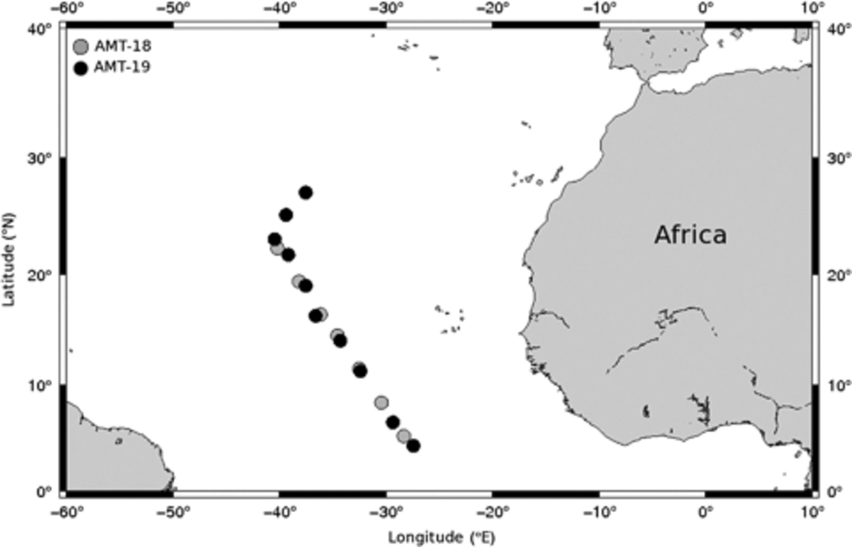
1 Cruise track of AMT-18 and AMT-19 undertaken in October/November 2008 and 2009, respectively.
Notes:
1 Cruise track of AMT-18 and AMT-19 undertaken in October/November 2008 and 2009, respectively.
Unless provided in the caption above, the following copyright applies to the content of this slide: © 2011 Federation of European Microbiological Societies Published by Blackwell Publishing Ltd. All rights reserved

Slide 2
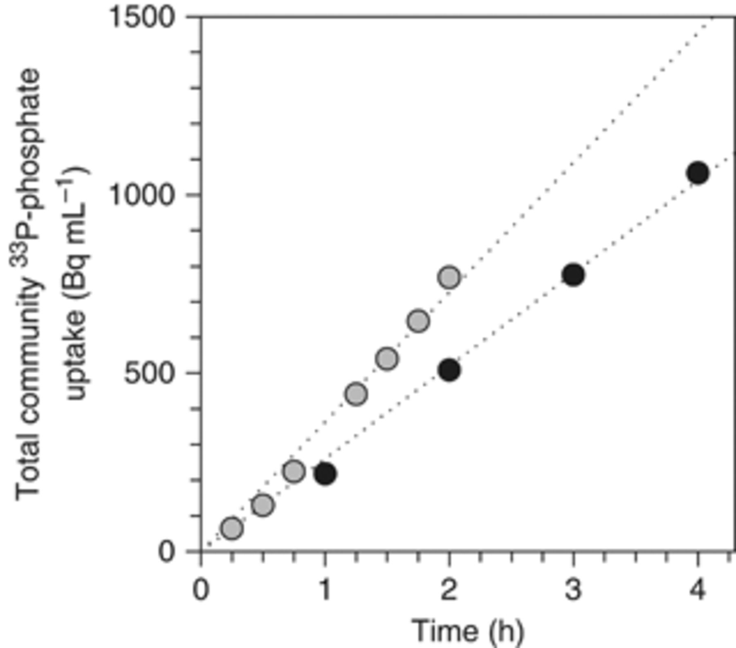
2 Total microbial³³P-phosphate uptake over time using two representative stations as examples. The ...
Notes:
2 Total microbial33P-phosphate uptake over time using two representative stations as examples. The colours indicate the different cruises on which the data were collected: AMT-18 (grey) and AMT-19 (black).
Unless provided in the caption above, the following copyright applies to the content of this slide: © 2011 Federation of European Microbiological Societies Published by Blackwell Publishing Ltd. All rights reserved

Slide 3
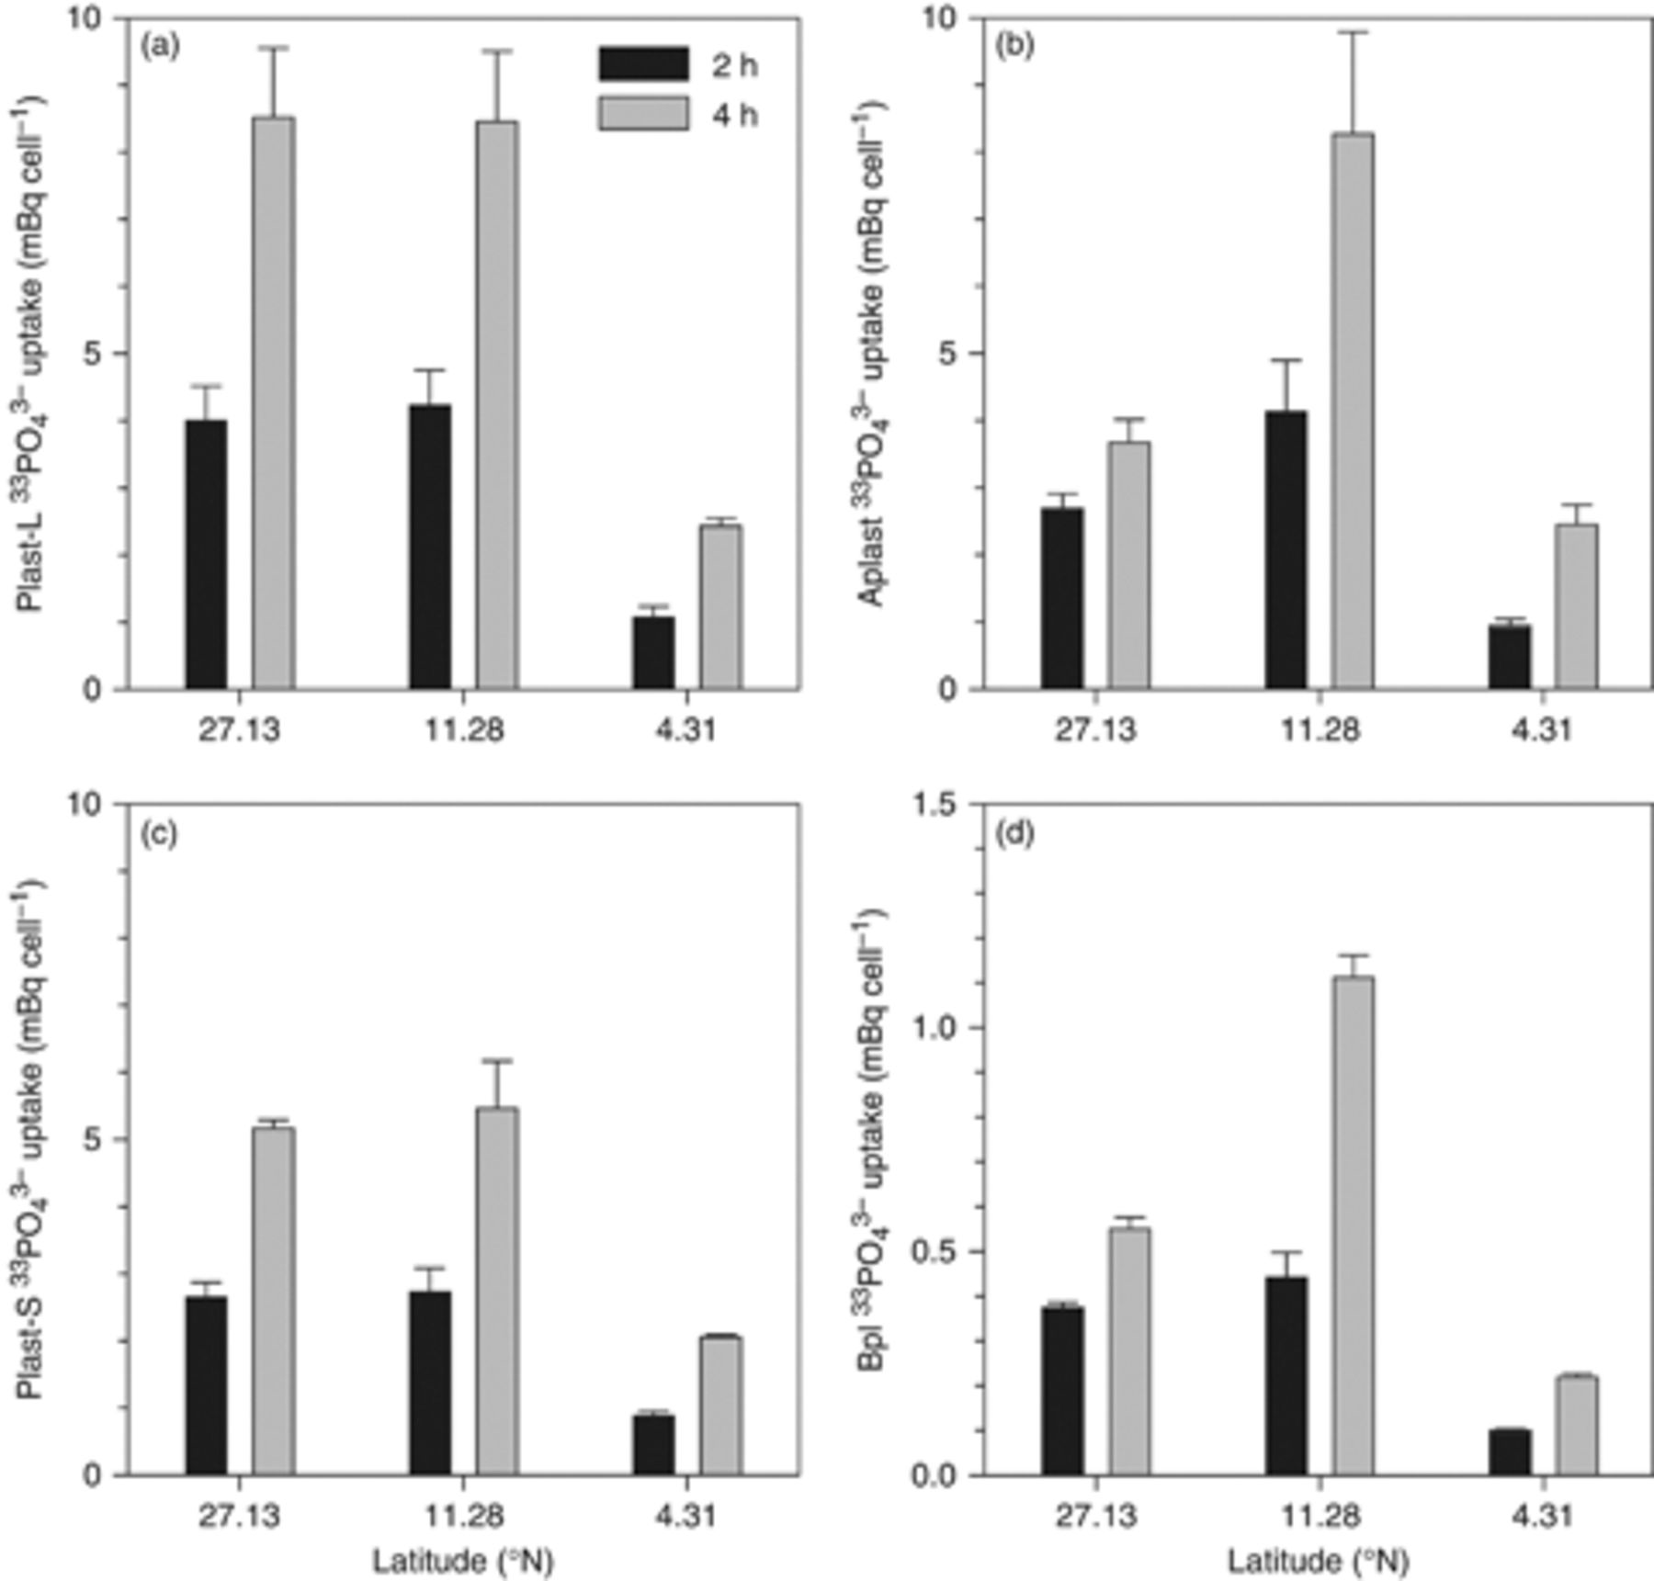
3 Per cell³³P-phosphate uptake after 2 h (black) and 4 h (grey) measured at three different ...
Notes:
3 Per cell33P-phosphate uptake after 2 h (black) and 4 h (grey) measured at three different stations. (a) Large plastidic protists (Plast-L), (b) aplastidic protists (Aplast), (c) small plastidic protists (Plast-S) and (d) average bacterioplankton cells (Bpl). Please note the different scale for the bacterioplankton plot (d).
Unless provided in the caption above, the following copyright applies to the content of this slide: © 2011 Federation of European Microbiological Societies Published by Blackwell Publishing Ltd. All rights reserved

Slide 4
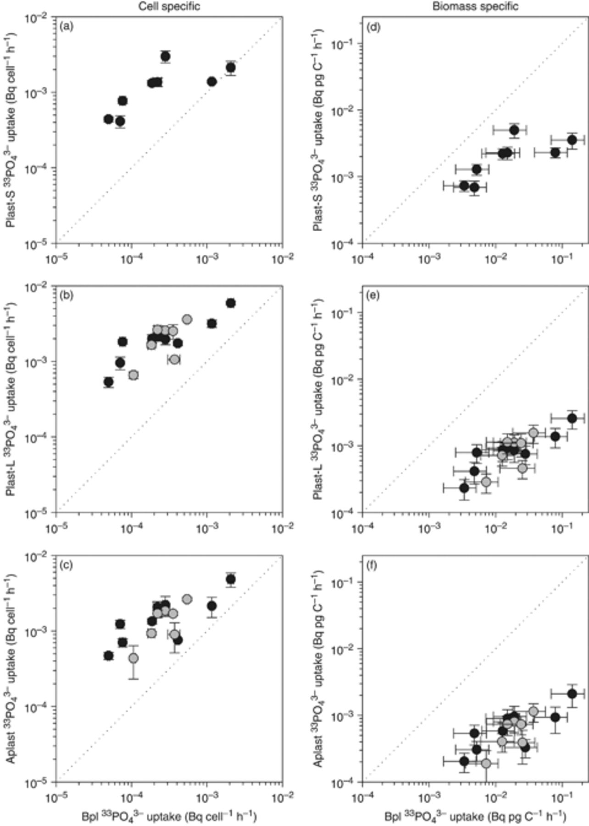
4 Cell-specific (left column) and biomass-specific (right column)³³P-phosphate uptake rates for ...
Notes:
4 Cell-specific (left column) and biomass-specific (right column)33P-phosphate uptake rates for individual protist groups in comparison with bacterioplankton. (a, d) Small plastidic protists (Plast-S), (b, e) large plastidic protists (Plast-L), (c, f) aplastidic protists (Aplast). The colours indicate the different cruises on which the data were collected: AMT-18 (grey) and AMT-19 (black).
Unless provided in the caption above, the following copyright applies to the content of this slide: © 2011 Federation of European Microbiological Societies Published by Blackwell Publishing Ltd. All rights reserved

Slide 5
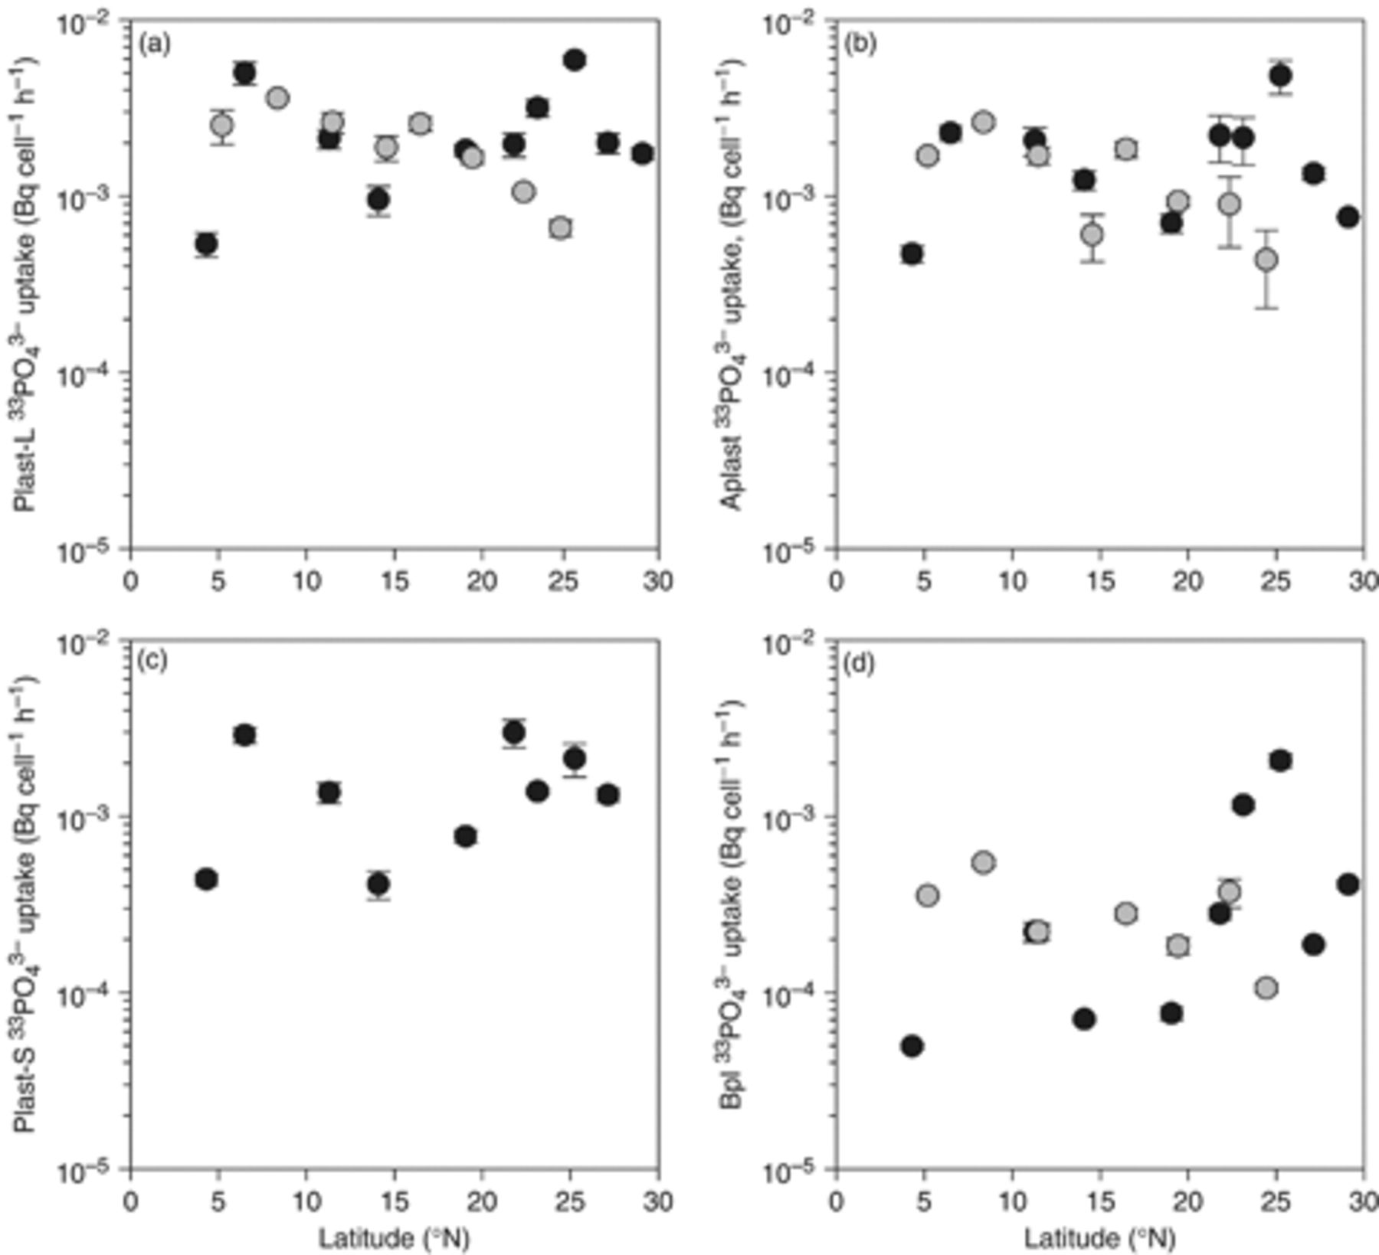
5 Latitudinal variability in cellular³³P-phosphate uptake rates of protist groups and ...
Notes:
5 Latitudinal variability in cellular33P-phosphate uptake rates of protist groups and bacterioplankton. (a) Large plastidic protists (Plast-L), (b) aplastidic protists (Aplast), (c) small plastidic protists (Plast-S) and (d) bacterioplankton (Bpl). The different colours indicate on which cruise the data were collected: AMT-18 (grey), and AMT-19 (black).
Unless provided in the caption above, the following copyright applies to the content of this slide: © 2011 Federation of European Microbiological Societies Published by Blackwell Publishing Ltd. All rights reserved

Slide 6
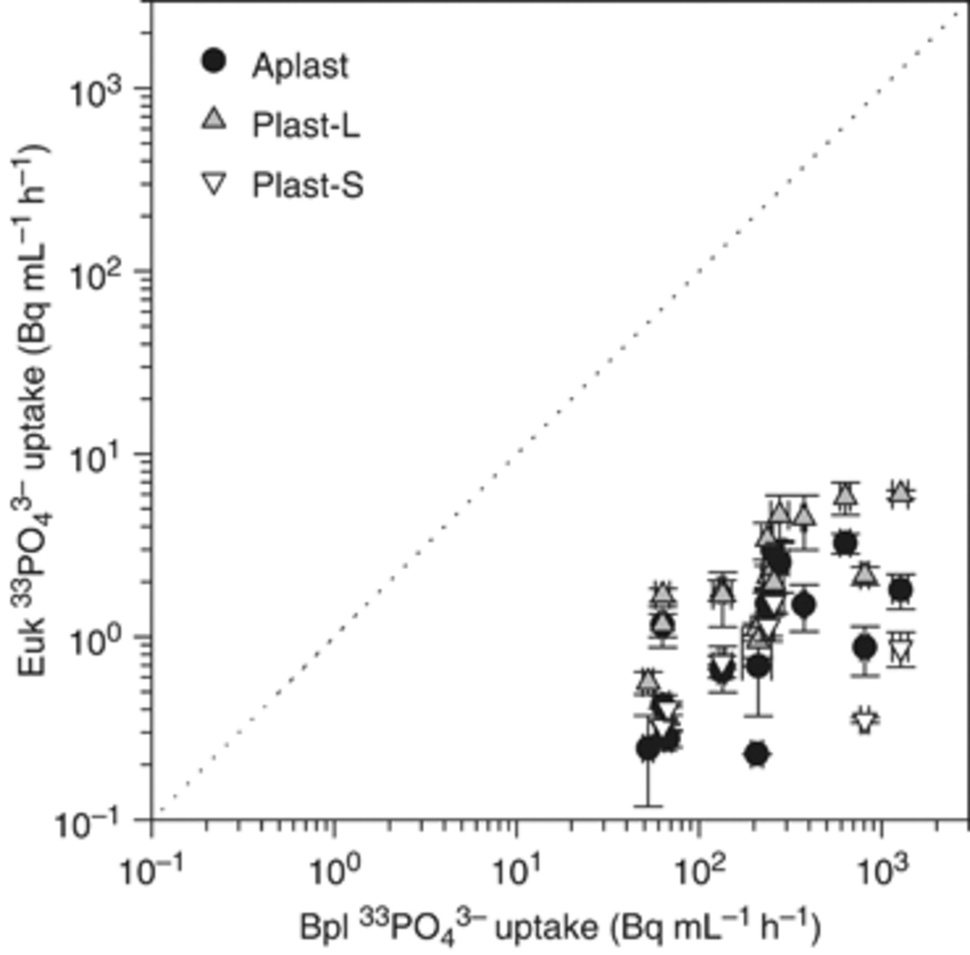
6 Population-specific³³P-phosphate uptake rates of aplastidic protists (Aplast, black), large ...
Notes:
6 Population-specific33P-phosphate uptake rates of aplastidic protists (Aplast, black), large plastidic protists (Plast-L, grey), and small plastidic protists (Plast-S, white), in comparison to bacterioplankton (Bpl).
Unless provided in the caption above, the following copyright applies to the content of this slide: © 2011 Federation of European Microbiological Societies Published by Blackwell Publishing Ltd. All rights reserved

