Slide 1
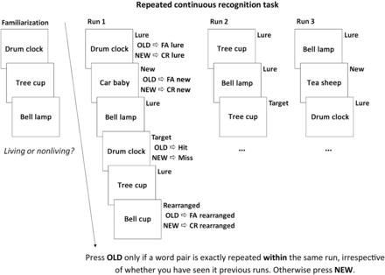
Figure 1. Experimental task design. FA, false alarm, CR, correct rejection.
Notes:
Figure 1. Experimental task design. FA, false alarm, CR, correct rejection.
Unless provided in the caption above, the following copyright applies to the content of this slide: © The Author 2013. Published by Oxford University Press. All rights reserved. For Permissions, please e-mail: journals.permissions@oup.com

Slide 2
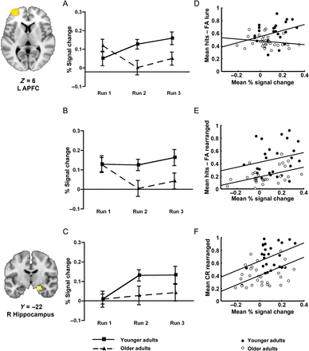
Figure 3. Regions-of-interest analysis for left APFC and right anterior hippocampus. The plots show age and run effects ...
Notes:
Figure 3. Regions-of-interest analysis for left APFC and right anterior hippocampus. The plots show age and run effects for the difference in % signal change extracted from the contrasts CR lure > CR new in left APFC (A), CR rearranged > CR new in left APFC (B), and CR rearranged > hits in right anterior hippocampus (C). The mean difference in % signal change in left APFC averaged across runs predicts mean recognition scores with lure pairs (D) and rearranged pairs (E), averaged across runs. The mean difference in % signal change in the right anterior hippocampus averaged across runs predicts mean rate of correct rejection of rearranged pairs averaged across runs (F).
Unless provided in the caption above, the following copyright applies to the content of this slide: © The Author 2013. Published by Oxford University Press. All rights reserved. For Permissions, please e-mail: journals.permissions@oup.com

Slide 3
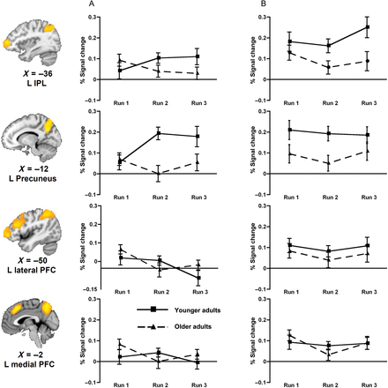
Figure 4. Regions-of-interest analysis for parietal and PFC regions during correct rejection of lure and rearranged ...
Notes:
Figure 4. Regions-of-interest analysis for parietal and PFC regions during correct rejection of lure and rearranged pairs. The plots show age and run effects for the difference in % signal change extracted from the contrasts CR lure > CR new (A) and CR rearranged > CR new (B). Left IPL and the precuneus were involved in the correct rejection of both lure and rearranged pairs. Left lateral and medial PFC were uniquely associated with correct rejection of rearranged pairs.
Unless provided in the caption above, the following copyright applies to the content of this slide: © The Author 2013. Published by Oxford University Press. All rights reserved. For Permissions, please e-mail: journals.permissions@oup.com

Slide 4
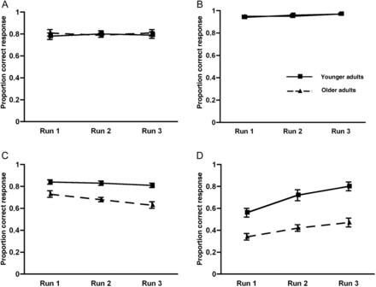
Figure 2. Behavioral performance across runs of the task. Proportion of correct responses to (A) target pairs, (B) new ...
Notes:
Figure 2. Behavioral performance across runs of the task. Proportion of correct responses to (A) target pairs, (B) new pairs, (C) lure pairs, (D) rearranged pairs. Error bars represent ± 1 SEM.
Unless provided in the caption above, the following copyright applies to the content of this slide: © The Author 2013. Published by Oxford University Press. All rights reserved. For Permissions, please e-mail: journals.permissions@oup.com

