Slide 1
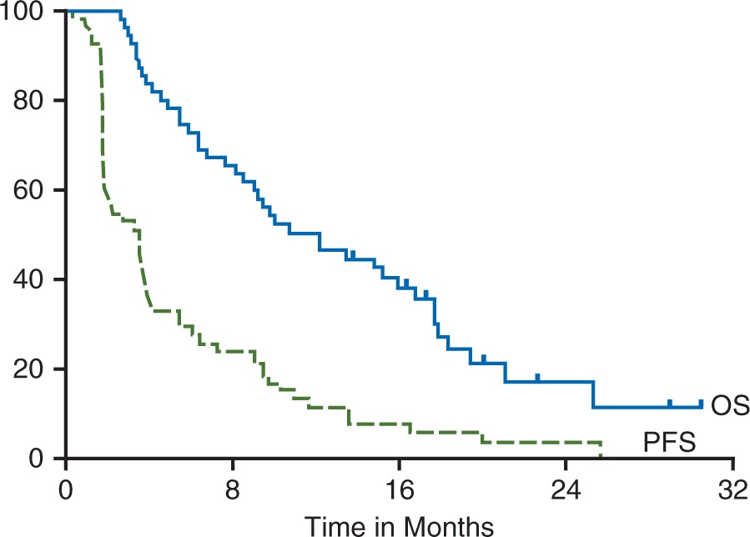
Figure 1. Kaplan–Meier curve of progression free survival (—) and overall survival (__) for all evaluable ...
Notes:
Figure 1. Kaplan–Meier curve of progression free survival (—) and overall survival (__) for all evaluable patients on study (n = 58). Median progression free survival was 3.5 months, (95% CI 1.8–3), and the median OS was 12.2 months, (95% CI 8.1–16.8).
Unless provided in the caption above, the following copyright applies to the content of this slide: © The Author 2016. Published by Oxford University Press on behalf of the European Society for Medical Oncology. All rights reserved. For permissions, please email: journals.permissions@oup.com.

Slide 2
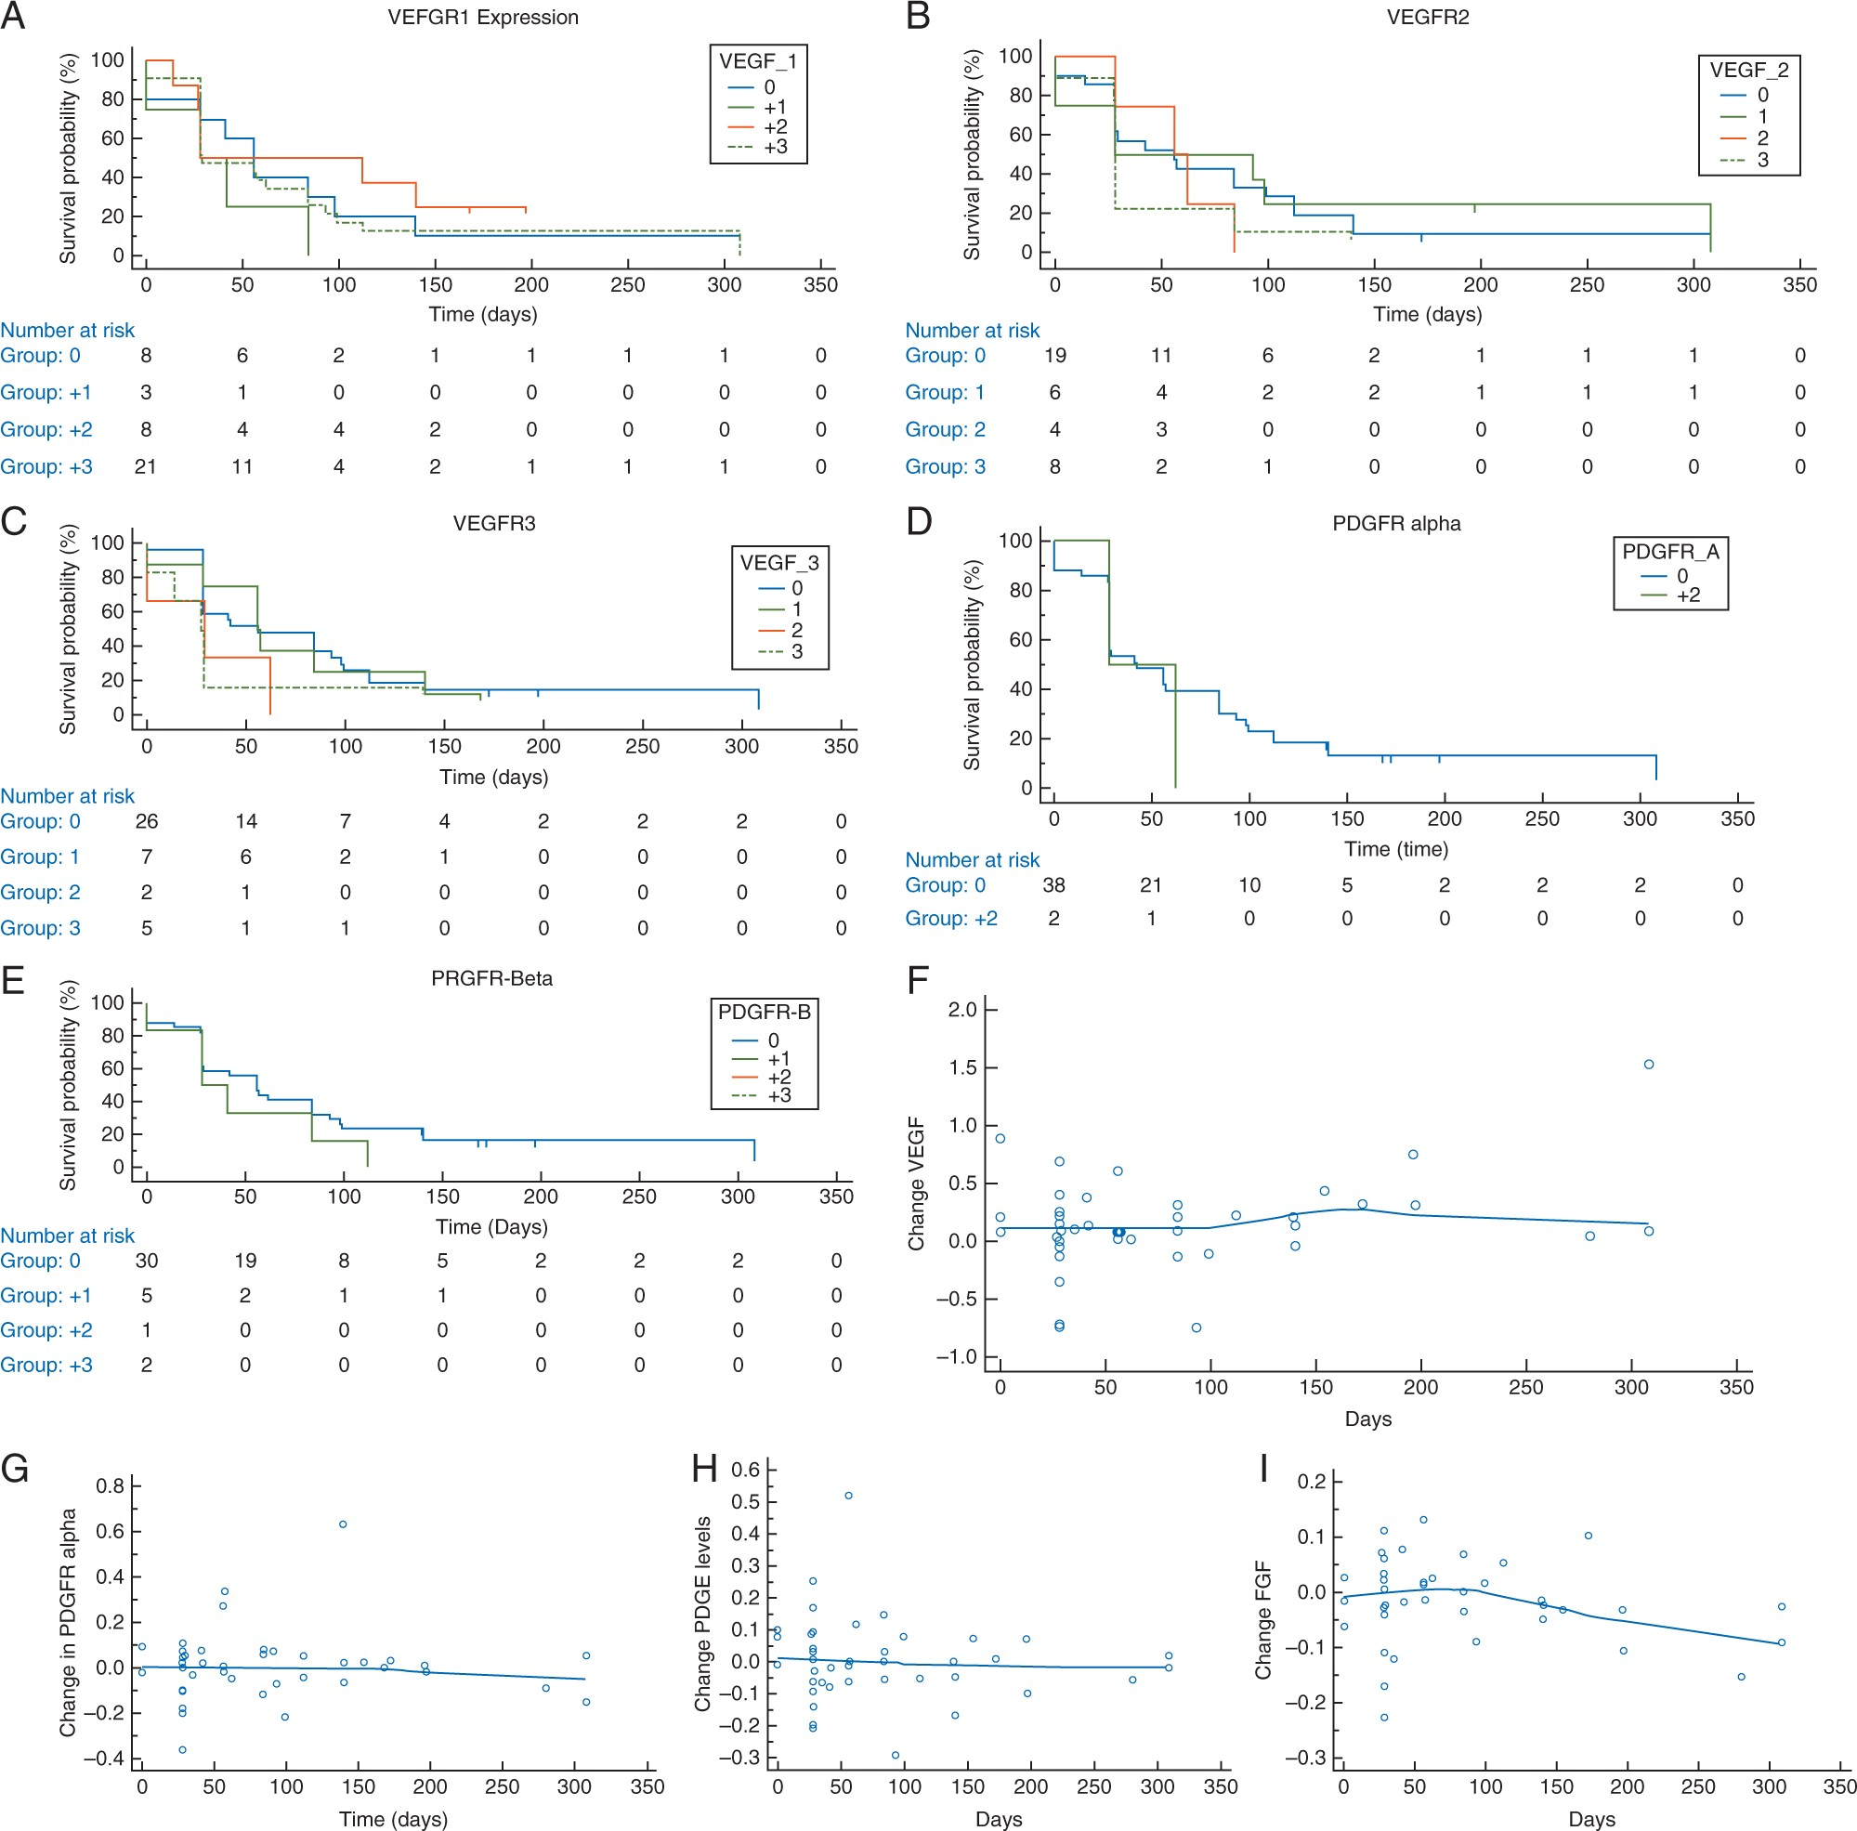
Figure 2. Kalan-Meier curves demonstrating no correlation between expression of (A) VEGFR1 (B) VEGFR2 (C) VEGFR3 (D) ...
Notes:
Figure 2. Kalan-Meier curves demonstrating no correlation between expression of (A) VEGFR1 (B) VEGFR2 (C) VEGFR3 (D) PDGFRa (E) PDGFRb with days on trial. The changes in circulating expression between day 30 minus day 1 of (F) VEGF (G) PDGFRa (H) PDGFRb (E) FGF2 did not correlate with time on trial.
Unless provided in the caption above, the following copyright applies to the content of this slide: © The Author 2016. Published by Oxford University Press on behalf of the European Society for Medical Oncology. All rights reserved. For permissions, please email: journals.permissions@oup.com.

