Slide 1
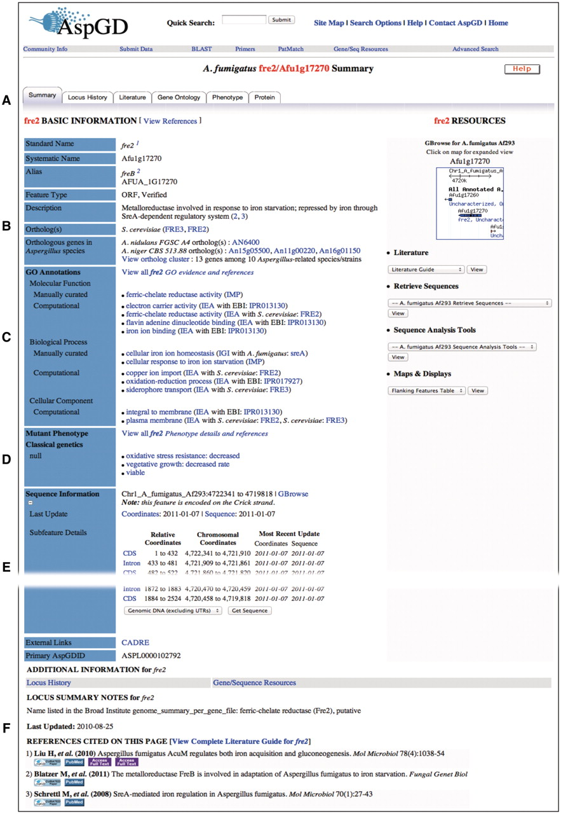
Figure 1. Locus Summary page for A. fumigatus fre2. (A) Navigation tabs lead to expanded reports on Locus History, ...
Notes:
Figure 1. Locus Summary page for A. fumigatus fre2. (A) Navigation tabs lead to expanded reports on Locus History, relevant literature, GO and phenotype annotations and protein details. (B) Basic Information section provides gene names and aliases, a headline-like description of the gene product, links to orthologous genes in other Aspergillus species in AspGD and links to orthologs in S. cerevisiae at SGD. (C) GO section lists functional annotations derived from manual curation of available data and from orthology-based and protein domain-based computational analysis. (D) Mutant Phenotype section outlines literature-derived experimental data for mutant phenotypes. (E) Sequence Information section gives an overview of the gene model and provides access to sequences (parts of this section have been removed from the figure to conserve space). (F) Additional Information section includes other notes and the list of references cited on the Locus Summary page. The comprehensive citation list for the gene is found on the gene’s Literature Guide, accessible from the Literature tab near the top of the Locus Summary page.
Unless provided in the caption above, the following copyright applies to the content of this slide: © The Author(s) 2011. Published by Oxford University Press.This is an Open Access article distributed under the terms of the Creative Commons Attribution Non-Commercial License (http://creativecommons.org/licenses/by-nc/3.0), which permits unrestricted non-commercial use, distribution, and reproduction in any medium, provided the original work is properly cited.

Slide 2
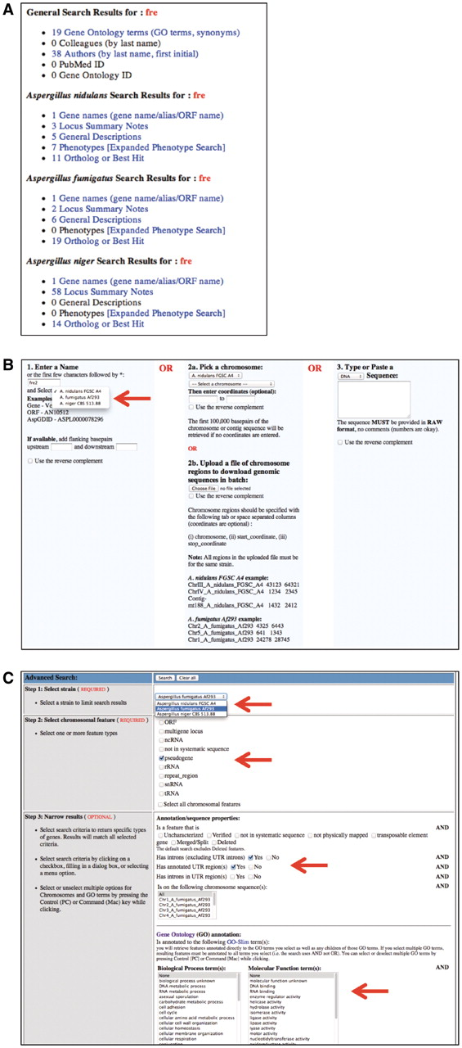
Figure 2. Multispecies search tools. (A) Quick Search Results page is divided into sections for general results, such ...
Notes:
Figure 2. Multispecies search tools. (A) Quick Search Results page is divided into sections for general results, such as GO terms or authors and for species-specific results, such as gene names, names of orthologous genes, as well as words found in descriptions, notes and phenotypes. (B) Gene and Sequence Resources tool retrieves DNA sequences for genes or chromosomal regions; the arrow points to the new pull-down menu for species selection. (C) Advanced Search tool allows retrieval of genes based on their properties; arrows indicate options for selection of a species, types of features, other properties and GO terms (lower part of the page is removed to conserve space).
Unless provided in the caption above, the following copyright applies to the content of this slide: © The Author(s) 2011. Published by Oxford University Press.This is an Open Access article distributed under the terms of the Creative Commons Attribution Non-Commercial License (http://creativecommons.org/licenses/by-nc/3.0), which permits unrestricted non-commercial use, distribution, and reproduction in any medium, provided the original work is properly cited.

Slide 3
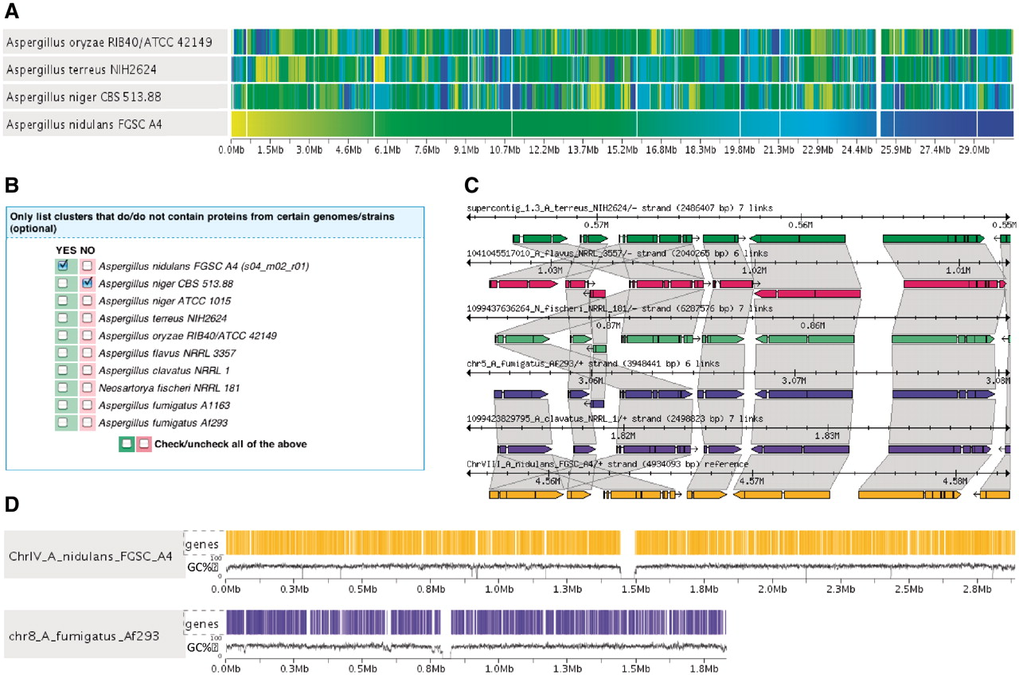
Figure 3. Search and visualization tools in the Sybil comparative genomics module. (A) Synteny gradient indicating the ...
Notes:
Figure 3. Search and visualization tools in the Sybil comparative genomics module. (A) Synteny gradient indicating the location of homologous blocks relative to a reference sequence, in this example A. nidulans FGSC A4. Vertical bars with the same shade of color represent orthologous genes across genomes. (B) Ortholog/Paralog cluster search tool, that allows researchers to retrieve homolog clusters meeting user-defined criteria regarding strain or species distribution. (C) Genomic region comparison depicting the structural annotation of syntenic and non-syntenic genes in a homologous genomic region. The trapezoids connect orthologous genes. (D) Whole-genome display showing the gene density and GC content along the sequence of A. nidulans chromosome IV and A. fumigatus chromosome 8. Colored vertical bars indicate gene locations.
Unless provided in the caption above, the following copyright applies to the content of this slide: © The Author(s) 2011. Published by Oxford University Press.This is an Open Access article distributed under the terms of the Creative Commons Attribution Non-Commercial License (http://creativecommons.org/licenses/by-nc/3.0), which permits unrestricted non-commercial use, distribution, and reproduction in any medium, provided the original work is properly cited.

Slide 4
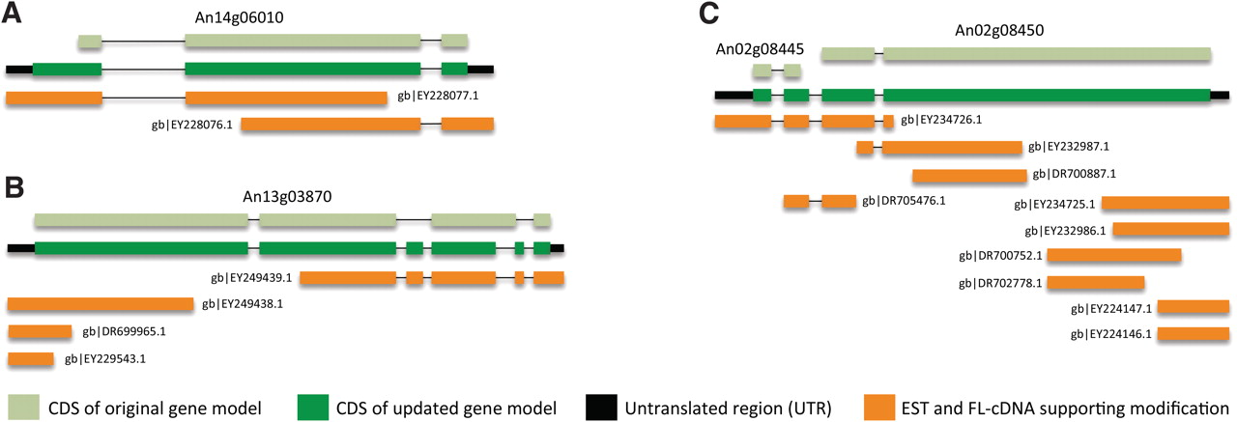
Figure 4. Examples of modifications to A. niger gene models based on analysis with PASA. The changes include (A) ...
Notes:
Figure 4. Examples of modifications to A. niger gene models based on analysis with PASA. The changes include (A) extension of coding sequence (CDS), (B) update of internal exon structure and (C) gene merging. Rectangles represent gene exons and are colored according to the legend. Displayed with each structure diagram is the name of the gene modified by the PASA analysis or the GenBank accession number of each EST and full-length cDNA sequence supporting the modifications.
Unless provided in the caption above, the following copyright applies to the content of this slide: © The Author(s) 2011. Published by Oxford University Press.This is an Open Access article distributed under the terms of the Creative Commons Attribution Non-Commercial License (http://creativecommons.org/licenses/by-nc/3.0), which permits unrestricted non-commercial use, distribution, and reproduction in any medium, provided the original work is properly cited.

