Slide 1
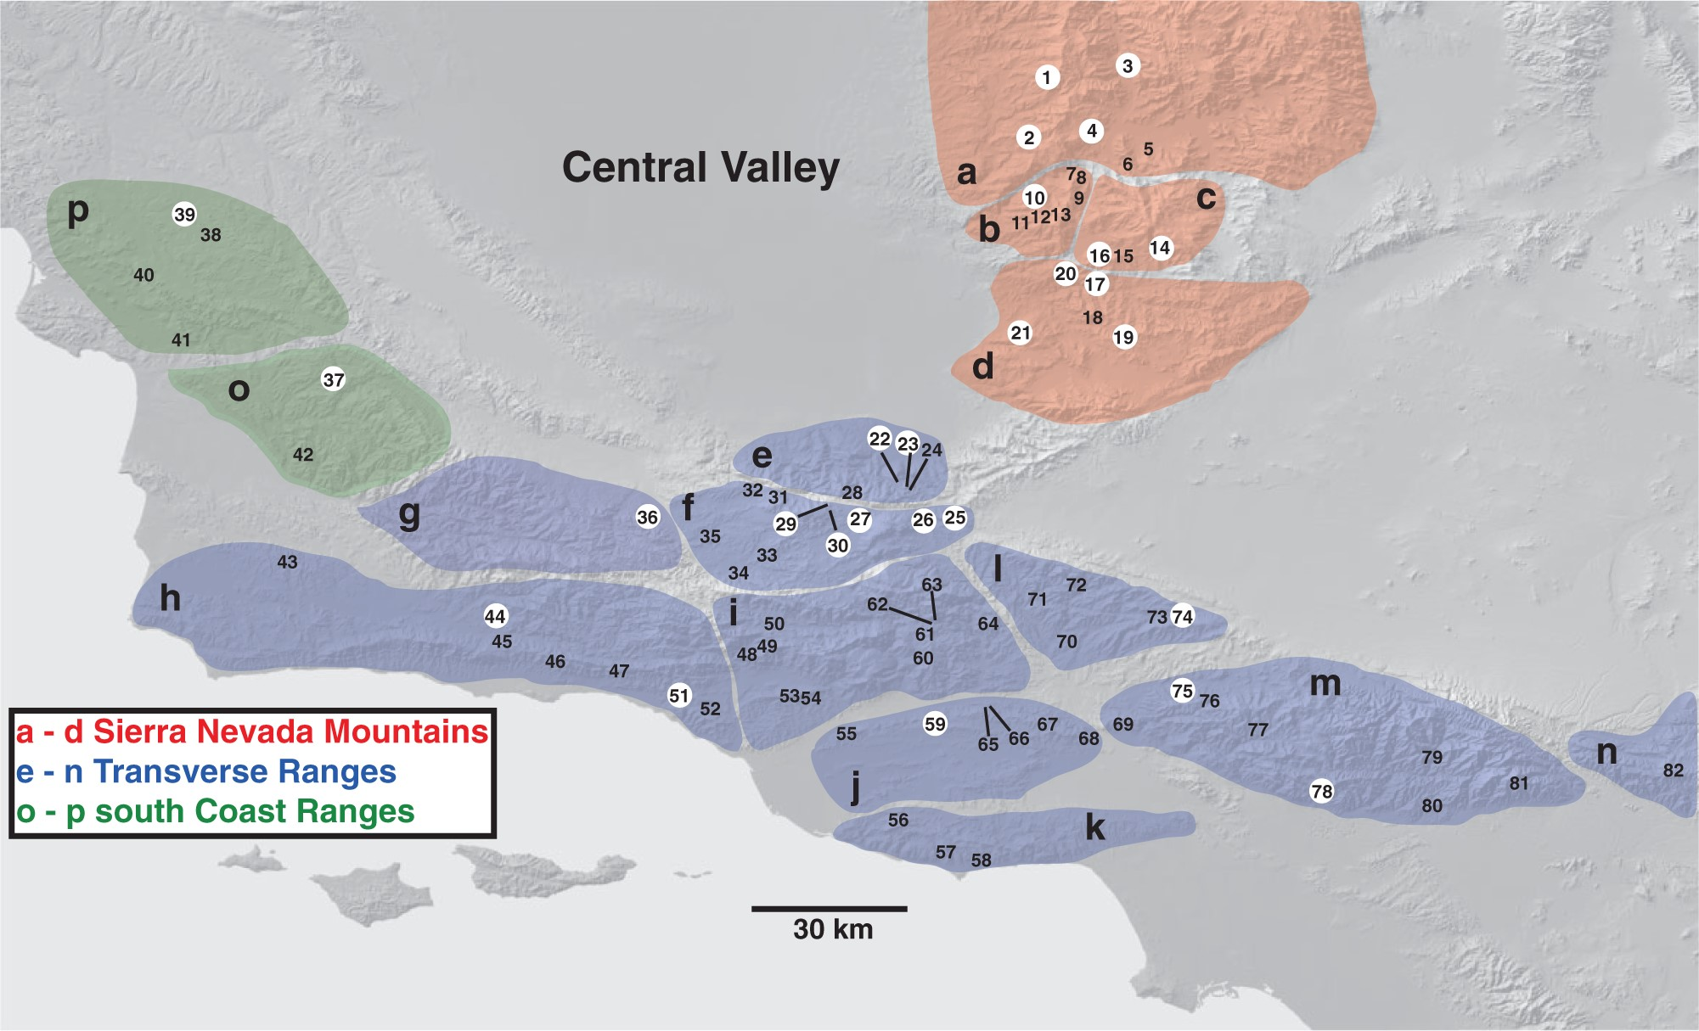
Figure 1 Map of southern California showing A. thompsoni sampling localities, with province designations [following ...
Notes:
Figure 1 Map of southern California showing A. thompsoni sampling localities, with province designations [following Bailey and Jahns (1954] and Buwalda (1954)) highlighted with letters and regions highlighted with shading. Localities used in multilocus species delimitation analyses highlighted with white circles (see Table 1). Detailed collection information for all localities can be found in Supplemental Table 1.
Unless provided in the caption above, the following copyright applies to the content of this slide: © The Author(s) 2013. Published by Oxford University Press, on behalf of the Society of Systematic Biologists. All rights reserved. For Permissions, please email: journals.permissions@oup.com

Slide 2
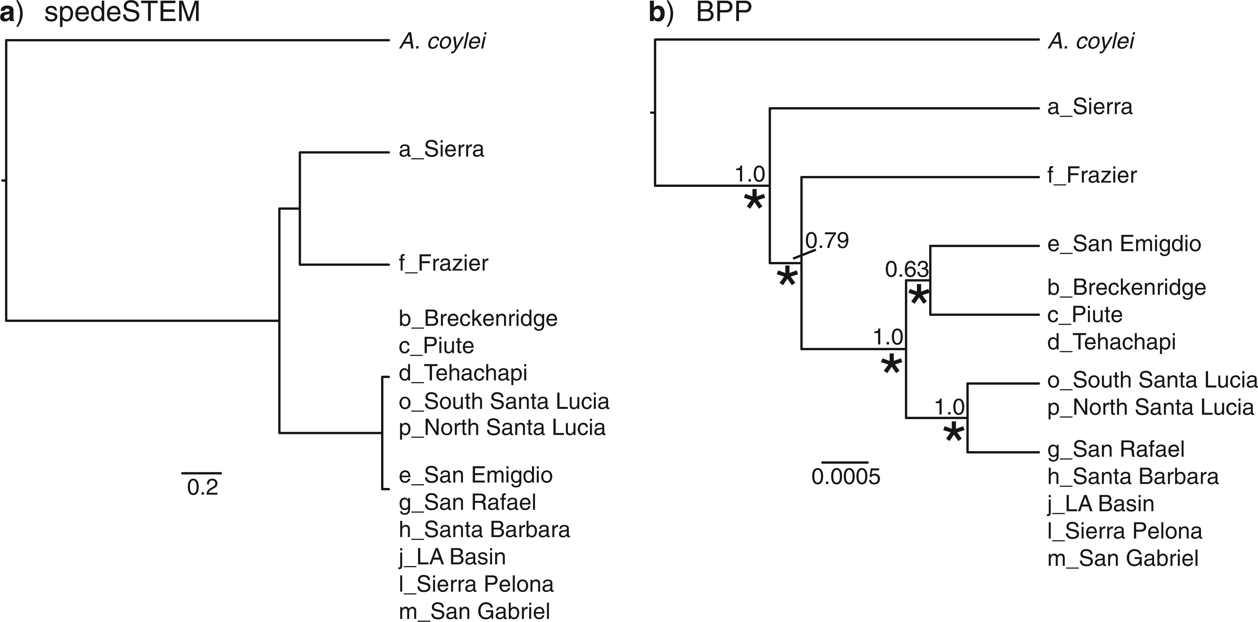
Figure 2 Species delimitations estimated with validation approaches. Results show final analysis with combined data. ...
Notes:
Figure 2 Species delimitations estimated with validation approaches. Results show final analysis with combined data. a) Results from spedeSTEM, represented on species trees estimated with STEM. Scale bar is in units of 2Ne generations. b) Results from BPP, represented on species tree estimated with *BEAST. Numerical values above nodes represent pp values; asterisks below nodes denote presence of split in BPP analyses. Scale bar represents substitutions per site.
Unless provided in the caption above, the following copyright applies to the content of this slide: © The Author(s) 2013. Published by Oxford University Press, on behalf of the Society of Systematic Biologists. All rights reserved. For Permissions, please email: journals.permissions@oup.com

Slide 3
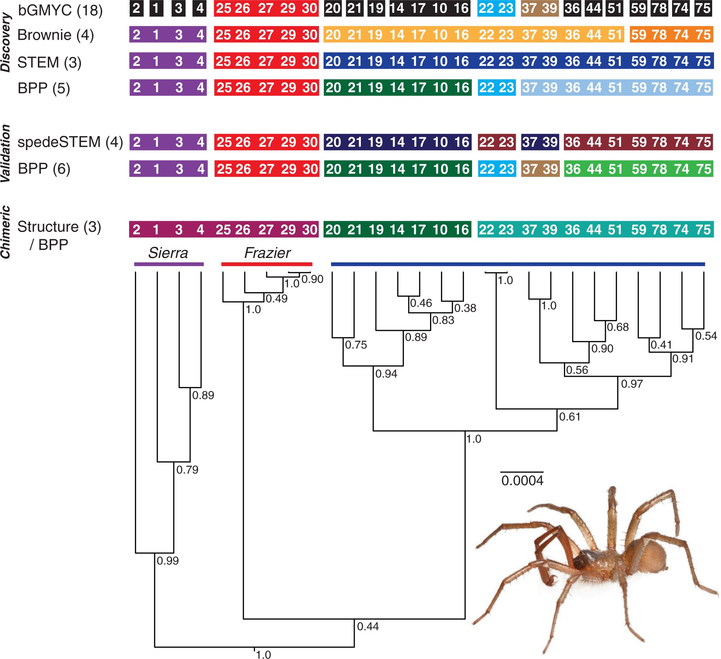
Figure 6 Summarized results from all species delimitation analyses, represented on *BEAST tree resulting from analysis ...
Notes:
Figure 6 Summarized results from all species delimitation analyses, represented on *BEAST tree resulting from analysis of all sampling locales. Colors correspond to recovered groupings, with each partition represented by a unique color. Colored bars above phylogeny represent hypothesized species groupings based on multiple analyses. Insert image of an adult male Aliatypus starretti, sp. nov. (Kern Co., Poso Flat Road).
Unless provided in the caption above, the following copyright applies to the content of this slide: © The Author(s) 2013. Published by Oxford University Press, on behalf of the Society of Systematic Biologists. All rights reserved. For Permissions, please email: journals.permissions@oup.com

Slide 4
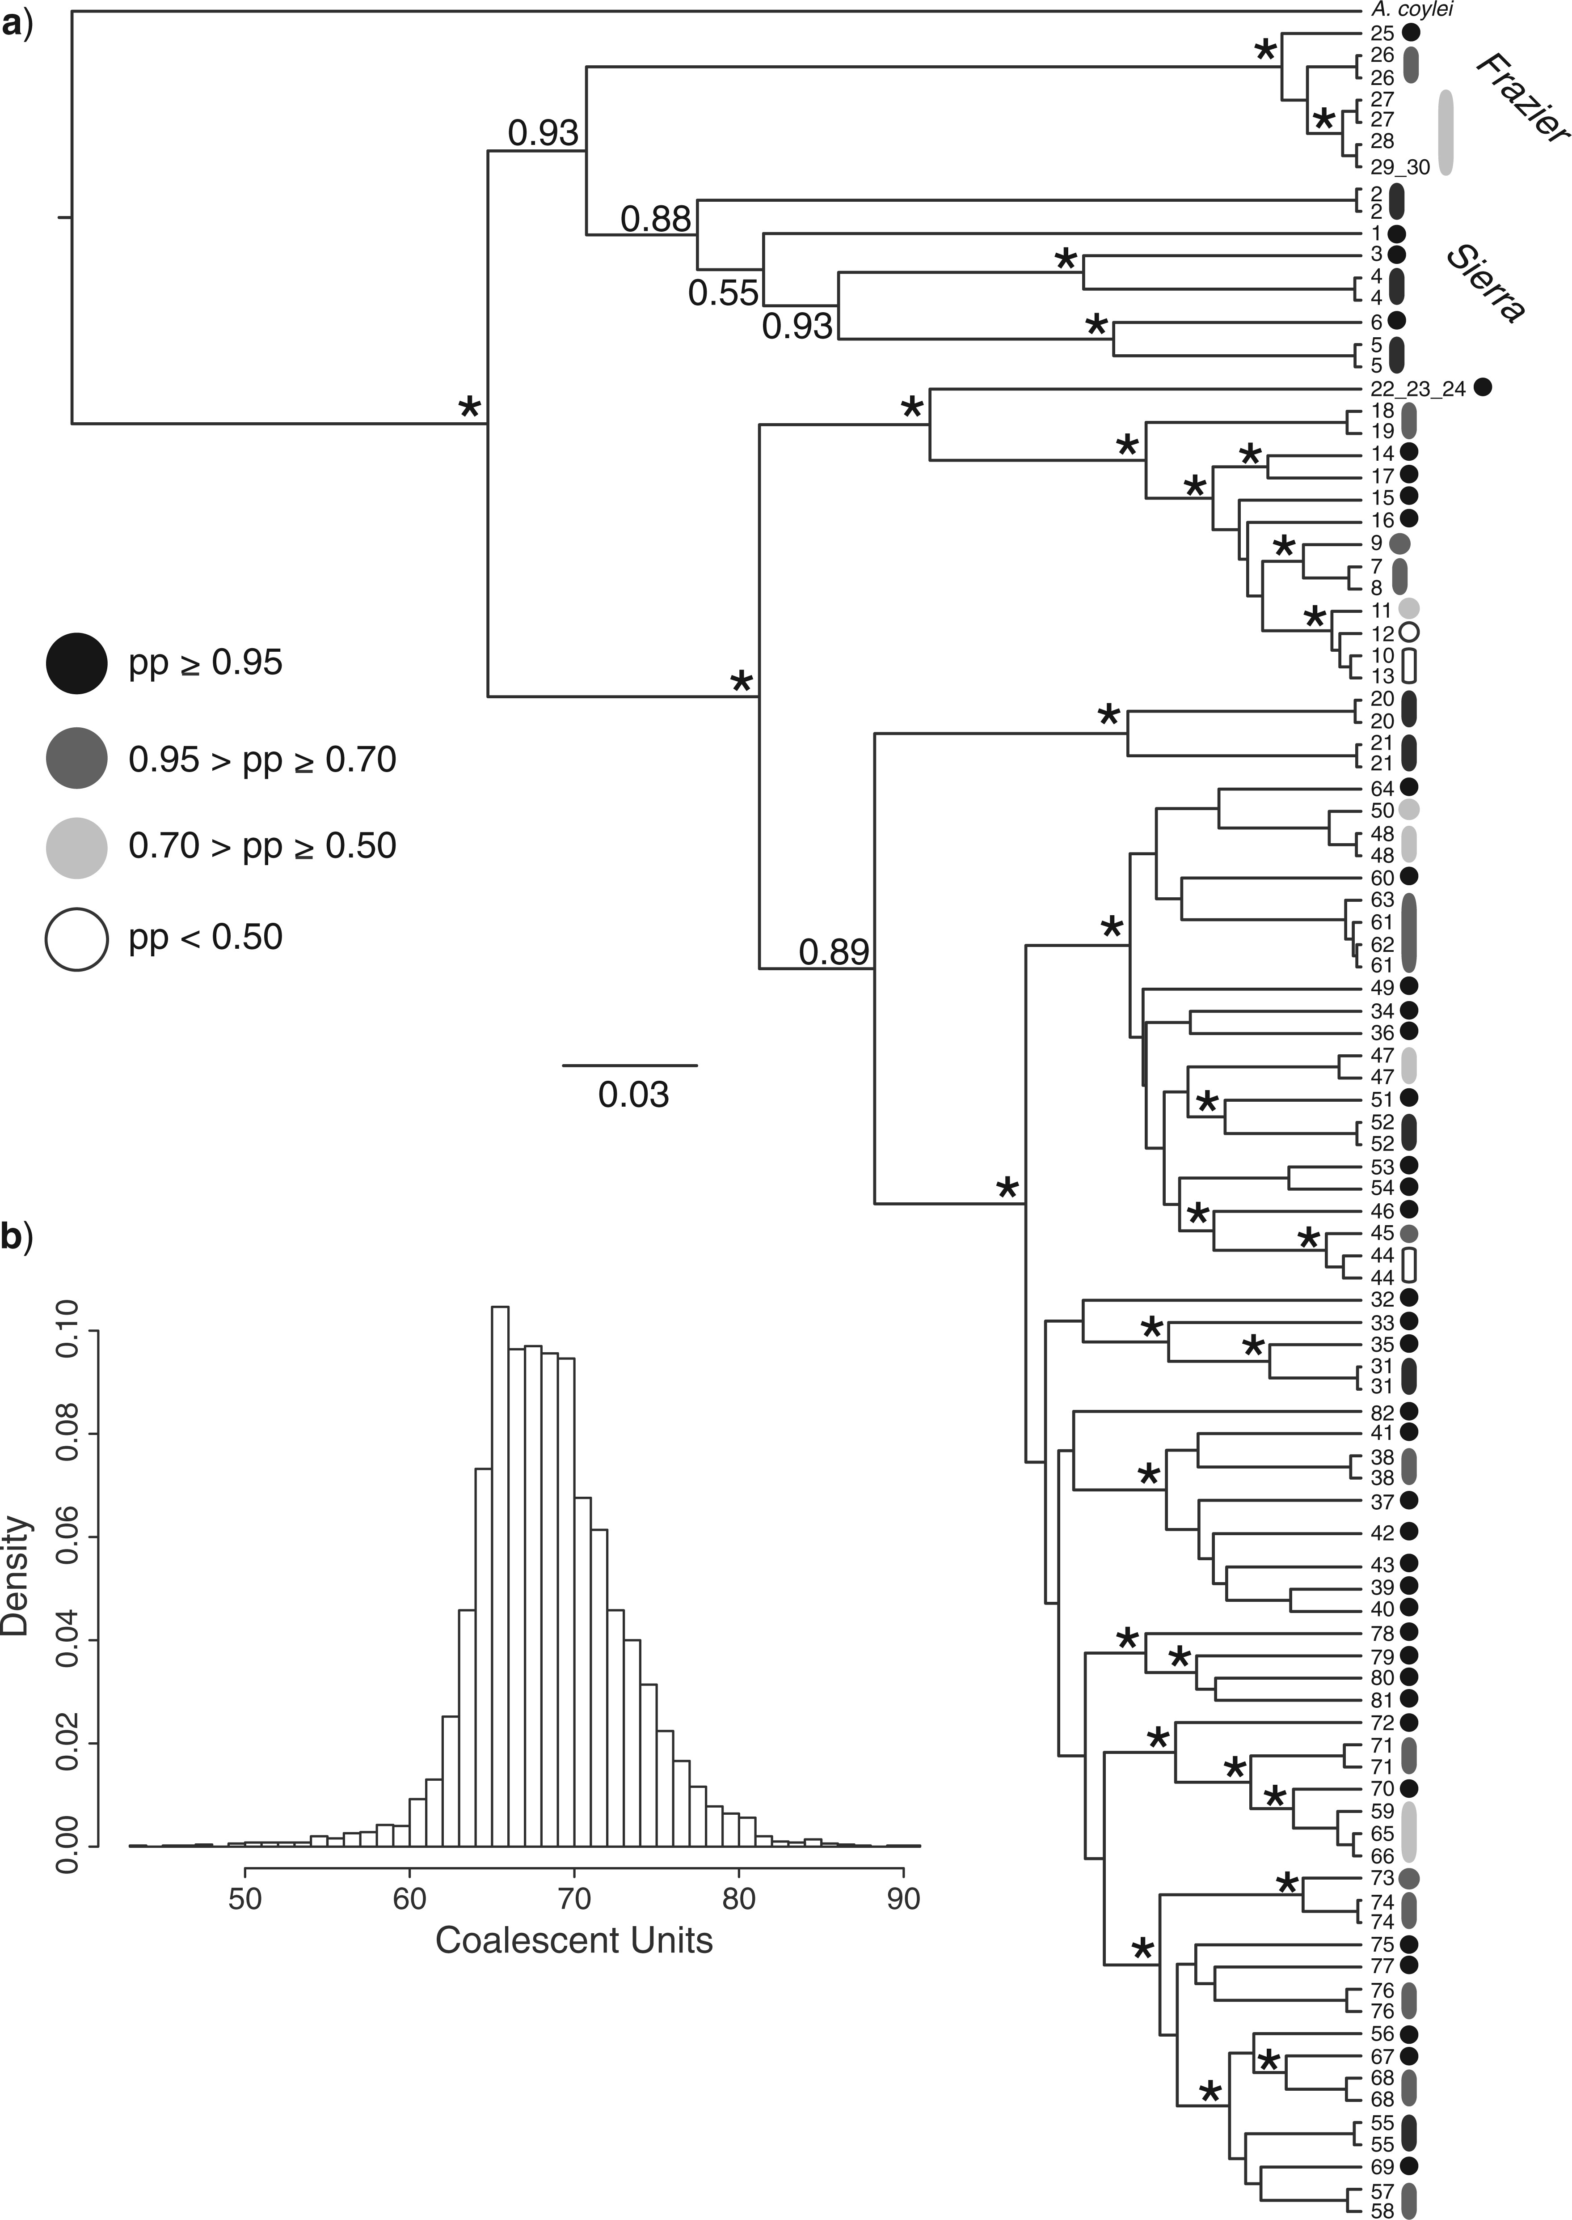
Figure 5 Results from bGMYC analysis on complete COI data set. a) COI gene tree. Nodal support corresponds to pp ...
Notes:
Figure 5 Results from bGMYC analysis on complete COI data set. a) COI gene tree. Nodal support corresponds to pp values from BEAST analysis, with an asterisk signifying >0.95 value. Terminal numbers correspond to sample site. Colors next to numbers correspond with pp for recovered coalescent unit. b) Histogram represents recovered species distribution in bGMYC, reflecting range of uncertainty in coalescent unit estimates.
Unless provided in the caption above, the following copyright applies to the content of this slide: © The Author(s) 2013. Published by Oxford University Press, on behalf of the Society of Systematic Biologists. All rights reserved. For Permissions, please email: journals.permissions@oup.com

Slide 5
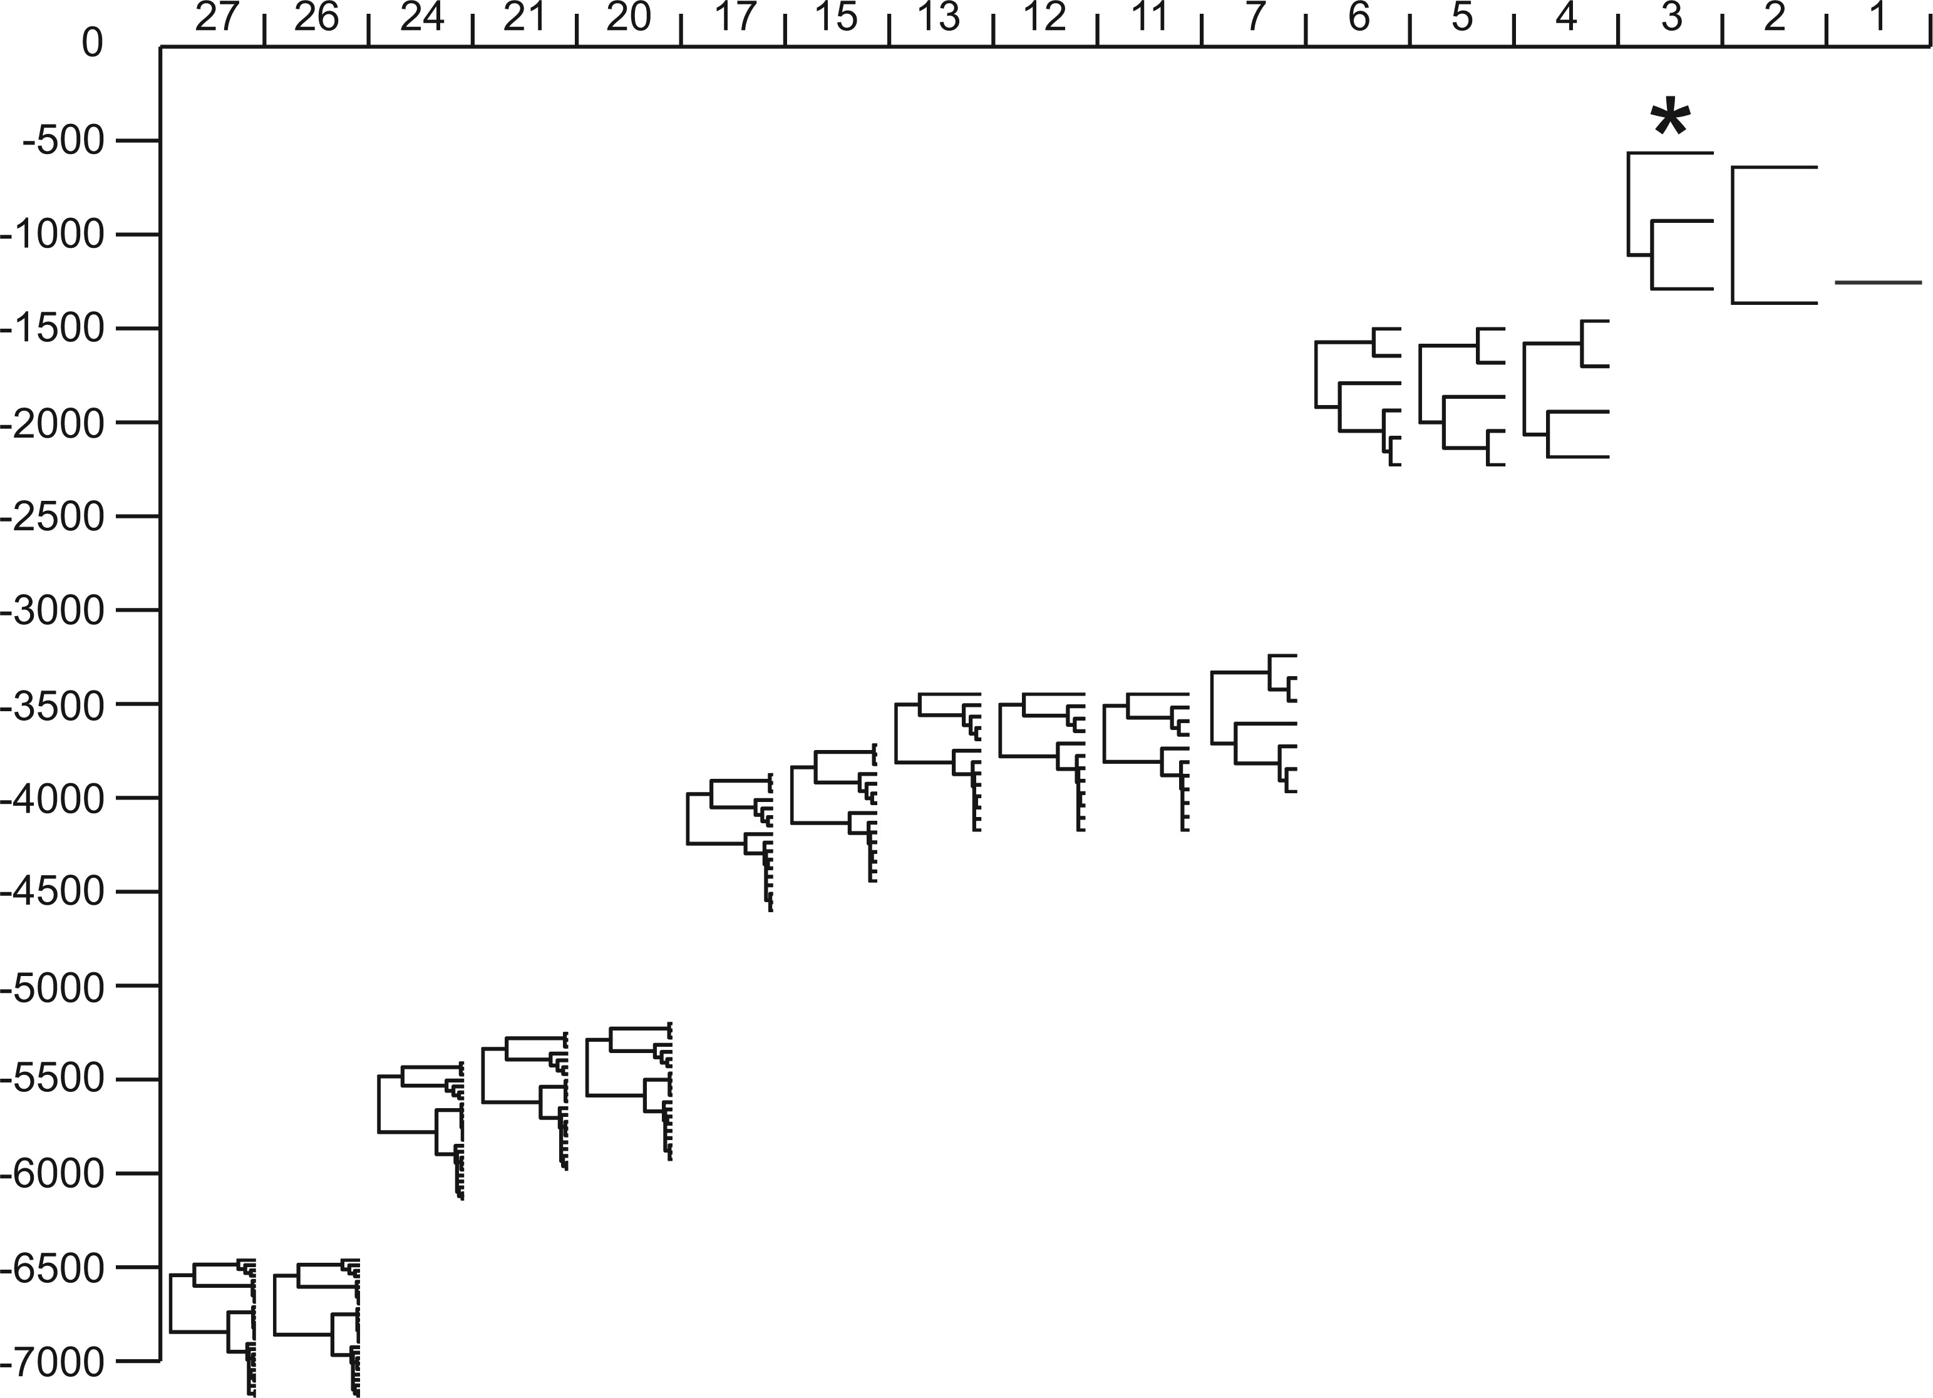
Figure 4 Likelihood plots from discovery STEM approach. X-axis is number of lineages, y-axis is log likelihood values. ...
Notes:
Figure 4 Likelihood plots from discovery STEM approach. X-axis is number of lineages, y-axis is log likelihood values. Each iteration is represented by the calculated phylogeny. An asterisk denotes the iteration with the most likely species delimitatation, representing 3 lineages. Out-group data have been removed for visual purposes.
Unless provided in the caption above, the following copyright applies to the content of this slide: © The Author(s) 2013. Published by Oxford University Press, on behalf of the Society of Systematic Biologists. All rights reserved. For Permissions, please email: journals.permissions@oup.com

Slide 6
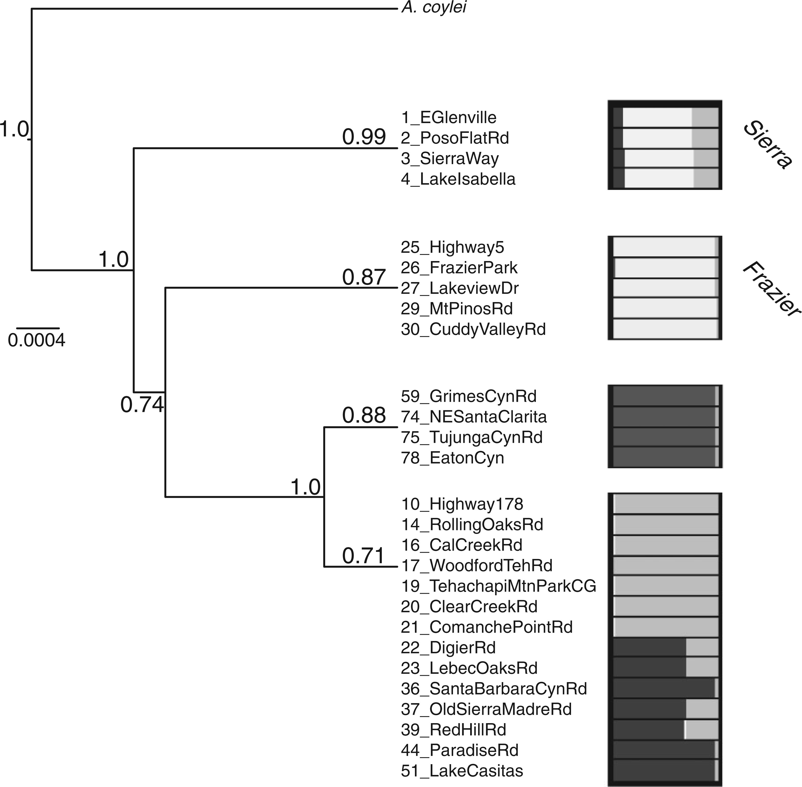
Figure 3 Species delimitations estimated with discovery approaches. Brownie results are represented on a species tree ...
Notes:
Figure 3 Species delimitations estimated with discovery approaches. Brownie results are represented on a species tree estimated with *BEAST. Values above terminal branches indicate frequency that grouping was recovered in Brownie; nodal support corresponds to pp values estimated with *BEAST. Values on terminal branches correspond to percentage of Brownie runs where grouping was recovered (out of 10,536 final trees; see Supplemental Table 2). Scale bar is in units of substitutions per site. Structure plot shows genetic clustering of individuals, with K = 3 (Sierra and Frazier are highlighted on terminal branches).
Unless provided in the caption above, the following copyright applies to the content of this slide: © The Author(s) 2013. Published by Oxford University Press, on behalf of the Society of Systematic Biologists. All rights reserved. For Permissions, please email: journals.permissions@oup.com

