Slide 1
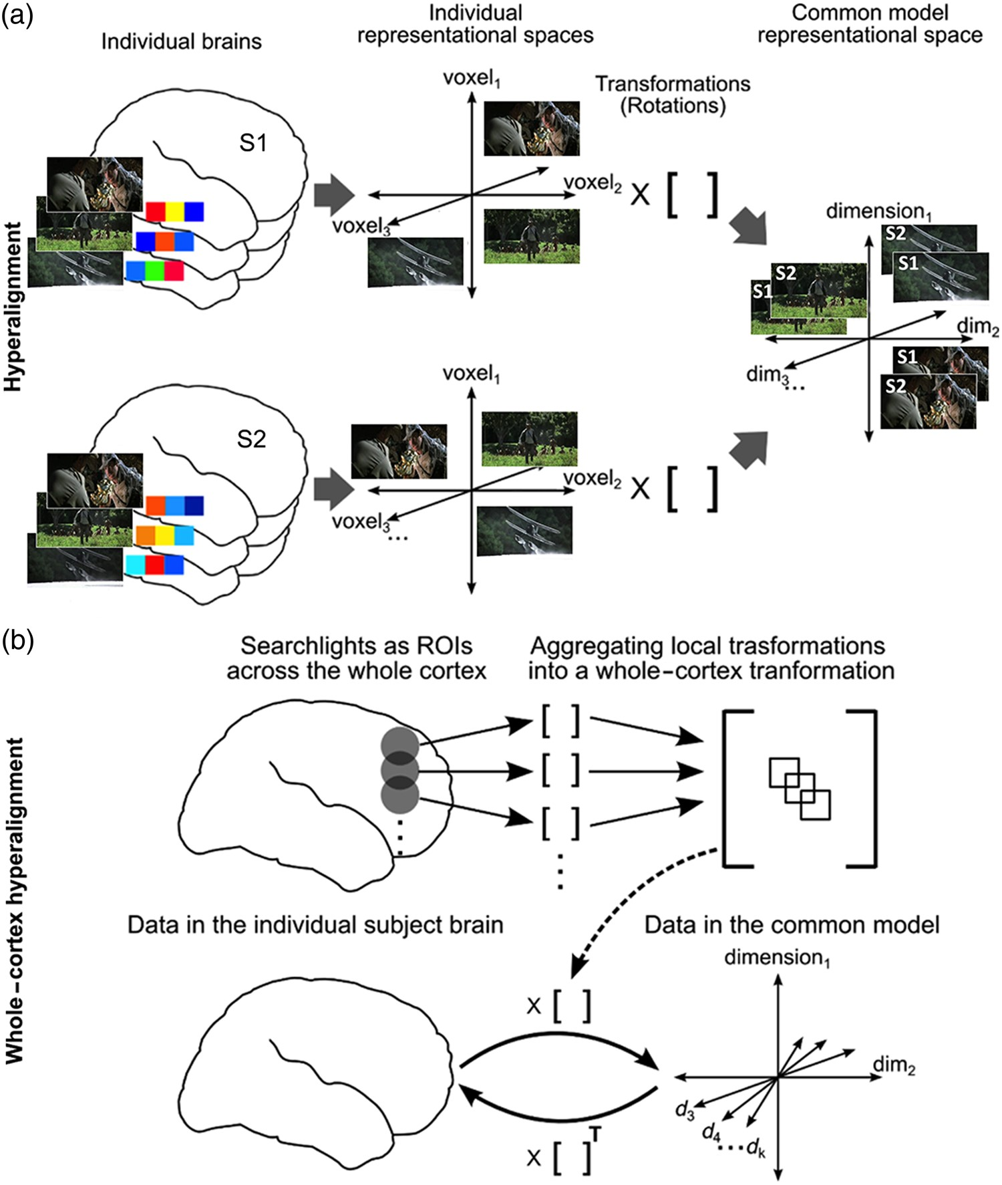
Figure 1. Schematic of whole-cortex searchlight hyperalignment. (a) Hyperalignment aligns neural representational ...
Notes:
Figure 1. Schematic of whole-cortex searchlight hyperalignment. (a) Hyperalignment aligns neural representational spaces of ROIs in individual subjects’ into a common model space of that ROI using rotation in a high-dimensional space. The Procrustes transformation finds the optimal orthogonal transformation matrix to minimize the distances between response vectors for the same movie timepoints in different subjects’ representational spaces. An individual subject's transformation matrix rotates that subject's anatomical space into the common space and can be applied to rotate any pattern of activity in that subject's brain into a vector in common space coordinates. (b) Searchlight hyperalignment aligns neural representational spaces in all cortical searchlights. Local searchlight transformation matrices are then aggregated into a single matrix for each subject. Each subject's whole-cortex transformation matrix maps any data from that subject's cortex into the common model space. The transpose of that matrix maps any data from the common model space into individual subject's cortex. Dimensions in the common space have common tuning basis functions, as documented by increased ISC of movie fMRI time series (Supplementary Fig. 1), and individual-specific topographic basis functions (Supplementary Fig. 2).
Unless provided in the caption above, the following copyright applies to the content of this slide: © The Author 2016. Published by Oxford University Press.This is an Open Access article distributed under the terms of the Creative Commons Attribution Non-Commercial License (http://creativecommons.org/licenses/by-nc/4.0/), which permits non-commercial re-use, distribution, and reproduction in any medium, provided the original work is properly cited. For commercial re-use, please contact journals.permissions@oup.com

Slide 2
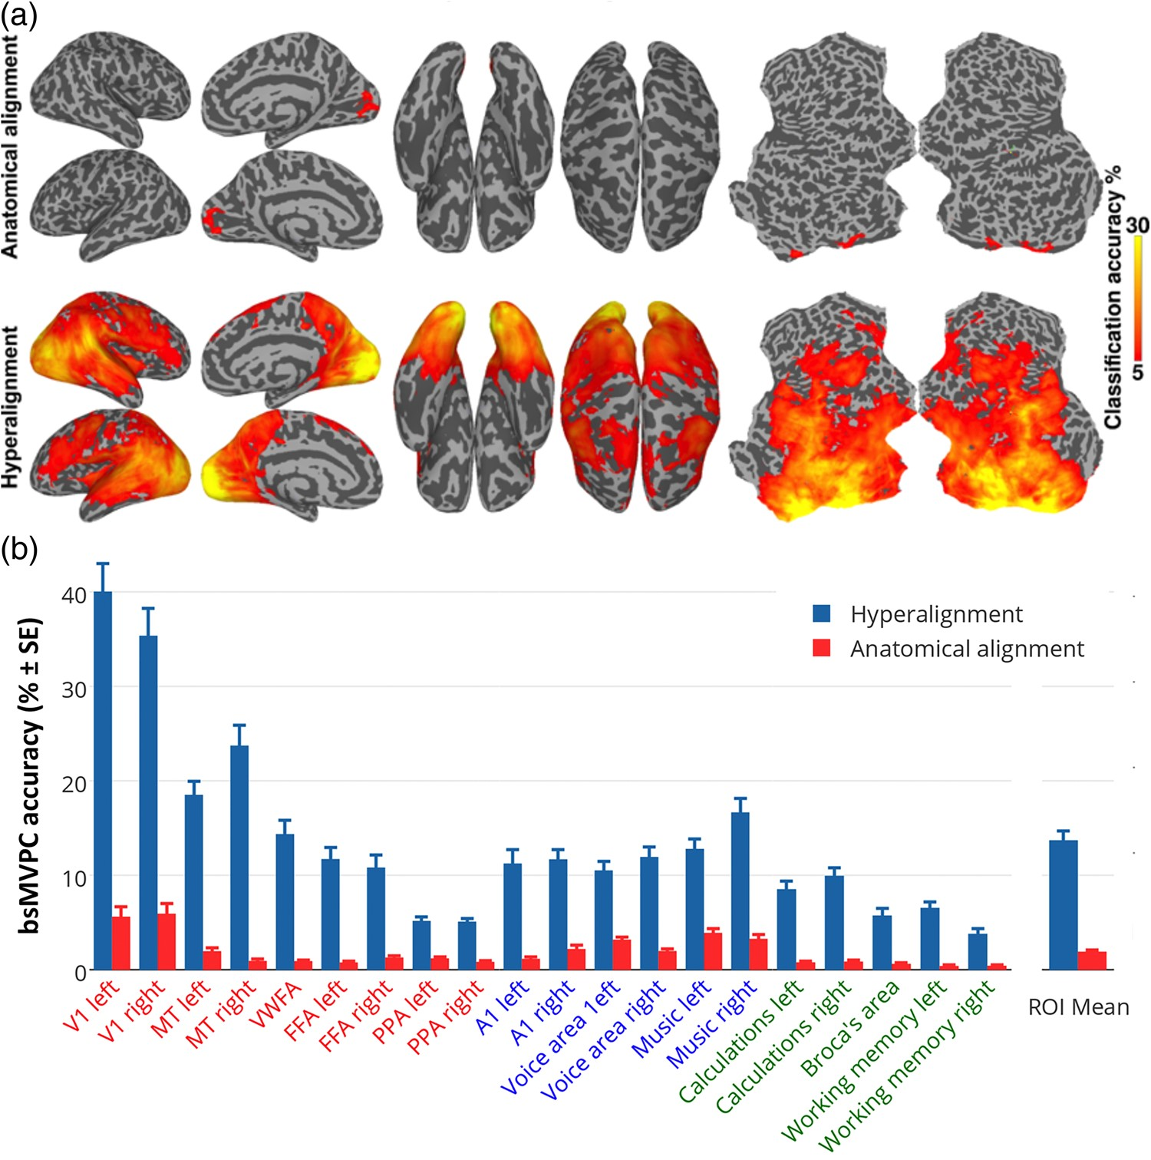
Figure 2. bsMVPC of movie time segments. (a) bsMVPC accuracies of 15 s movie segments using voxels in 3-voxel radius ...
Notes:
Figure 2. bsMVPC of movie time segments. (a) bsMVPC accuracies of 15 s movie segments using voxels in 3-voxel radius searchlights before (top) and after whole-cortex hyperalignment (bottom). Model dimensions are assigned to searchlights based on their locations in the reference subject's brain. As in all validation tests on movie data, the common model space and transformation matrices were derived from one half of the movie data and then applied to the other half for cross-validated tests, in this case bsMVPC. (b) bsMVPC accuracies in twenty searchlight ROIs that were selected to cover a range of early and late visual areas in occipital and temporal cortices (V1, MT - middle temporal visual motion area, VWFA—visual word form area, FFA—fusiform face area, PPA—parahippocampal place area), auditory areas in superior temporal cortices (A1, voice areas, music areas), and areas in parietal and prefrontal cortices that are associated with cognitive and language functions (calculations, working memory, expressive speech). We used the coordinates for the peak location associated with selected terms in the Neurosynth database (http://www.neurosynth.org; Supplementary Table 1) as searchlight centers. ROI names are colored to group visual (orange and red), auditory (blue), and cognitive areas (green).
Unless provided in the caption above, the following copyright applies to the content of this slide: © The Author 2016. Published by Oxford University Press.This is an Open Access article distributed under the terms of the Creative Commons Attribution Non-Commercial License (http://creativecommons.org/licenses/by-nc/4.0/), which permits non-commercial re-use, distribution, and reproduction in any medium, provided the original work is properly cited. For commercial re-use, please contact journals.permissions@oup.com

Slide 3
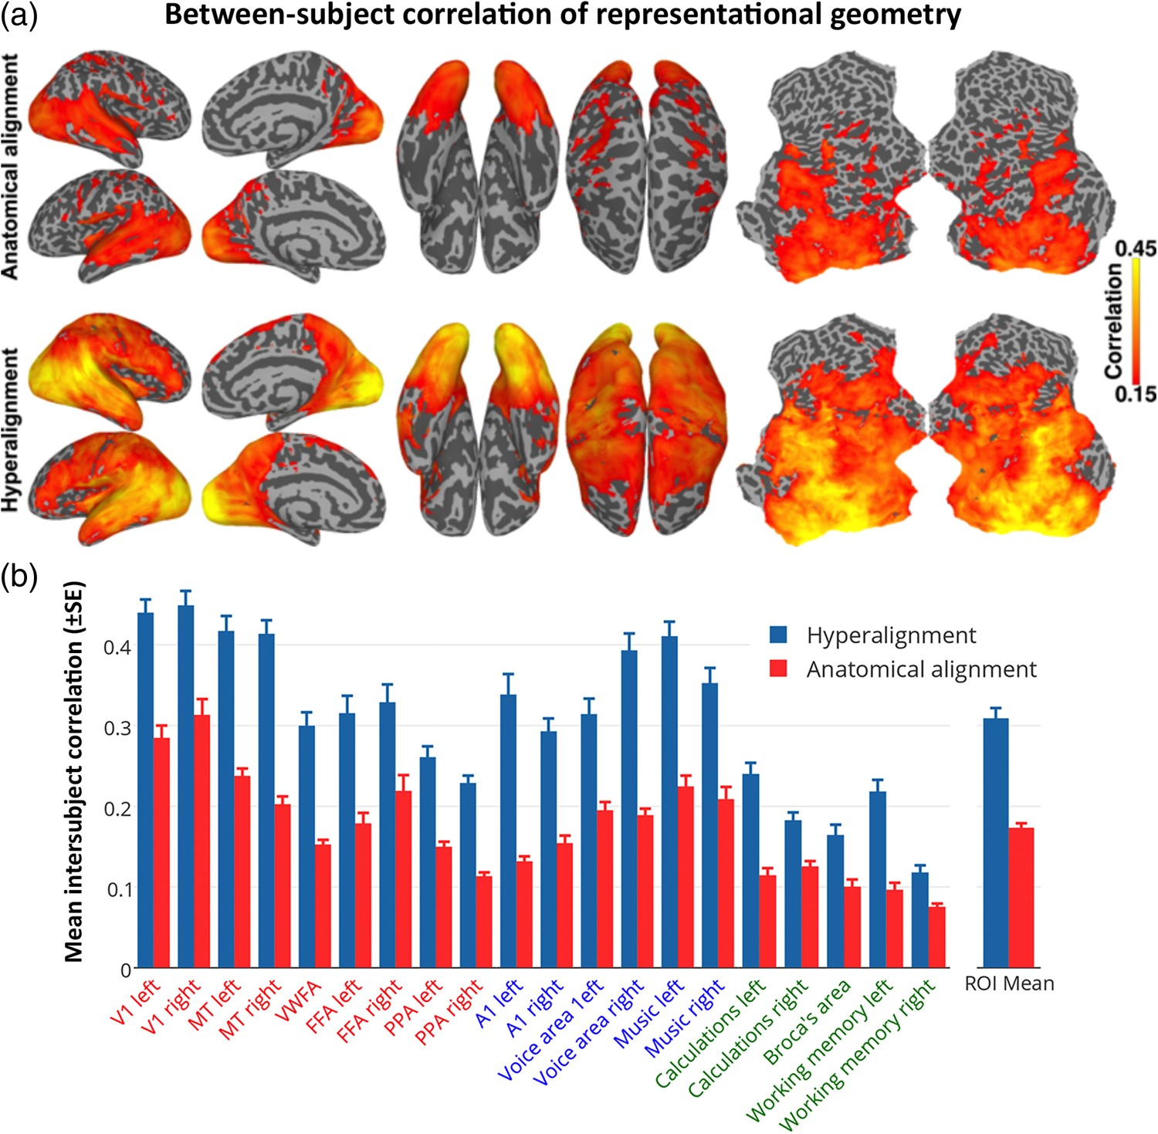
Figure 3. ISC of neural representational geometry for movie content. (a) ISCs of representational geometries before ...
Notes:
Figure 3. ISC of neural representational geometry for movie content. (a) ISCs of representational geometries before (top) and after whole-cortex hyperalignment (bottom). Local representational geometries were computed as the similarities among responses to all movie timepoints within a 3-voxel radius searchlight, and the correlations were mapped to the center voxel. (b) The size of these effects is illustrated in the same 20 searchlight ROIs as shown in Figure 2b.
Unless provided in the caption above, the following copyright applies to the content of this slide: © The Author 2016. Published by Oxford University Press.This is an Open Access article distributed under the terms of the Creative Commons Attribution Non-Commercial License (http://creativecommons.org/licenses/by-nc/4.0/), which permits non-commercial re-use, distribution, and reproduction in any medium, provided the original work is properly cited. For commercial re-use, please contact journals.permissions@oup.com

Slide 4
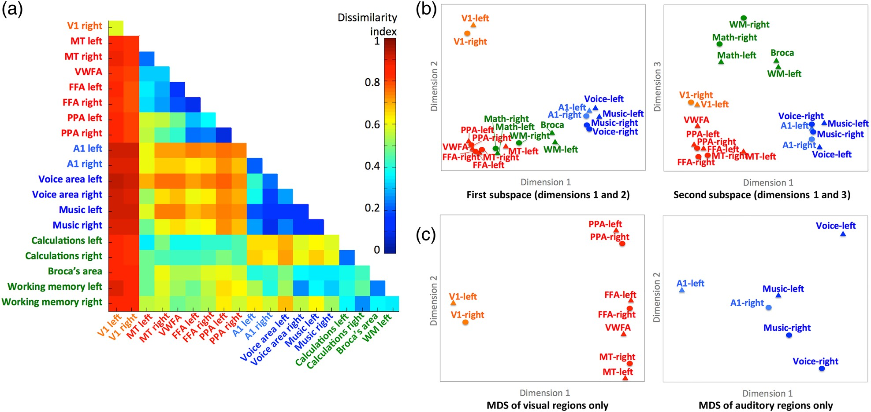
Figure 4. Second-order RSA of functional areas. (a) Matrix of all pairwise dissimilarities between the representational ...
Notes:
Figure 4. Second-order RSA of functional areas. (a) Matrix of all pairwise dissimilarities between the representational geometries in searchlight ROIs. (b) Multidimensional scaling (MDS) plots of the relationships among the representational geometries in visual (orange and red), auditory (blue), and cognitive (green) ROIs. Searchlight ROIs are the same as those shown in Figures 2 and 3. The plot on the left shows the ROIs plotted on the first and second dimensions. The plot on the right shows the ROIs plotted on the first and third dimensions. (c) Separate MDS analyses restricted to the visual (left) and auditory areas (right).
Unless provided in the caption above, the following copyright applies to the content of this slide: © The Author 2016. Published by Oxford University Press.This is an Open Access article distributed under the terms of the Creative Commons Attribution Non-Commercial License (http://creativecommons.org/licenses/by-nc/4.0/), which permits non-commercial re-use, distribution, and reproduction in any medium, provided the original work is properly cited. For commercial re-use, please contact journals.permissions@oup.com

Slide 5
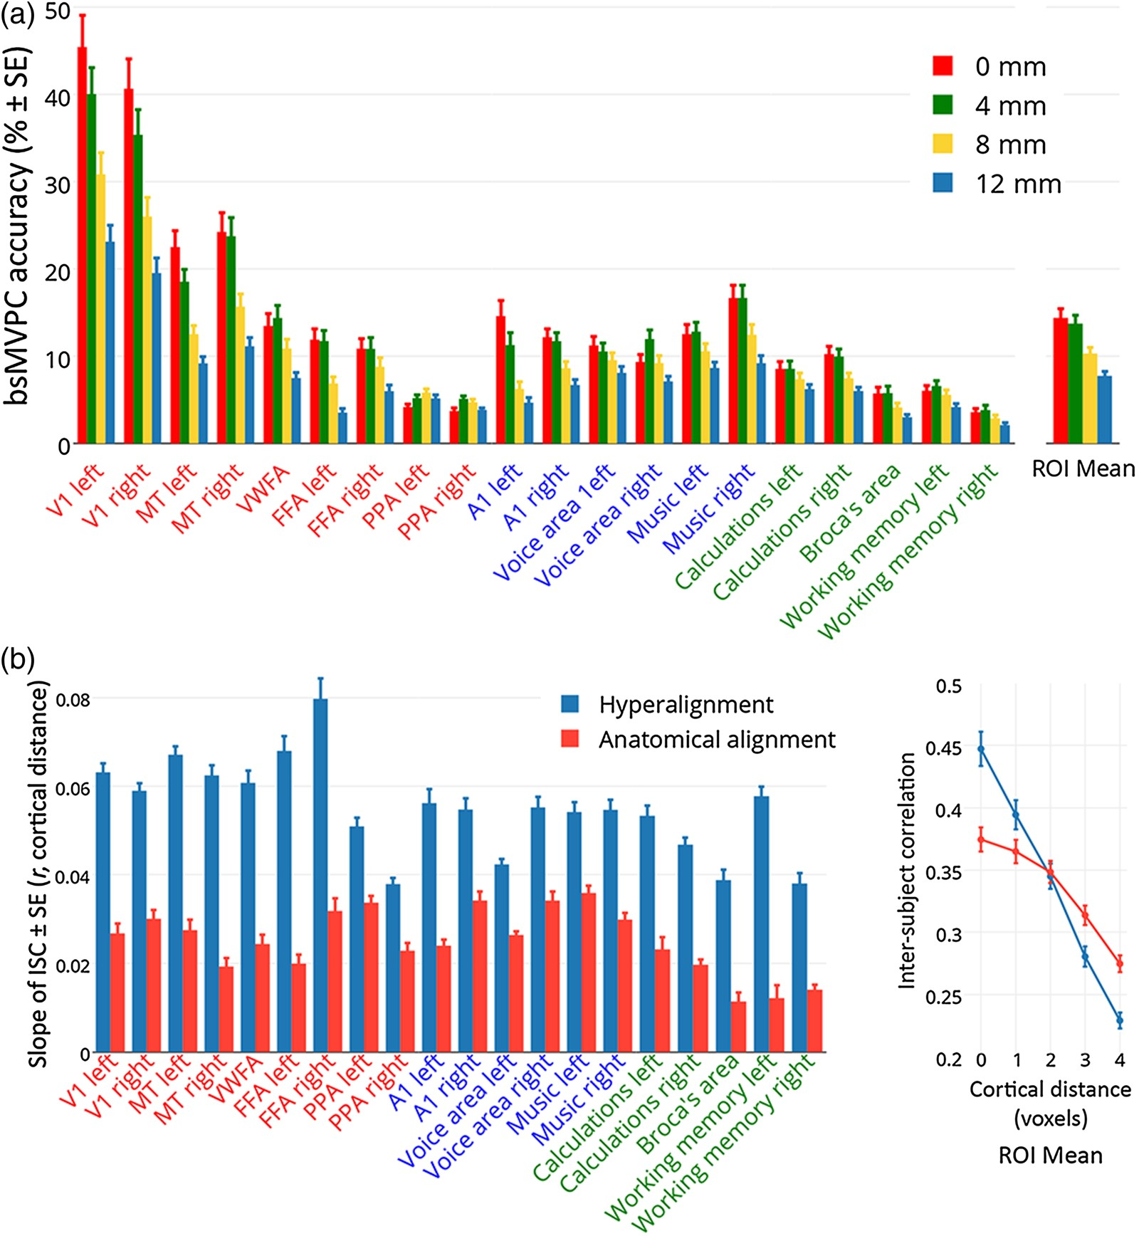
Figure 5. Estimating the spatial resolution of shared representations in the common model space. (a) Effect of spatial ...
Notes:
Figure 5. Estimating the spatial resolution of shared representations in the common model space. (a) Effect of spatial smoothing of fMRI data on accuracies of bsMVPC of 15 s movie time segments in 20 selected searchlight ROIs (same as those used in Figs 2–4, Supplementary Table 1). Smoothing filters had a FWHM of 0 mm, 4 mm, 8 mm, and 12 mm. See Supplementary Figure 7 for brain maps of the effect of smoothing. (b) The slope of ISCs of time series by cortical distance in 20 searchlight ROIs after hyperalignment and anatomical alignment (left). The ROI mean correlations between time series for voxels in the same locations and for voxels at different distances from each other are shown on the right. ISC of time series for anatomically aligned data were calculated on data that were controlled for the effect of filtering (see Supplementary Fig. 1).
Unless provided in the caption above, the following copyright applies to the content of this slide: © The Author 2016. Published by Oxford University Press.This is an Open Access article distributed under the terms of the Creative Commons Attribution Non-Commercial License (http://creativecommons.org/licenses/by-nc/4.0/), which permits non-commercial re-use, distribution, and reproduction in any medium, provided the original work is properly cited. For commercial re-use, please contact journals.permissions@oup.com

Slide 6
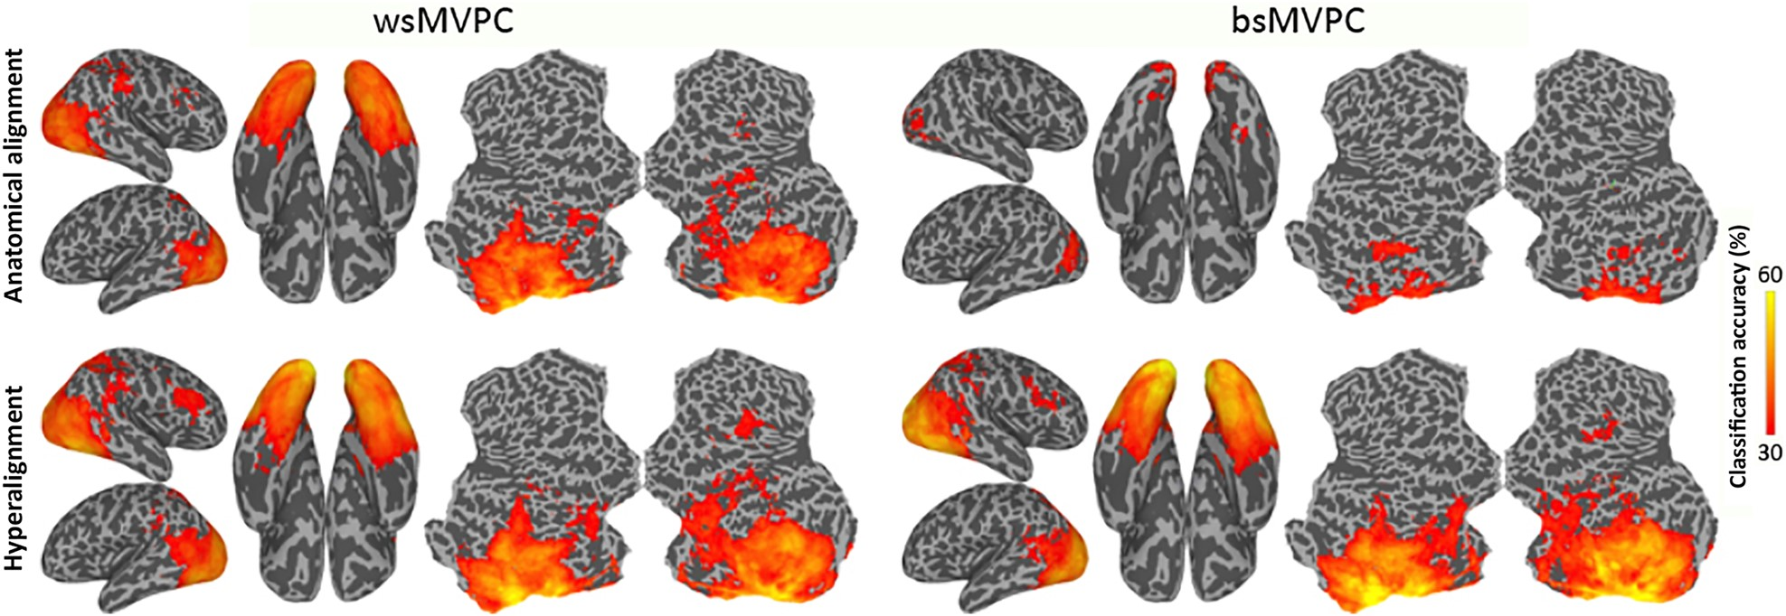
Figure 6. MVPC of responses to animal species. Searchlight-based classification accuracies of 6 animal species ...
Notes:
Figure 6. MVPC of responses to animal species. Searchlight-based classification accuracies of 6 animal species within-subjects (left) and between-subjects (right). Classification is performed on the data after anatomical alignment (top row) and whole-cortex hyperalignment (bottom row). Whole-cortex transformation matrices were derived from the movie data.
Unless provided in the caption above, the following copyright applies to the content of this slide: © The Author 2016. Published by Oxford University Press.This is an Open Access article distributed under the terms of the Creative Commons Attribution Non-Commercial License (http://creativecommons.org/licenses/by-nc/4.0/), which permits non-commercial re-use, distribution, and reproduction in any medium, provided the original work is properly cited. For commercial re-use, please contact journals.permissions@oup.com

Slide 7
Figure 7. Modeling individual retinotopy maps using the common model. Polar angle and eccentricity maps were estimated ...
Notes:
Figure 7. Modeling individual retinotopy maps using the common model. Polar angle and eccentricity maps were estimated in each subject based on corresponding maps of other subjects aligned into the common model derived from the movie data. (a) Polar angle maps in a subject based on that subject's own retinotopy scan and based on others’ retinotopy that was rotated into common model dimensions then projected in this subject's cortical anatomy. See Supplementary Figure 9 for all subjects. (b) Mean correlations between the polar angle and eccentricity maps of each subject and maps estimated from other subjects after anatomical alignment (surface alignment using sulcal curvature, blue) and whole-cortex hyperalignment (red). Retinotopic maps based on the common model are significantly better predictors of individual retinotopy than are maps based on anatomical features.
Unless provided in the caption above, the following copyright applies to the content of this slide: © The Author 2016. Published by Oxford University Press.This is an Open Access article distributed under the terms of the Creative Commons Attribution Non-Commercial License (http://creativecommons.org/licenses/by-nc/4.0/), which permits non-commercial re-use, distribution, and reproduction in any medium, provided the original work is properly cited. For commercial re-use, please contact journals.permissions@oup.com

