Slide 1
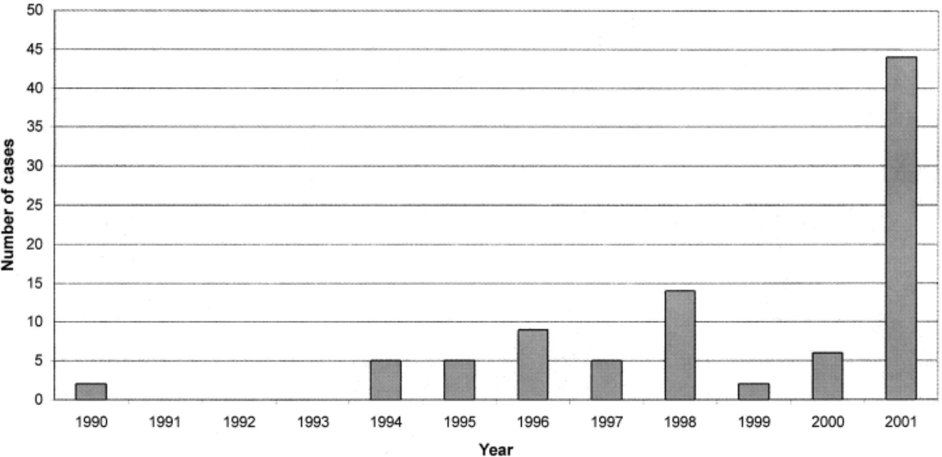
Figure 1 Reports of inflammatory mass cases by year of occurrence, 1990–2001.
Notes:
Figure 1 Reports of inflammatory mass cases by year of occurrence, 1990–2001.
Unless provided in the caption above, the following copyright applies to the content of this slide:

Slide 2
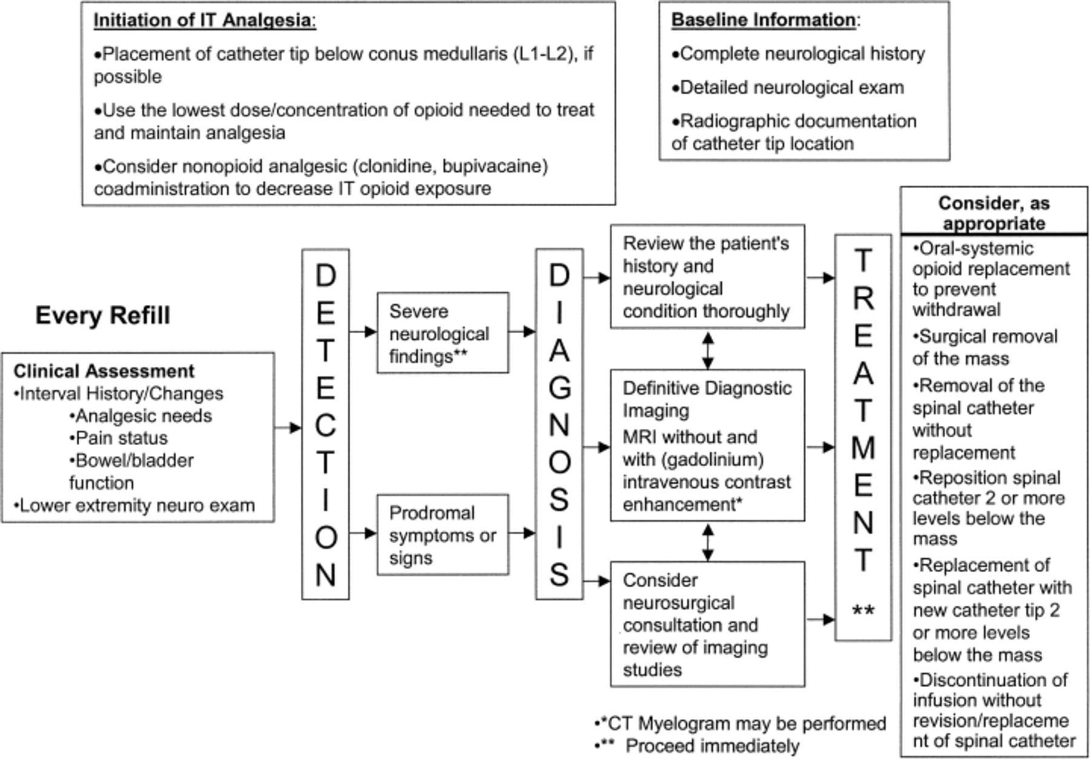
Figure 2 Management algorithm for intrathecal inflammatory masses.
Notes:
Figure 2 Management algorithm for intrathecal inflammatory masses.
Unless provided in the caption above, the following copyright applies to the content of this slide:

