Slide 1
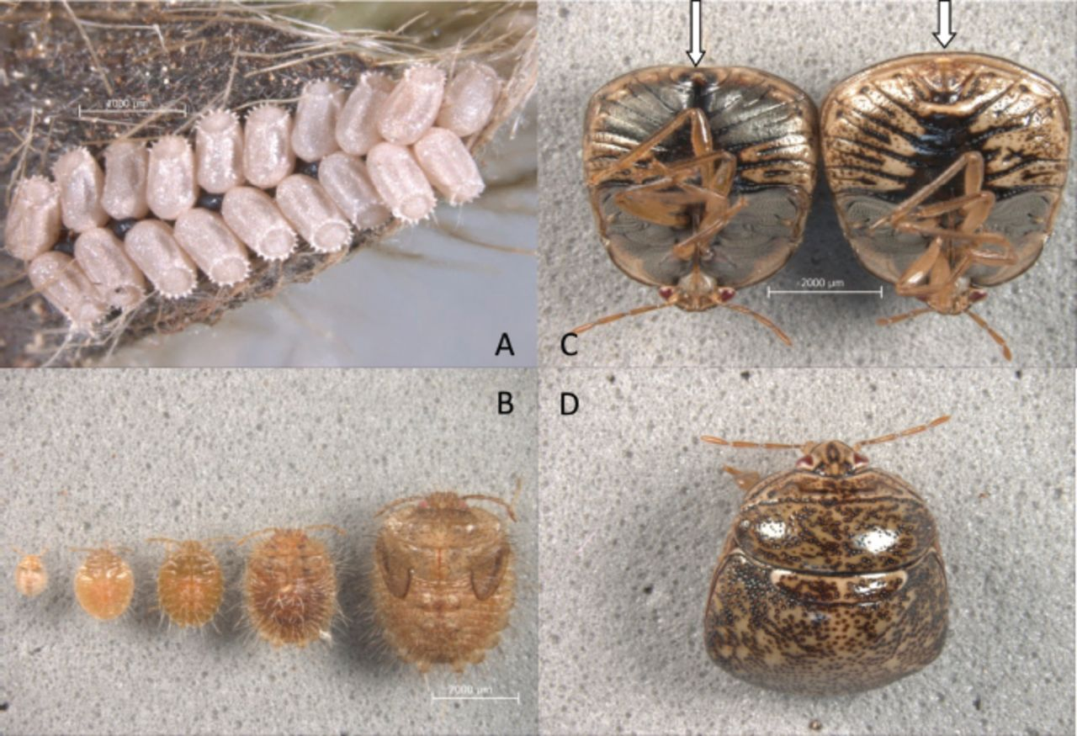
Fig. 1. Eggs (A), five nymphal instars (B), ventral view of male (left) and female (right) (C), and dorsal view of an ...
Notes:
Fig. 1. Eggs (A), five nymphal instars (B), ventral view of male (left) and female (right) (C), and dorsal view of an adult M. cribraria (D). (Online figure in color.)
Unless provided in the caption above, the following copyright applies to the content of this slide: © 2012 Entomological Society of AmericaThis is an Open Access article distributed under the terms of the Creative Commons Attribution Non-Commercial License (http://creativecommons.org/licenses/by-nc/3.0/), which permits non-commercial reuse, distribution, and reproduction in any medium, provided the original work is properly cited. For commercial re-use, please contact journals.permissions@oup.com

Slide 2
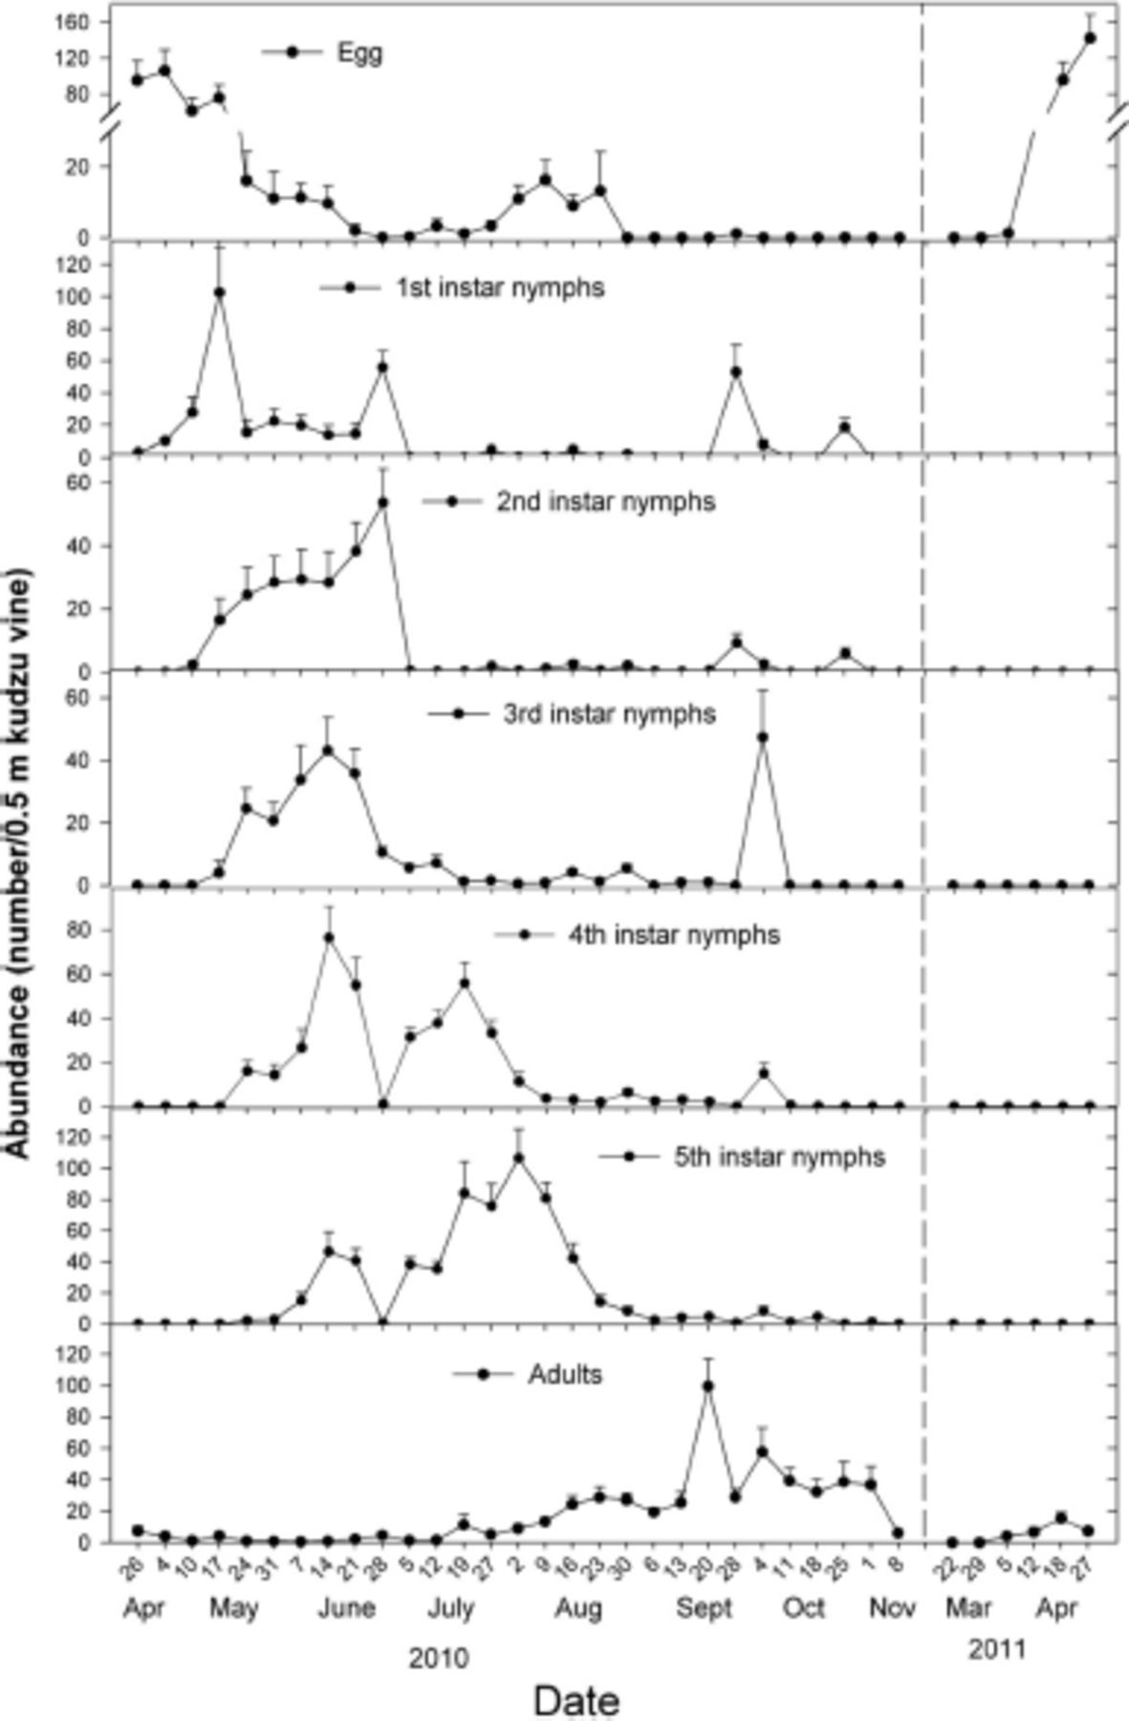
Fig. 2. Abundance of eggs, nymphs, and adults on 0.5-m lengths of kudzu vine (N=10) collected from a patch of kudzu ...
Notes:
Fig. 2. Abundance of eggs, nymphs, and adults on 0.5-m lengths of kudzu vine (N=10) collected from a patch of kudzu in Athens, GA from 26 April 2010 to 27 April 2011.
Unless provided in the caption above, the following copyright applies to the content of this slide: © 2012 Entomological Society of AmericaThis is an Open Access article distributed under the terms of the Creative Commons Attribution Non-Commercial License (http://creativecommons.org/licenses/by-nc/3.0/), which permits non-commercial reuse, distribution, and reproduction in any medium, provided the original work is properly cited. For commercial re-use, please contact journals.permissions@oup.com

Slide 3
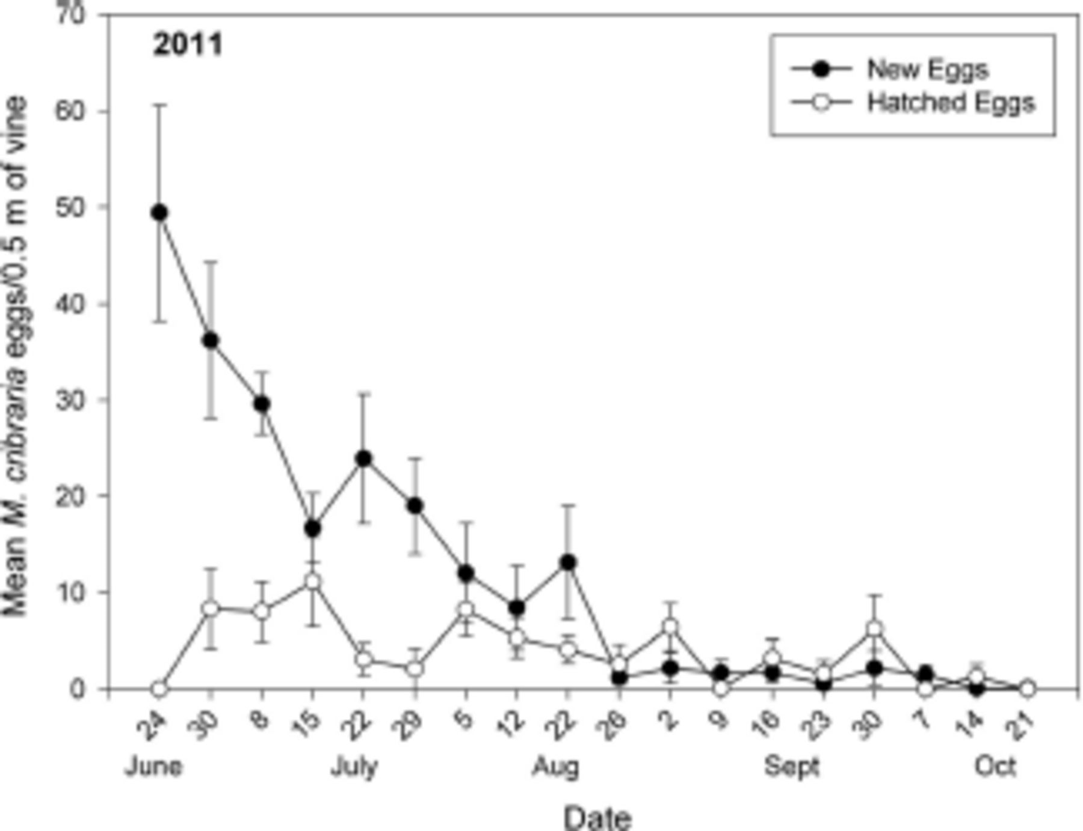
Fig. 3. Mean (±SE) (N=10) number of newly laid and hatched eggs of M. cribraria per 0.5-m-long sections of kudzu vine ...
Notes:
Fig. 3. Mean (±SE) (N=10) number of newly laid and hatched eggs of M. cribraria per 0.5-m-long sections of kudzu vine tip from 24 June to 21 October 2011.
Unless provided in the caption above, the following copyright applies to the content of this slide: © 2012 Entomological Society of AmericaThis is an Open Access article distributed under the terms of the Creative Commons Attribution Non-Commercial License (http://creativecommons.org/licenses/by-nc/3.0/), which permits non-commercial reuse, distribution, and reproduction in any medium, provided the original work is properly cited. For commercial re-use, please contact journals.permissions@oup.com

Slide 4
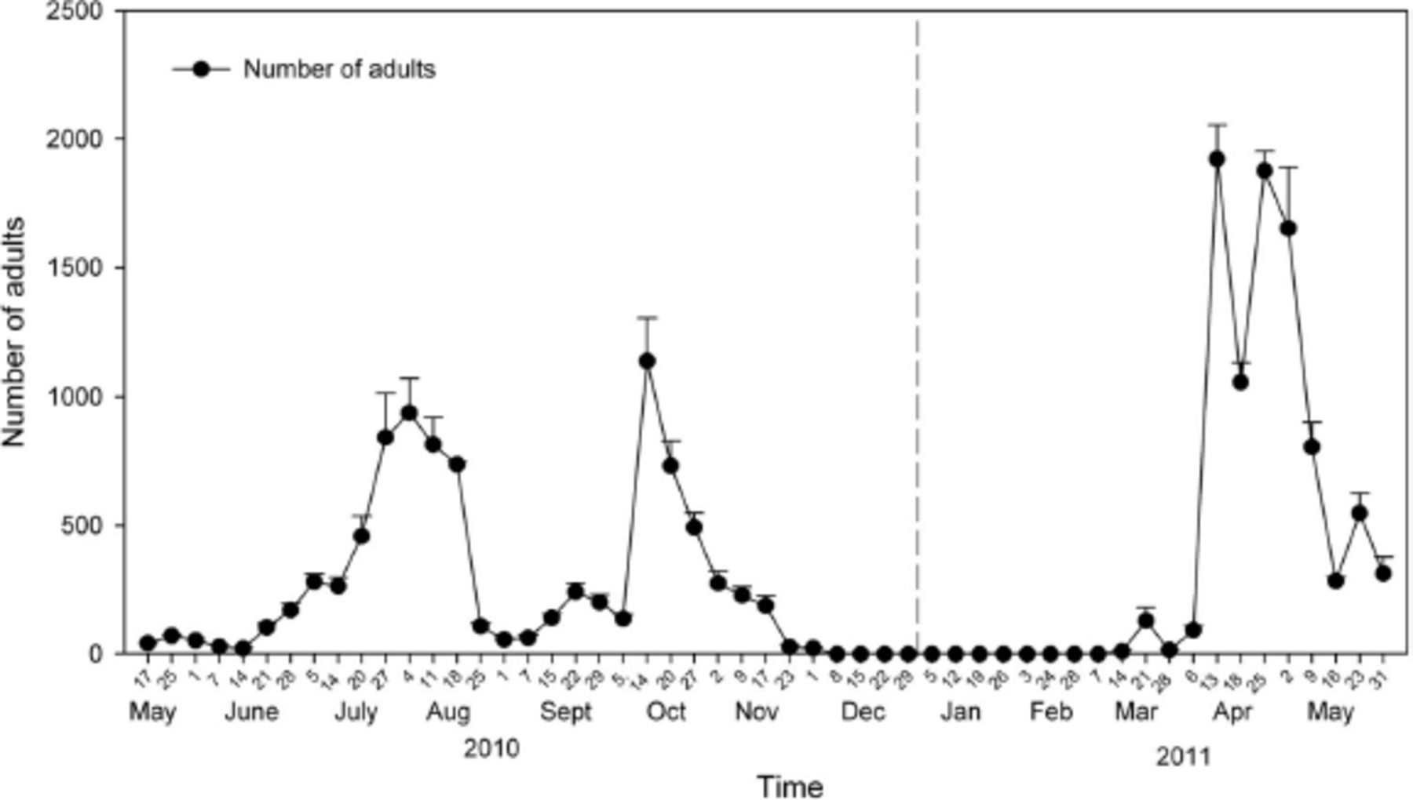
Fig. 4. Mean (±SE) (N=8) number of adult M. cribraria captured in flight intercept traps in 2010 and 2011.
Notes:
Fig. 4. Mean (±SE) (N=8) number of adult M. cribraria captured in flight intercept traps in 2010 and 2011.
Unless provided in the caption above, the following copyright applies to the content of this slide: © 2012 Entomological Society of AmericaThis is an Open Access article distributed under the terms of the Creative Commons Attribution Non-Commercial License (http://creativecommons.org/licenses/by-nc/3.0/), which permits non-commercial reuse, distribution, and reproduction in any medium, provided the original work is properly cited. For commercial re-use, please contact journals.permissions@oup.com

Slide 5
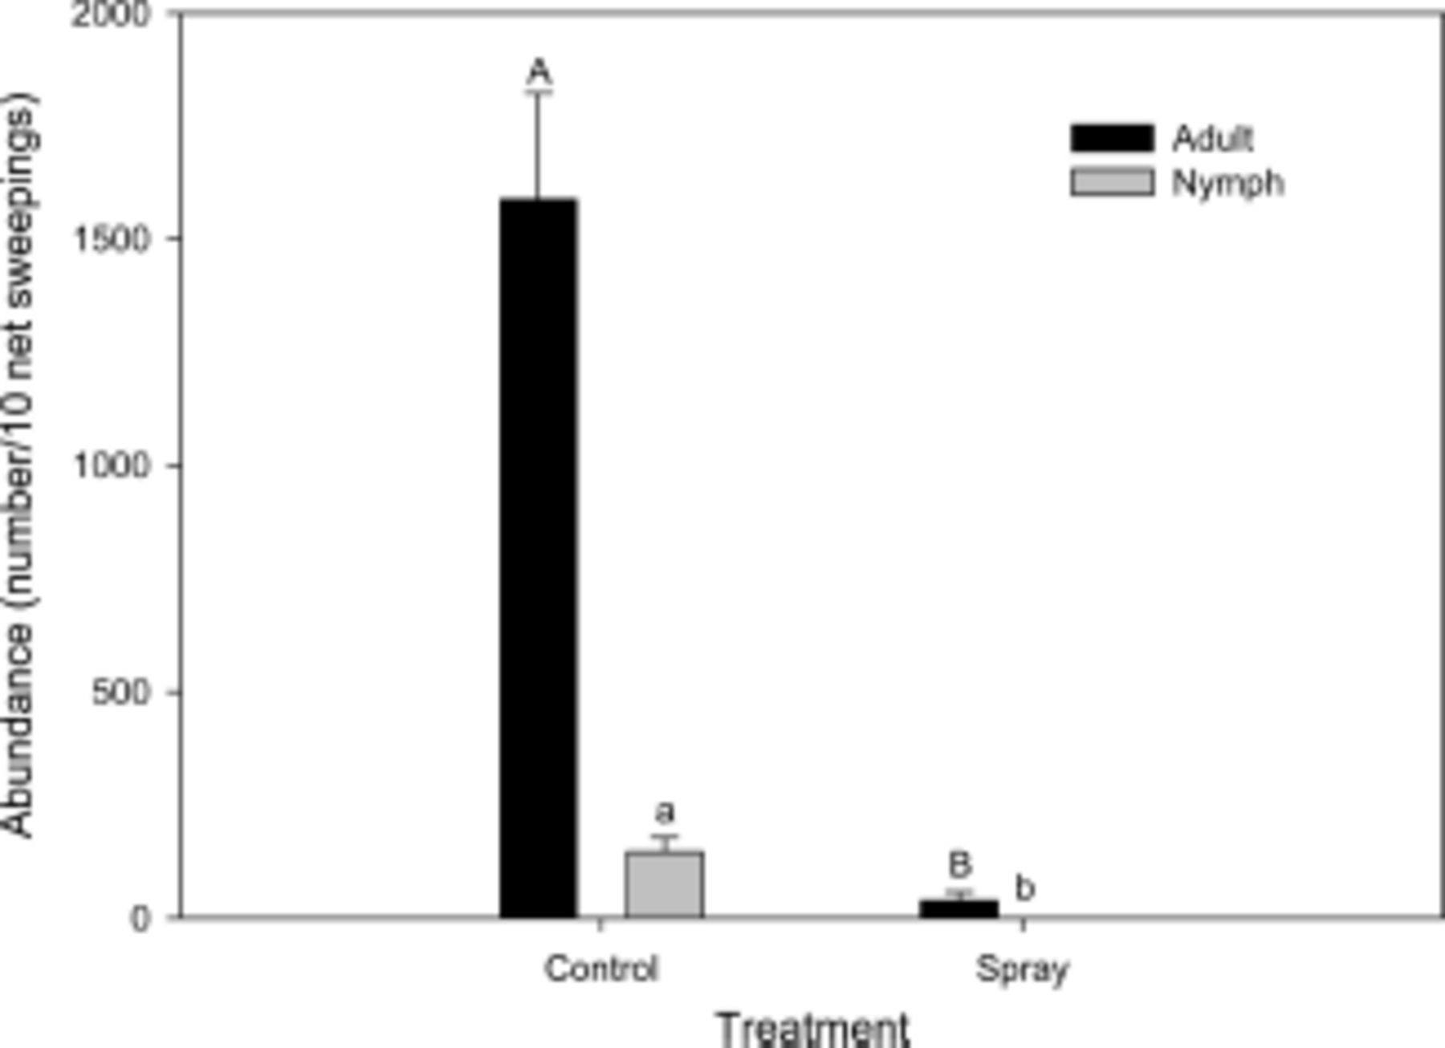
Fig. 5. Mean (±SE) (N=5) number adults and nymphs per 10 sweeps with a sweep net in unsprayed control plots and ...
Notes:
Fig. 5. Mean (±SE) (N=5) number adults and nymphs per 10 sweeps with a sweep net in unsprayed control plots and insecticide sprayed plots.
Unless provided in the caption above, the following copyright applies to the content of this slide: © 2012 Entomological Society of AmericaThis is an Open Access article distributed under the terms of the Creative Commons Attribution Non-Commercial License (http://creativecommons.org/licenses/by-nc/3.0/), which permits non-commercial reuse, distribution, and reproduction in any medium, provided the original work is properly cited. For commercial re-use, please contact journals.permissions@oup.com

Slide 6
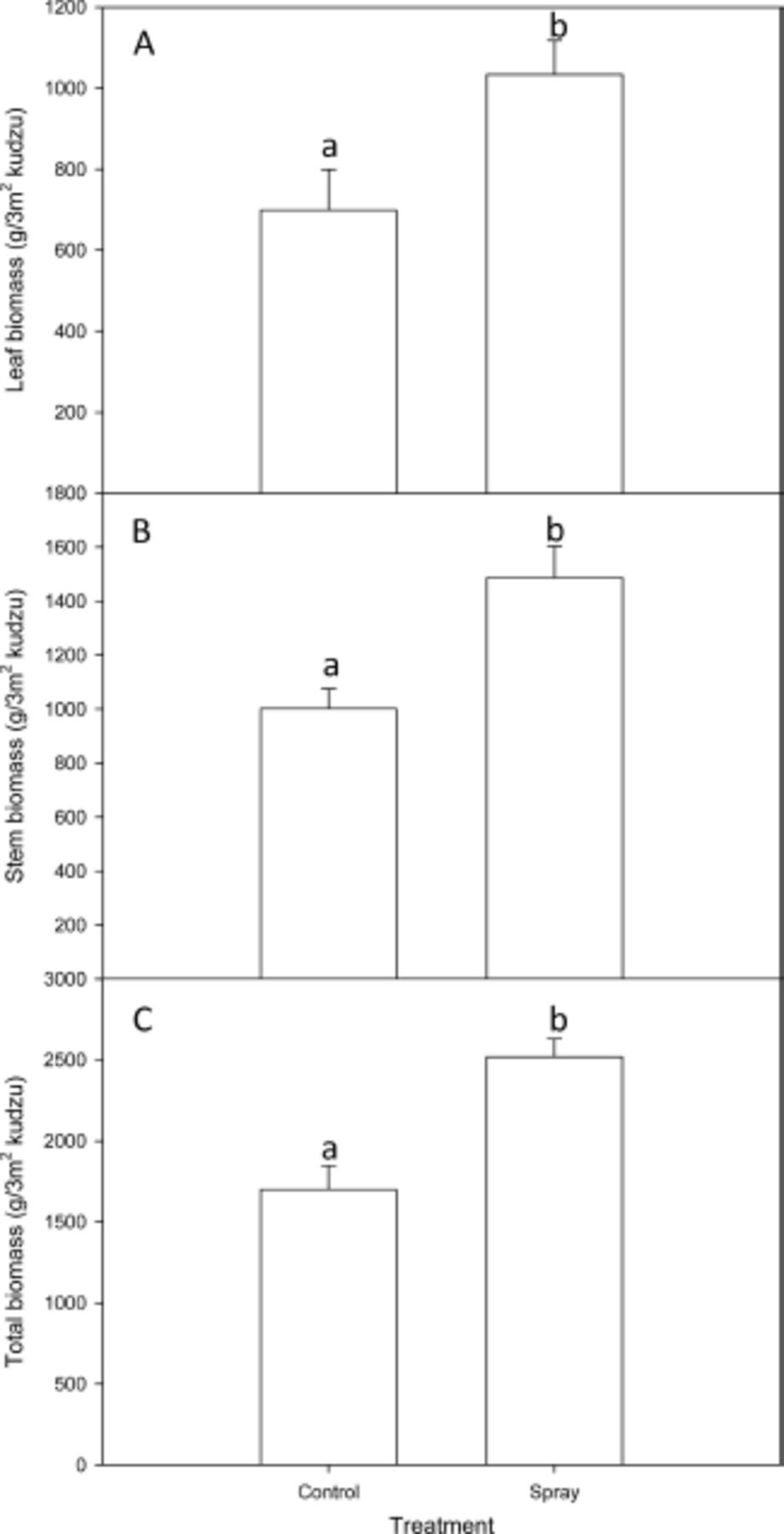
Fig. 6. Mean (±SE) (N=5) leaf (A), stem (B), and total biomass (C) of kudzu per 3 m² in unsprayed control ...
Notes:
Fig. 6. Mean (±SE) (N=5) leaf (A), stem (B), and total biomass (C) of kudzu per 3 m2 in unsprayed control plots and insecticide sprayed plots.
Unless provided in the caption above, the following copyright applies to the content of this slide: © 2012 Entomological Society of AmericaThis is an Open Access article distributed under the terms of the Creative Commons Attribution Non-Commercial License (http://creativecommons.org/licenses/by-nc/3.0/), which permits non-commercial reuse, distribution, and reproduction in any medium, provided the original work is properly cited. For commercial re-use, please contact journals.permissions@oup.com

