Slide 1
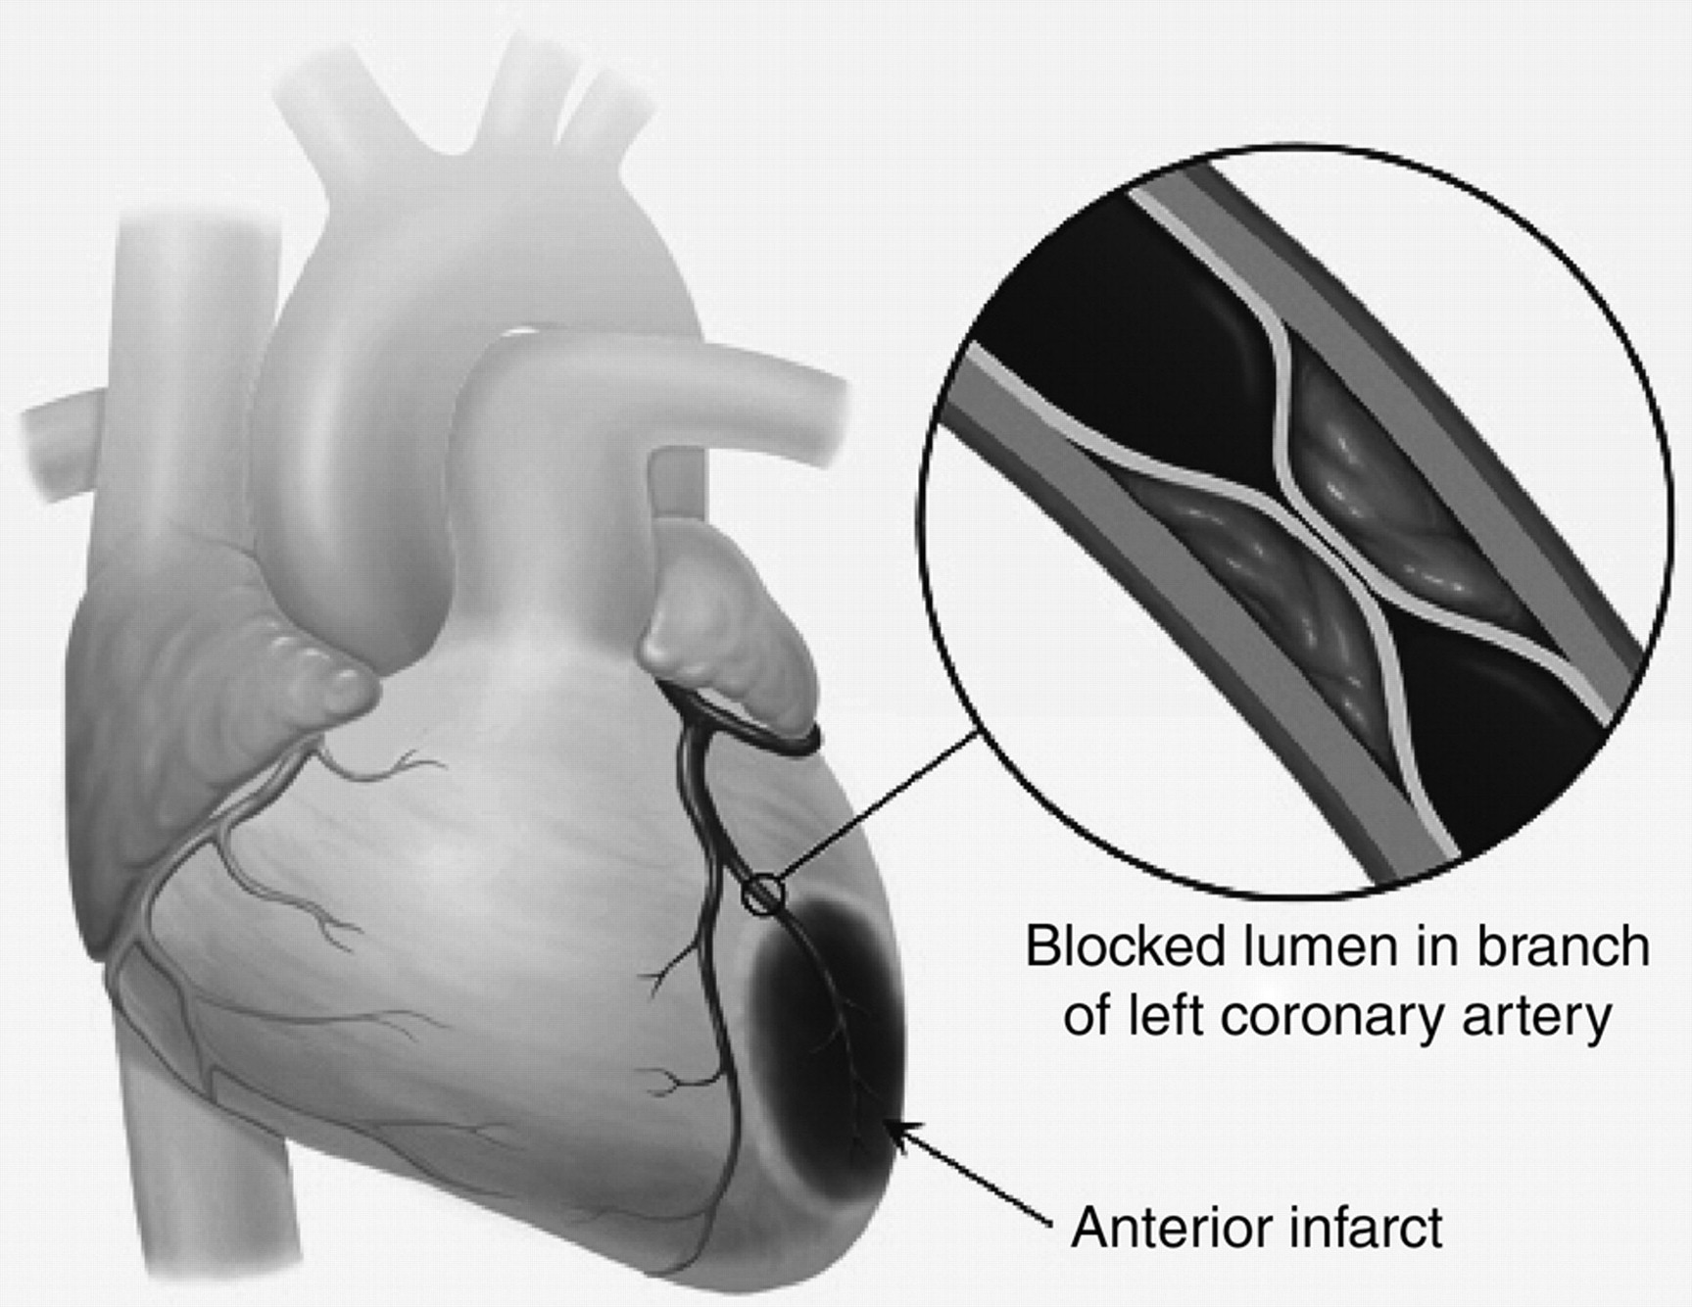
Fig. 1 Schematic diagram illustrating the damage caused by an MI in human heart. Source: http://www.uptodate.com ...
Notes:
Fig. 1 Schematic diagram illustrating the damage caused by an MI in human heart. Source: http://www.uptodate.com (accessed 20 June 2008).
Unless provided in the caption above, the following copyright applies to the content of this slide: © The Author 2008. Published by Oxford University Press. All rights reserved. For permissions, please e-mail: journals.permissions@oxfordjournals.org

Slide 2
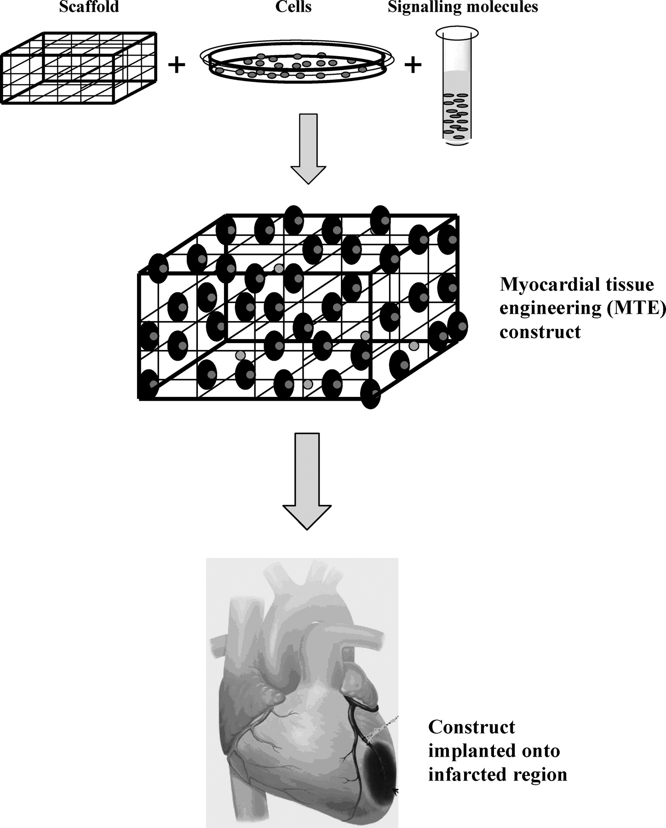
Fig. 2 Schematic diagram illustrating the principle of tissue engineering for myocardial regeneration.
Notes:
Fig. 2 Schematic diagram illustrating the principle of tissue engineering for myocardial regeneration.
Unless provided in the caption above, the following copyright applies to the content of this slide: © The Author 2008. Published by Oxford University Press. All rights reserved. For permissions, please e-mail: journals.permissions@oxfordjournals.org

