Slide 1
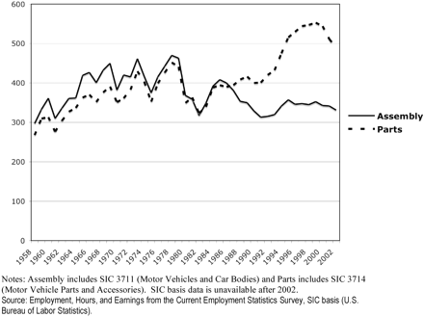
Figure 2. Outsourcing in the U.S. automotive industry, assembly and parts employment, 1958–2002.
Notes:
Figure 2. Outsourcing in the U.S. automotive industry, assembly and parts employment, 1958–2002.
Unless provided in the caption above, the following copyright applies to the content of this slide: © The Author (2008). Published by Oxford University Press. All rights reserved. For Permissions, please email: journals.permissions@oxfordjournals.org

Slide 2
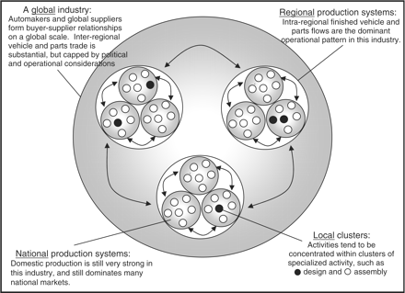
Figure 1. The nested geographic and organizational structure of the automotive industry.
Notes:
Figure 1. The nested geographic and organizational structure of the automotive industry.
Unless provided in the caption above, the following copyright applies to the content of this slide: © The Author (2008). Published by Oxford University Press. All rights reserved. For Permissions, please email: journals.permissions@oxfordjournals.org

Slide 3
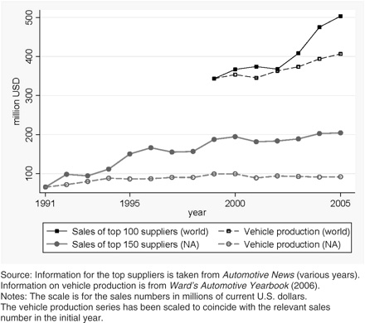
Figure 3. The increasing importance of suppliers in the automotive industry.
Notes:
Figure 3. The increasing importance of suppliers in the automotive industry.
Unless provided in the caption above, the following copyright applies to the content of this slide: © The Author (2008). Published by Oxford University Press. All rights reserved. For Permissions, please email: journals.permissions@oxfordjournals.org

Slide 4
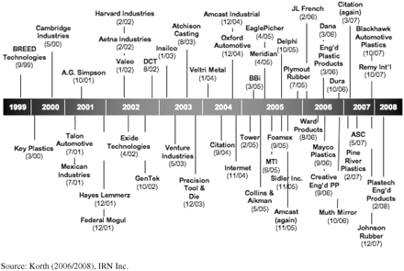
Figure 4. Major Automotive Supplier Bankruptcies, 1 January 1999 to 10 February 2008.
Notes:
Figure 4. Major Automotive Supplier Bankruptcies, 1 January 1999 to 10 February 2008.
Unless provided in the caption above, the following copyright applies to the content of this slide: © The Author (2008). Published by Oxford University Press. All rights reserved. For Permissions, please email: journals.permissions@oxfordjournals.org

Slide 5
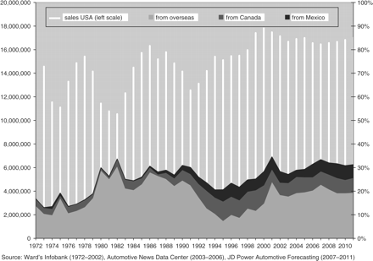
Figure 5. Net vehicle imports in the US from Mexico, Canada and countries outside of North America, 1972–2011 ...
Notes:
Figure 5. Net vehicle imports in the US from Mexico, Canada and countries outside of North America, 1972–2011 (forecast).
Unless provided in the caption above, the following copyright applies to the content of this slide: © The Author (2008). Published by Oxford University Press. All rights reserved. For Permissions, please email: journals.permissions@oxfordjournals.org

Slide 6
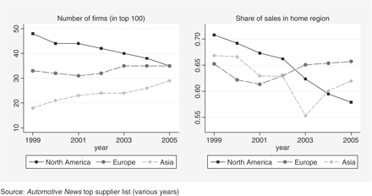
Figure 6. Regional organization of the automotive supply base.
Notes:
Figure 6. Regional organization of the automotive supply base.
Unless provided in the caption above, the following copyright applies to the content of this slide: © The Author (2008). Published by Oxford University Press. All rights reserved. For Permissions, please email: journals.permissions@oxfordjournals.org

Slide 7
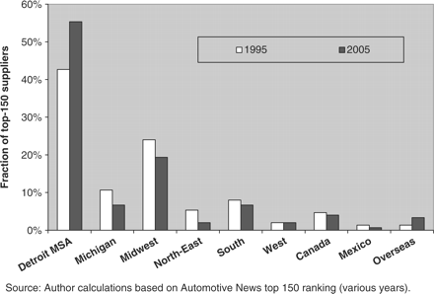
Figure 7. Location of (regional) headquarters of top 150 suppliers to the North American automotive industry.
Notes:
Figure 7. Location of (regional) headquarters of top 150 suppliers to the North American automotive industry.
Unless provided in the caption above, the following copyright applies to the content of this slide: © The Author (2008). Published by Oxford University Press. All rights reserved. For Permissions, please email: journals.permissions@oxfordjournals.org

