Slide 1
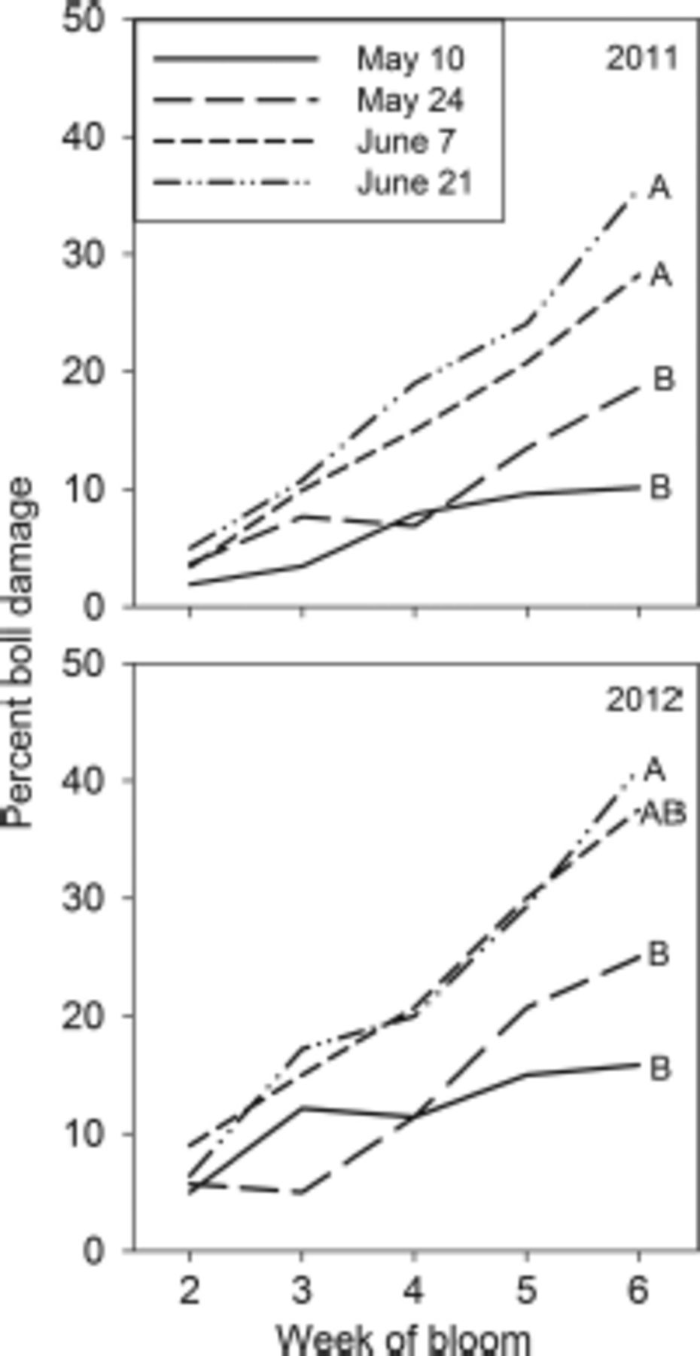
Fig. 1 The mean percentage boll damage by the week of bloom for four cotton planting dates in 2011 (top) and 2012 ...
Notes:
Fig. 1 The mean percentage boll damage by the week of bloom for four cotton planting dates in 2011 (top) and 2012 (bottom). Comparisons among planting dates were conducted by contrasting the slopes of two planting dates at a time. Statistically different slopes are indicated by different letters (P < 0.05).
Unless provided in the caption above, the following copyright applies to the content of this slide: © 2014 Entomological Society of AmericaThis is an Open Access article distributed under the terms of the Creative Commons Attribution Non-Commercial License (http://creativecommons.org/licenses/by-nc/3.0/), which permits non-commercial reuse, distribution, and reproduction in any medium, provided the original work is properly cited. For commercial re-use, please contact journals.permissions@oup.com

Slide 2
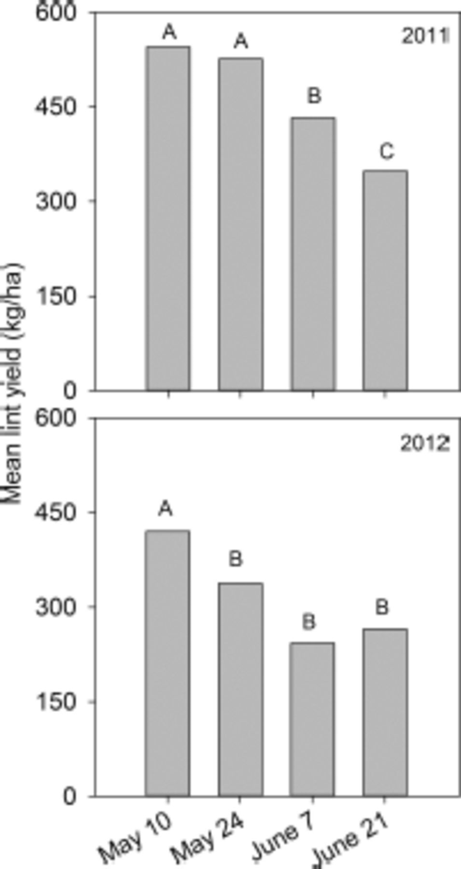
Fig. 2 The mean lint yield (kg/ha) recorded for four different planting dates in 2011 (top) and 2012 (bottom). Means ...
Notes:
Fig. 2 The mean lint yield (kg/ha) recorded for four different planting dates in 2011 (top) and 2012 (bottom). Means within a year followed by different letters are significantly different. LSMEANS test (P < 0.05).
Unless provided in the caption above, the following copyright applies to the content of this slide: © 2014 Entomological Society of AmericaThis is an Open Access article distributed under the terms of the Creative Commons Attribution Non-Commercial License (http://creativecommons.org/licenses/by-nc/3.0/), which permits non-commercial reuse, distribution, and reproduction in any medium, provided the original work is properly cited. For commercial re-use, please contact journals.permissions@oup.com

Slide 3
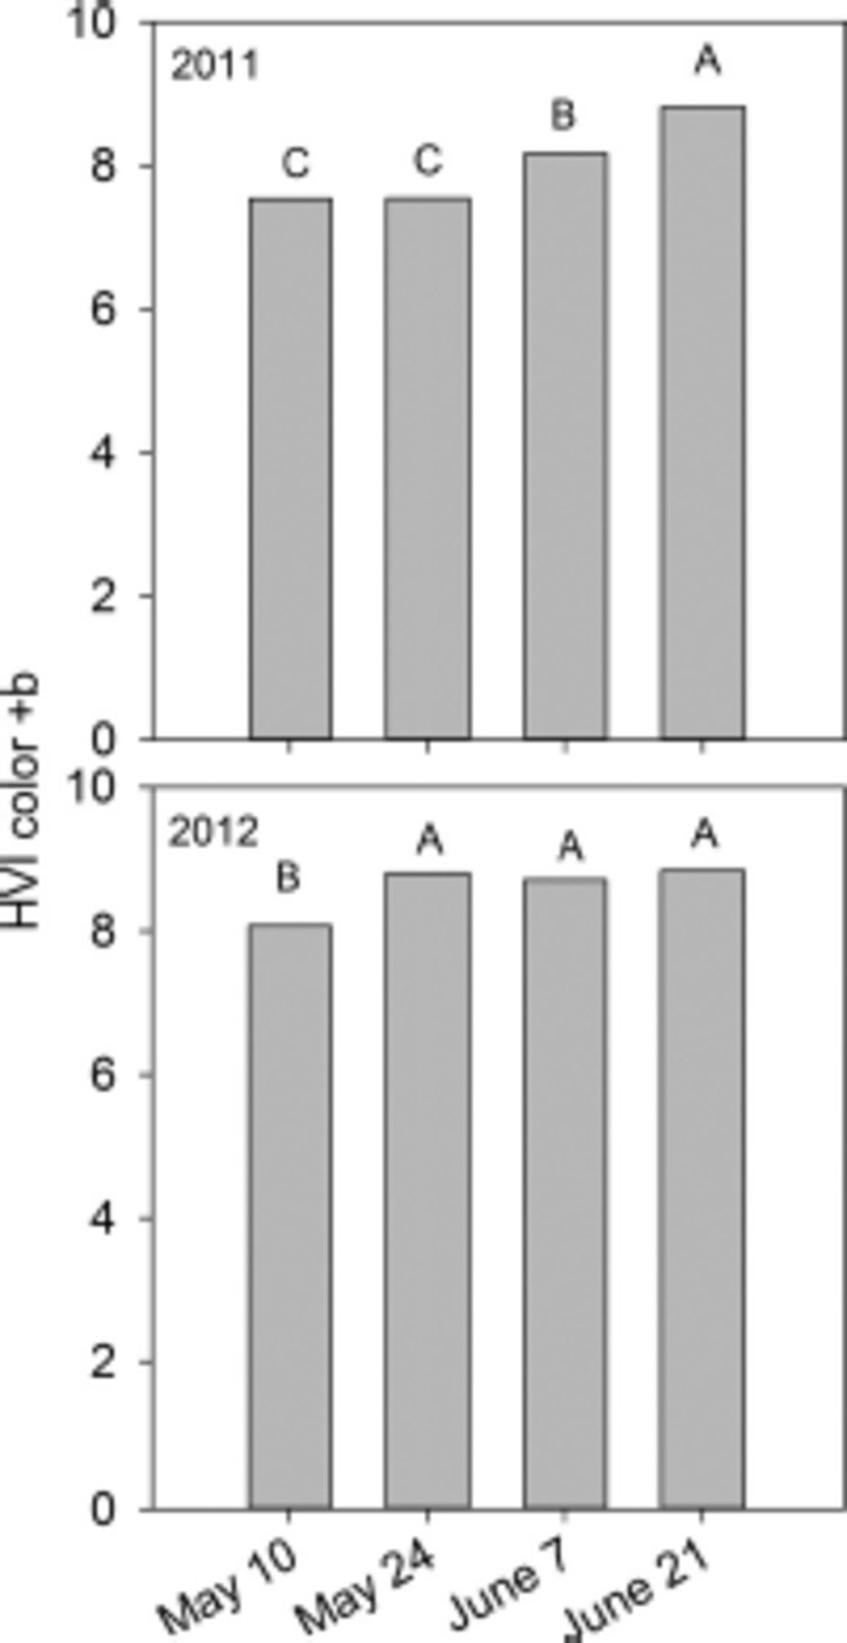
Fig. 3 The mean HVI color +b value recorded for lint harvested from four different planting dates in 2011 (top) and ...
Notes:
Fig. 3 The mean HVI color +b value recorded for lint harvested from four different planting dates in 2011 (top) and 2012 (bottom). Means within year followed by different letters are significantly different. LSMEANS test (P < 0.05).
Unless provided in the caption above, the following copyright applies to the content of this slide: © 2014 Entomological Society of AmericaThis is an Open Access article distributed under the terms of the Creative Commons Attribution Non-Commercial License (http://creativecommons.org/licenses/by-nc/3.0/), which permits non-commercial reuse, distribution, and reproduction in any medium, provided the original work is properly cited. For commercial re-use, please contact journals.permissions@oup.com

Slide 4
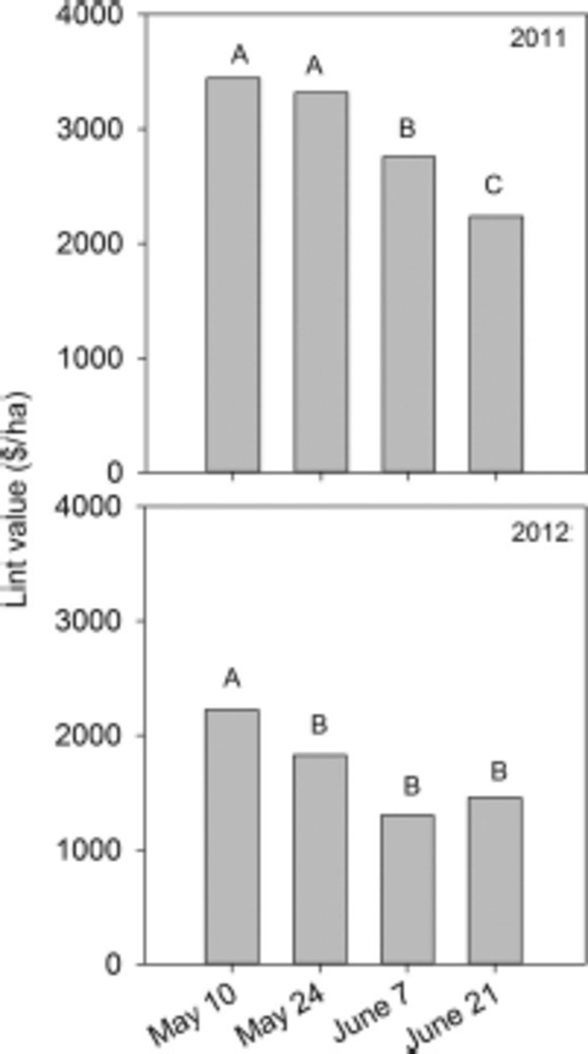
Fig. 4 Mean lint value (US$/ha) by planting date for 2011 (top) and 2012 (bottom). Scale bars denoted by same ...
Notes:
Fig. 4 Mean lint value (US$/ha) by planting date for 2011 (top) and 2012 (bottom). Scale bars denoted by same letters are not significantly different. Means within a year followed by different letters are significantly different. LSMEANS test (P < 0.05).
Unless provided in the caption above, the following copyright applies to the content of this slide: © 2014 Entomological Society of AmericaThis is an Open Access article distributed under the terms of the Creative Commons Attribution Non-Commercial License (http://creativecommons.org/licenses/by-nc/3.0/), which permits non-commercial reuse, distribution, and reproduction in any medium, provided the original work is properly cited. For commercial re-use, please contact journals.permissions@oup.com

