Slide 1
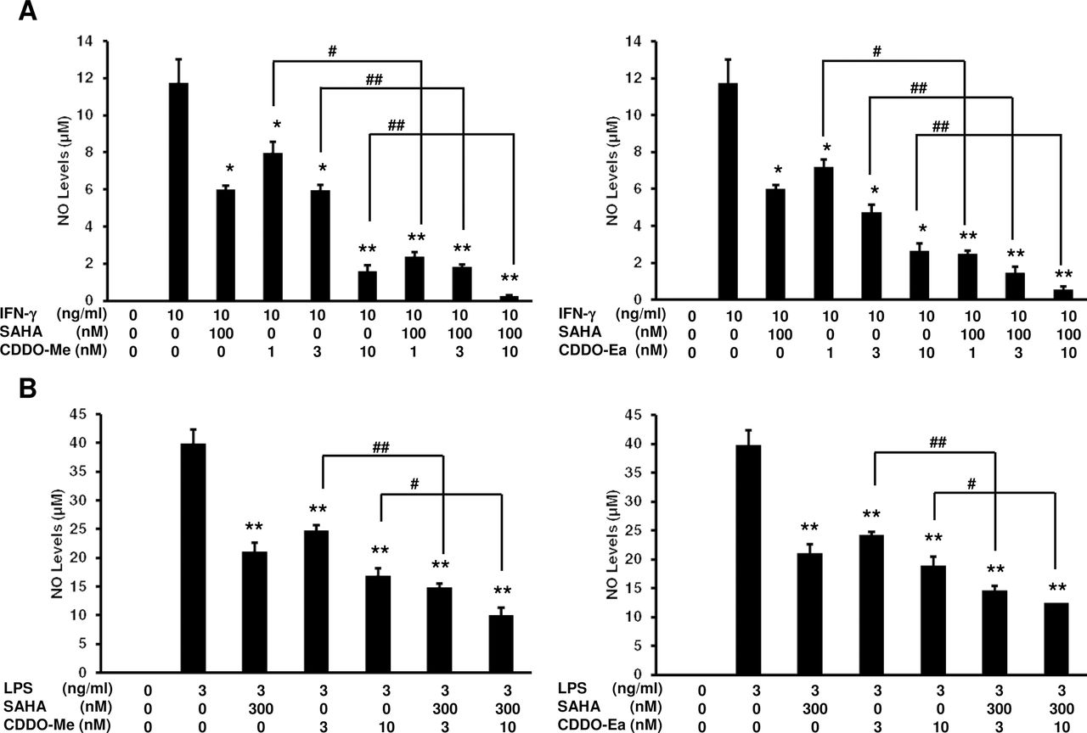
Fig. 1. SAHA enhances the ability of CDDO-Me and CDDO-Ea to suppress NO production in RAW 264.7 cells and in primary ...
Notes:
Fig. 1. SAHA enhances the ability of CDDO-Me and CDDO-Ea to suppress NO production in RAW 264.7 cells and in primary mouse macrophages. RAW 264.7 cells were treated with CDDO-Me or CDDO-Ea, SAHA or the combination of SAHA and a triterpenoid and stimulated with IFN-γ ( A ) or LPS ( B ) for24h. Peritoneal macrophages from PyMT mice ( C, D ) were treated with the same combinations of drugs for 48h. The supernatants from the treated cells were assayed by the Griess reaction for NO production. * P < 0.05 and ** P < 0.001 versus controls stimulated with IFN-γ or LPS (A–D); # P < 0.05 and ## P < 0.001 versus single drug treatment (A, B); # P < 0.05 versus one single drug treatment and ## P < 0.05 versus both single drug treatments. ( E) Primary PyMT tumor cells, pancreas-1343 and VC-1 lung cancer cells were treated with increasing concentrations of CDDO-Me or CDDO-Ea, SAHA or the combination of SAHA and triterpenoids for 48h, and effects on proliferation were measured via 3-(4,5-dimethylthiazol-2-yl)-2,5-diphenyltetrazolium bromide analysis. * P < 0.05 and ** P < 0.001 versus controls.
Unless provided in the caption above, the following copyright applies to the content of this slide: © The Author 2012. Published by Oxford University Press. All rights reserved. For Permissions, please email: journals.permissions@oup.com

Slide 2
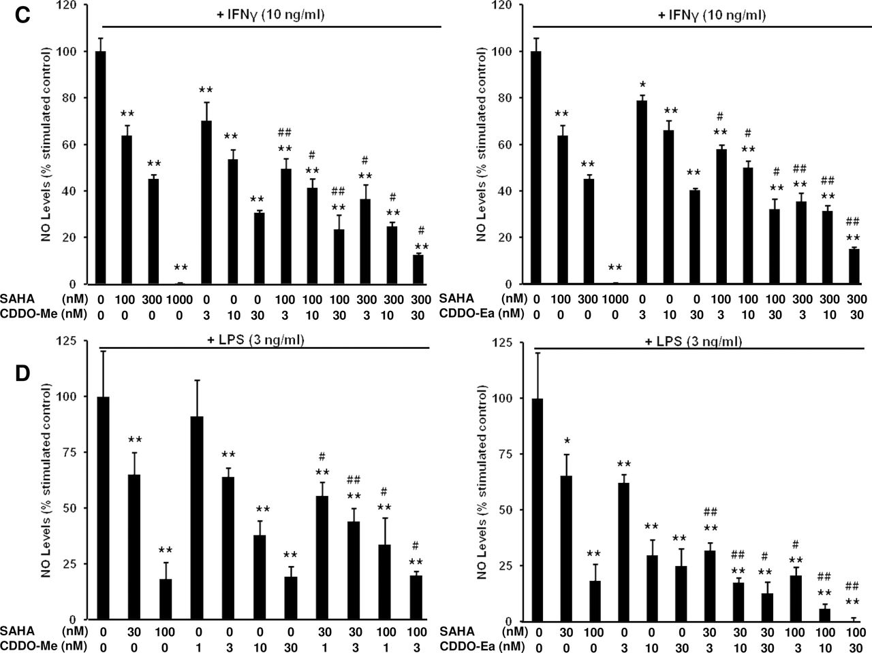
Fig. 1. SAHA enhances the ability of CDDO-Me and CDDO-Ea to suppress NO production in RAW 264.7 cells and in primary ...
Notes:
Fig. 1. SAHA enhances the ability of CDDO-Me and CDDO-Ea to suppress NO production in RAW 264.7 cells and in primary mouse macrophages. RAW 264.7 cells were treated with CDDO-Me or CDDO-Ea, SAHA or the combination of SAHA and a triterpenoid and stimulated with IFN-γ ( A ) or LPS ( B ) for24h. Peritoneal macrophages from PyMT mice ( C, D ) were treated with the same combinations of drugs for 48h. The supernatants from the treated cells were assayed by the Griess reaction for NO production. * P < 0.05 and ** P < 0.001 versus controls stimulated with IFN-γ or LPS (A–D); # P < 0.05 and ## P < 0.001 versus single drug treatment (A, B); # P < 0.05 versus one single drug treatment and ## P < 0.05 versus both single drug treatments. ( E) Primary PyMT tumor cells, pancreas-1343 and VC-1 lung cancer cells were treated with increasing concentrations of CDDO-Me or CDDO-Ea, SAHA or the combination of SAHA and triterpenoids for 48h, and effects on proliferation were measured via 3-(4,5-dimethylthiazol-2-yl)-2,5-diphenyltetrazolium bromide analysis. * P < 0.05 and ** P < 0.001 versus controls.
Unless provided in the caption above, the following copyright applies to the content of this slide: © The Author 2012. Published by Oxford University Press. All rights reserved. For Permissions, please email: journals.permissions@oup.com

Slide 3
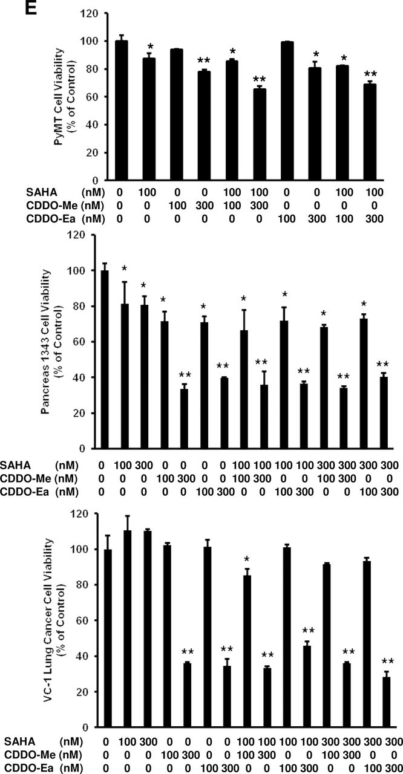
Fig. 1. SAHA enhances the ability of CDDO-Me and CDDO-Ea to suppress NO production in RAW 264.7 cells and in primary ...
Notes:
Fig. 1. SAHA enhances the ability of CDDO-Me and CDDO-Ea to suppress NO production in RAW 264.7 cells and in primary mouse macrophages. RAW 264.7 cells were treated with CDDO-Me or CDDO-Ea, SAHA or the combination of SAHA and a triterpenoid and stimulated with IFN-γ ( A ) or LPS ( B ) for24h. Peritoneal macrophages from PyMT mice ( C, D ) were treated with the same combinations of drugs for 48h. The supernatants from the treated cells were assayed by the Griess reaction for NO production. * P < 0.05 and ** P < 0.001 versus controls stimulated with IFN-γ or LPS (A–D); # P < 0.05 and ## P < 0.001 versus single drug treatment (A, B); # P < 0.05 versus one single drug treatment and ## P < 0.05 versus both single drug treatments. ( E) Primary PyMT tumor cells, pancreas-1343 and VC-1 lung cancer cells were treated with increasing concentrations of CDDO-Me or CDDO-Ea, SAHA or the combination of SAHA and triterpenoids for 48h, and effects on proliferation were measured via 3-(4,5-dimethylthiazol-2-yl)-2,5-diphenyltetrazolium bromide analysis. * P < 0.05 and ** P < 0.001 versus controls.
Unless provided in the caption above, the following copyright applies to the content of this slide: © The Author 2012. Published by Oxford University Press. All rights reserved. For Permissions, please email: journals.permissions@oup.com

Slide 4
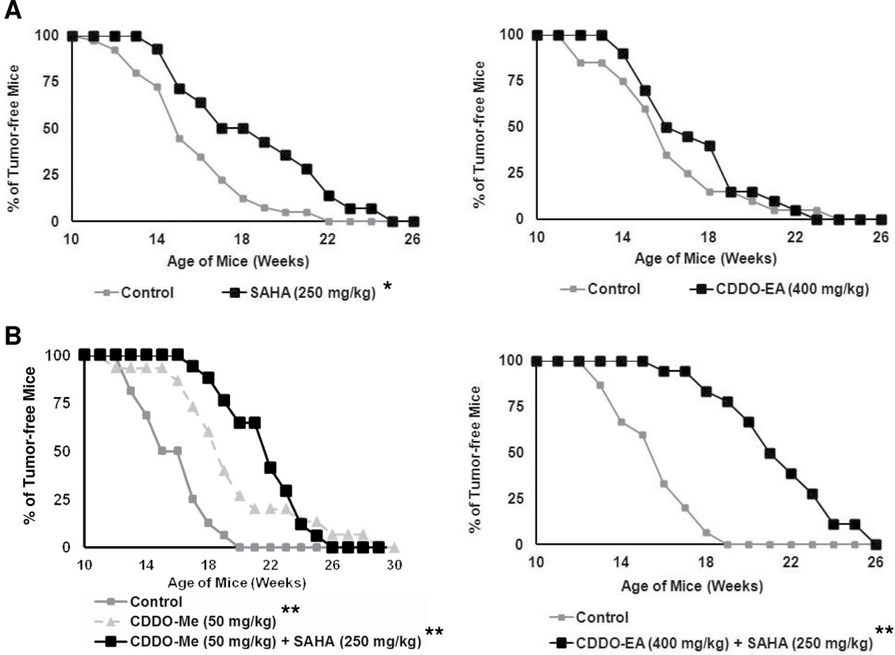
Fig. 2. SAHA enhances the ability of CDDO-Me and CDDO-Ea to delay the development of ER− mammary tumors in PyMT ...
Notes:
Fig. 2. SAHA enhances the ability of CDDO-Me and CDDO-Ea to delay the development of ER− mammary tumors in PyMT mice. Beginning at 4 weeks of age, female transgenic mice were fed powdered control diet or diet containing SAHA (250mg/kg diet), CDDO-Ea (400mg/kg diet), the combination of SAHA (250mg/kg diet) and CDDO-Me (50mg/kg diet) or the combination of SAHA (250mg/kg diet) and CDDO-Ea (400mg/kg diet). Mice were palpated twice a week. The effects of single agents ( A ) or drug combinations ( B ) on tumor development in PyMT mice as compared with control diet are shown. n = 15 mice per arm. * P < 0.05 versus control in A and ** P < 0.001 versus control in B.
Unless provided in the caption above, the following copyright applies to the content of this slide: © The Author 2012. Published by Oxford University Press. All rights reserved. For Permissions, please email: journals.permissions@oup.com

Slide 5
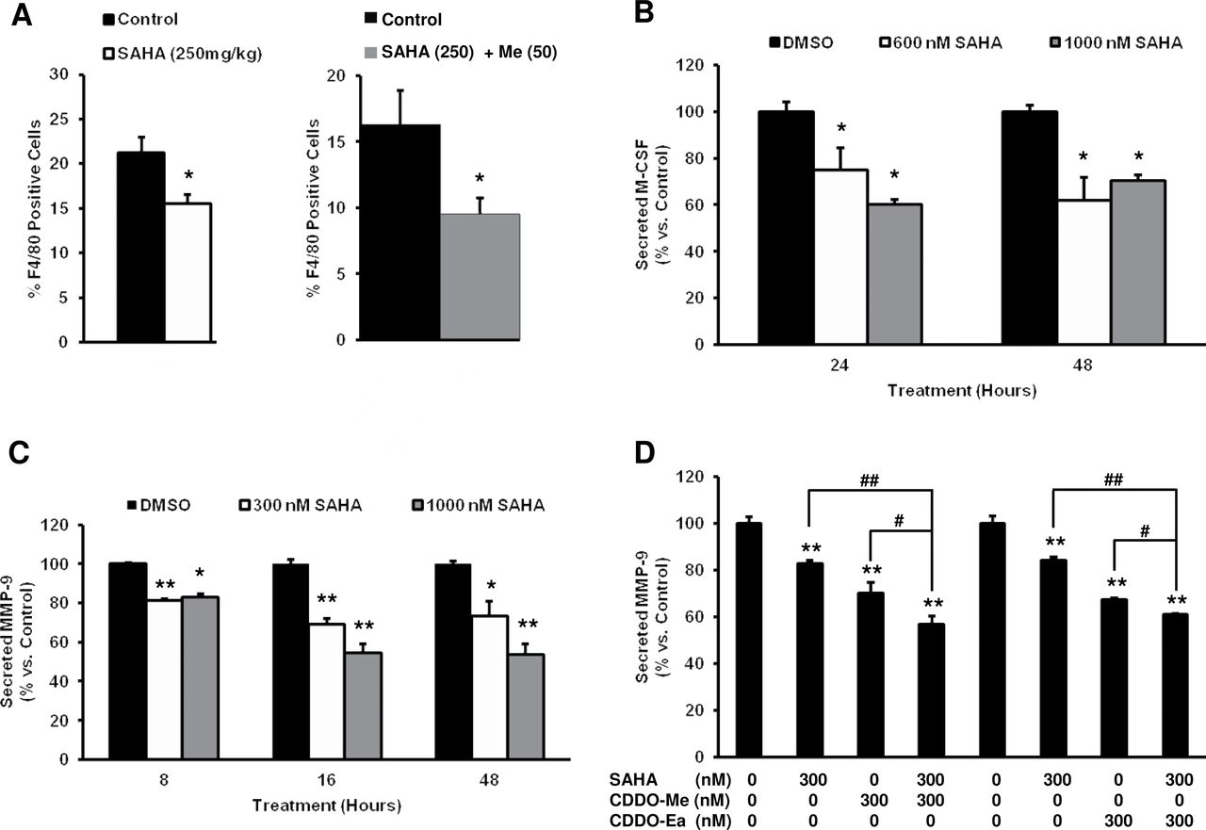
Fig. 3. SAHA, alone or in combination with CDDO-Me, inhibits the infiltration of macrophages into the mammary glands ...
Notes:
Fig. 3. SAHA, alone or in combination with CDDO-Me, inhibits the infiltration of macrophages into the mammary glands of PyMT mice and suppresses levels of M-CSF and MMP-9 in primary PyMT tumor cells. Beginning at 4 weeks of age, female transgenic mice were fed powdered control diet, SAHA diet (250mg/kg diet) or SAHA (250mg/kg diet) + CDDO-Me (50mg/kg diet) and killed at 12 weeks of age ( A ). Quantitation of macrophage infiltration was detected by flow cytometry analysis of F4/80 in homogenized mammary glands, n = 5 per group for the SAHA study and n = 19 per group for the SAHA + CDDO-Me study. * P < 0.05 versus age-matched littermate controls. Primary PyMT tumor cells were treated with SAHA (0–1000nM) for varying time points (8–48h), and supernatants were assayed by ELISA for M-CSF ( B ) or MMP-9 ( C ) secretion. * P < 0.05 and ** P < 0.001 versus control treatment. ( D) Primary PyMT tumor cells were treated with the combination of SAHA (300nM) and CDDO-Me or CDDO-Ea (300nM) for 24h, and supernatants were assayed by ELISA for MMP-9. ** P < 0.001 versus control treatment; # P < 0.05 and ## P < 0.001 versus single drug treatment.
Unless provided in the caption above, the following copyright applies to the content of this slide: © The Author 2012. Published by Oxford University Press. All rights reserved. For Permissions, please email: journals.permissions@oup.com

Slide 6
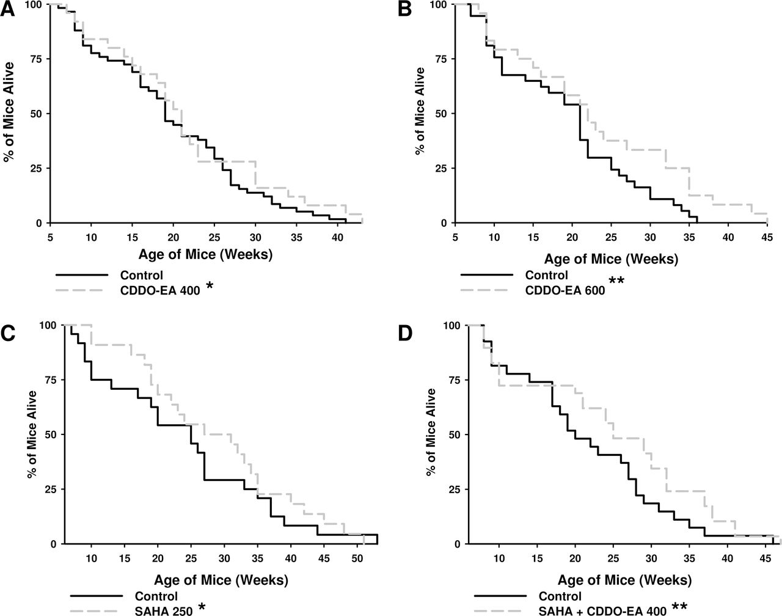
Fig. 4. Triterpenoids and SAHA extend lifespan in the KPC mouse model of pancreatic cancer. Beginning at 4 week of ...
Notes:
Fig. 4. Triterpenoids and SAHA extend lifespan in the KPC mouse model of pancreatic cancer. Beginning at 4 week of age, KPC transgenic mice were fed powdered control diet or diet containing CDDO-Ea (400 or 600mg/kg diet), SAHA (250mg/kg diet) or the combination of CDDO-Ea (400mg/kg diet) and SAHA (250mg/kg diet). ( A ) n = 58 for control and 25 for CDDO-Ea 400; ( B ) n = 37 for control and 24 for CDDO-Ea 600; ( C ) n = 24 for control and 22 for SAHA 250; ( D ) n = 27 for control and 29 for SAHA + CDDO-Ea. * P < 0.05 versus control for CDDO-Ea (400mg/kg diet) and SAHA (250mg/kg diet) alone in A and C; ** P < 0.001 versus control for CDDO-Ea (600mg/kg diet) and SAHA + CDDO-Ea (400mg/kg diet) in B and D.
Unless provided in the caption above, the following copyright applies to the content of this slide: © The Author 2012. Published by Oxford University Press. All rights reserved. For Permissions, please email: journals.permissions@oup.com

Slide 7
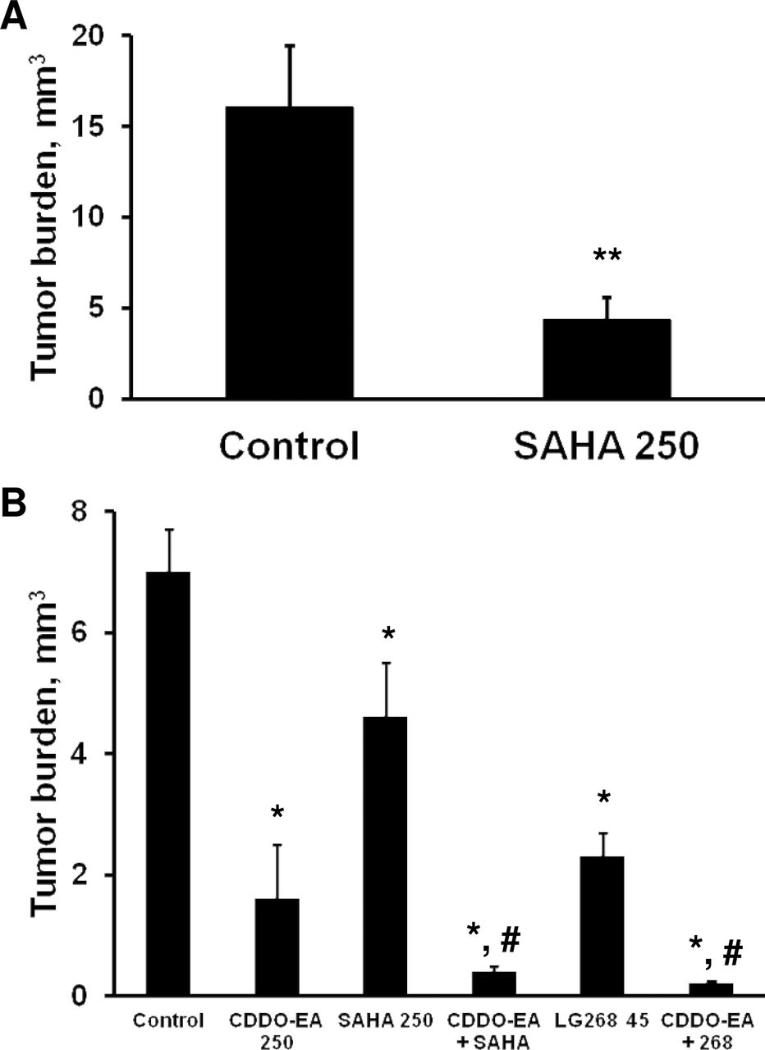
Fig. 5. SAHA or the combination of SAHA and triterpenoids inhibit lung carcinogenesis in A/J mice. ( A ) Beginning 1 ...
Notes:
Fig. 5. SAHA or the combination of SAHA and triterpenoids inhibit lung carcinogenesis in A/J mice. ( A ) Beginning 1 week before injection with a single dose of vinyl carbamate, mice were fed AIN diet or AIN diet containing SAHA (250mg/kg diet) for a total of 26 weeks; n = 26 mice in the control group and n = 11 mice in the SAHA group. ( B ) Female A/J mice were injected with two doses of vinyl carbamate, and drugs were fed in diet for 15 weeks, beginning 1 week after the last injection of carcinogen. * P < 0.05 versus control; ** P < 0.001 versus control; # P < 0.05 versus SAHA or LG268 alone.
Unless provided in the caption above, the following copyright applies to the content of this slide: © The Author 2012. Published by Oxford University Press. All rights reserved. For Permissions, please email: journals.permissions@oup.com

Slide 8
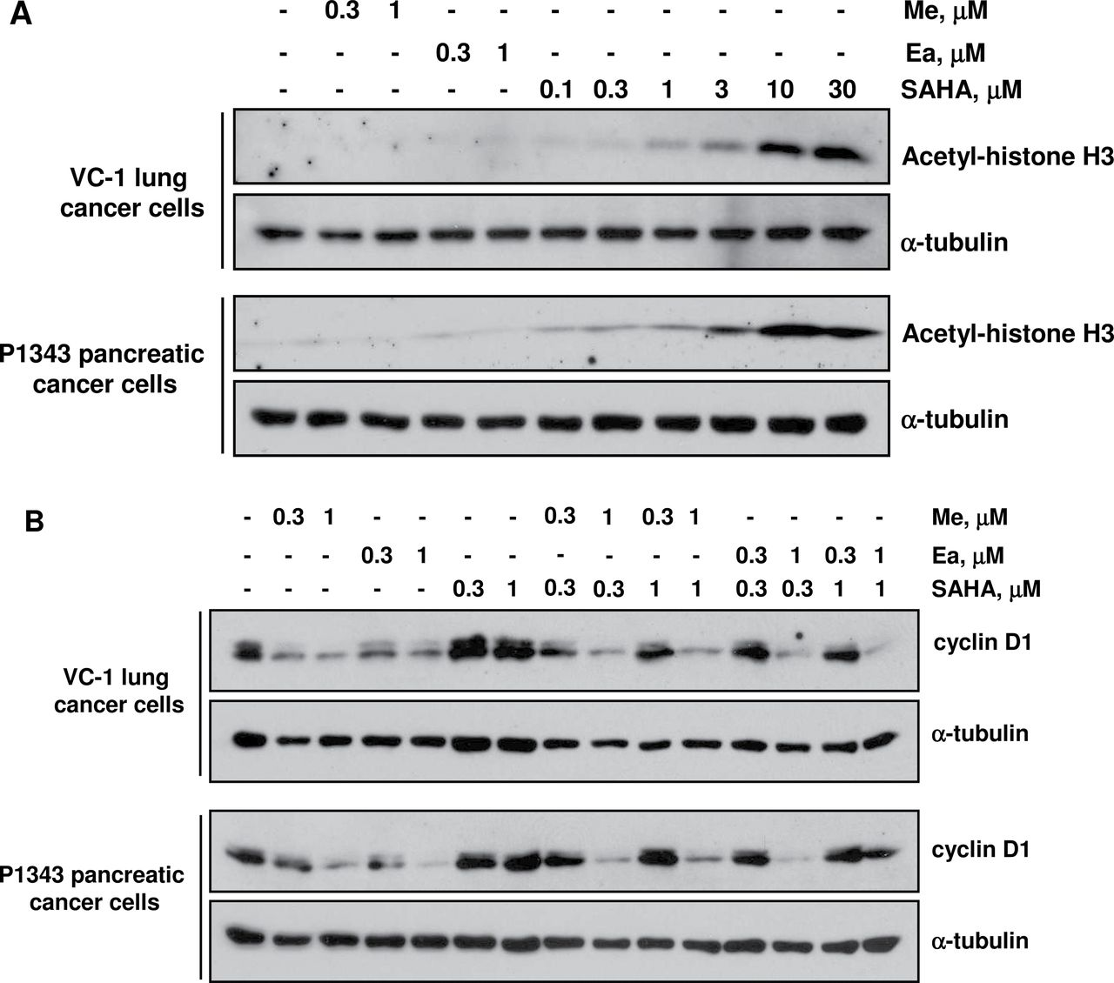
Fig. 6. The effects of SAHA and triterpenoids on histone acetylation and cyclin D1 levels. VC-1 lung cancer cells or ...
Notes:
Fig. 6. The effects of SAHA and triterpenoids on histone acetylation and cyclin D1 levels. VC-1 lung cancer cells or P1343 pancreatic cancer cells were treated with the indicated concentrations of drugs for 6h ( A ) or 24h ( B ) and lysates were immunoblotted with antibodies against acetyl-histone H3, cyclin D1 and tubulin.
Unless provided in the caption above, the following copyright applies to the content of this slide: © The Author 2012. Published by Oxford University Press. All rights reserved. For Permissions, please email: journals.permissions@oup.com

