Slide 1
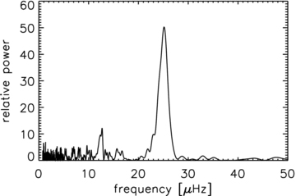
Figure 1 Power spectrum of the power spectrum in a window with equidistant frequency peaks. The power is normalized, ...
Notes:
Figure 1 Power spectrum of the power spectrum in a window with equidistant frequency peaks. The power is normalized, such that the noise level is 1. The Δν/2 at ∼25 μHz and Δν/4 at ∼12 μHz features are clearly visible.
Unless provided in the caption above, the following copyright applies to the content of this slide: © 2009 The Authors. Journal compilation © 2009 RAS

Slide 2
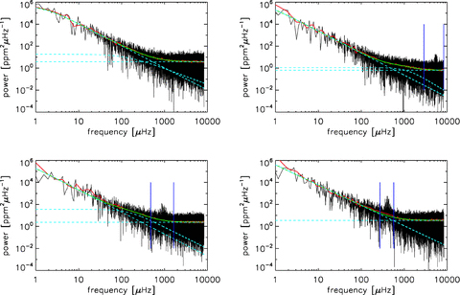
Figure 6 Power spectra of four artificial Kepler stars with oscillations at different frequencies, displayed in a ...
Notes:
Figure 6 Power spectra of four artificial Kepler stars with oscillations at different frequencies, displayed in a log–log scale. The red lines indicate the binned power spectrum and the green lines the background fits, with the individual components shown in cyan dashed lines. The identified oscillation frequency ranges are indicated with vertical blue lines. No oscillations could be identified in the top-left power spectrum, while for the bottom-right power spectrum we could only fit one power law for the background.
Unless provided in the caption above, the following copyright applies to the content of this slide: © 2009 The Authors. Journal compilation © 2009 RAS

Slide 3
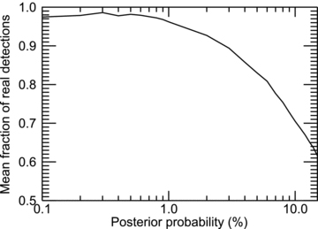
Figure A1 Fraction of real frequency detections as a function of posterior probability.
Notes:
Figure A1 Fraction of real frequency detections as a function of posterior probability.
Unless provided in the caption above, the following copyright applies to the content of this slide: © 2009 The Authors. Journal compilation © 2009 RAS

Slide 4
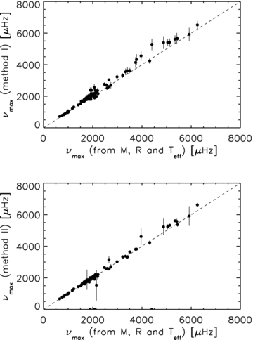
Figure 2 ν_{max} results from Method I (top) and Method II (bottom) (see Section 3.4) versus ν_{max} ...
Notes:
Figure 2 νmax results from Method I (top) and Method II (bottom) (see Section 3.4) versus νmax computed using the input M, R and Teff in equation (12). The one-to-one relations are indicated with a dashed line.
Unless provided in the caption above, the following copyright applies to the content of this slide: © 2009 The Authors. Journal compilation © 2009 RAS

Slide 5
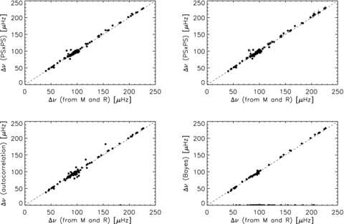
Figure 3 Top: Δν results from the PS⊗PS versus Δν computed using the input M and R in equation (13). In the left-hand ...
Notes:
Figure 3 Top: Δν results from the PS⊗PS versus Δν computed using the input M and R in equation (13). In the left-hand panel, the Δν values are computed as the power-weighted mean centroids of the features in the PS⊗PS. In the right-hand panel, Δν values are computed using the Bayesian posterior probability to compute the centroids of the features in the PS⊗PS. Bottom: Δν results from autocorrelations versus Δν computed using the input M and R in equation (13). In the left-hand panel, the autocorrelations of the full oscillation frequency range are used to compute Δν. In the right-hand panel, the individual frequencies obtained using a Bayesian approach are used to compute the autocorrelations, from which we determine Δν. The one-to-one relations are indicated with a dashed line.
Unless provided in the caption above, the following copyright applies to the content of this slide: © 2009 The Authors. Journal compilation © 2009 RAS

Slide 6
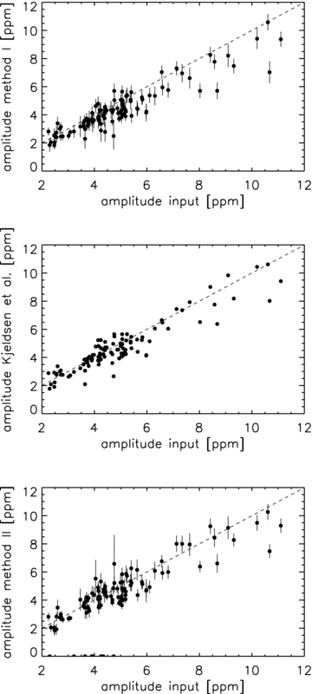
Figure 4 Results for the average mode amplitude from Method I (top), Kjeldsen et al. (2008) (centre) and Method II ...
Notes:
Figure 4 Results for the average mode amplitude from Method I (top), Kjeldsen et al. (2008) (centre) and Method II (bottom) versus the input mode amplitude. The one-to-one relations are indicated with a dashed line.
Unless provided in the caption above, the following copyright applies to the content of this slide: © 2009 The Authors. Journal compilation © 2009 RAS

Slide 7
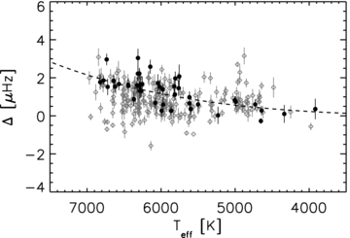
Figure 5 Linewidth as a function of temperature, with results for stars brighter than 9 mag indicated with black dots. ...
Notes:
Figure 5 Linewidth as a function of temperature, with results for stars brighter than 9 mag indicated with black dots. Results for fainter stars are indicated with grey diamonds. The Δ∼T4eff input relation (Chaplin et al. 2009b) is indicated with a dashed line.
Unless provided in the caption above, the following copyright applies to the content of this slide: © 2009 The Authors. Journal compilation © 2009 RAS

Slide 8
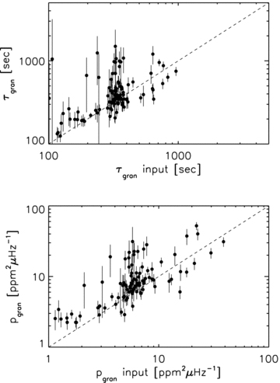
Figure 7 Results of the time-scale (τ_{gran}, top) and power (p_{gran}, bottom) of the granulation as ...
Notes:
Figure 7 Results of the time-scale (τgran, top) and power (pgran, bottom) of the granulation as a function of the input values. The one-to-one relations are indicated with a dashed line.
Unless provided in the caption above, the following copyright applies to the content of this slide: © 2009 The Authors. Journal compilation © 2009 RAS

Slide 9
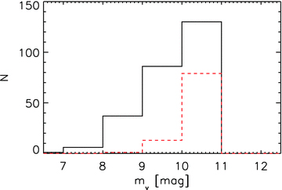
Figure 8 Distribution of apparent magnitudes of stars for which we detected oscillations (black solid line) and of ...
Notes:
Figure 8 Distribution of apparent magnitudes of stars for which we detected oscillations (black solid line) and of stars for which we did not detect oscillations (red dashed line).
Unless provided in the caption above, the following copyright applies to the content of this slide: © 2009 The Authors. Journal compilation © 2009 RAS

Slide 10
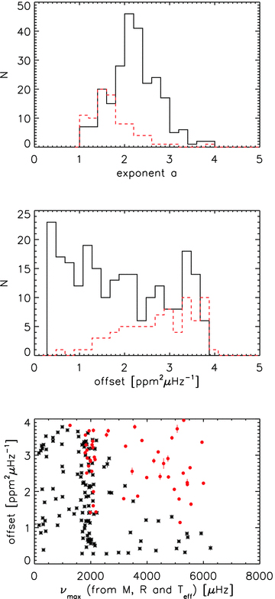
Figure 9 Distribution of the exponent a (top), the offset (middle) (see equation 4), and offset as a function of input ...
Notes:
Figure 9 Distribution of the exponent a (top), the offset (middle) (see equation 4), and offset as a function of input νmax for stars with detected oscillations (black solid line, black asterisks) and stars without detected oscillations (red dashed line, red dots).
Unless provided in the caption above, the following copyright applies to the content of this slide: © 2009 The Authors. Journal compilation © 2009 RAS

