Slide 1
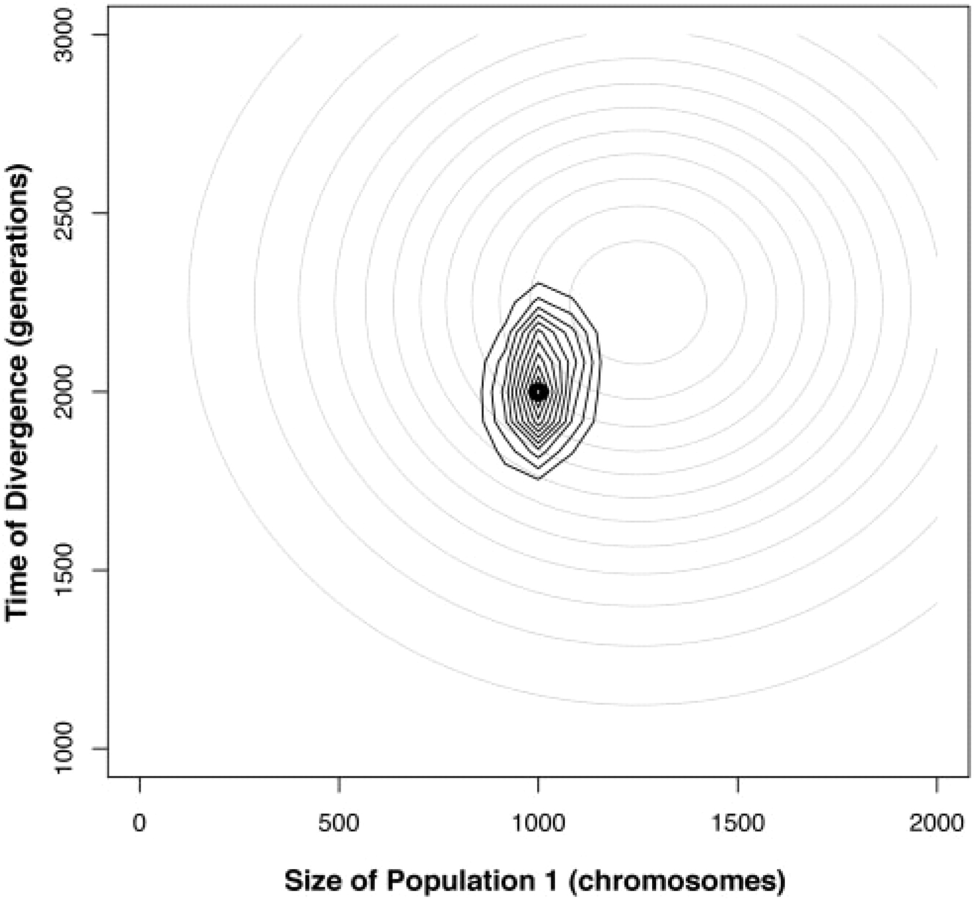
Fig. 1. Density plot of time of divergence versus size of Population 1 for 100 unlinked short tandem repeats (STRs) ...
Notes:
Fig. 1. Density plot of time of divergence versus size of Population 1 for 100 unlinked short tandem repeats (STRs) using the summary statistics δμ2 and microsatellite variance. The light gray contours represent prior distributions for time of divergence (mean=2250 generations, SD=500) and size of Population 1 (mean=1250 chromosomes, SD=500). The darker contours represent the posterior distribution of parameter values collected from 100 000 iterations of REJECTOR with a tolerance of 0.05. The small black circle marks the true values of the parameters—2000 generations for time of divergence and 1000 chromosomes for size of Population 1.
Unless provided in the caption above, the following copyright applies to the content of this slide: © The Author 2008. Published by Oxford University Press. All rights reserved. For Permissions, please email: journals.permissions@oxfordjournals.org

