Slide 1
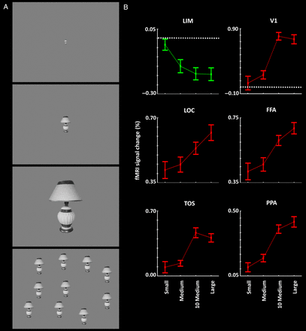
Figure 2. (A) Stimulus examples and results in Experiment 2. Stimuli were single small, medium, large, and multiple ...
Notes:
Figure 2. (A) Stimulus examples and results in Experiment 2. Stimuli were single small, medium, large, and multiple medium faces and nonface objects, independent of those used in Experiment 1 (see Methods). (B) The results of group-averaged activity analysis in LIM and well-established visual areas. Other details are similar to those in Figure 1.
Unless provided in the caption above, the following copyright applies to the content of this slide: © The Author 2014. Published by Oxford University PressThis is an Open Access article distributed under the terms of the Creative Commons Attribution Non-Commercial License (http://creativecommons.org/licenses/by-nc/4.0/), which permits non-commercial re-use, distribution, and reproduction in any medium, provided the original work is properly cited. For commercial re-use, please contact journals.permissions@oup.com

Slide 2
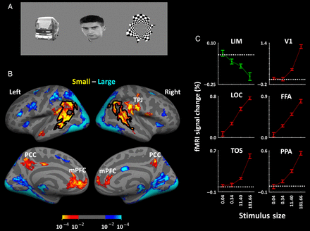
Figure 1. Stimulus examples and results in Experiments 1A and 1B. Stimuli consisted of everyday objects, faces, and ...
Notes:
Figure 1. Stimulus examples and results in Experiments 1A and 1B. Stimuli consisted of everyday objects, faces, and geometrical shapes (A), presented within different blocks. (B) The group-averaged activity maps from lateral (top) and medial (bottom) views. Preferential responses to either large (blue to cyan) or small (red to yellow) stimuli are based on P-values, using random-effect analysis, corrected for multiple comparisons. (C) The results of ROI analysis in LIM, in comparison with the responses in well-established visual areas including V1, FFA, LOC, TOS, and PPA. Error bars indicate 1 standard error of the mean.
Unless provided in the caption above, the following copyright applies to the content of this slide: © The Author 2014. Published by Oxford University PressThis is an Open Access article distributed under the terms of the Creative Commons Attribution Non-Commercial License (http://creativecommons.org/licenses/by-nc/4.0/), which permits non-commercial re-use, distribution, and reproduction in any medium, provided the original work is properly cited. For commercial re-use, please contact journals.permissions@oup.com

Slide 3
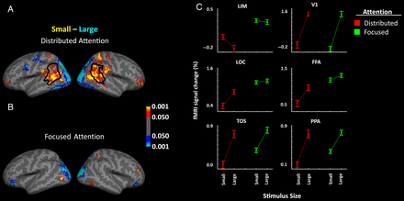
Figure 4. Group-averaged activity maps showing areas that responded preferentially to small (red-yellow) or large ...
Notes:
Figure 4. Group-averaged activity maps showing areas that responded preferentially to small (red-yellow) or large (blue-cyan) stimuli, during spatially distributed (A) or centrally focused (B) attention. The border of LIM is defined based on independent scans (Experiment 1) in the same pool of subjects. (C) The results of the ROI analysis in LIM and in well-established visual areas. Other details are similar to those in Figure 1.
Unless provided in the caption above, the following copyright applies to the content of this slide: © The Author 2014. Published by Oxford University PressThis is an Open Access article distributed under the terms of the Creative Commons Attribution Non-Commercial License (http://creativecommons.org/licenses/by-nc/4.0/), which permits non-commercial re-use, distribution, and reproduction in any medium, provided the original work is properly cited. For commercial re-use, please contact journals.permissions@oup.com

Slide 4
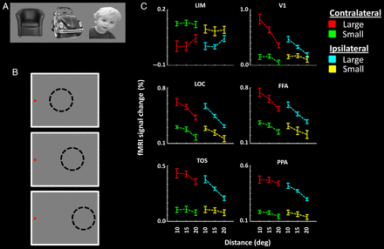
Figure 3. Stimuli and results in Experiment 3. Stimuli were everyday objects and faces, independent of those used in ...
Notes:
Figure 3. Stimuli and results in Experiment 3. Stimuli were everyday objects and faces, independent of those used in Experiments 1 and 2 (A). Stimuli were presented in the periphery of the visual field, and subjects were instructed to maintain fixation on a target presented either on the left (B) or the right side of the screen. The distance between the stimulus (presented by dashed circles) and the fixation spot was systematically varied across blocks. (C) The results of ROI analysis. The eccentricity of the stimulus center is indicated on the x-axis. Other details are as in Figure 1.
Unless provided in the caption above, the following copyright applies to the content of this slide: © The Author 2014. Published by Oxford University PressThis is an Open Access article distributed under the terms of the Creative Commons Attribution Non-Commercial License (http://creativecommons.org/licenses/by-nc/4.0/), which permits non-commercial re-use, distribution, and reproduction in any medium, provided the original work is properly cited. For commercial re-use, please contact journals.permissions@oup.com

Slide 5
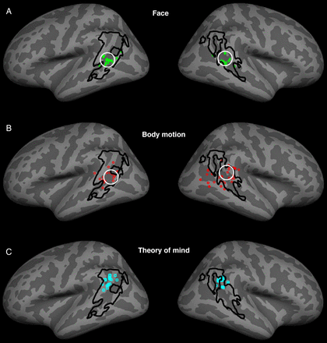
Figure 5. Co-localization of LIM relative to the reported peaks of activity in previous studies describing selectivity ...
Notes:
Figure 5. Co-localization of LIM relative to the reported peaks of activity in previous studies describing selectivity for faces (A) and biological motion (B) in STS (see Tables 1 and 2). The location of LIM was based on the results of Experiment 1. The peaks of activity to face- and biological motion-selective localizers in our subjects are indicated by white circles, in A and B, respectively. (C) The reported peaks of activity during ToM tasks, relative to the borders of LIM (see Table 3).
Unless provided in the caption above, the following copyright applies to the content of this slide: © The Author 2014. Published by Oxford University PressThis is an Open Access article distributed under the terms of the Creative Commons Attribution Non-Commercial License (http://creativecommons.org/licenses/by-nc/4.0/), which permits non-commercial re-use, distribution, and reproduction in any medium, provided the original work is properly cited. For commercial re-use, please contact journals.permissions@oup.com

Slide 6
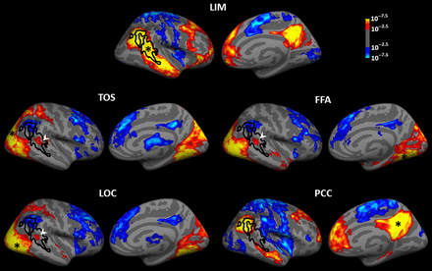
Figure 6. Functional connectivity of LIM and adjacent visual areas, including TOS, LOC, and FFA, illustrated in the ...
Notes:
Figure 6. Functional connectivity of LIM and adjacent visual areas, including TOS, LOC, and FFA, illustrated in the right hemisphere. The bottom panel shows the functional connectivity of PCC. Black lines show the borders of LIM. The white arrowhead indicates the anterior/ventral part of LIM, which shows a positive functional connection with the FFA, TOS, and LOC. In each panel, black asterisks indicate the center of the seeded area.
Unless provided in the caption above, the following copyright applies to the content of this slide: © The Author 2014. Published by Oxford University PressThis is an Open Access article distributed under the terms of the Creative Commons Attribution Non-Commercial License (http://creativecommons.org/licenses/by-nc/4.0/), which permits non-commercial re-use, distribution, and reproduction in any medium, provided the original work is properly cited. For commercial re-use, please contact journals.permissions@oup.com

Slide 7
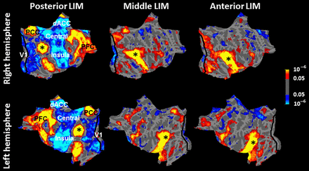
Figure 7. Functional connectivity map of posterior (left); middle (center) and anterior (right) LIM, overlaid on ...
Notes:
Figure 7. Functional connectivity map of posterior (left); middle (center) and anterior (right) LIM, overlaid on flattened right (top) and left (bottom) hemispheres. Asterisks mark the center of the seeded area in each map. Probabilistic borders of area V1 (Hinds et al. 2008) are also indicated with a black line.
Unless provided in the caption above, the following copyright applies to the content of this slide: © The Author 2014. Published by Oxford University PressThis is an Open Access article distributed under the terms of the Creative Commons Attribution Non-Commercial License (http://creativecommons.org/licenses/by-nc/4.0/), which permits non-commercial re-use, distribution, and reproduction in any medium, provided the original work is properly cited. For commercial re-use, please contact journals.permissions@oup.com

Slide 8
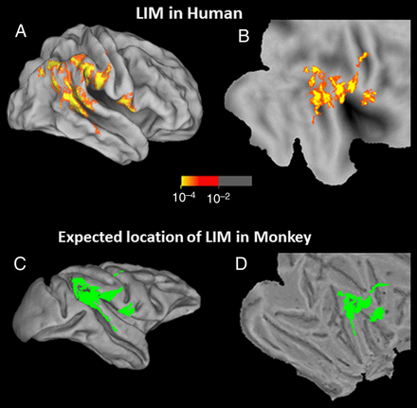
Figure 8. Topographic projection of the human data to predict the location of putative LIM in macaque monkey, based on ...
Notes:
Figure 8. Topographic projection of the human data to predict the location of putative LIM in macaque monkey, based on warping of the cortical surfaces. The top 2 panels show the group-averaged activity map showing the inverted size bias (red-through-yellow) based on the results from Experiment 1, in inflated (A) and flattened (B) views of the human brain. The bottom 2 panels show the predicted location of LIM in the macaque, in corresponding inflated (C) and flattened (D) views of the macaque brain, shown in solid green.
Unless provided in the caption above, the following copyright applies to the content of this slide: © The Author 2014. Published by Oxford University PressThis is an Open Access article distributed under the terms of the Creative Commons Attribution Non-Commercial License (http://creativecommons.org/licenses/by-nc/4.0/), which permits non-commercial re-use, distribution, and reproduction in any medium, provided the original work is properly cited. For commercial re-use, please contact journals.permissions@oup.com

Slide 9
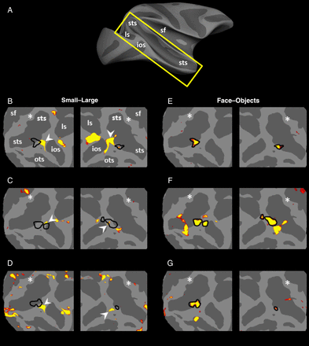
Figure 9. Results of Experiment 7A in 3 monkeys. (A) The approximate location of insets on a monkey brain with ...
Notes:
Figure 9. Results of Experiment 7A in 3 monkeys. (A) The approximate location of insets on a monkey brain with anatomical landmarks highlighted on the map. (B–D) Regions that responded preferentially to small (rather than large) stimuli during passive fixation (red-through-yellow). Stimuli were a subset of stimuli used in Experiment 1, which included faces and nonface everyday objects. The locations of small functional patches that are functionally similar to human LIM are indicated by white arrows. Based on the cortical projection, the predicted activity peak of LIM is indicated with a white asterisk. Black lines (E–G) show the borders of the posterior face-selective patches located in the same hemispheres. STS, superior temporal sulcus; LS, lunate sulcus; IOS, inferior occipital sulcus; OTS, occipital temporal sulcus; SF, sylvian fissure.
Unless provided in the caption above, the following copyright applies to the content of this slide: © The Author 2014. Published by Oxford University PressThis is an Open Access article distributed under the terms of the Creative Commons Attribution Non-Commercial License (http://creativecommons.org/licenses/by-nc/4.0/), which permits non-commercial re-use, distribution, and reproduction in any medium, provided the original work is properly cited. For commercial re-use, please contact journals.permissions@oup.com

Slide 10
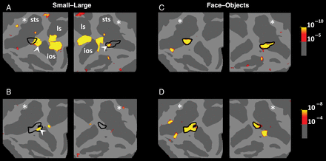
Figure 10. Results of Experiment 7B in 2 monkeys. A and B show activity patches that responded preferentially to small ...
Notes:
Figure 10. Results of Experiment 7B in 2 monkeys. A and B show activity patches that responded preferentially to small rather than larger stimuli during an active task comparable with the dot-detection task used in humans. The location of the posterior face-selective patches in the same hemispheres is shown in C and D. Other details are similar to those in Figure 8.
Unless provided in the caption above, the following copyright applies to the content of this slide: © The Author 2014. Published by Oxford University PressThis is an Open Access article distributed under the terms of the Creative Commons Attribution Non-Commercial License (http://creativecommons.org/licenses/by-nc/4.0/), which permits non-commercial re-use, distribution, and reproduction in any medium, provided the original work is properly cited. For commercial re-use, please contact journals.permissions@oup.com

