Slide 1
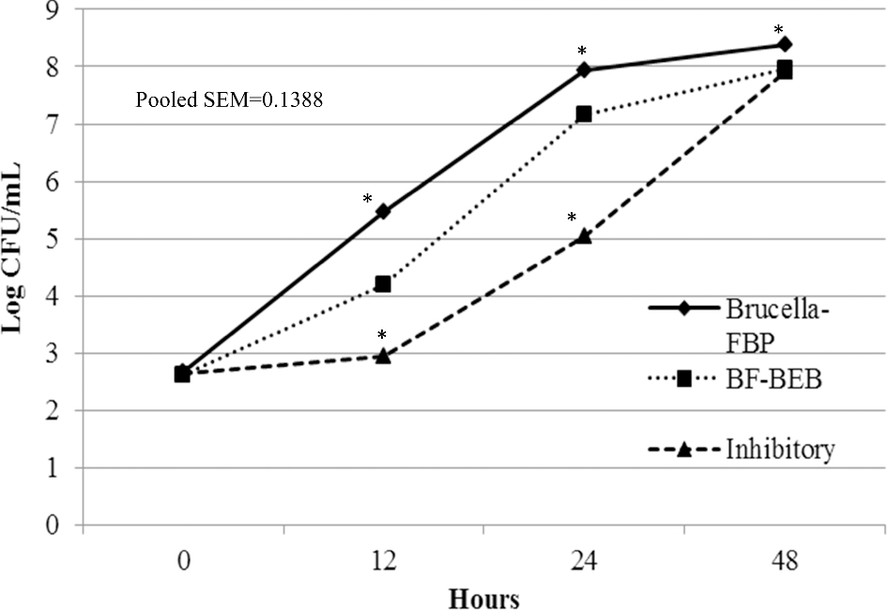
Figure 1. Growth of C. jejuni cultured in Brucella-FBP, blood-free Bolton's enrichment broth (BF-BEB), and inhibitory ...
Notes:
Figure 1. Growth of C. jejuni cultured in Brucella-FBP, blood-free Bolton's enrichment broth (BF-BEB), and inhibitory broth formulation under microaerophilic conditions for 48 h reported as mean log colony-forming units of C. jejuni per mL for each treatment. *Indicates difference (P ≤ 0.05) in C. jejuni counts compared to BF-BEB within 48 hours.
Unless provided in the caption above, the following copyright applies to the content of this slide: © 2017 Poultry Science Association Inc.

Slide 2
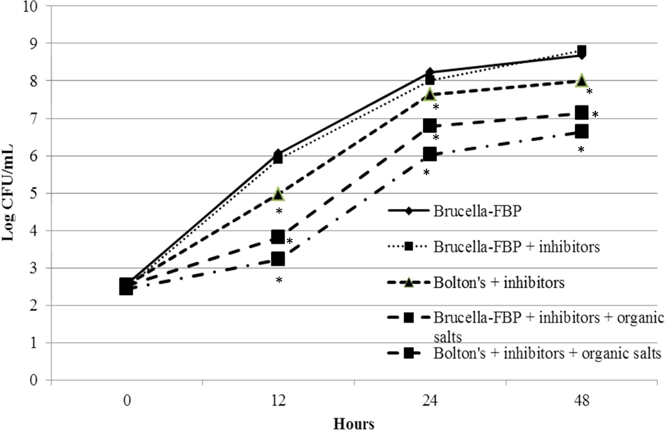
Figure 2. Growth of C. jejuni cultured in Brucella-FBP and Bolton's base broth incorporated with inhibitors ...
Notes:
Figure 2. Growth of C. jejuni cultured in Brucella-FBP and Bolton's base broth incorporated with inhibitors (cefoperazone and amphotericin B) and organic salts (100 mM pyruvate and 50 mM fumarate) under microaerophilic conditions for 48 h reported as mean log colony-forming units of C. jejuni per mL for each treatment. *Indicates difference (P ≤ 0.05) in C. jejuni counts compared to Brucella-FBP within 48 hours.
Unless provided in the caption above, the following copyright applies to the content of this slide: © 2017 Poultry Science Association Inc.

