Slide 1
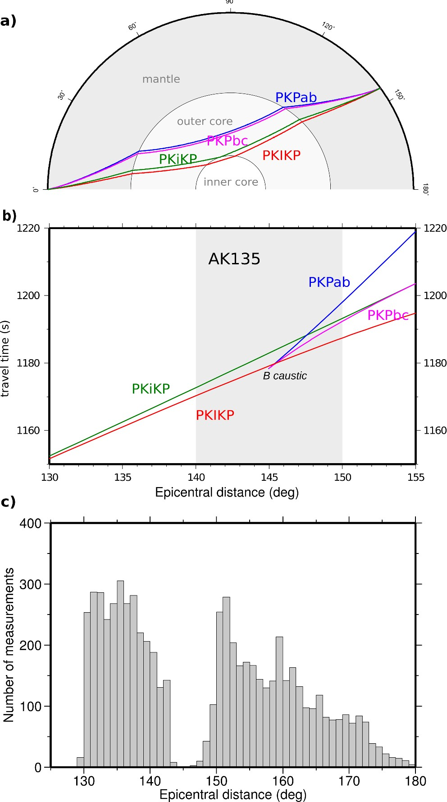
Figure 1. (a) Ray paths of the different compressional seismic phases that pass through the core. PKIKP (red) passes ...
Notes:
Figure 1. (a) Ray paths of the different compressional seismic phases that pass through the core. PKIKP (red) passes through the inner core, PKiKP (green) reflects off the inner core boundary, PKPbc (purple) travels through the deep outer core and PKPab (blue) passes through the shallower outer core. (b) Traveltime curves for the same phases at epicentral distances of 130–155°, calculated for AK135. The shaded area between 140 and 150° indicates the range of epicentral distances which has been ignored in previous studies, and the caustic at the B point is indicated. (c) Histogram showing the frequency of differential and absolute PKIKP measurements used in previous studies as a function of epicentral distance. A clear gap is visible at epicentral distances of ∼143–148°. The histogram was generated from data from Waszek & Deuss (2011), Irving & Deuss (2011) and Lythgoe et al. (2014).
Unless provided in the caption above, the following copyright applies to the content of this slide: © The Authors 2015. Published by Oxford University Press on behalf of The Royal Astronomical Society.

Slide 2
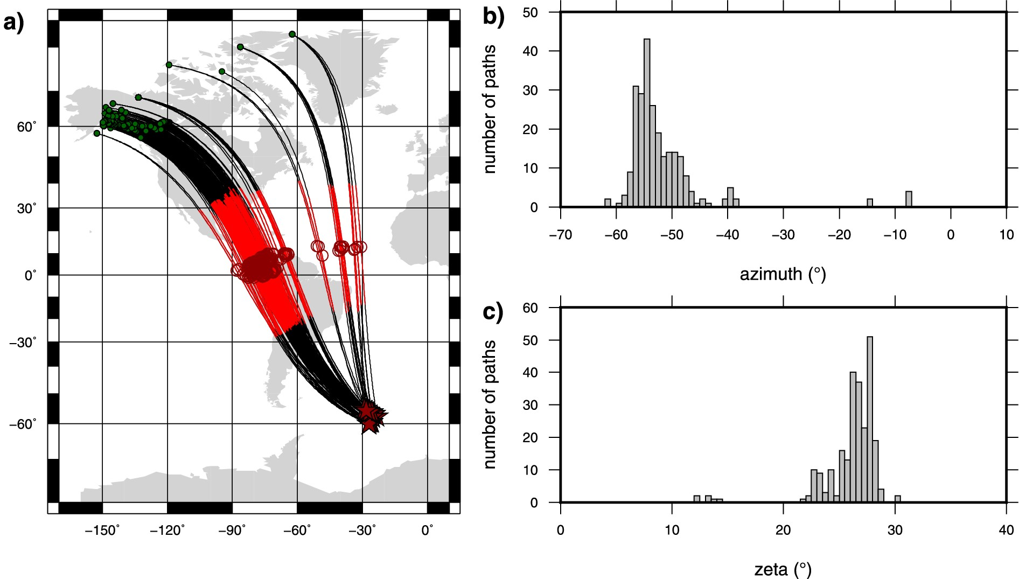
Figure 2. (a) Ray paths of all the seismograms used for the computation of the vespagrams between 140 and 150° ...
Notes:
Figure 2. (a) Ray paths of all the seismograms used for the computation of the vespagrams between 140 and 150° epicentral distance. Dark red stars are the events (see Table 1), green dots the stations and the red part of the ray path is the portion which goes through the inner core, where the turning point is denoted with a dark red circle. (b) Histogram showing the range of ray-path azimuths of the used seismograms. Most of the rays leave the event with an azimuth of 60 to 40° W of N. (c) Histogram showing the range of ζ of the used seismograms. To a large extent, this is the mirror image of the range of azimuths because zeta is always a positive number and the used azimuths are all below zero. Because almost all rays turn very close to the equator, zeta is around half of the absolute value of the azimuth.
Unless provided in the caption above, the following copyright applies to the content of this slide: © The Authors 2015. Published by Oxford University Press on behalf of The Royal Astronomical Society.

Slide 3
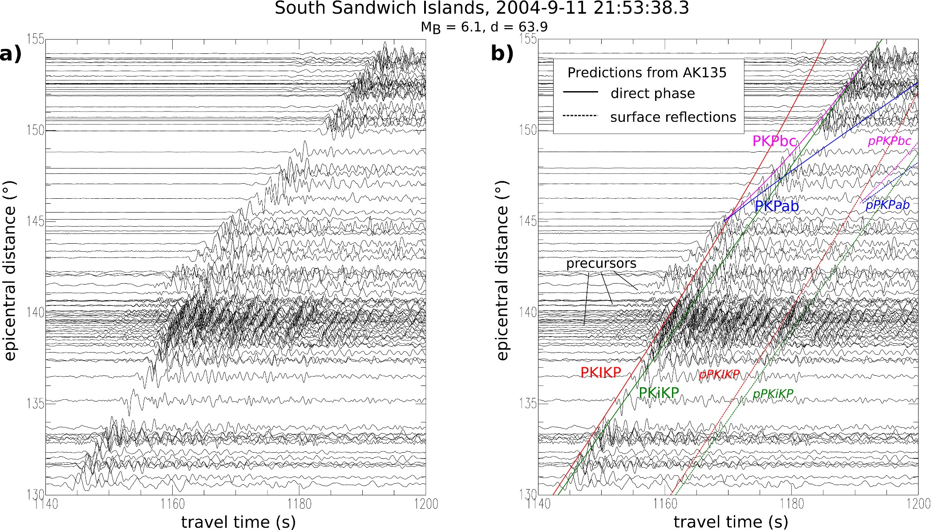
Figure 3. (a) Seismograms for PKIKP signals travelling in the Western hemisphere in the polar direction (ζ < 35°), ...
Notes:
Figure 3. (a) Seismograms for PKIKP signals travelling in the Western hemisphere in the polar direction (ζ < 35°), filtered around 1 Hz. (b) The same as (a), but with predictions for the arrival times are shown as solid lines (direct phases) and dotted lines (surface reflections), calculated for model AK135 and using the same colours as in Fig. 1.
Unless provided in the caption above, the following copyright applies to the content of this slide: © The Authors 2015. Published by Oxford University Press on behalf of The Royal Astronomical Society.

Slide 4
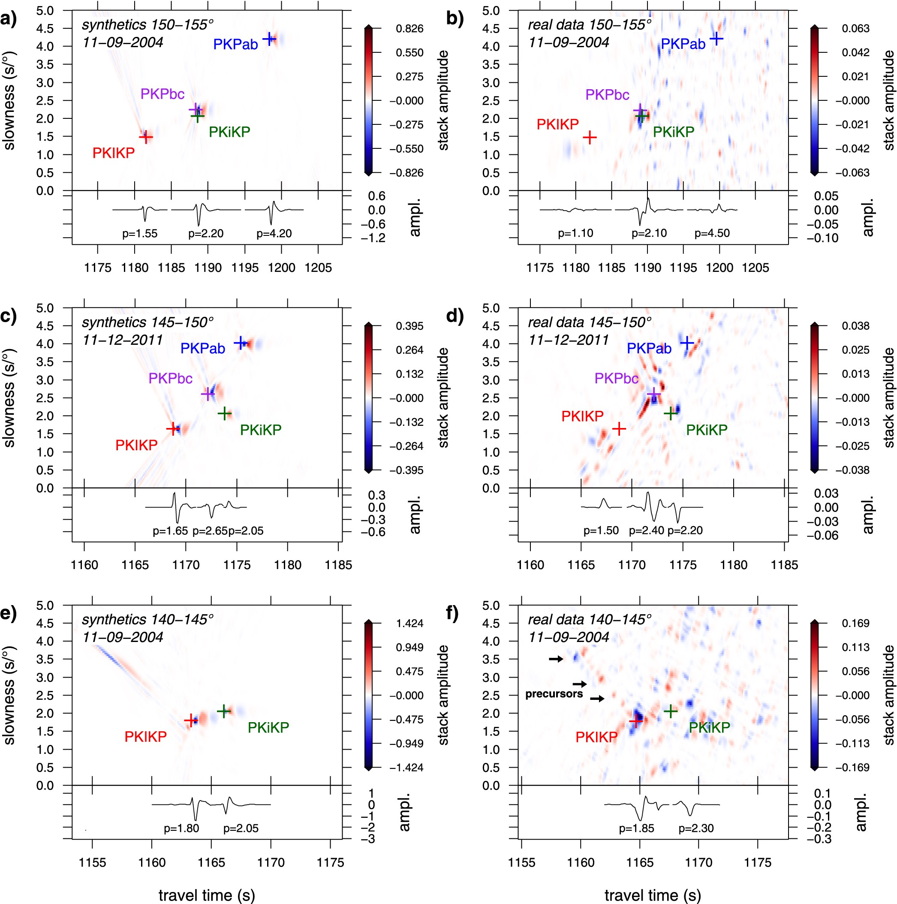
Figure 4. Vespagrams produced using the Phase Weighted Stacking technique with ν = 3 [see Schimmel & Paulssen (1997)] ...
Notes:
Figure 4. Vespagrams produced using the Phase Weighted Stacking technique with ν = 3 [see Schimmel & Paulssen (1997)] for South Sandwich Islands events of 2004 September 11 and 2011 December 11. (a, b) Stacks of the epicentral distance bin 150–155°; (c, d) bin 145–150°; (e, f) bin 140–145°. Vespagrams in the left column (a, c, e) are computed from synthetic data, those on the right (b, d, f) from the real observed data. Model predictions for the arrival time and slowness of the direct phases and surface reflections for model A135 are plotted as pluses. The bottom panel in each subplot shows cross sections through the vespagrams at the appropriate slowness for the PKP phases. These cross sections are used to measure differential traveltimes.
Unless provided in the caption above, the following copyright applies to the content of this slide: © The Authors 2015. Published by Oxford University Press on behalf of The Royal Astronomical Society.

Slide 5
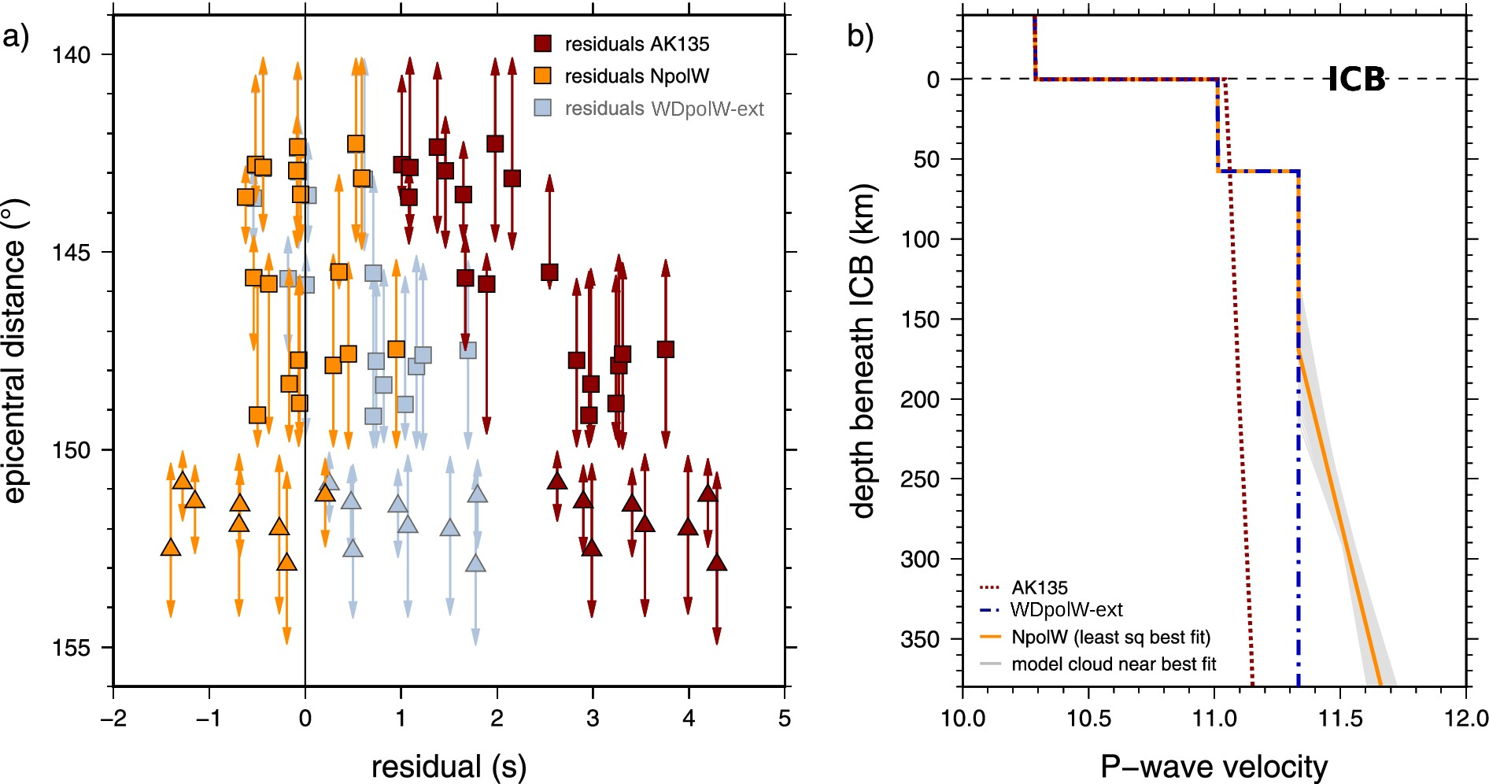
Figure 5. (a) Differential traveltime residuals of PKiKP–PKIKP for the data in the bins 140–145°, 142.5–147.5° and ...
Notes:
Figure 5. (a) Differential traveltime residuals of PKiKP–PKIKP for the data in the bins 140–145°, 142.5–147.5° and 145–150° (squares), and of PKPbc–PKIKP for the bin 150–155 (triangles). The residuals have been calculated with eq. (1) for models AK135 (red), the ‘best-fit’ model NpolW (yellow) and WDpolW-ext (light blue). Residuals are plotted at the reference epicentral distance of the stack, and the vertical arrows indicate the actual width of the epicentral distance bin, which is variable according to the exact spread of stations that were available. (b) Velocity models used in this study. Model NpolW (yellow) is the least-squares minimum RSS model generated using PKiKP–PKIKP differential traveltimes at epicentral distances of 140–150° obtained in this study (RSS = 3.07). The models plotted in grey around it have a similar fit to the data (RSS<4) and show the trade-off between starting depth and gradient of the velocity increase.
Unless provided in the caption above, the following copyright applies to the content of this slide: © The Authors 2015. Published by Oxford University Press on behalf of The Royal Astronomical Society.

Slide 6
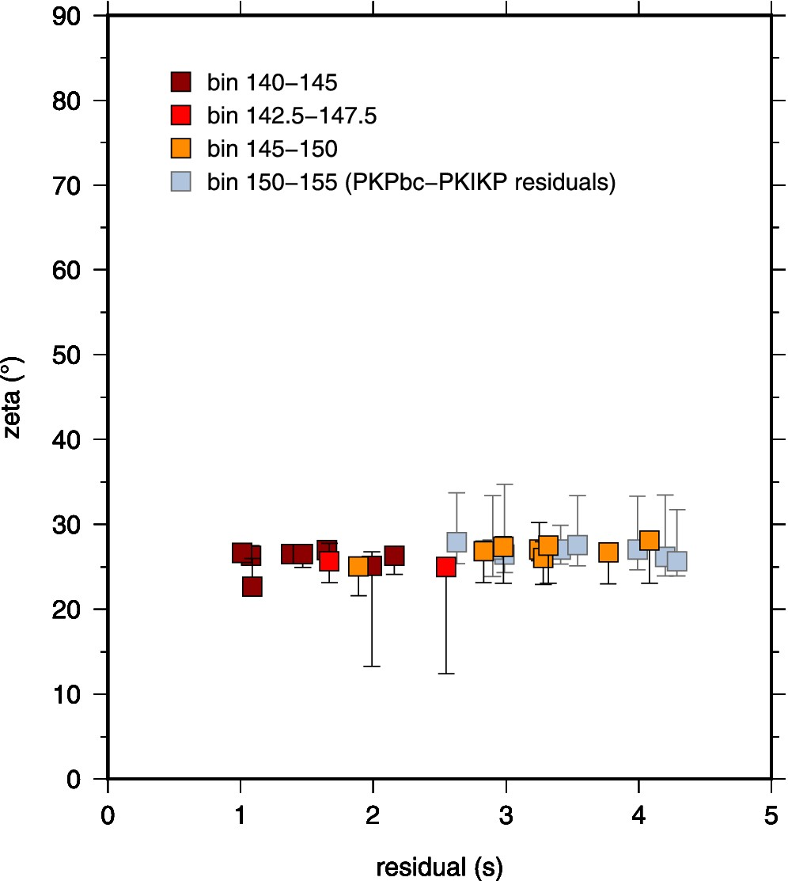
Figure 6. Differential traveltimes residuals of PKiKP–PKIKP with respect to model AK135. The residuals are the same as ...
Notes:
Figure 6. Differential traveltimes residuals of PKiKP–PKIKP with respect to model AK135. The residuals are the same as in Fig. 5 but as a function of ζ. Residuals are plotted at the median ζ of the bin, and the vertical bars indicate the variation of ζ within the bin. The median ζ is ∼25–27° for all bins.
Unless provided in the caption above, the following copyright applies to the content of this slide: © The Authors 2015. Published by Oxford University Press on behalf of The Royal Astronomical Society.

