Slide 1
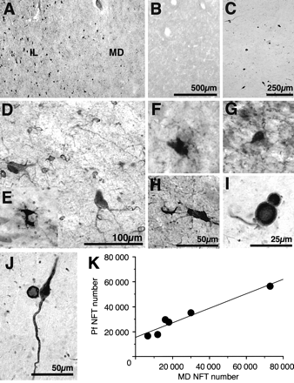
Fig. 1 Representative photomicrographs of sections through the caudal intralaminar nuclei in patients with ...
Notes:
Fig. 1 Representative photomicrographs of sections through the caudal intralaminar nuclei in patients with Parkinson's disease (B, C, I, J) or PSP (A, D–H), and graph showing the correlation between NFT number in different thalamic nuclei in PSP (K). (A) Differential density of tau NFT pathology in the caudal intralaminar (IL) and MD nuclei in a PSP patient. (B) Absence of tau pathology in the IL nuclei of a patient with Parkinson's disease. (C) Serial section to B stained immunohistochemically for α-synuclein. Many Lewy bodies and some neurons were immunoreactive for α-synuclein in the IL in Parkinson's disease. Scale in C is equivalent to that in A and B. (D) High magnification of the IL nuclei stained immunohistochemically for tau, showing NFT (in larger cells) and coiled glial bodies (small cells) in PSP. (E) High magnification of intracellular NFT in the IL nuclei in PSP stained with nickel peroxidase and counterstained with cresyl violet. The majority of NFT had clearly labelled nuclei when the cresyl violet counterstain was used. (F, G) High magnification of IL nuclei stained immunohistochemically for tau and counterstained with cresyl violet, showing intracellular tau-positive NFT. (H) High magnification of the IL nuclei stained immunohistochemically for tau and counterstained with cresyl violet, showing an extracellular NFT (smaller structure) and a neuron filled with tau immunoreactivity. Scale in H is equivalent to that in D–G. (I) High magnification of the IL nuclei stained immunohistochemically for α-synuclein, showing two Lewy bodies. (J) High magnification of the IL nuclei stained immunohistochemically for α-synuclein, showing a Lewy body and a Lewy neurite. (K) Regression plot demonstrating positive relationship between NFT number in the thalamic Pf and MD nuclei.
Unless provided in the caption above, the following copyright applies to the content of this slide: © Oxford University Press 2000

Slide 2
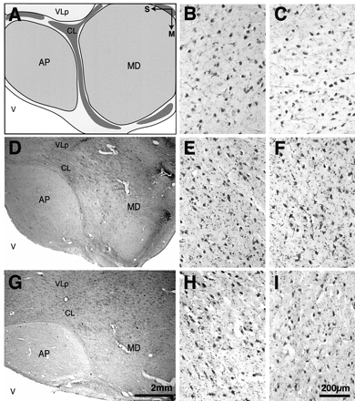
Fig. 2 Anatomy and cell composition of the limbic thalamus in controls (A–C), Parkinson's disease patients (D–F) and ...
Notes:
Fig. 2 Anatomy and cell composition of the limbic thalamus in controls (A–C), Parkinson's disease patients (D–F) and PSP patients (G–I). Scale in G is the same as that in A and D; scale in I is the same as that in B, C, E, F and H. (A) Diagrammatic representation delineating the normal boundaries of the limbic thalamic nuclei, AP and MD. These nuclei are separated by the internal medullary lamina. Neurons of the centrolateral thalamic (CL) nucleus are found between the MD and ventral lateral posterior thalamic (VLp) nuclei. Anatomical positioning is indicated by arrows showing the direction of the superior surface of the brain (S) versus the midline (M). (D and G) Low-power sections from representative Parkinson's disease (D) and PSP (G) patients, stained immunohistochemically for the calcium binding-protein calbindin, showing clear delineation of the AP and MD nuclei with respect to the surrounding thalamic regions. (B, E and H) High-power cresyl violet-stained sections of Nissl-stained neurons in the AP in representative control subjects (B), Parkinson's disease patients (E) and PSP patients (H). Note the similar morphologies and densities of neurons in the three groups. (C, F and I) High-power cresyl violet-stained sections of Nissl-stained neurons in the MD in representative control subjects (C), Parkinson's disease patients (F) and PSP patients (I). Note the similar morphologies and densities of neurons in the three groups. V = third ventricle.
Unless provided in the caption above, the following copyright applies to the content of this slide: © Oxford University Press 2000

Slide 3
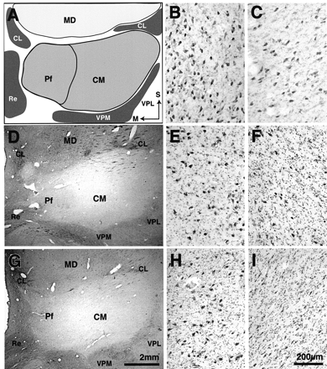
Fig. 3 Anatomy and cell composition of the caudal intralaminar thalamus in controls (A–C), Parkinson's disease ...
Notes:
Fig. 3 Anatomy and cell composition of the caudal intralaminar thalamus in controls (A–C), Parkinson's disease patients (D–F) and PSP patients (G–I). Scale in G is the same as that in A and D. Scale in I is the same as that in B, C, E, F and H. (A) Diagrammatic representation delineating the boundaries of the caudal intralaminar thalamic nuclei. Anatomical positioning is indicated by arrows showing the direction of the superior surface of the brain (S) versus the midline (M). These nuclei are separated from the MD by the internal medullary lamina. Neurons of the centrolateral thalamic nucleus (CL) nucleus are found between the MD and these nuclei. (D and G) Low-power sections from representative Parkinson's disease (D) and PSP (G) patients stained immunohistochemically for the calcium-binding protein calbindin, showing clear delineation of the CM and Pf nuclei with respect to the surrounding thalamic regions. (B, E and H) High-power cresyl violet-stained sections of Nissl-stained neurons in the Pf nucleus in representative control subjects (B), Parkinson's disease patients (E) and PSP patients (H). Note the decreased density of neurons and increased gliosis in the two patient groups compared with the controls. (C, F and I) High-power magnification of cresyl violet-stained sections from representative control subjects (C), Parkinson's disease patients (F) and PSP patients (I), showing neurons and glial cells in the CM. Note the different morphologies and densities of Pf and CM neurons in B and C. The CM neurons (C) are smaller and further apart than those of the Pf (B). In both Parkinson's disease (F) and PSP (I), there was marked neuronal loss and gliosis of the CM compared with controls (C). Re = reuniens thalamic nucleus; VPM = ventral posterior medial thalamic nucleus; VPL = ventral posterior lateral thalamic nucleus.
Unless provided in the caption above, the following copyright applies to the content of this slide: © Oxford University Press 2000

Slide 4
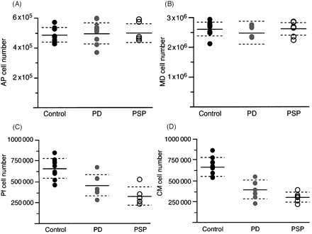
Fig. 4 Graphs of total neuronal number in the limbic (A and B) and caudal intralaminar (C and D) thalamic nuclei in ...
Notes:
Fig. 4 Graphs of total neuronal number in the limbic (A and B) and caudal intralaminar (C and D) thalamic nuclei in the control subjects, Parkinson's disease patients and PSP patients. (A and B) Total neuronal number in the limbic thalamus in the three groups. There was no difference in total neuronal number in either the AP (A) or the MD (B) nuclei in the three groups of patients. (C and D) Total neuronal number in the caudal intralaminar thalamus. There was a significant reduction in total neuronal number in both the Pf (C) and the CM (D) nuclei in the Parkinson's disease and PSP groups relative to controls.
Unless provided in the caption above, the following copyright applies to the content of this slide: © Oxford University Press 2000

Slide 5
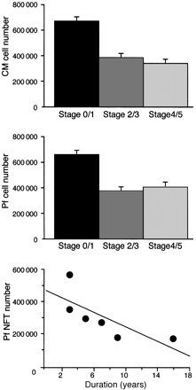
Fig. 5 Graphs of the relationship between cell (top and middle) or NFT (bottom) number and clinical disease indices. ...
Notes:
Fig. 5 Graphs of the relationship between cell (top and middle) or NFT (bottom) number and clinical disease indices. (Upper two panels) The number of neurons in the three groups plotted against Hoehn and Yahr stage at death. In parkinsonian patients (stages 2–5) there was a significant reduction in total neuronal number in the CM (top) and Pf (middle) nuclei relative to controls. This cell loss occurred irrespective of whether patients had milder (stage 2–3) or more severe (stage 4–5) disease. (Bottom) The number of NFT declined significantly with increasing duration of PSP.
Unless provided in the caption above, the following copyright applies to the content of this slide: © Oxford University Press 2000

