Slide 1
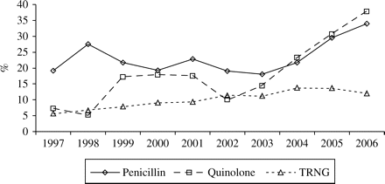
Figure 1 Aggregated trend data for resistance to the penicillins (by any mechanism), ciprofloxacin non-susceptible ...
Notes:
Figure 1 Aggregated trend data for resistance to the penicillins (by any mechanism), ciprofloxacin non-susceptible gonococci (MIC ≥ 0.06 mg/L) and for high-level tetracycline resistance (TRNG, MIC ≥ 16 mg/L), Australia, 1997–2006.
Unless provided in the caption above, the following copyright applies to the content of this slide: © The Author 2007. Published by Oxford University Press on behalf of the British Society for Antimicrobial Chemotherapy. All rights reserved. For Permissions, please e-mail: journals.permissions@oxfordjournals.org

Slide 2
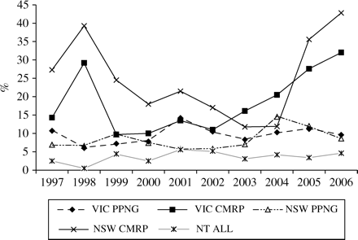
Figure 2 Proportion of penicillinase-producing gonococci (PPNG) and gonococci with chromosomally mediated penicillin ...
Notes:
Figure 2 Proportion of penicillinase-producing gonococci (PPNG) and gonococci with chromosomally mediated penicillin resistance (CMRP) in New South Wales (NSW) and Victoria (VIC), and all gonococci penicillin resistant by any mechanism in the Northern Territory (NT), 1997–2006.
Unless provided in the caption above, the following copyright applies to the content of this slide: © The Author 2007. Published by Oxford University Press on behalf of the British Society for Antimicrobial Chemotherapy. All rights reserved. For Permissions, please e-mail: journals.permissions@oxfordjournals.org

Slide 3
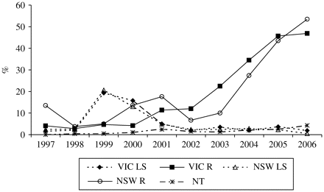
Figure 3 Proportion of isolates less susceptible (LS) and resistant (R) to ciprofloxacin in New South Wales (NSW) and ...
Notes:
Figure 3 Proportion of isolates less susceptible (LS) and resistant (R) to ciprofloxacin in New South Wales (NSW) and Victoria (VIC), and all quinolone non-susceptible gonococci in the Northern Territory (NT), 1997–2006.
Unless provided in the caption above, the following copyright applies to the content of this slide: © The Author 2007. Published by Oxford University Press on behalf of the British Society for Antimicrobial Chemotherapy. All rights reserved. For Permissions, please e-mail: journals.permissions@oxfordjournals.org

