Slide 1
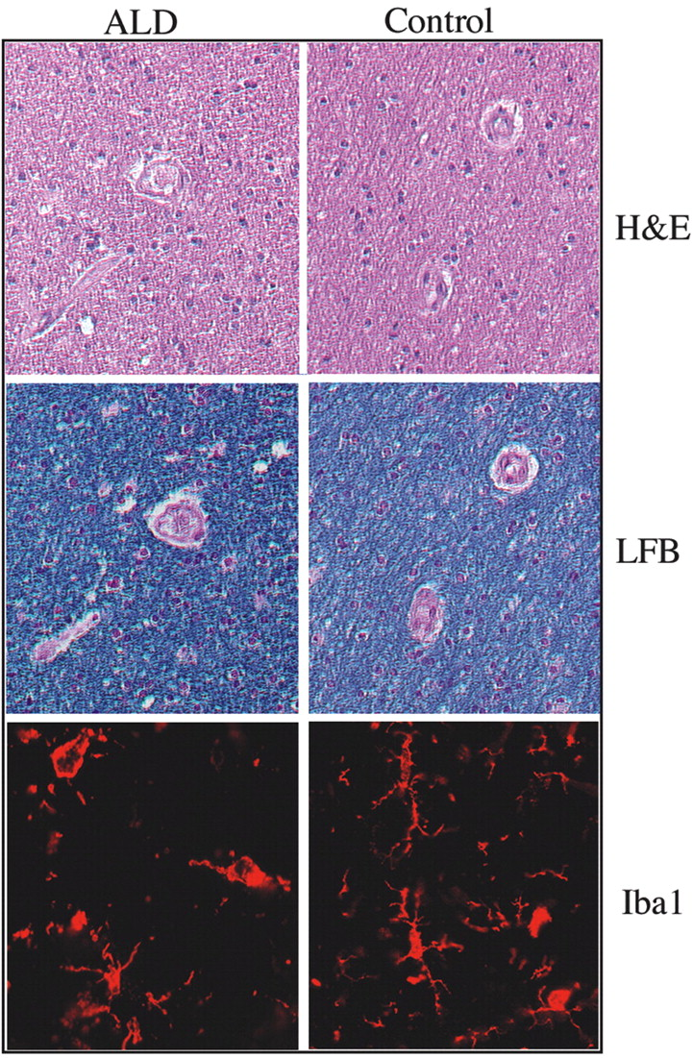
Figure 1. Representative ‘normal-appearing’ white matter from ALD patients and controls. LFB and H&E staining ...
Notes:
Figure 1. Representative ‘normal-appearing’ white matter from ALD patients and controls. LFB and H&E staining showed no significant difference between the ‘normal-appearing’ white matter from ALD patients and the controls. Staining with the microglial marker Iba1 (in red, Cy3) reveals the same number of microglia in white matter from ALD patients and controls. However, the microglial cells from the ALD white matter are less ramified.
Unless provided in the caption above, the following copyright applies to the content of this slide: © The Author 2005. Published by Oxford University Press. All rights reserved. For Permissions, please email: journals.permissions@oupjournals.org

Slide 2
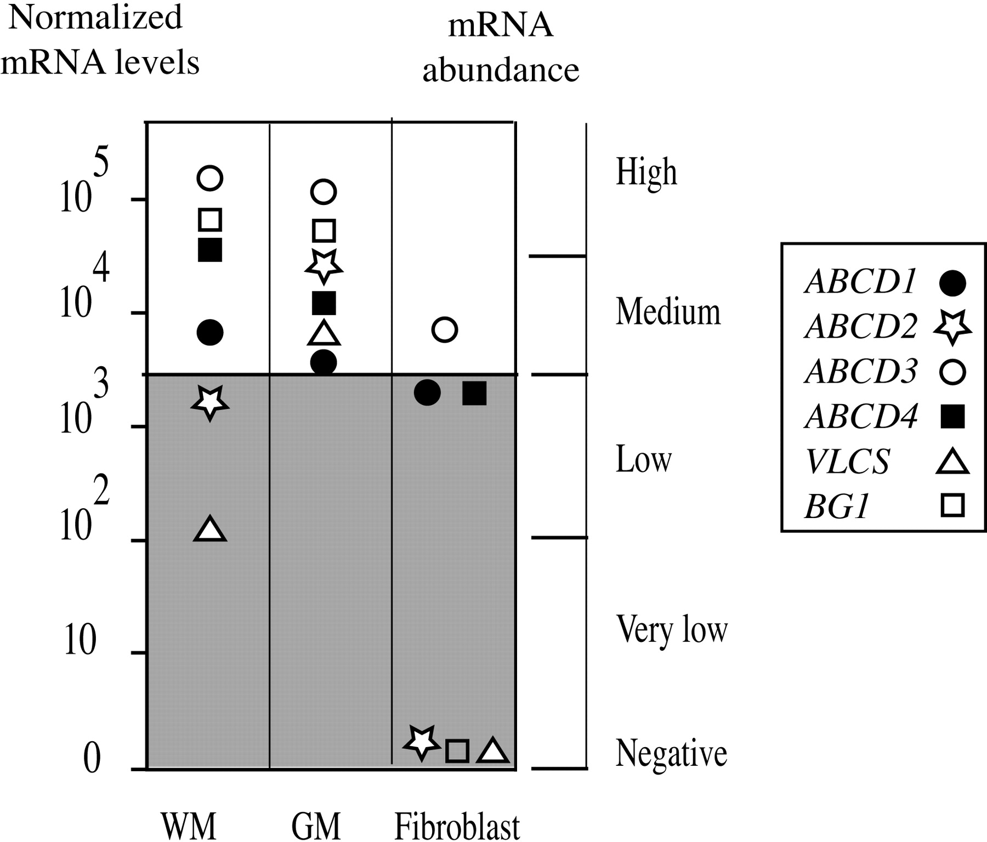
Figure 2. Expression of the ABCD1, ABCD2, ABCD3, ABCD4, VLCS and BG1 genes in normal WM, GM and fibroblasts. ...
Notes:
Figure 2. Expression of the ABCD1, ABCD2, ABCD3, ABCD4, VLCS and BG1 genes in normal WM, GM and fibroblasts. mRNA levels were measured by quantitative RT–PCR and normalized to RPLP0 and to the sample that displayed the lowest detectable and quantifiable level of gene expression (the value 1 on the left ordinate corresponds to a Ct value of 40). A scale indicating qualitative mRNA abundance is included on the right ordinate to assist the reader in interpreting the figure.
Unless provided in the caption above, the following copyright applies to the content of this slide: © The Author 2005. Published by Oxford University Press. All rights reserved. For Permissions, please email: journals.permissions@oupjournals.org

Slide 3
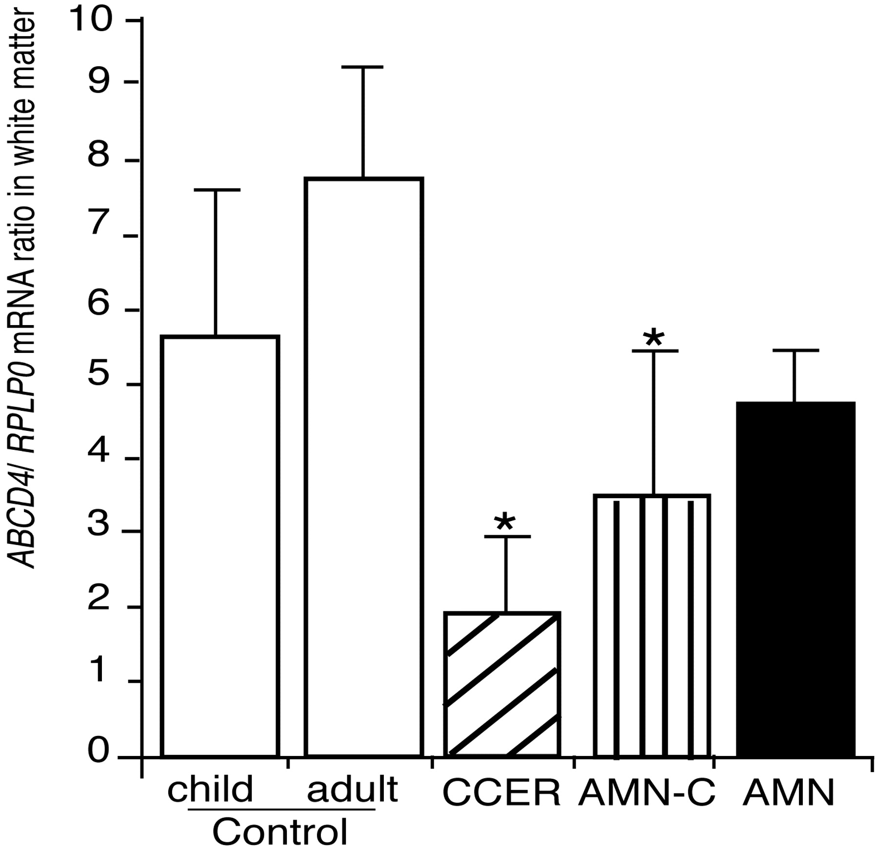
Figure 3.ABCD4-gene expression in the WM from ALD patients with CCER, AMN-C and AMN phenotypes. The levels of ...
Notes:
Figure 3.ABCD4-gene expression in the WM from ALD patients with CCER, AMN-C and AMN phenotypes. The levels of ABCD4 mRNA are decreased in the WM from CCER and AMN-C (*P<0.05).
Unless provided in the caption above, the following copyright applies to the content of this slide: © The Author 2005. Published by Oxford University Press. All rights reserved. For Permissions, please email: journals.permissions@oupjournals.org

Slide 4
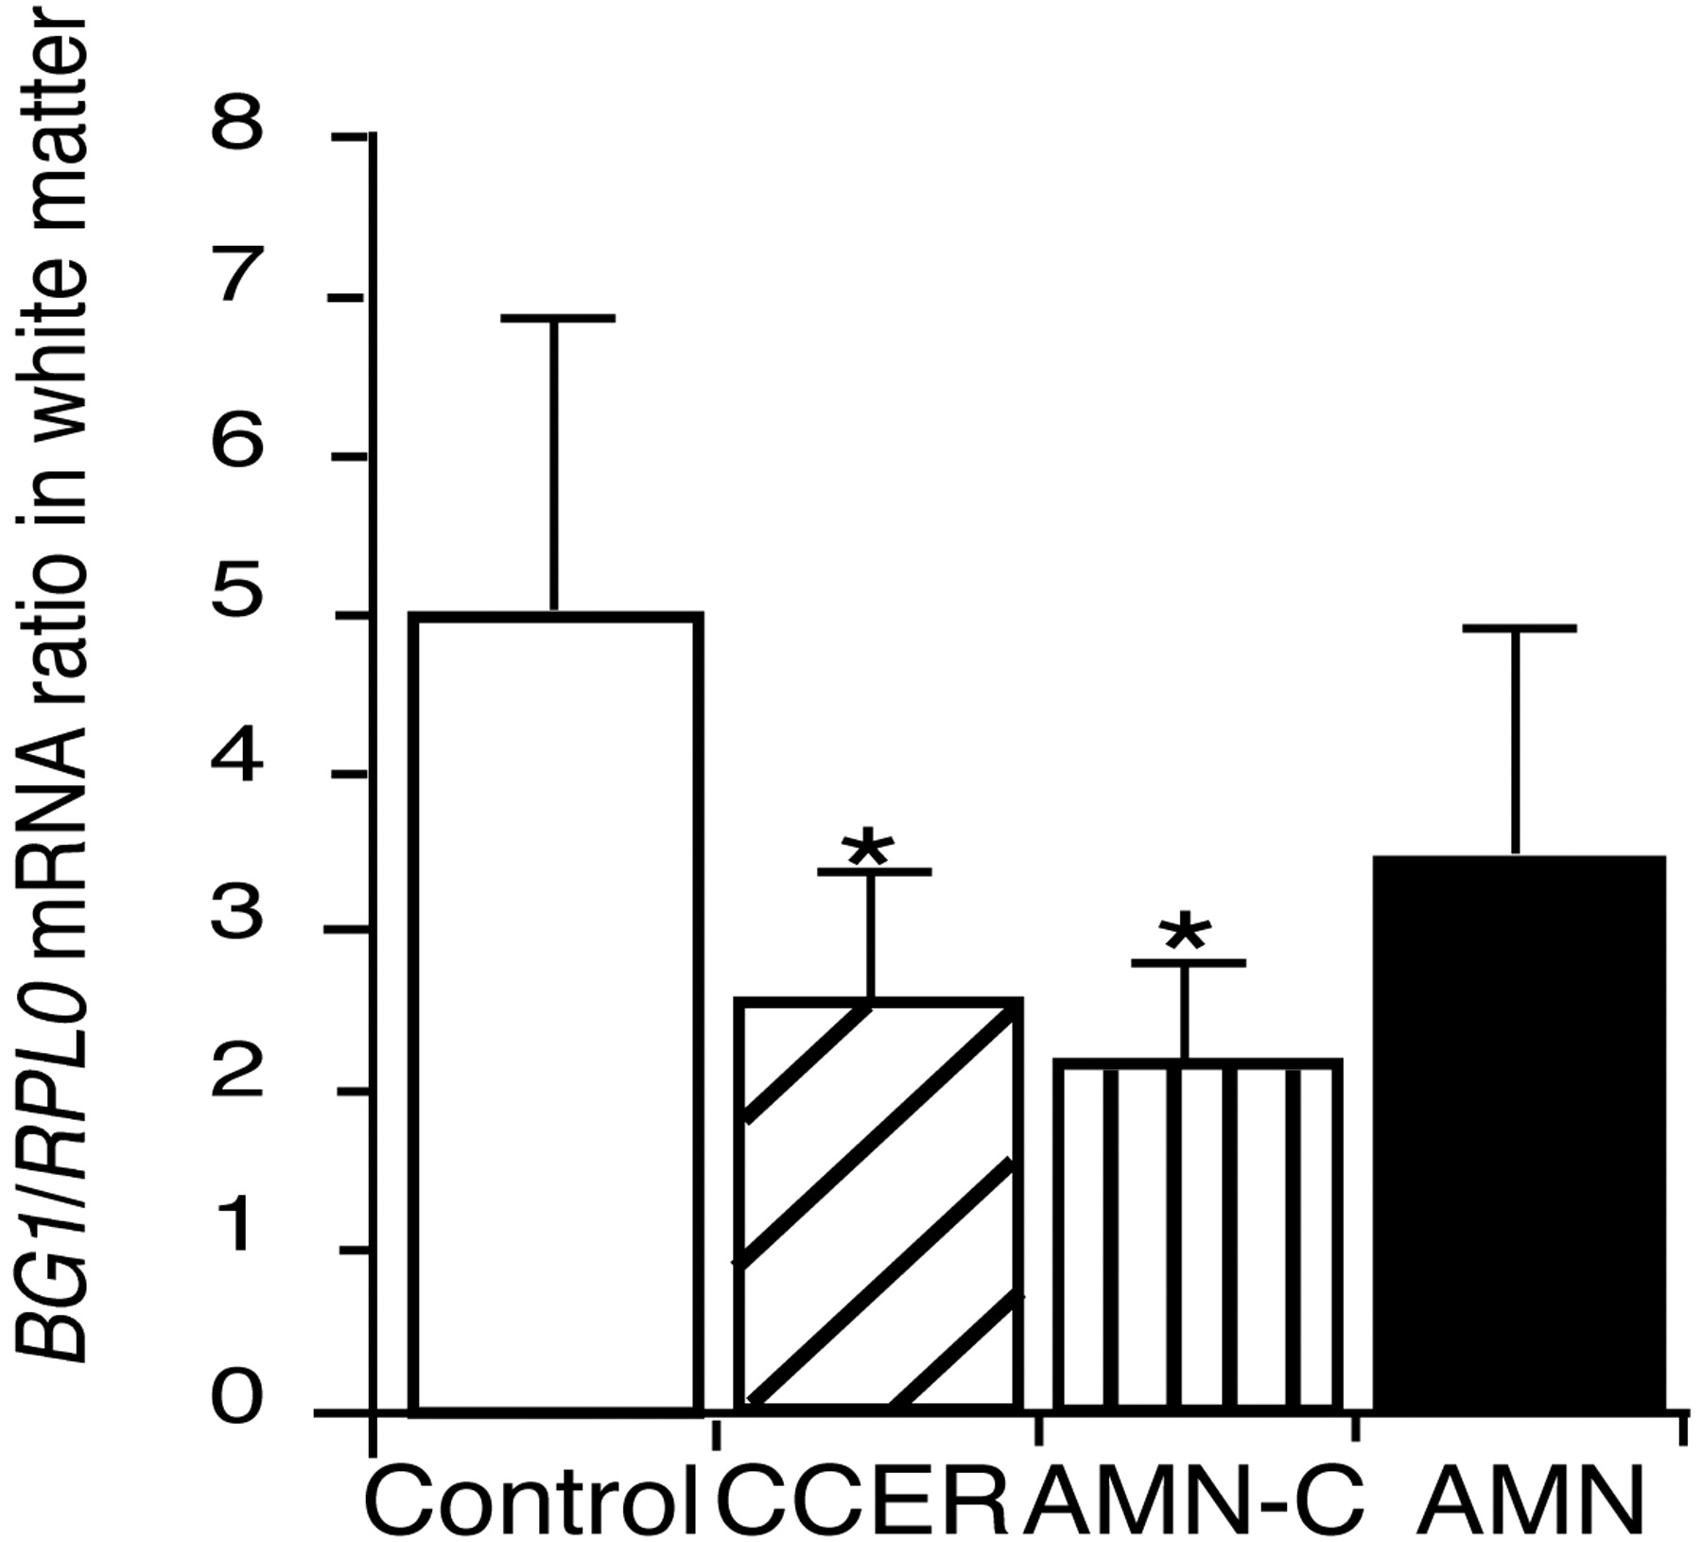
Figure 4.BG1-gene expression in the WM from ALD patients with CCER, AMN-C and AMN phenotypes. The levels of ...
Notes:
Figure 4.BG1-gene expression in the WM from ALD patients with CCER, AMN-C and AMN phenotypes. The levels of BG1 mRNA are decreased in the WM from CCER and AMN-C (*P<0.01).
Unless provided in the caption above, the following copyright applies to the content of this slide: © The Author 2005. Published by Oxford University Press. All rights reserved. For Permissions, please email: journals.permissions@oupjournals.org

Slide 5
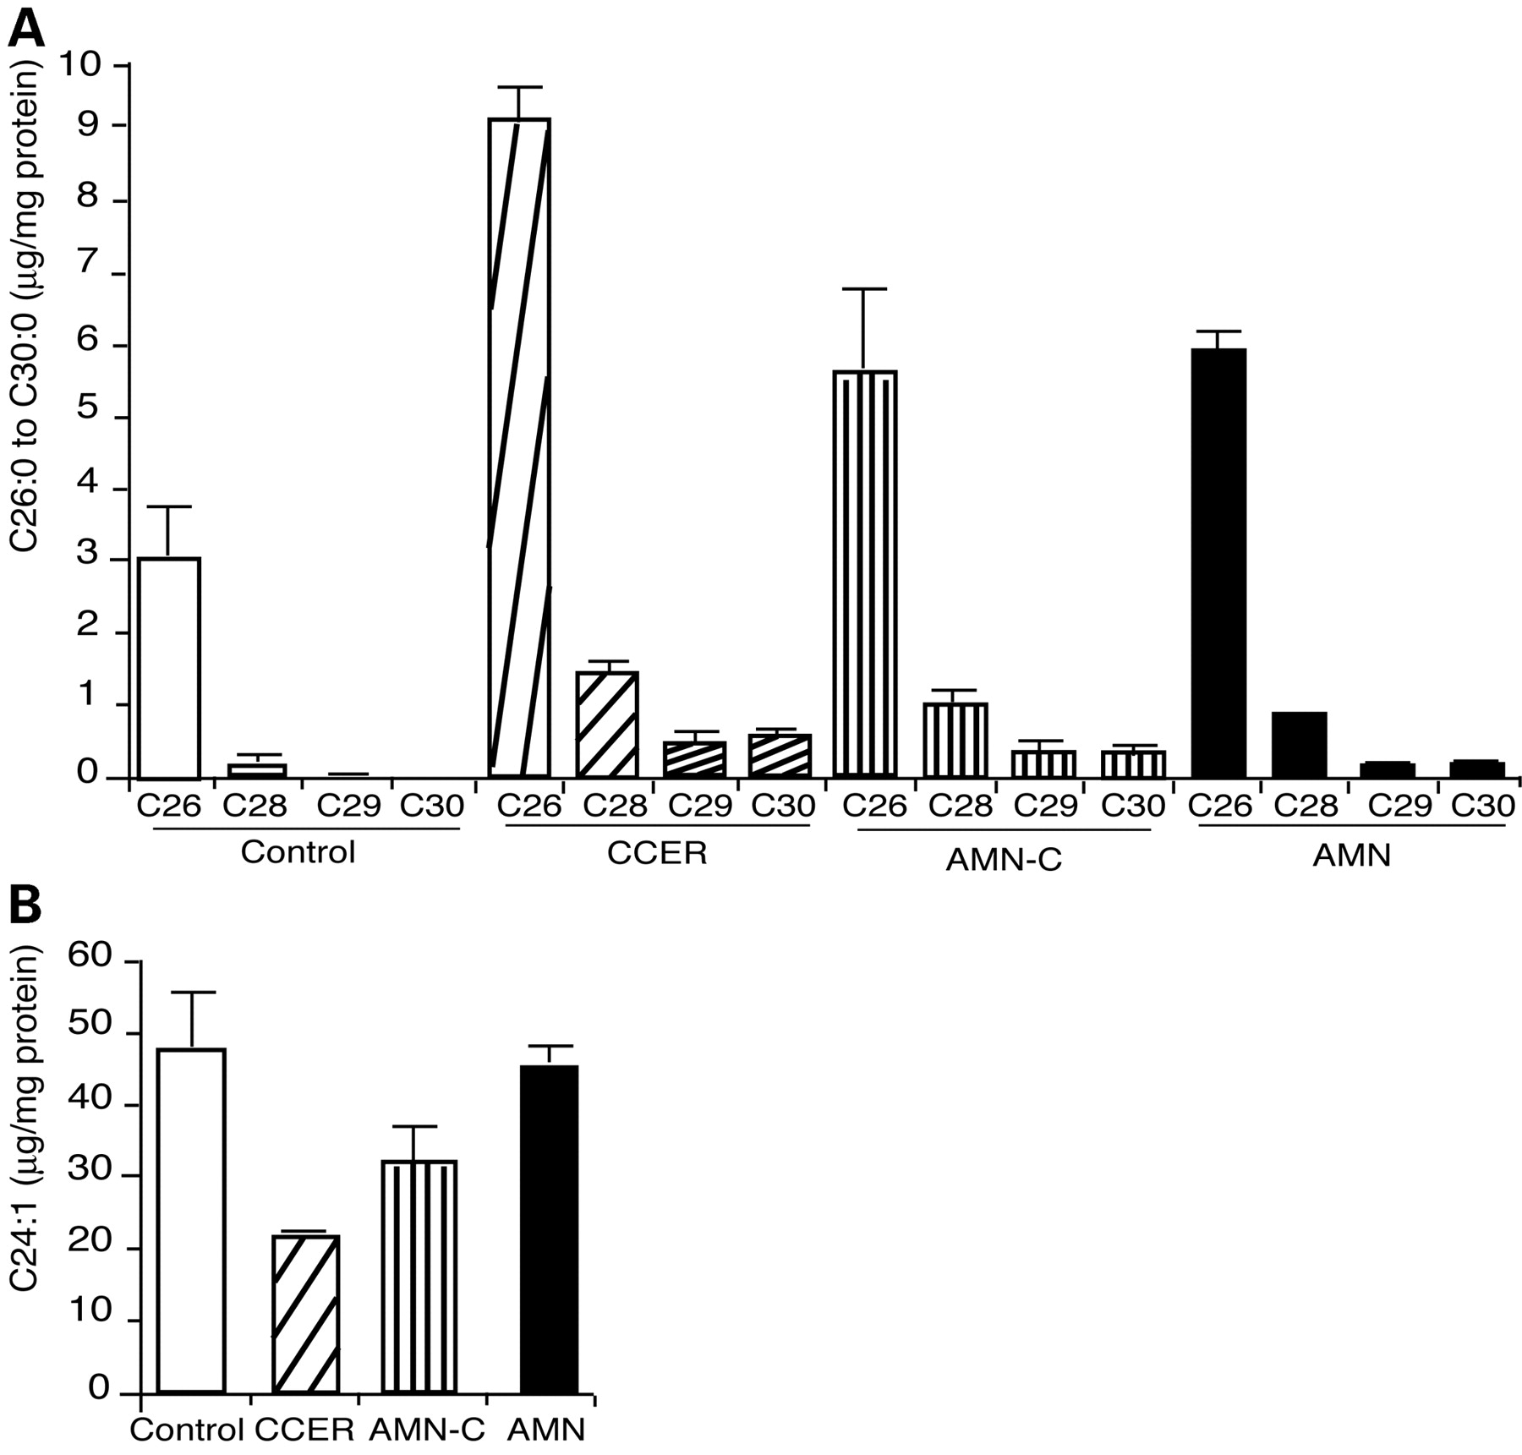
Figure 5. VLCFAs levels in the normal WM from ALD patients. (A) Saturated VLCFAs (C26 : 0–C30 : 0) levels in ...
Notes:
Figure 5. VLCFAs levels in the normal WM from ALD patients. (A) Saturated VLCFAs (C26 : 0–C30 : 0) levels in the WM of patients with CCER, AMN-C, AMN and controls. Results are expressed in µg/mg protein. (B) Nervonic acid (C24 : 1) levels in the white matter of patients with CCER, AMN-C, AMN phenotypes and controls. Results are expressed in µg/mg protein.
Unless provided in the caption above, the following copyright applies to the content of this slide: © The Author 2005. Published by Oxford University Press. All rights reserved. For Permissions, please email: journals.permissions@oupjournals.org

