Slide 1
Figure 1. Example trial sequence in the task.
Notes:
Figure 1. Example trial sequence in the task.
Unless provided in the caption above, the following copyright applies to the content of this slide: © The Author 2015. Published by Oxford University Press. All rights reserved. For Permissions, please e-mail: journals.permissions@oup.com

Slide 2
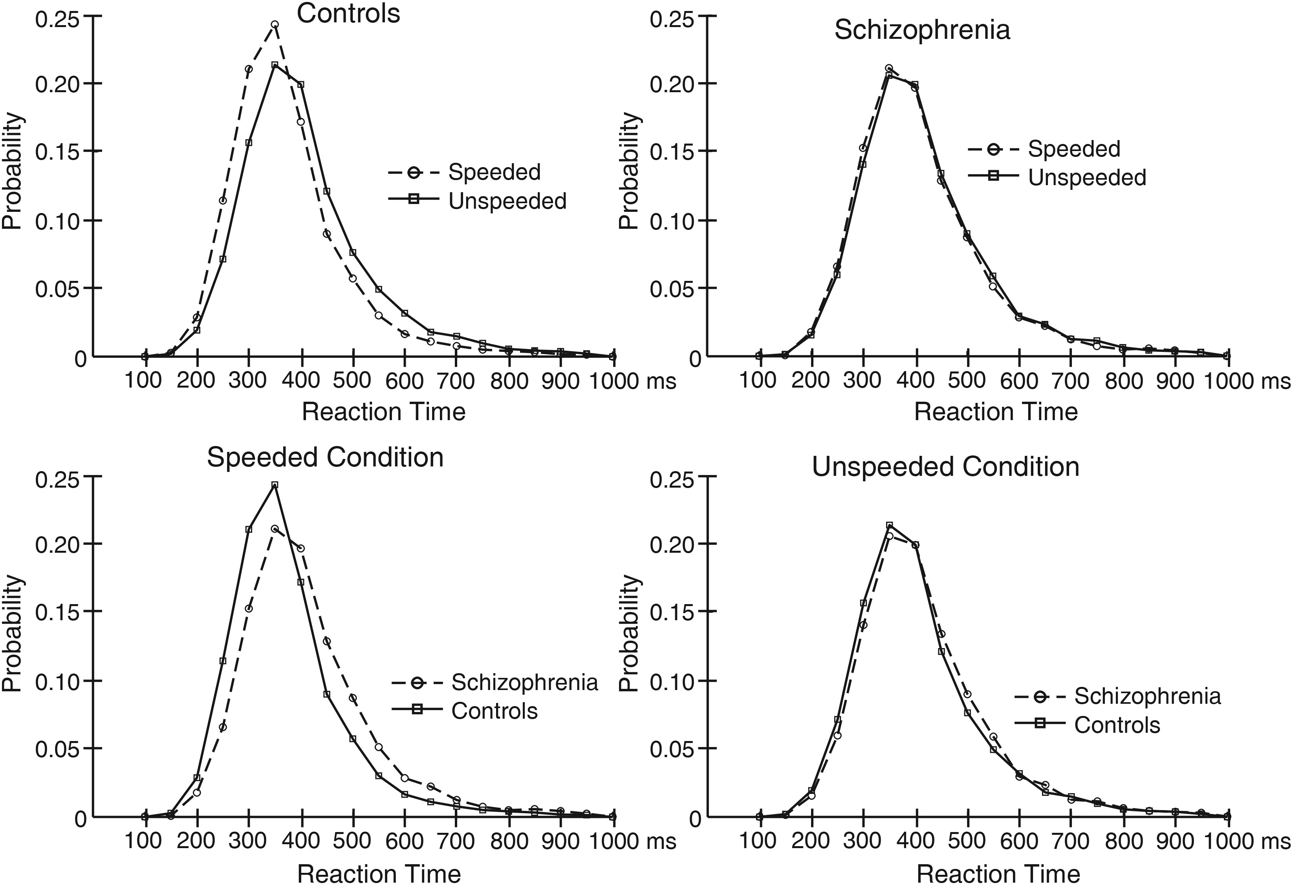
Figure 2. RT probability histograms for the speeded and unspeeded conditions for people with schizophrenia and ...
Notes:
Figure 2. RT probability histograms for the speeded and unspeeded conditions for people with schizophrenia and controls. The top panel shows data from the speeded and unspeeded conditions overlaid, separately for controls (left) and people with schizophrenia (right). The bottom panel shows data from people with schizophrenia and controls overlaid separately for the speeded (left) and unspeeded (right) conditions.
Unless provided in the caption above, the following copyright applies to the content of this slide: © The Author 2015. Published by Oxford University Press. All rights reserved. For Permissions, please e-mail: journals.permissions@oup.com

Slide 3
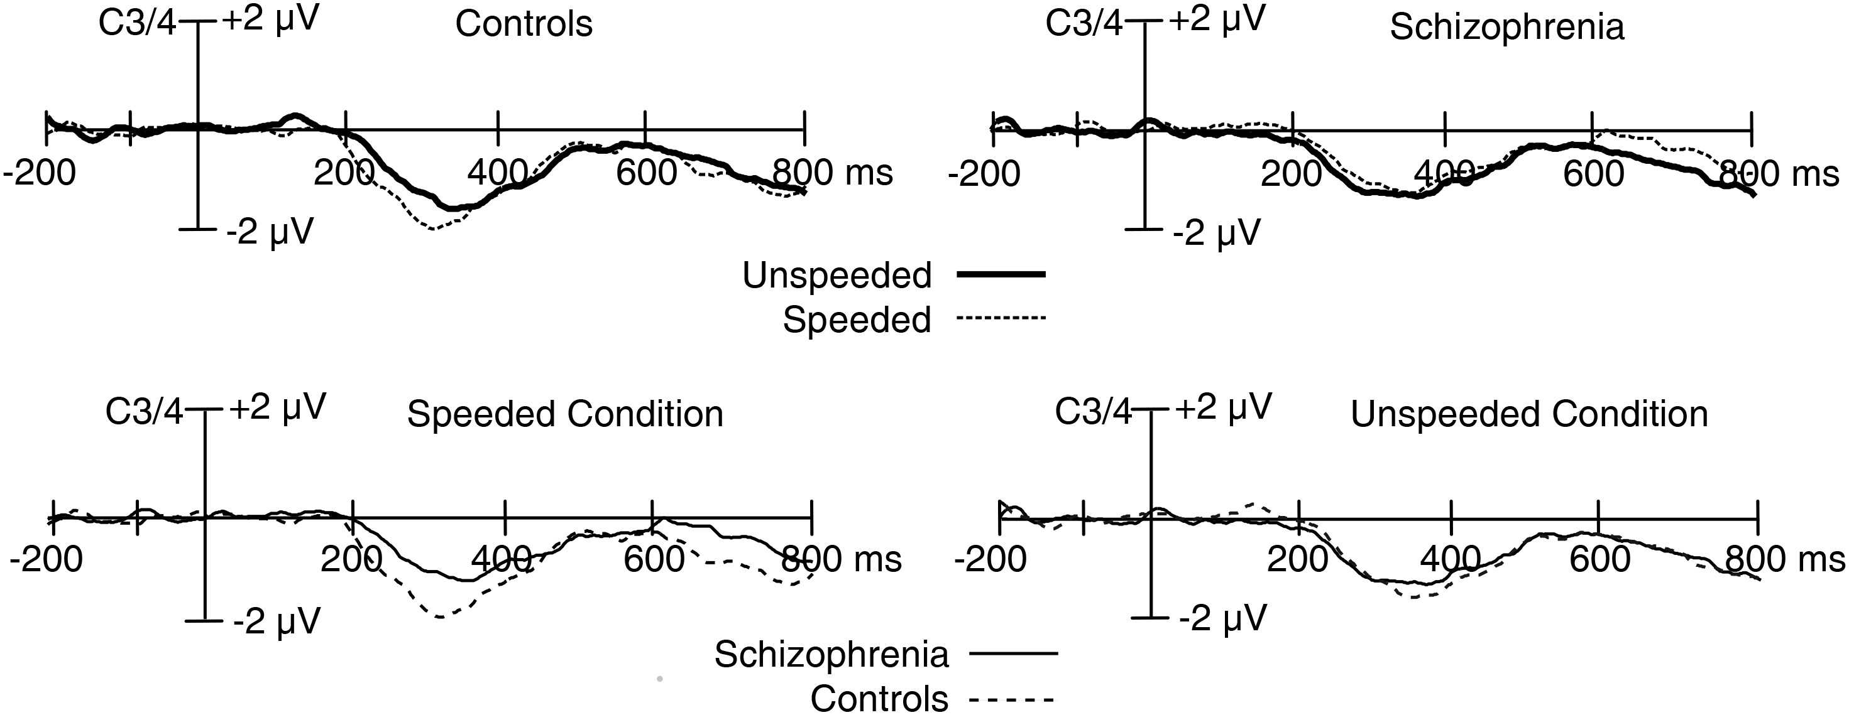
Figure 3. Stimulus-locked grand average ERP difference waveforms (contralateral-minus-ipsilateral) collapsed across the ...
Notes:
Figure 3. Stimulus-locked grand average ERP difference waveforms (contralateral-minus-ipsilateral) collapsed across the C3 and C4 electrode sites. The top panel shows data from the speeded and unspeeded conditions overlaid separately for controls (left) and people with schizophrenia (right). The bottom panel shows data from people with schizophrenia and controls overlaid separately for the speeded (left) and unspeeded (right) conditions. A digital low-pass filter was applied offline before plotting the waveforms shown here and in the subsequent figures (Butterworth impulse response function, half-amplitude cutoff = 30.0 Hz, 12 dB/oct roll-off).
Unless provided in the caption above, the following copyright applies to the content of this slide: © The Author 2015. Published by Oxford University Press. All rights reserved. For Permissions, please e-mail: journals.permissions@oup.com

Slide 4
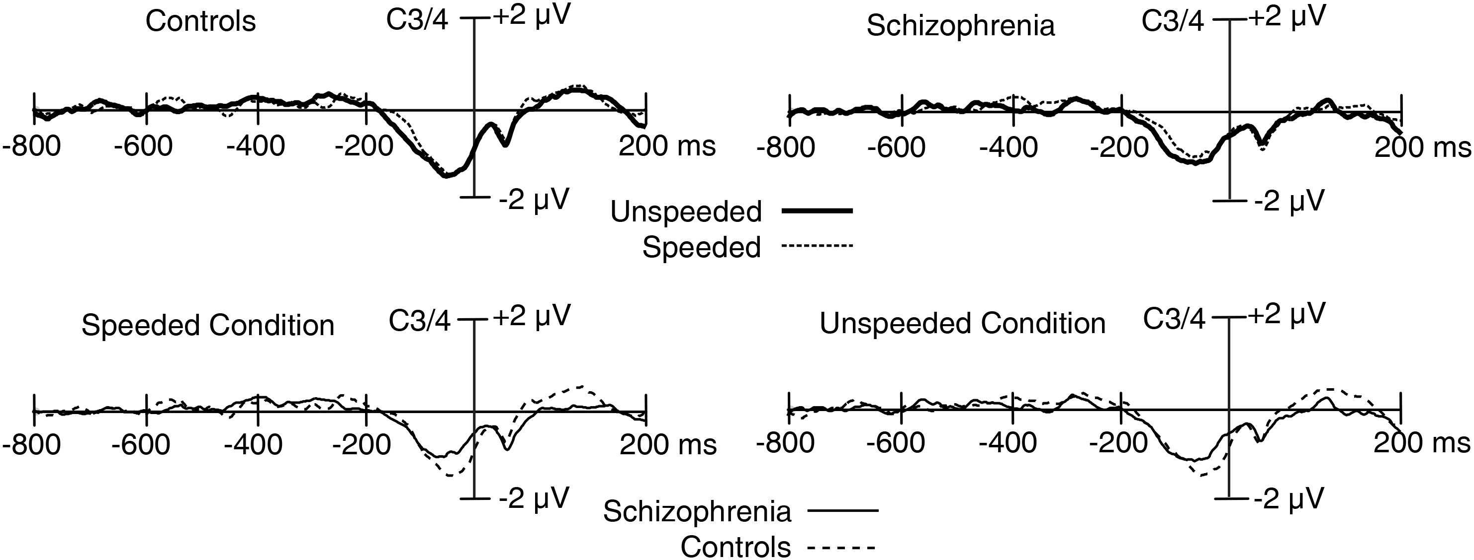
Figure 4. Response-locked grand average ERP difference waveforms (contralateral-minus-ipsilateral) collapsed across the ...
Notes:
Figure 4. Response-locked grand average ERP difference waveforms (contralateral-minus-ipsilateral) collapsed across the C3 and C4 electrode sites. The top panel shows data from the speeded and unspeeded conditions overlaid separately for controls (left) and people with schizophrenia (right). The bottom panel shows data from people with schizophrenia and controls overlaid separately for the speeded (left) and unspeeded (right) conditions.
Unless provided in the caption above, the following copyright applies to the content of this slide: © The Author 2015. Published by Oxford University Press. All rights reserved. For Permissions, please e-mail: journals.permissions@oup.com

